Slide 1


Heavy Flavor at
ATLAS & CMS
23rd Rencontres de Blois
29/5-2/6/2011
Erez Etzion
Tel-Aviv University
For the ATLAS & CMS Collaborations

Slide 2
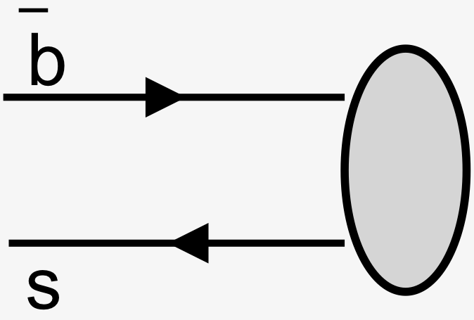
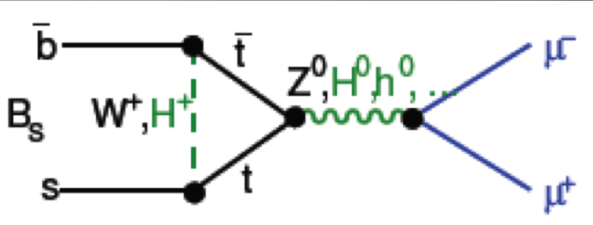

Early Heavy Flavor studies @ LHC
Sizable samples available from early data.
b quark
  A key ingredient for signals and background to various analyses.
Quarkonia, a calibration test bed
  Align/calibrate/monitor trigger & detector.
HF Production: tests of perturbative QCD
Hadronization: Fragmentation functions, in cc or bb states (low relative velocity of the bound state), test NRQCD approaches.
  Precision measurement, search for deviation from the theoretical predictions.
New Physics
  Decay: Search for indirect hints of NP in rare weak decays, e.g: Non-SM CP violation in
  Prob MSSM and other 2HD models and direct BSM searches

Slide 3
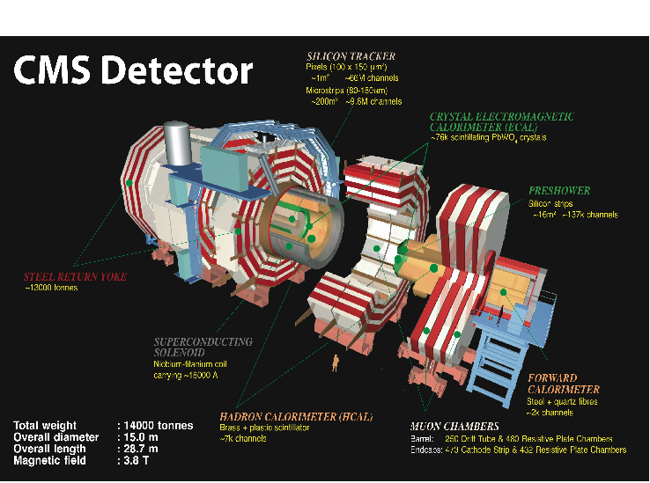
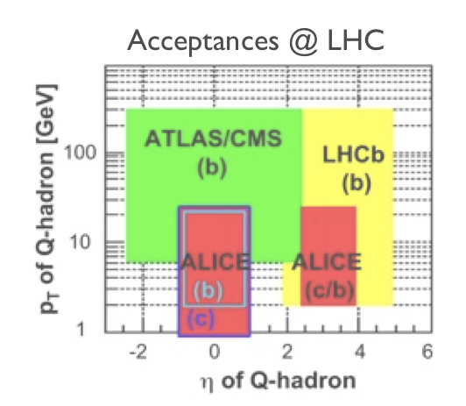
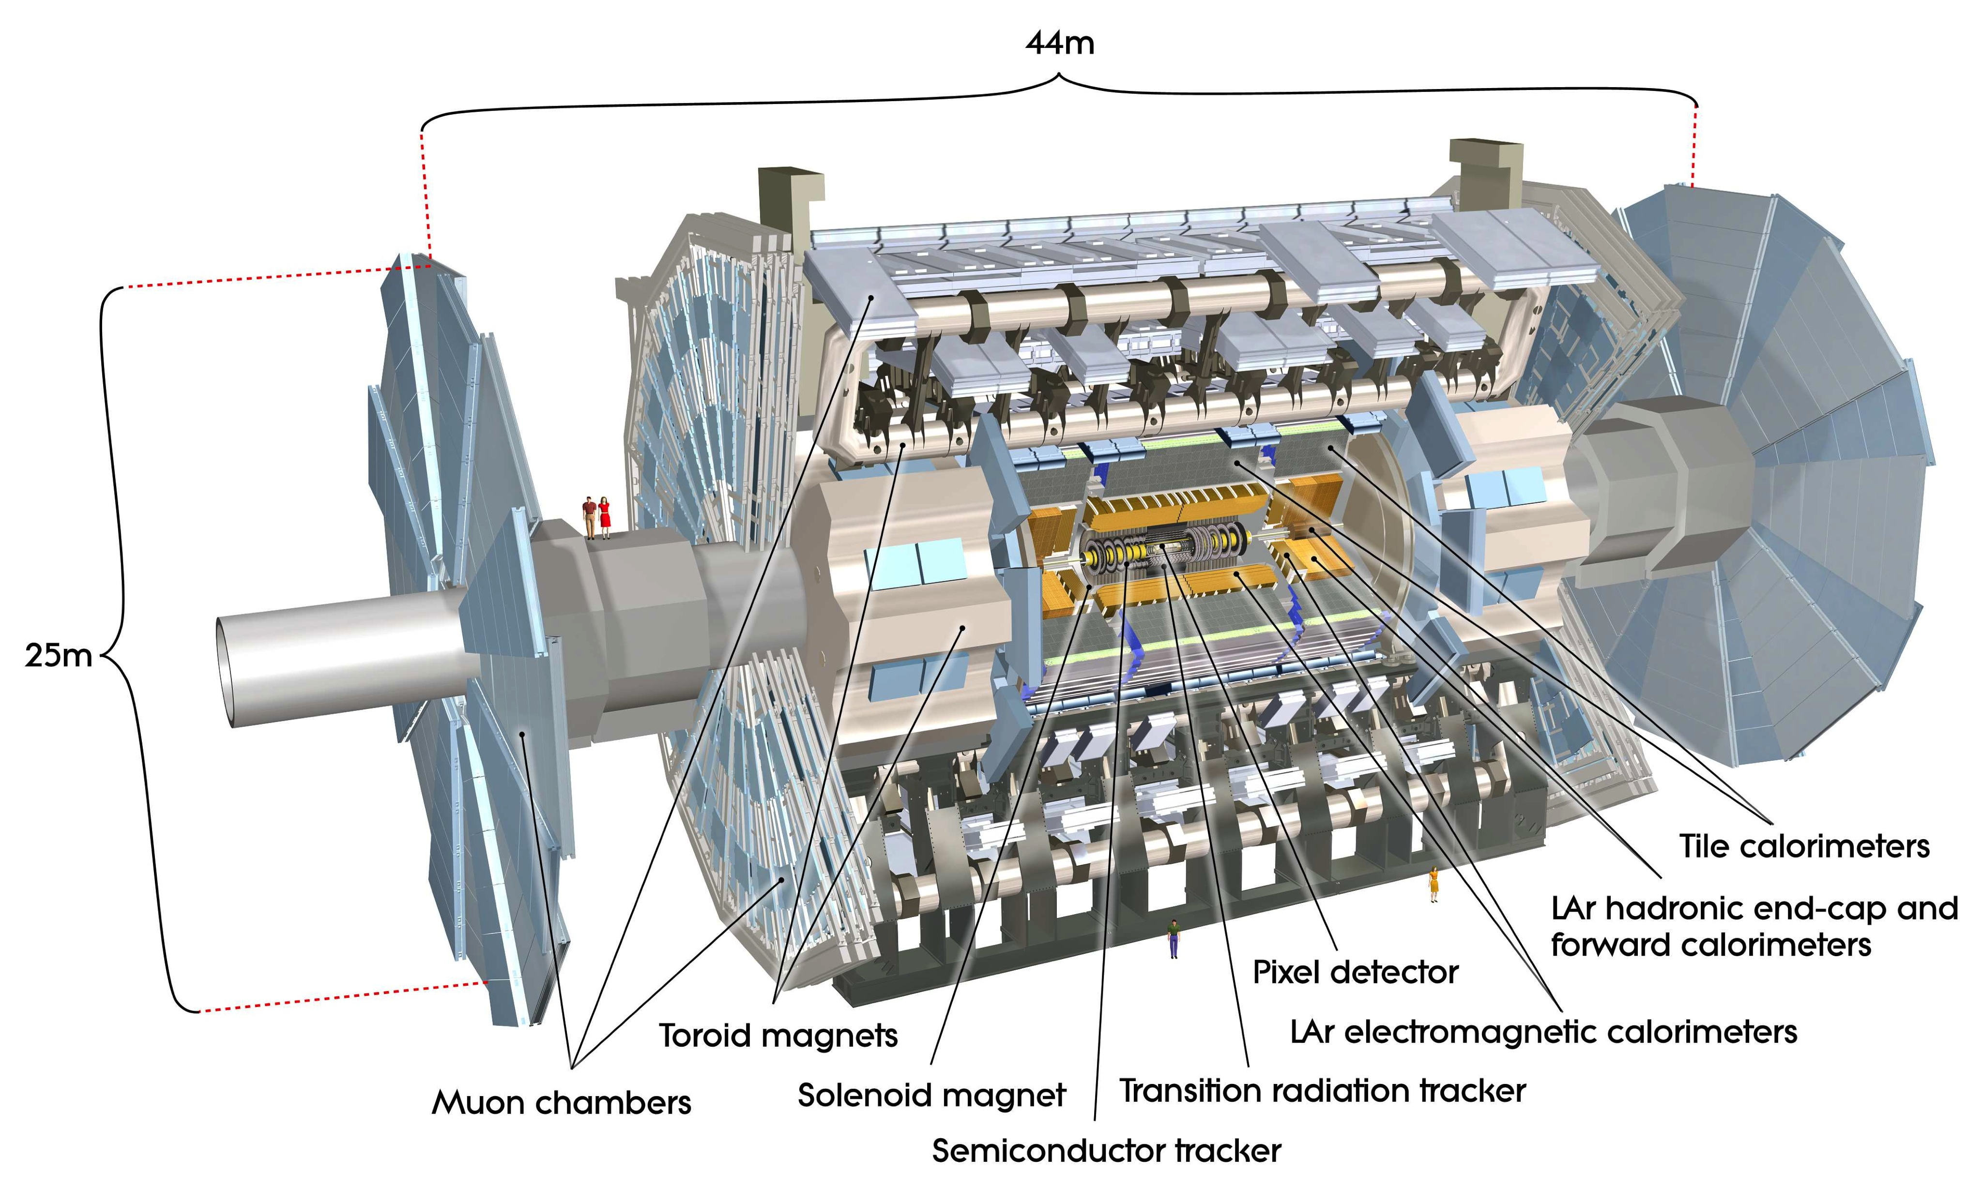
Detectors
Precise vertexing and tracking
Robust muon triggering and tracking
Minimal (dE/dx) k/π separation
Tracking: σ (d₀) ~15μm
σ/p_{T} ~1.5x10⁻⁴p_{T}-3.5x10⁻⁴p_{T} GeV
Muon: σ/p_{T}@ 1TeV ~10%
<100GeV 1-2%
p_{T} Threshold (GeV) 1-3 (CMS) ~4 (ATLAS)
ATLAS Detector

Slide 4
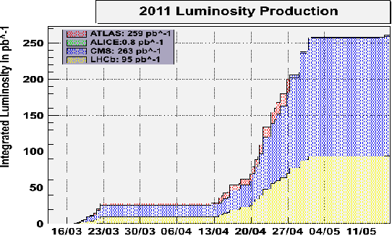
Data (CMS & ATLAS) pp @ 7 TeV
CMS:
Delivered 47.03 pb⁻¹
Recorded 43.17 pb⁻¹
Results shown here are from the
2010 Data only
Peak luminosity 2.1x1033 cm⁻² s⁻¹
Uncertainty 3-4%
Detectors efficiency >94%
Already more than 270 pb⁻¹ delivered in 2011.
So far, max. instantaneous luminosity of ~10³³ cm⁻² s⁻¹
270 pb⁻¹
0.43 fb⁻¹ delivered in 2011

Slide 5

Quarkonium
Notes:
This is another option for an overview using transitions to advance through several slides.

Slide 6
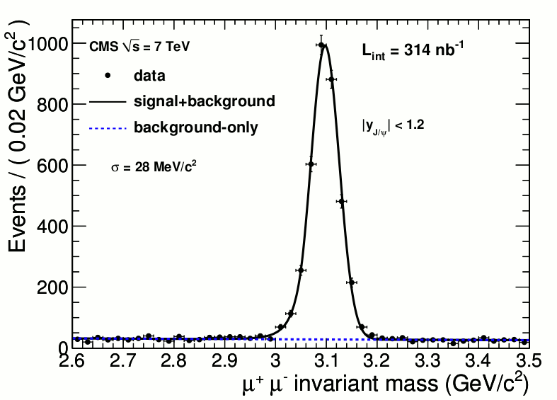
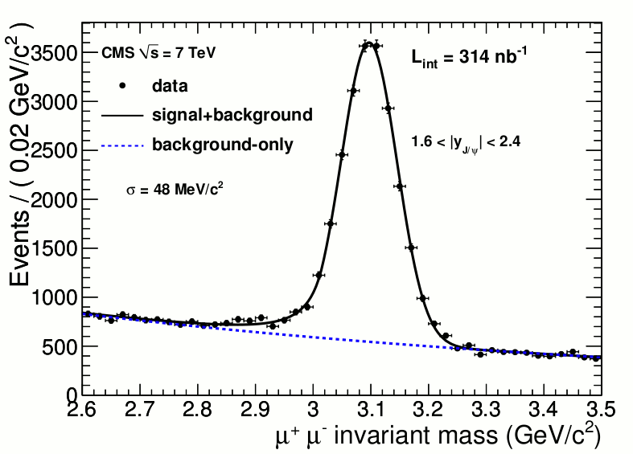
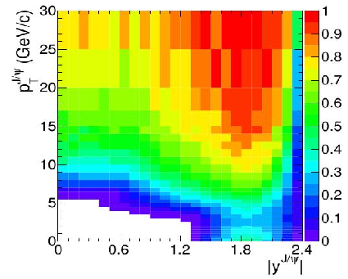

J/ψ production
CMS:Eur.Phys.J C71(2011) 1575
Data 314 /nb
Reconstructing J/ψ decaying to two muons
Cross section determined in p_{T} and y intervals
Muon momentum corrected for scale distortion through a fit on invariant mass peak shape
Yield corrected for acceptance and efficiency:
  Acceptance derived from MC using three scenarios: isotropic (unpolarized), polarized along the J/ψ momentum and polarized along the collision axis
  Efficiency determined from data (tag & probe)
Main systematic uncertainties:
  Kinematical distributions (<3%)
  B-hadron fraction (3.1%)

Slide 7
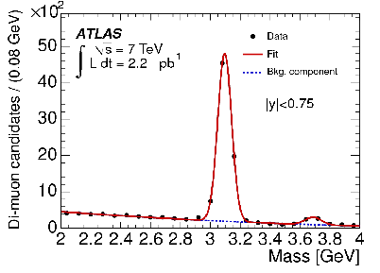
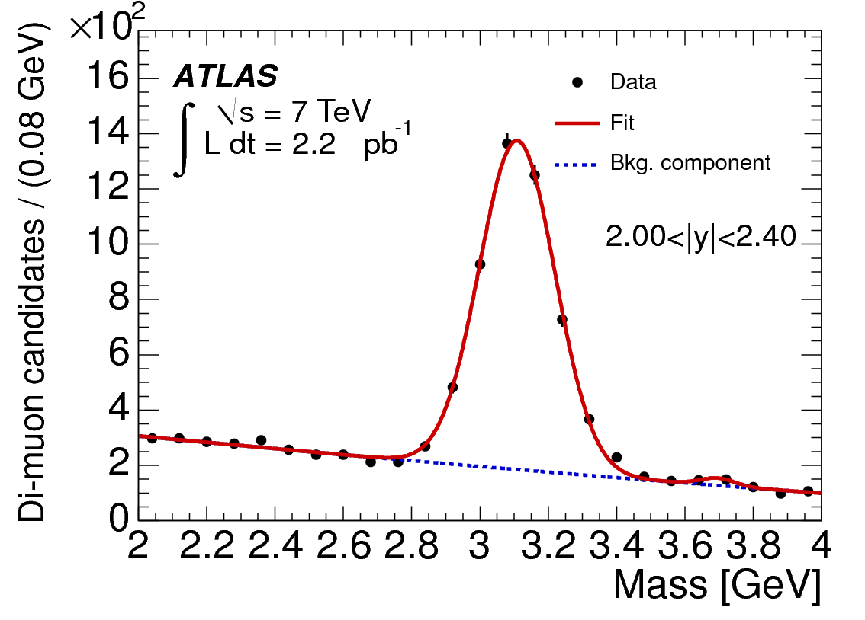
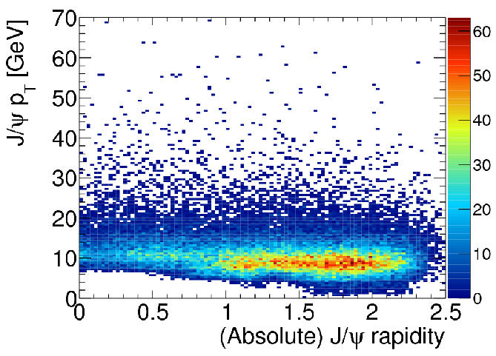
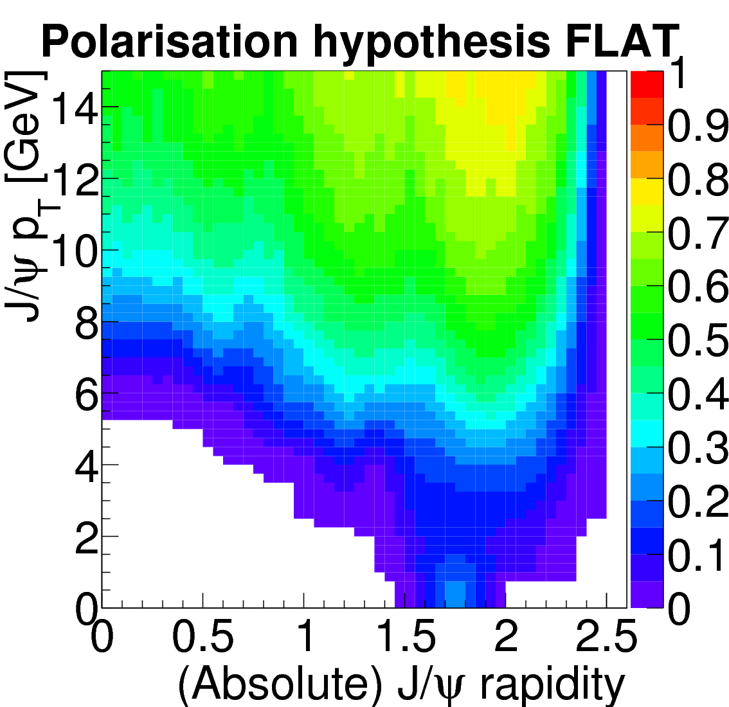
J/ψ production
ATLAS: Nucl. Phys B, arXiv:1104.3038 [hep-ex]
Data 2.2/pb
Measured in 4 rapidity regions:
|y| 0<->0.75<->1.5<->2<->2.4
Transverse momentum up to 70 GeV
Acceptance from MC
Efficiency data (tag & probe)
ATLAS MC
Notes:
Detector Acceptance: Probability for J/ψ muons to fall into the fiducial detector volume. Calculated using generator-level MC with muon p_{T} and η cuts to emulate detector geometry
To model the spin-alignment dependence of the acceptance – calculated maps for 5 extreme spin-alignment scenarios for systematics
Bin migration correction: Migration of the true value of J/ψ p_{T} to a measured value which may not remain in a given analysis bin. p_{T} distribution parameterized with and without detector resolution smearing. The ratio of the two in a given analysis bin used as a correction factor
Inner Detector tracking efficiency: 99.0%±0.5% per track
Muon reconstruction efficiency: Data-driven efficiency map using Tag & Probe method. Muons (tags) were paired with Inner Detector tracks (probes). Fitting invariant mass of pairs to acquire number of J/ψ
Trigger efficiency: Using a hybrid data-driven and MC approach. MC-based efficiency maps used to model fine-structure of trigger features. Data-driven efficiencies used to scale MC-based efficiencies to data in wider regions

Slide 8
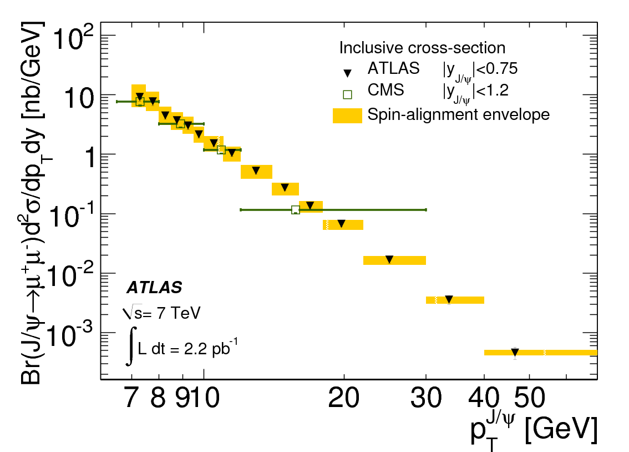
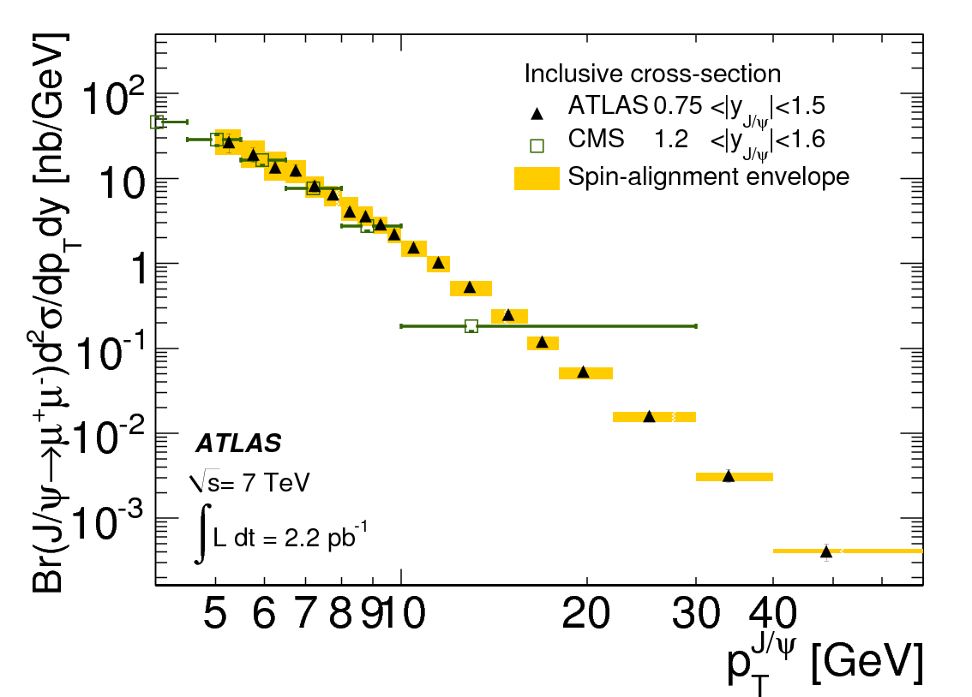
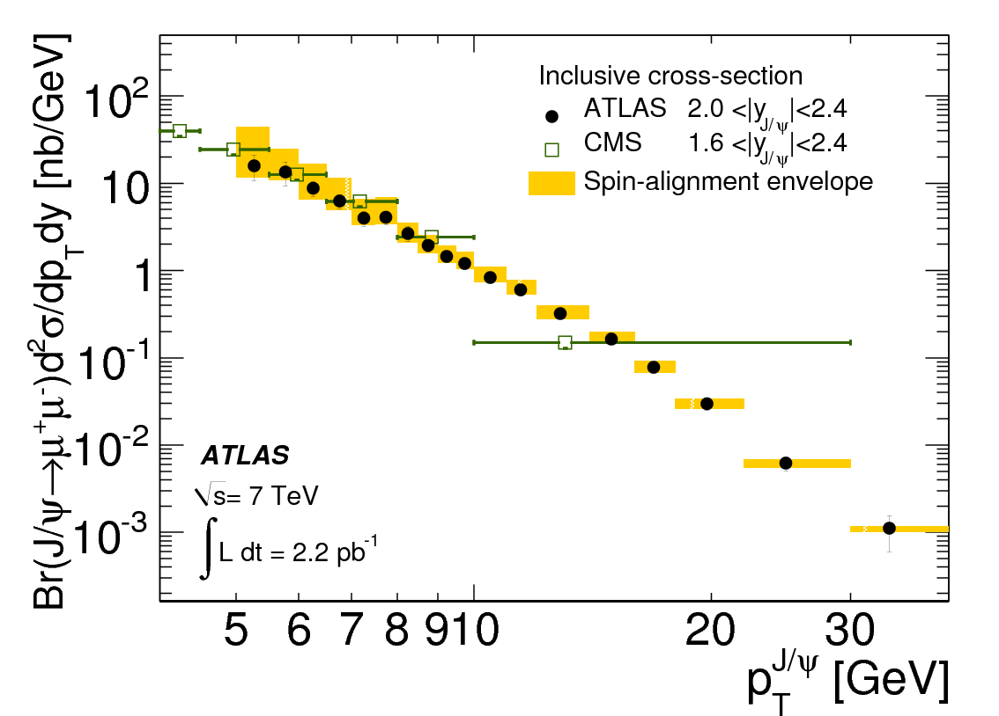
J/ψ Inclusive cross section
CMS
ATLAS
Notes:
Inclusive J/ψ production cross-section as a function of J/ψ p_{T} in four rapidity slices. Yellow regions represent uncertainty due to different spin-alignment scenarios

Slide 9
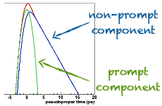
Prompt and non-prompt J/ψ
µ
µ
J/ψ
L_{xy}
.
d0
Mass and pseudo-proper time are simultaneously fitted to extract the fraction of the non-prompt J/ψ
B fraction of signal
Pseudo-proper time PDF
Mass PDF
µ
µ
µ
µ
Pseudo-proper time
Pseudo-proper time
L_{xy} - the B flight distance from the primary vertex (PV)
projected on the xy plane was used to calculate
pseudo-proper time
L_{xy} - the B flight distance from the primary vertex (PV)
projected on the xy plane was used to calculate
pseudo-proper time
J/ψ
J/ψ
L_{xy}
L_{xy}
.
.
d0
d0

Slide 10
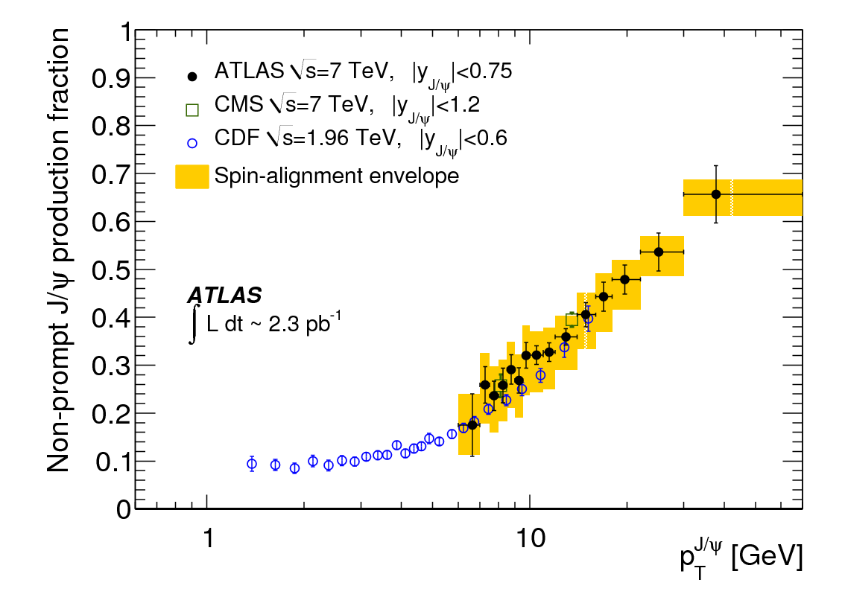
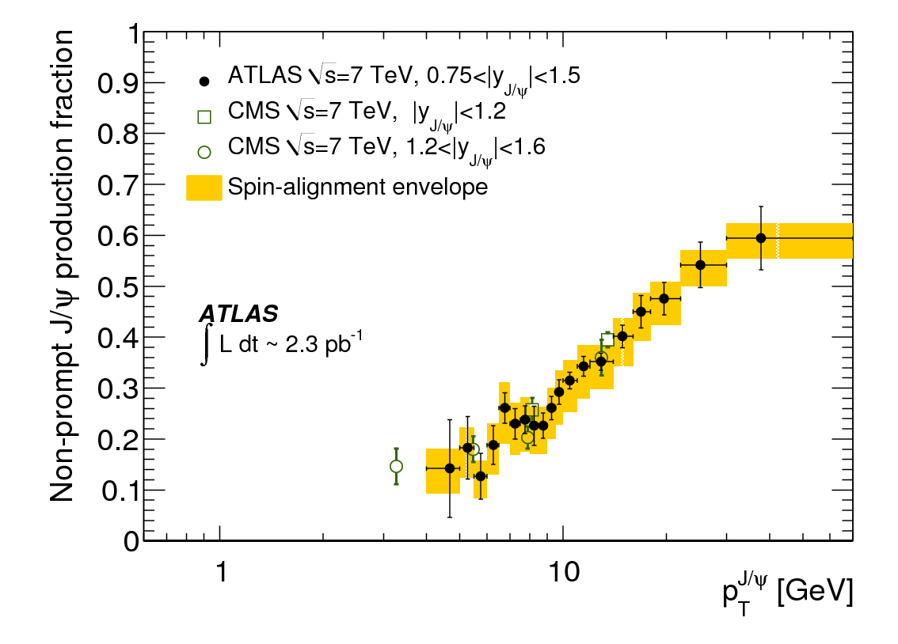
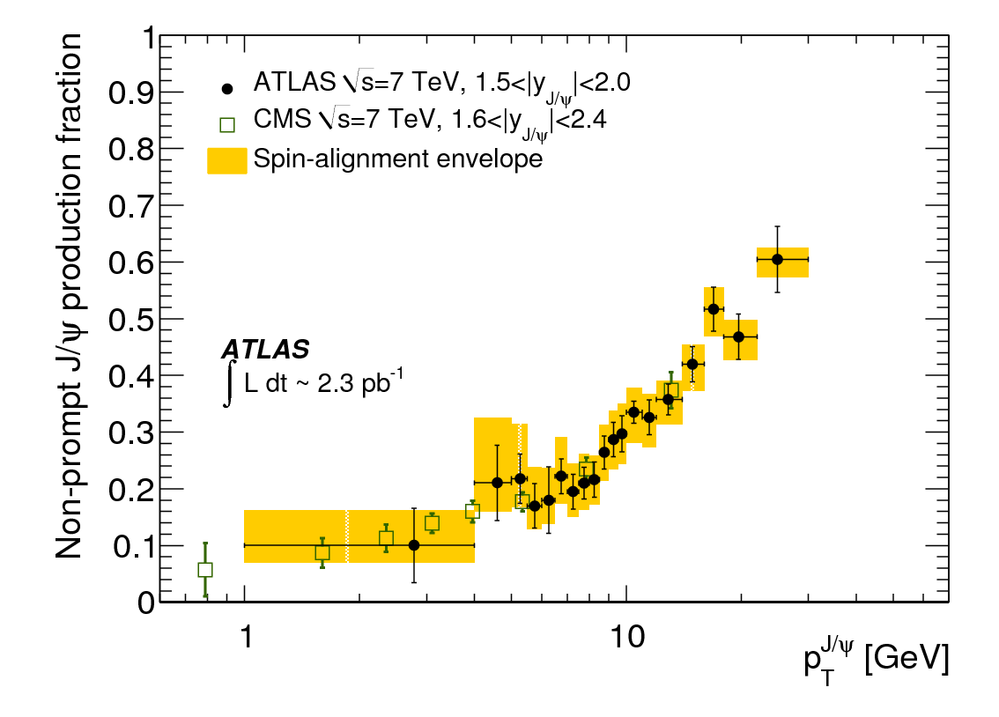
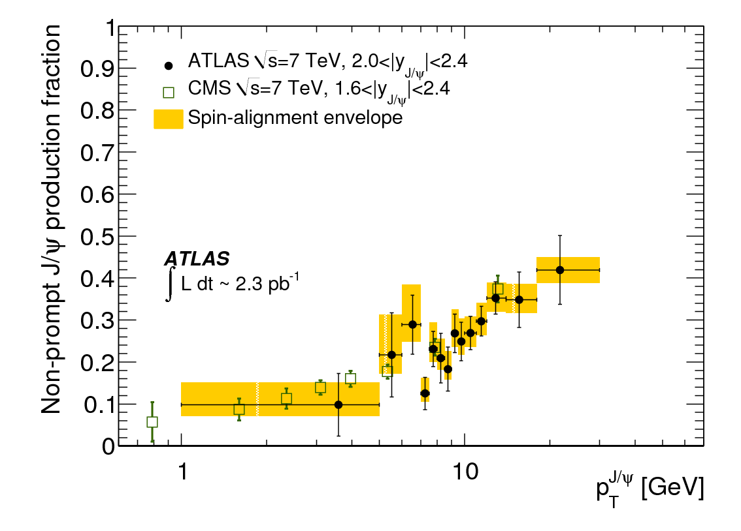
Non-prompt J/ψ fraction
CMS
ATLAS
CDF
No strong y dependence
Strong p_{T} dependence (10%-65%p_{T} from <10 to 70 GeV
CMS and ATLAS agree with CDF and extend the pT coverage-> no dependence on production energy

Slide 11
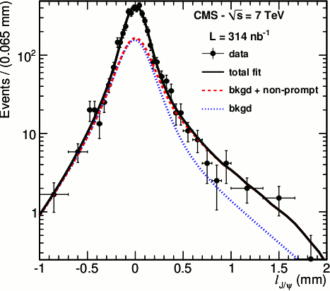

J/ψ cross-section
Non-prompt J/ψ
CMS
ATLAS
Prompt J/ψ
CMS
ATLAS
Good agreement between CMS, ATLAS and LHCb
Polarization is a main source of systematics
Other sources are primary vertex estimation, lifetime resolution, tracking,

Slide 12
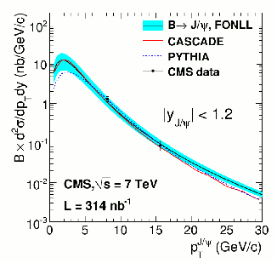
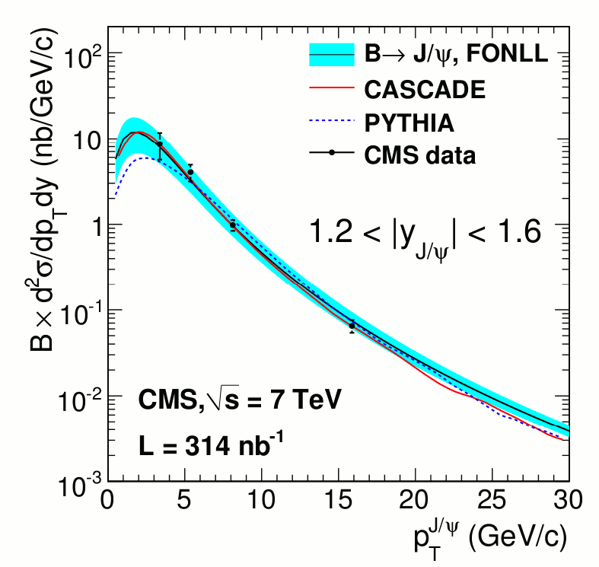
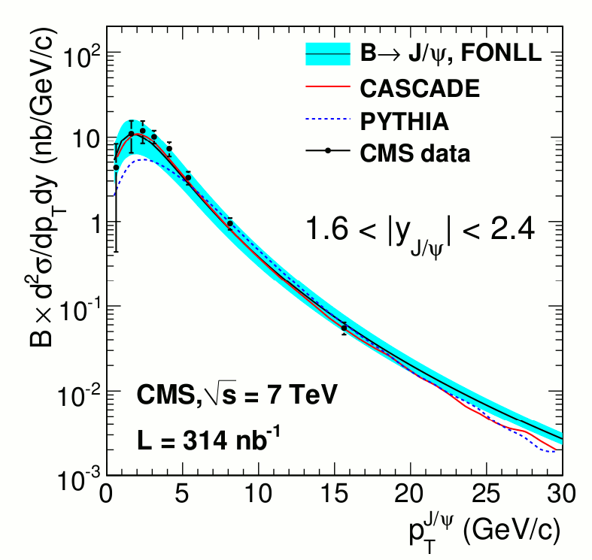
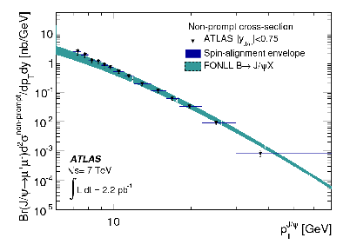
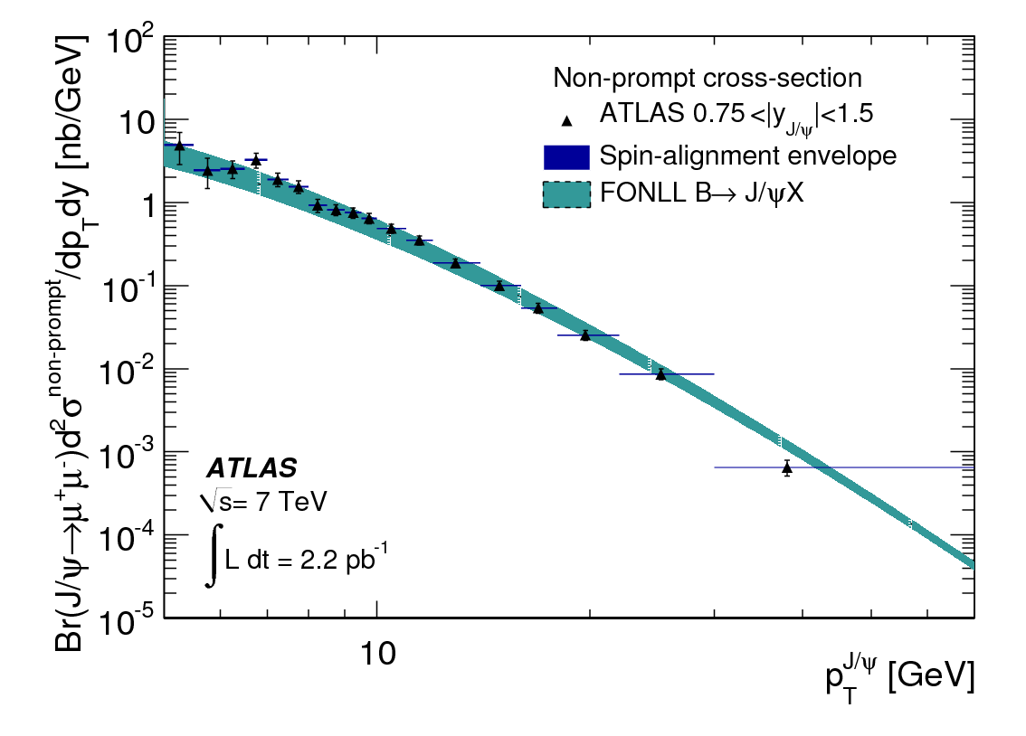
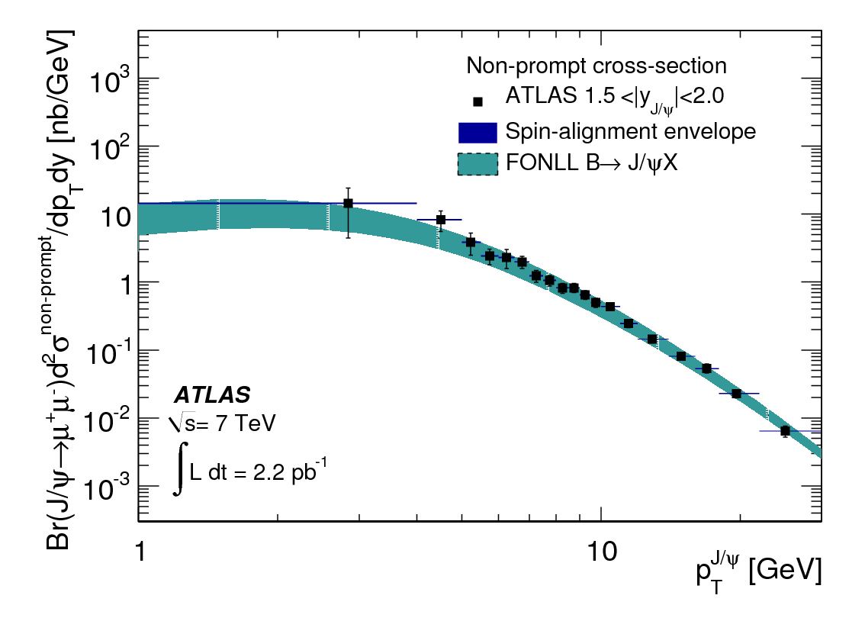
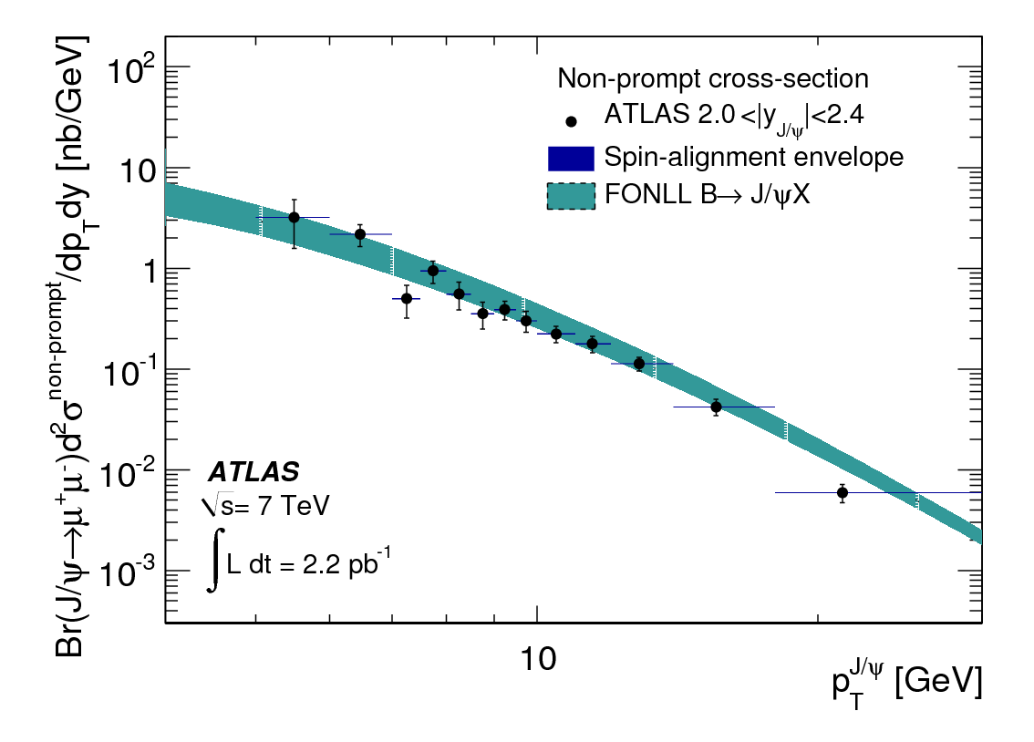
Non-prompt J/ψ vs Theory
CMS
ATLAS
In general, theory in good agreement with the data.
µ
µ
µ
µ
Pseudo-proper time
Pseudo-proper time
L_{xy} - the B flight distance from the primary vertex (PV)
projected on the xy plane was used to calculate
pseudo-proper time
L_{xy} - the B flight distance from the primary vertex (PV)
projected on the xy plane was used to calculate
pseudo-proper time
J/ψ
J/ψ
L_{xy}
L_{xy}
.
.
d0
d0

Slide 13
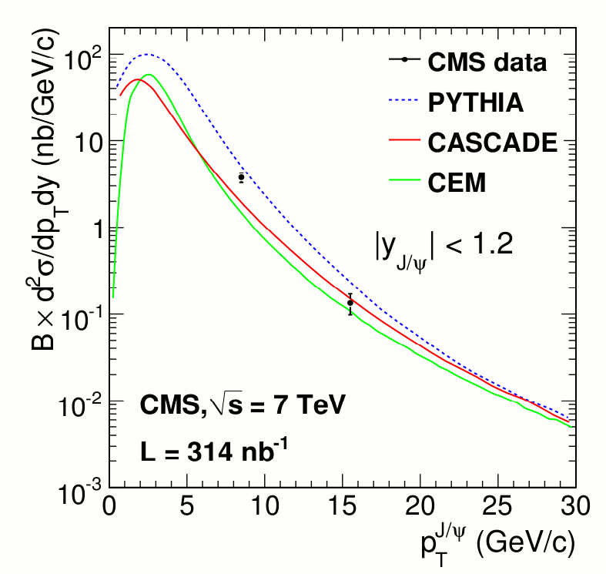
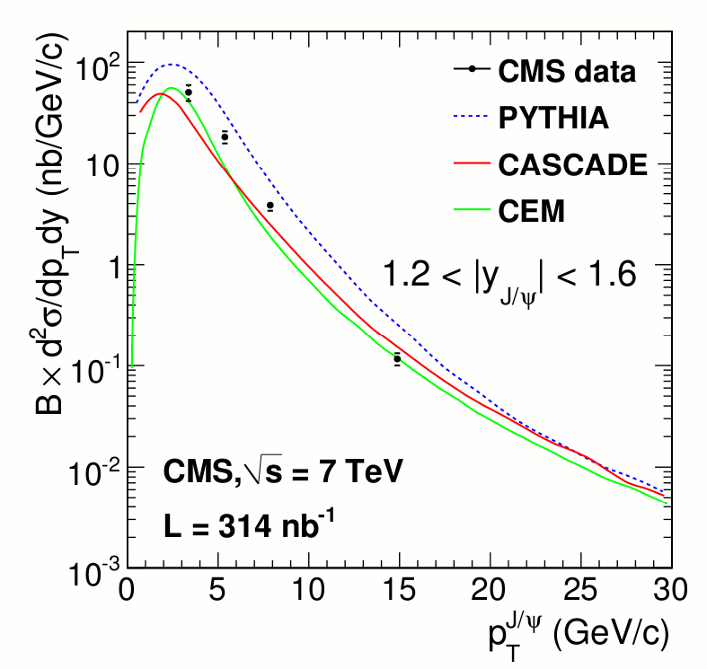

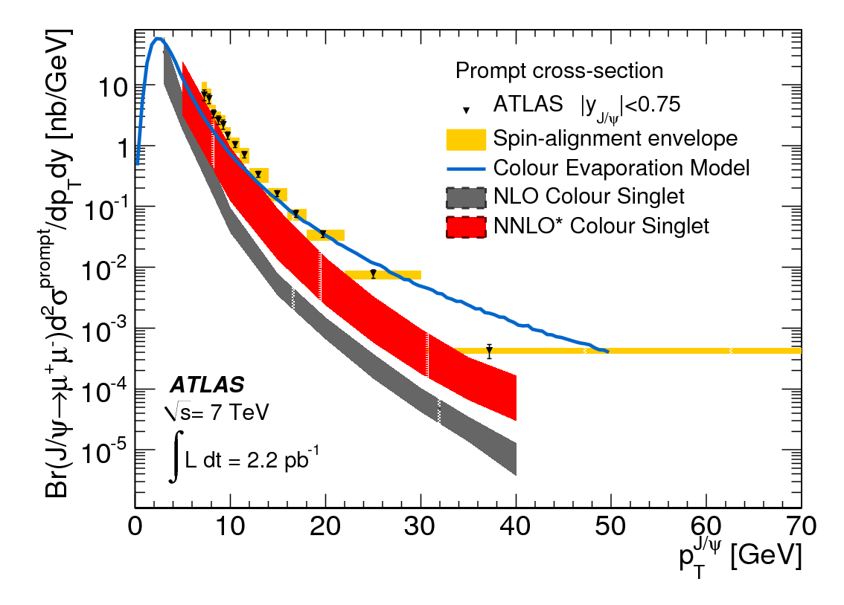
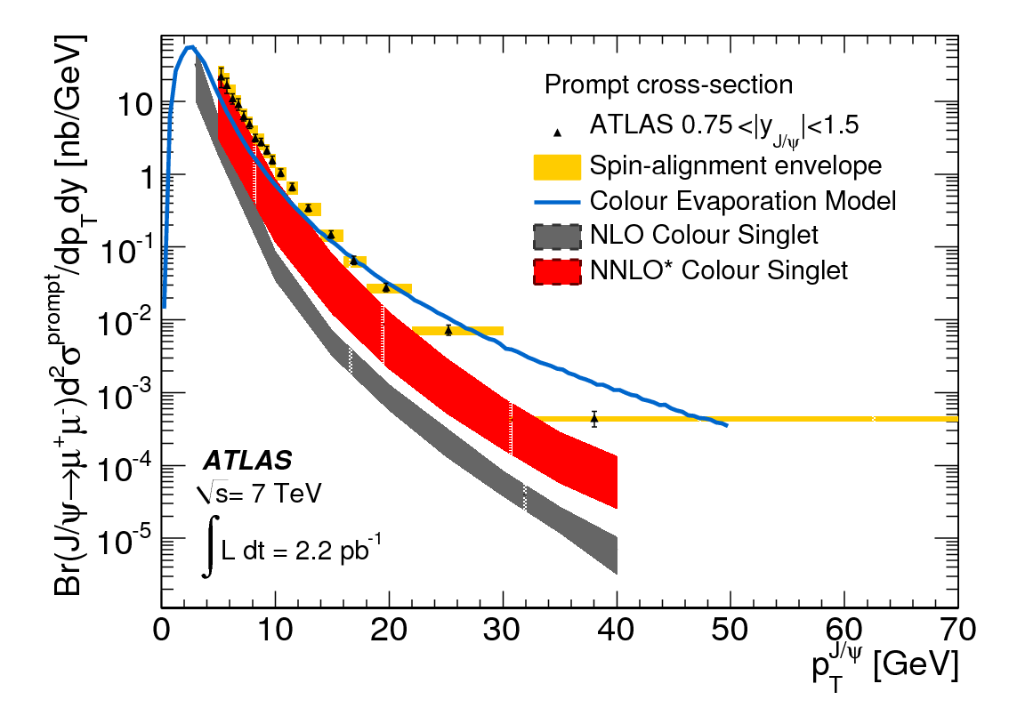
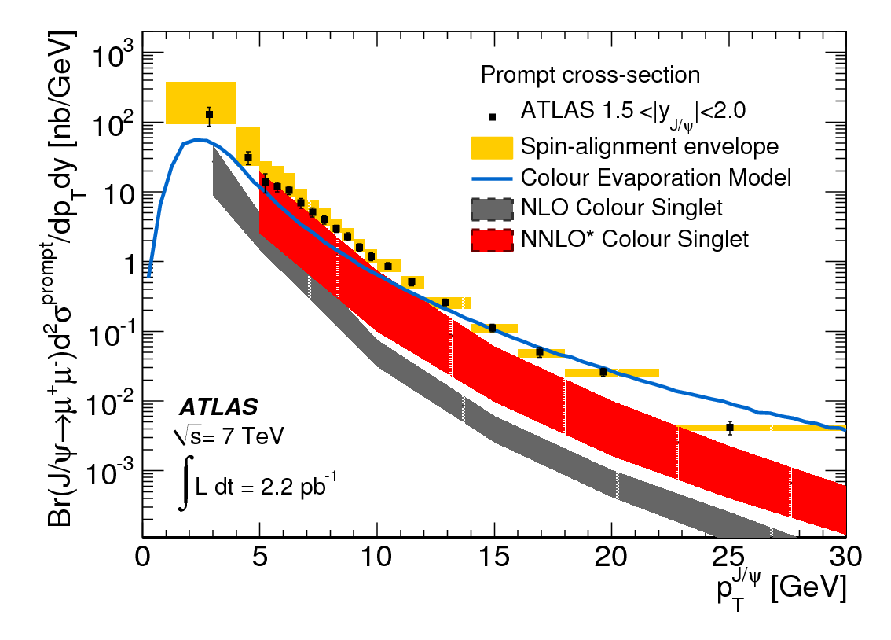
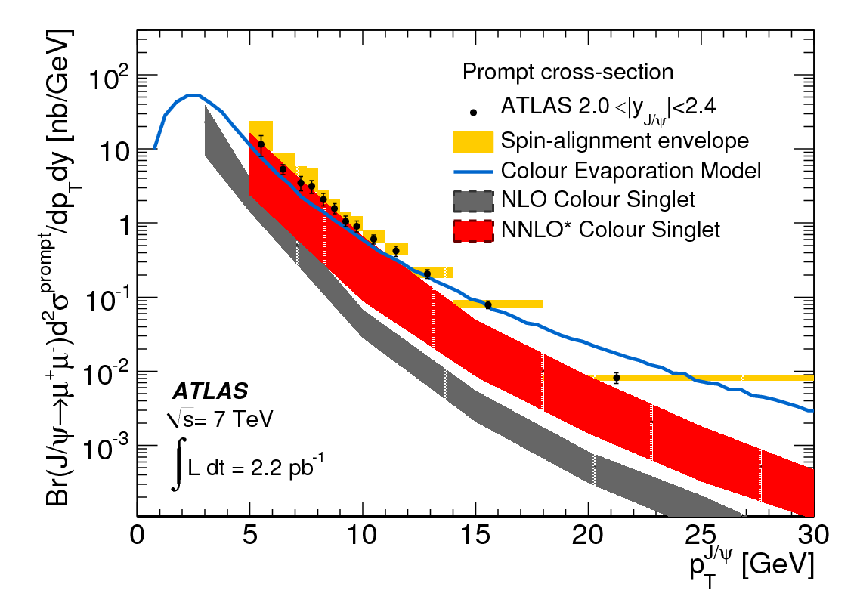
Prompt J/ψ vs Theory
CMS
ATLAS
Theory shows reasonable agreement with data in shape and normalization,
Great progress since last year.
Color Evaporation model is getting closer but underestimates at low p_{T}
Notes:
Production cross-section for prompt J/ψ as a function of J/ψ p_{T} in four rapidity slices. Yellow regions represent uncertainty due to different spin-alignment scenarios. NLO, NNLO and phenomenological Color Evaporation predictions overlaid

Slide 14

Υ production
CMS: arXiv:1012.5545 [hep-ex], submitted to PRD
Reconstructed in di-muons
Resolution of ~70 MeV in |η|<1
Extract yield simultaneously with ML in p_{T} & y intervals.
Agrees with Tevatron measurements.
Y(3s) Y(2S) increase with p_{T}
Y(ns) diff. cross-section Y(1s) diff. cross-section Y(ns) cross-section ratios

Slide 15
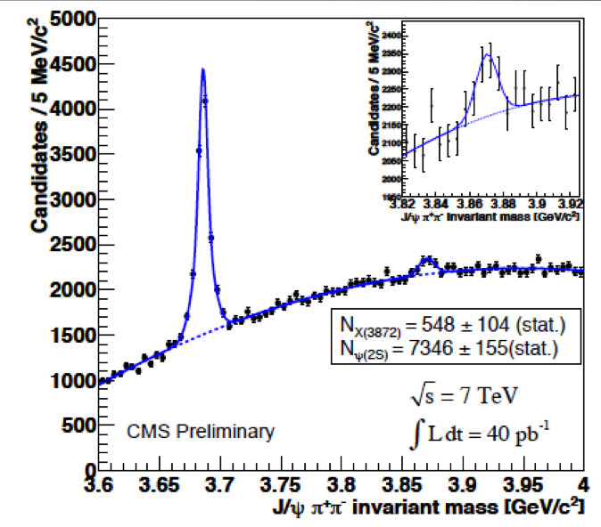
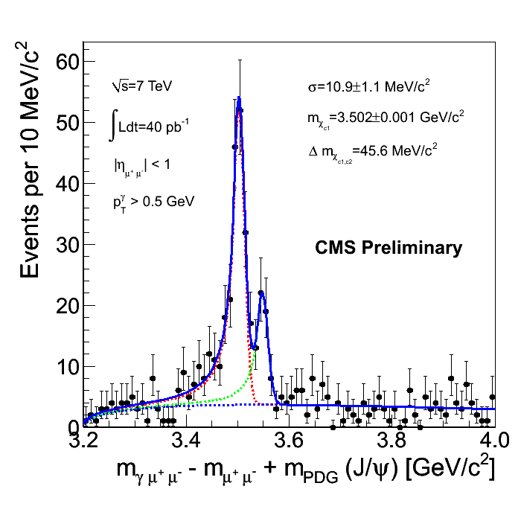
Additional states
CMS has recently presented first measurement of
X(3872)/ ψ’ [cross section x Br]
R=0.087+/-0.017+/-0.009
Separation of χ_{c1}/χ_{c2} states using the J/ψ+γ (γ->ee) final state, via novel tracker-based method for low energy conversions reconstruction
µ
µ
µ
µ
Pseudo-proper time
Pseudo-proper time
L_{xy} - the B flight distance from the primary vertex (PV)
projected on the xy plane was used to calculate
pseudo-proper time
L_{xy} - the B flight distance from the primary vertex (PV)
projected on the xy plane was used to calculate
pseudo-proper time
J/ψ
J/ψ
L_{xy}
L_{xy}
.
.
d0
d0

Slide 16
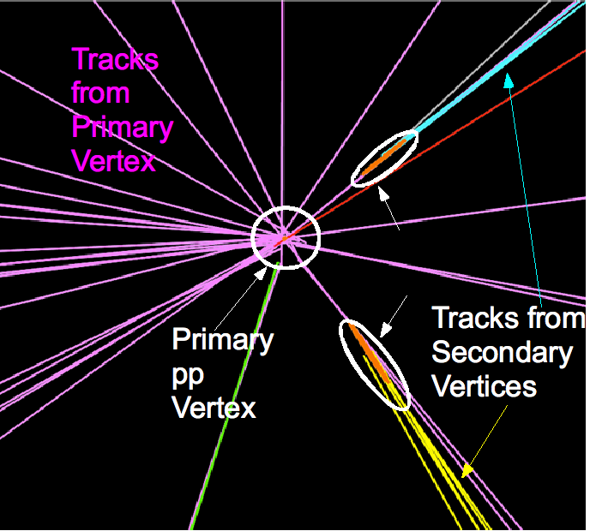

b jets

Slide 17
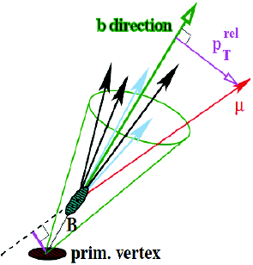
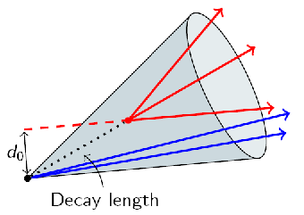
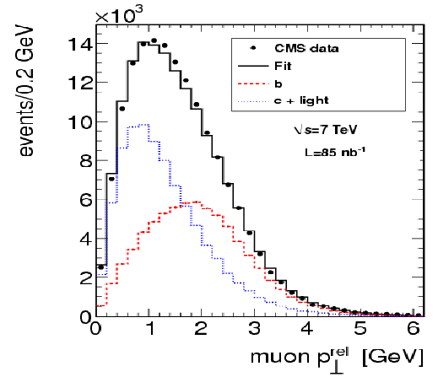
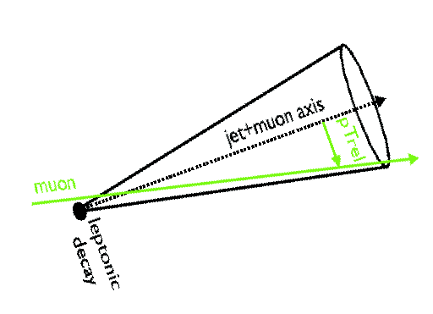

Identifying b’s as jets
CMS
1. Secondary vertex tagging
ATLAS
Search for b decay vertex:
  Secondary vertex tagging
  Calculate the mass of assoc tracks
Semiletonic decays
  B->μνX
  Look at the p_{T} of the muon wrt jet axis
2. Discriminate μ from b by the distance from the jet axis (larger than udsc).
Use p_{T} rel template from MC (data) for b and c (udsg) with signal validated in b-enriched data. Background template combined in the fit

Slide 18
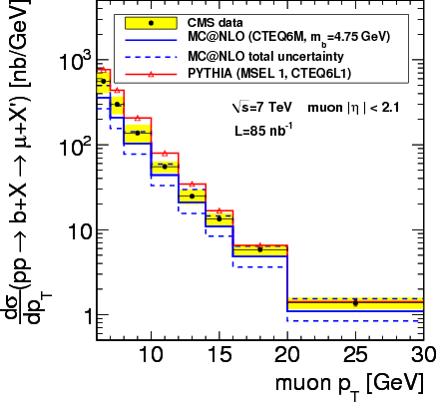
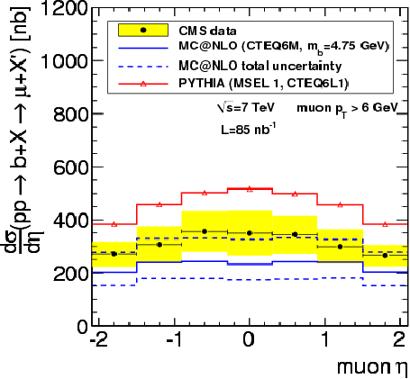
Inclusive beauty cross section (CMS)
CMS: JHEP 1103 (2011) 090
σ(pp →b X→μ X) = (1.32 ± 0.01(stat.) ± 0.30(syst.) ± 0.15 (lumi.) ) μb
σ_{MC@NLO} = (0.95_{-0.21}^{+0.42} (scale) ± 0.09(m_{b}) ± 0.05(pdf) ) μb; σ_{PYTHIA} = 1.9 μb
uncertainty dominated by signal and background p_{T} rel shapes
Notes:
CMS – only muon ptrel is used

Slide 19
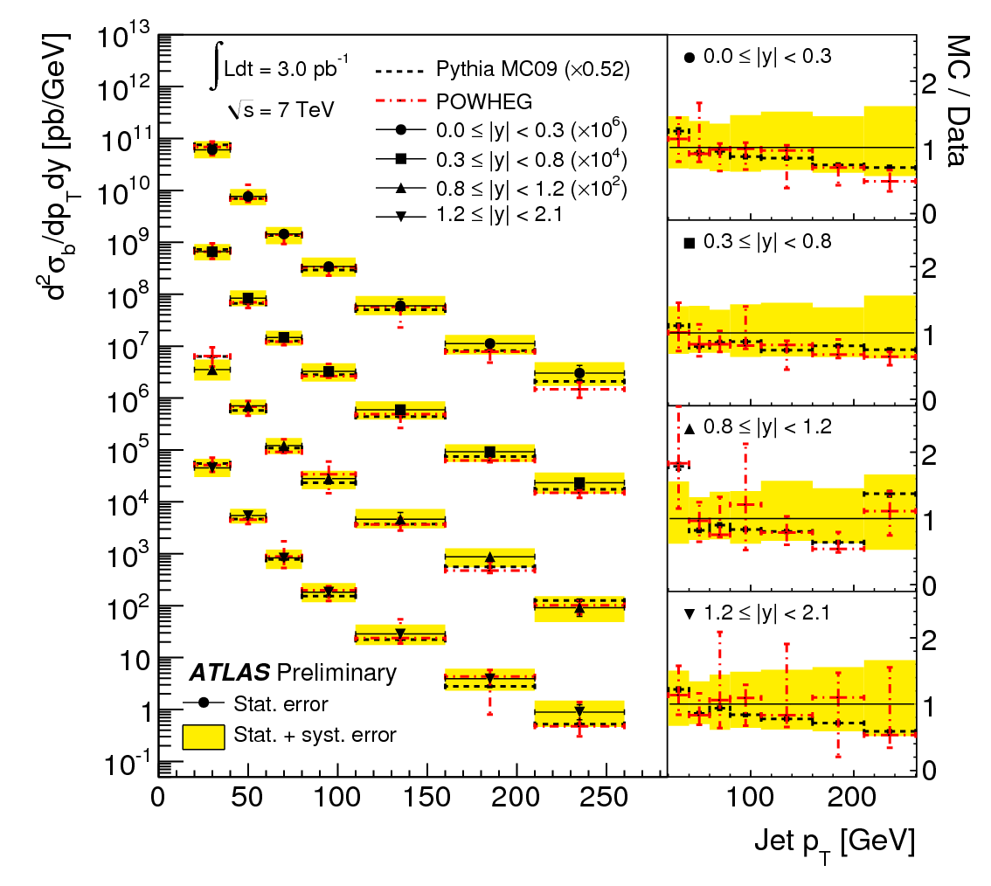
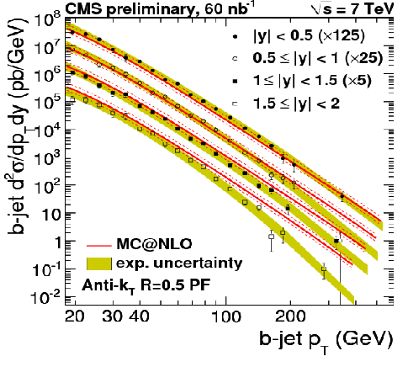
Inclusive b-jet cross section
ATLAS-CONF-2011-056, CMS-PAS-BPH-10-009
Pythia (LL) too high (x2)
POWHEG (NLO) fine in absolute
Both MC shapes are slightly steeper than data
Systematics:
Jet energy scale,
b-tag efficiency
b mis-tag
Notes:
CMS - only the SV is used w/o muon requirement.

Slide 20
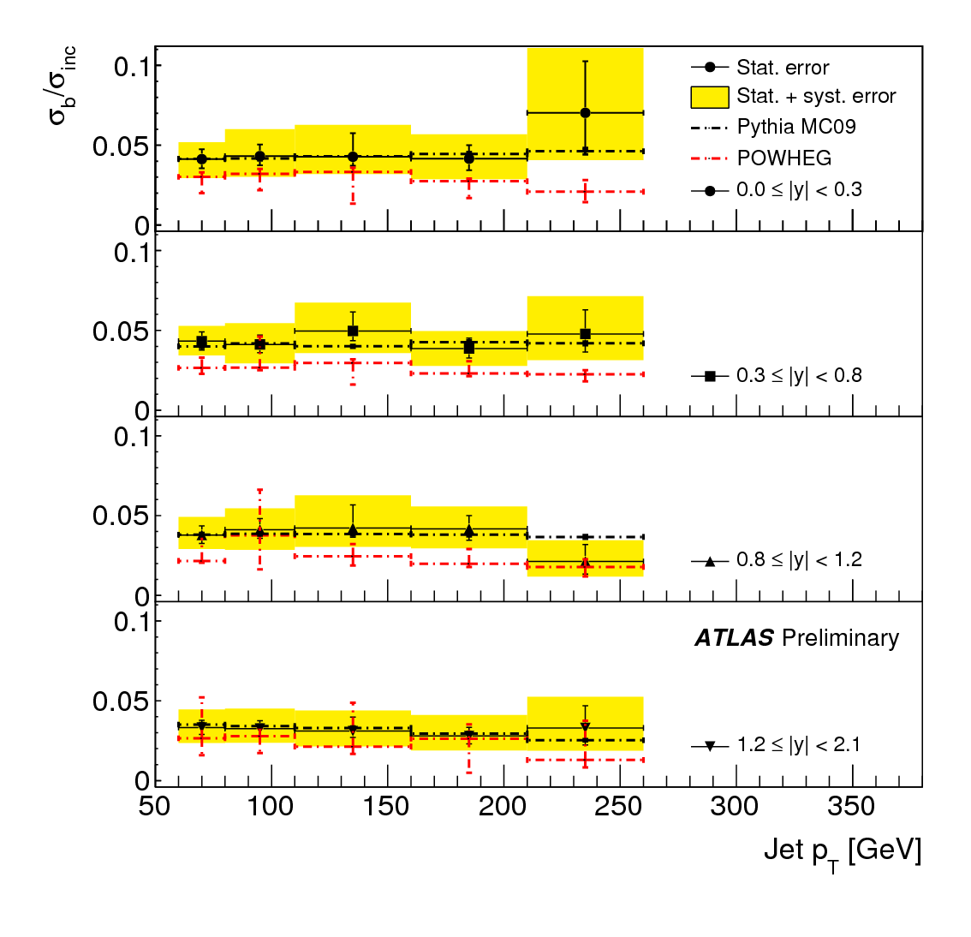
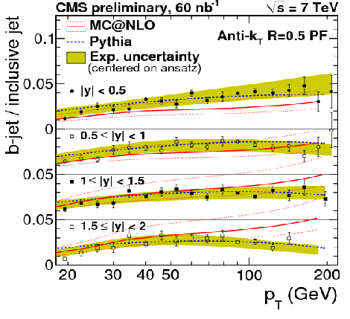
Inclusive b-jet /jets cross section
ATLAS-CONF-2011-056, CMS-PAS-BPH-10-009
B jets 3.5-5% of all jets
Pythia (LL) fine
POWHEG (NLO) systematically low,
MC@NLO too low at low |y|
too high at high |y|

Slide 21
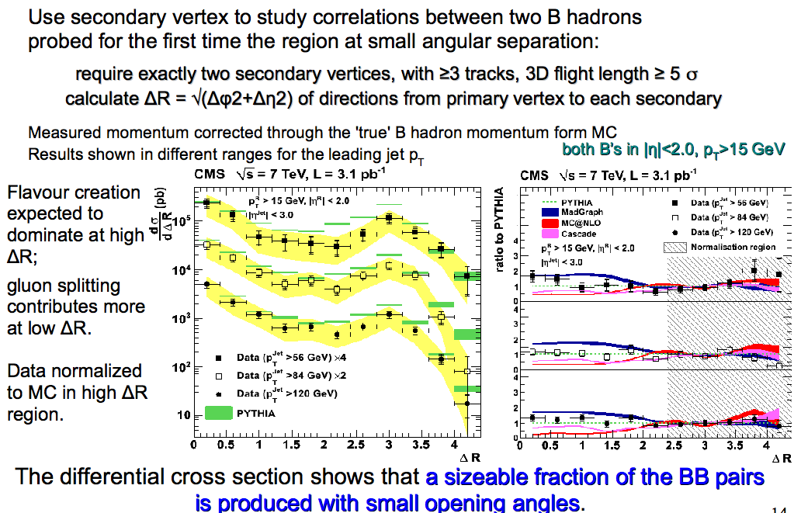
BB correlation
CMS: JHEP 1103 (2011) 136

Slide 22
Open Charm

Slide 23
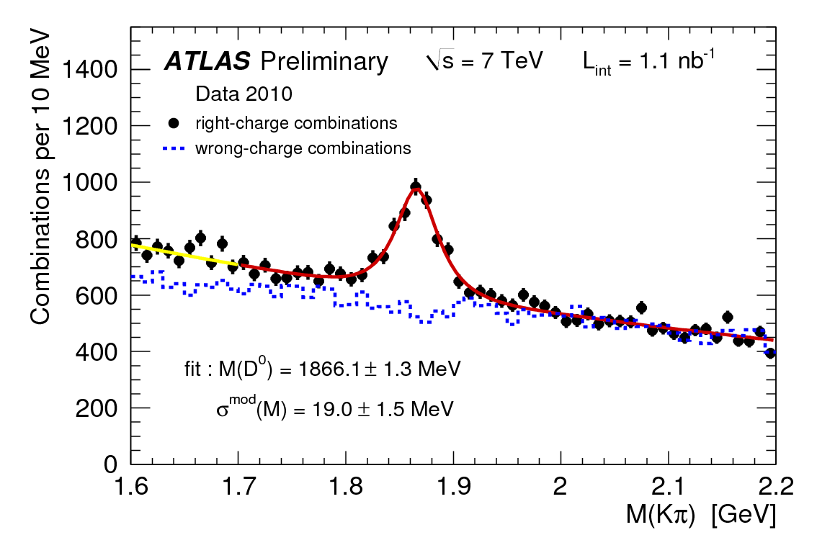









OPEN Charm in D and D* mesons
ATLAS-CONF-NOTE-2-11-017
At the early runs when collected collisions with Minimum Bias trigger 1.1 /nb
µ
µ
µ
µ
Pseudo-proper time
Pseudo-proper time
L_{xy} - the B flight distance from the primary vertex (PV)
projected on the xy plane was used to calculate
pseudo-proper time
L_{xy} - the B flight distance from the primary vertex (PV)
projected on the xy plane was used to calculate
pseudo-proper time
J/ψ
J/ψ
L_{xy}
L_{xy}
.
.
d0
d0

Slide 24

OPEN Charm in D and D* mesons
MC is lower than the data
No distinction between
Prompt D’s
and
D’s from B’s
From the J/ψ we learned that the B’s are OK=> it is probably low charm
D*±
D±
Notes:
consistent with the prompt J/psi

Slide 25

Exclusive
Beauty Production

Slide 26

Exclusive b meson production
High bb cross section allows measurements with early LHC data
Based on J/ψ→μ⁺μ⁻
Triggering on J/ψ di-muon
Combined fit to the B meson mass and lifetime to reject the background
B⁰ and B_{s} results obtained over the whole 2010 statistics (39.6 pb⁻¹)

Slide 27

B⁺->J/ψ K⁺

Slide 28

B⁰->J/ψ K_{s}
CMS: arXiv:1104.2892 [hep-ex], accepted by PRL

Slide 29

B_{s}->J/ψ φ

Slide 30
Summary
Calculation of hidden and open HF x-sect at hadron colliders has been long standing challenge for QCD.
Until recently, models were not able to reproduce both hidden HF x-sect and polarization. New NRQCD developments agree better with Ύ measurements.
There are improved theoretical prediction of open HF cross sections.
ATLAS and CMS had very fruitful B/C 2010 physics program using the early low luminosity runs to perform various HF measurements (J/ψ and Ύ production, inclusive b production, bb angular correlations, open charm, exclusive B⁺, B⁰, B_{S} production).
Many results are still on going e.g. quarkonium polarization (essential for theoretical model studies i.e. NRQCD), lifetimes, rare decays, with both 2010 and 2011 data.
Wealth of new data will refine theoretical models and improve MC simulation.
NLO seems to handle beauty quite well but more delicate for charm (NNLO?)

Slide 31
Backup

