Slide 1
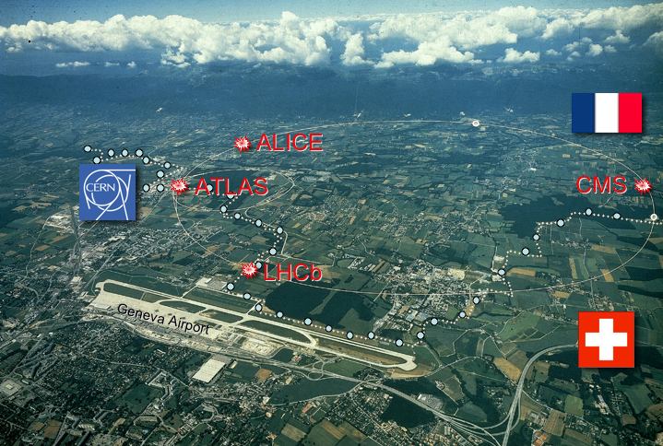

Status of the LHC:
Past, Present and Future
24th Rencontres de Blois
May 27, 2012
Sergio Bertolucci
CERN
LHC

Slide 2

The LHC
S. Myers QUB March 11, 2009
2
Notes:
2

Slide 3
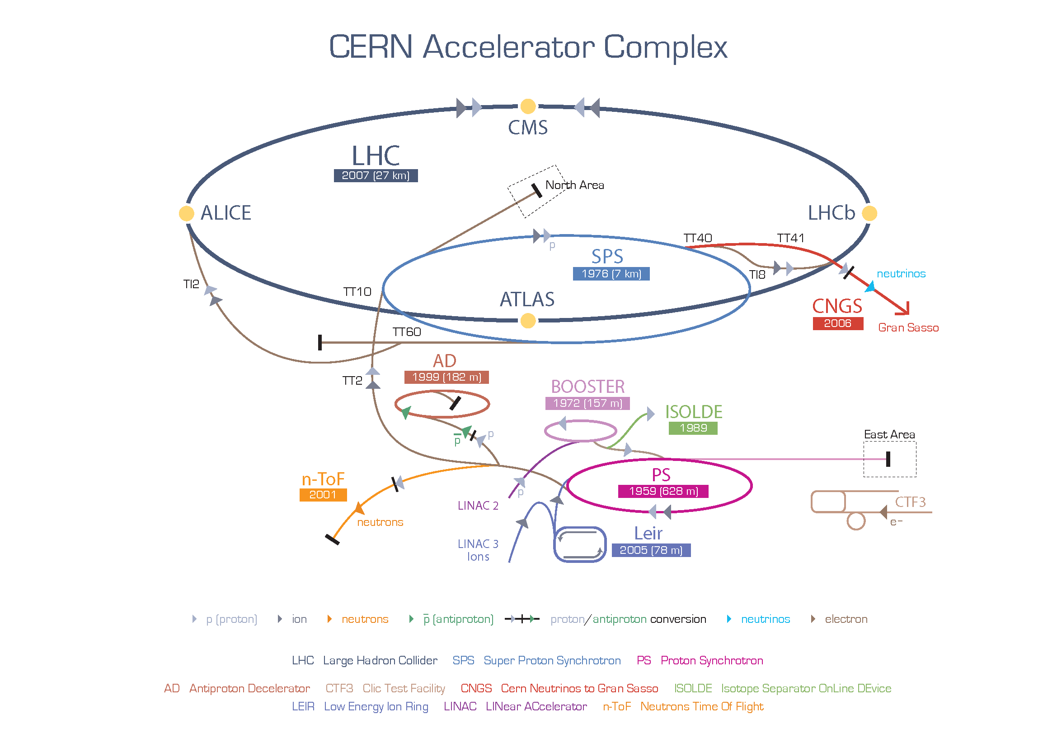

Slide 4
LHC: Some of the Technical Challenges
Circumference (km) | 26.7 | 100-150m underground
Number of Dipoles | 1232 | Cable Nb-Ti, cold mass 37million kg
Length of Dipole (m) | 14.3
Dipole Field Strength (Tesla) | 8.4 | Results from the high beam energy needed
Operating Temperature (K) | 1.9 | Superconducting magnets needed for the high magnetic field Super-fluid helium
Current in dipole sc coils (A) | 13000 | Results from the high magnetic field 1ppm resolution
Beam Intensity (A) | 0.5 | 2.2.10⁻⁶ loss causes quench
Beam Stored Energy (MJoules) | 362 | Results from high beam energy and high beam current 1MJ melts 2kg Cu
Magnet Stored Energy (MJoules)/octant | 1100 | Results from the high magnetic field
Sector Powering Circuit | 8 | 1612 different electrical circuits

Slide 5
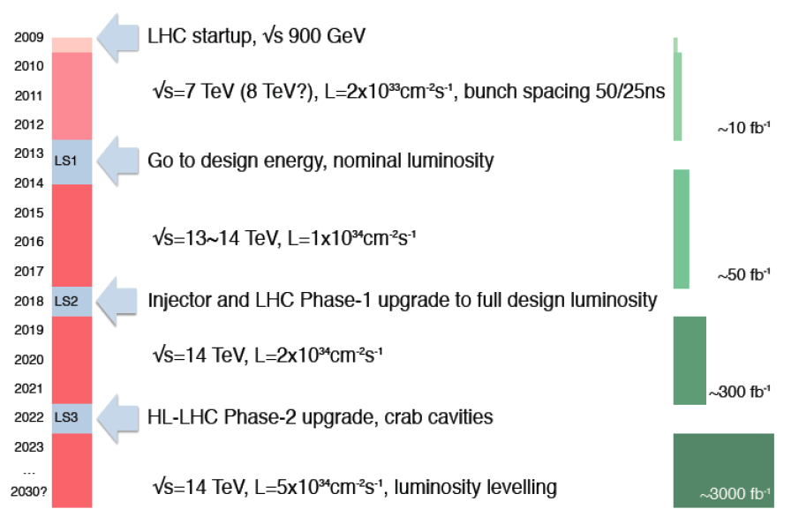
The LHC Timeline
LHC startup, √s = 900 GeV
4x
, bunch spacing 50 ns
√s=7~8 TeV, L=6x10³³ cm⁻² s⁻¹, bunch spacing 50 ns
~20-25 fb⁻¹
Go to design energy, nominal luminosity
√s=13~14 TeV, L~1x10³⁴ cm⁻² s⁻¹, bunch spacing 25 ns
, bunch spacing 25 ns
~75-100 fb⁻¹
Injector and LHC Phase-1 upgrade to ultimate design luminosity
√s=14 TeV, L~2x10³⁴ cm⁻² s⁻¹, bunch spacing 25 ns
, bunch spacing 25 ns
~350 fb⁻¹
HL-LHC Phase-2 upgrade, IR, crab cavities?
?, IR
√s=14 TeV, L=5x10³⁴ cm⁻² s⁻¹, luminosity levelling

Slide 6
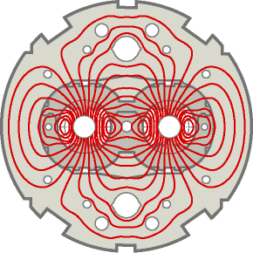
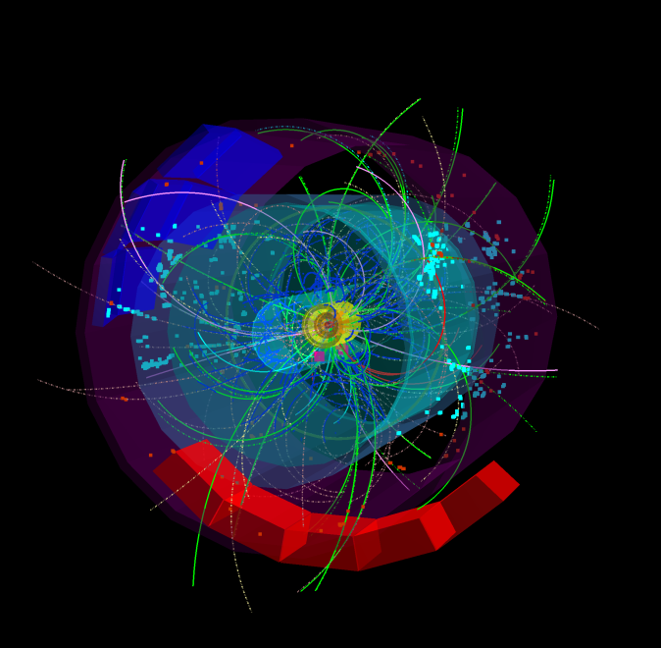
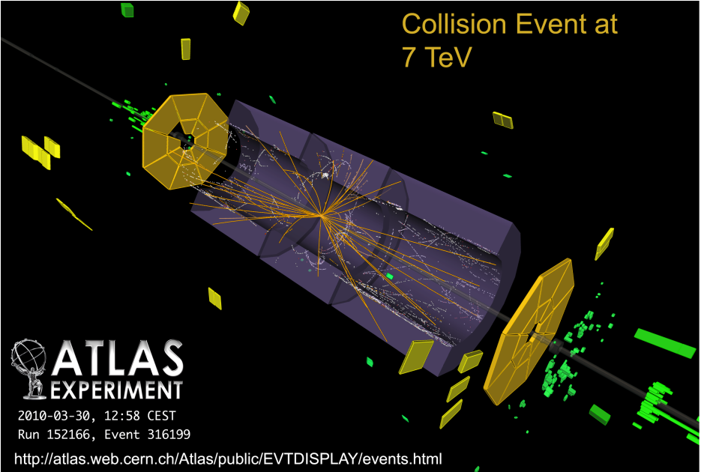
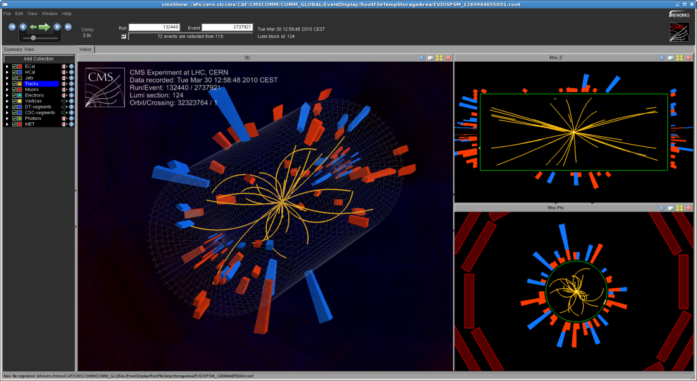
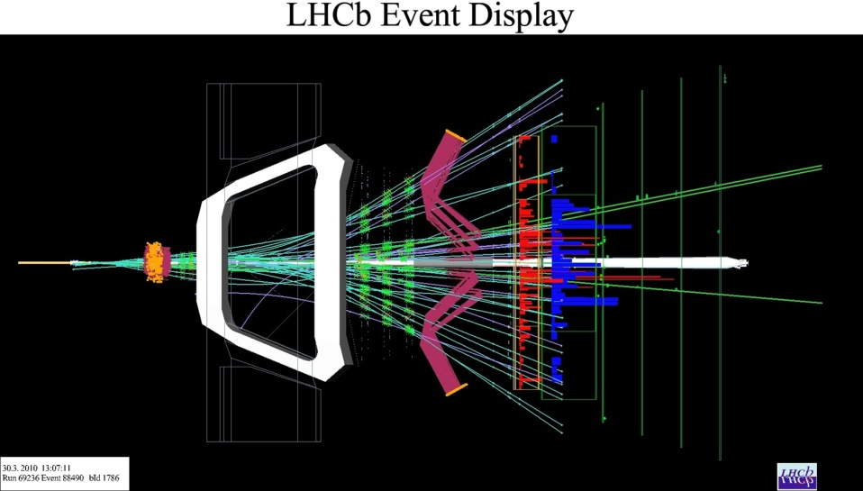
LHC: First collisions at 7 TeV on 30 March 2010
ALICE
LHCb
CMS
Peak Luminosity for First Run 10²⁷ cm⁻² s⁻¹

Slide 7
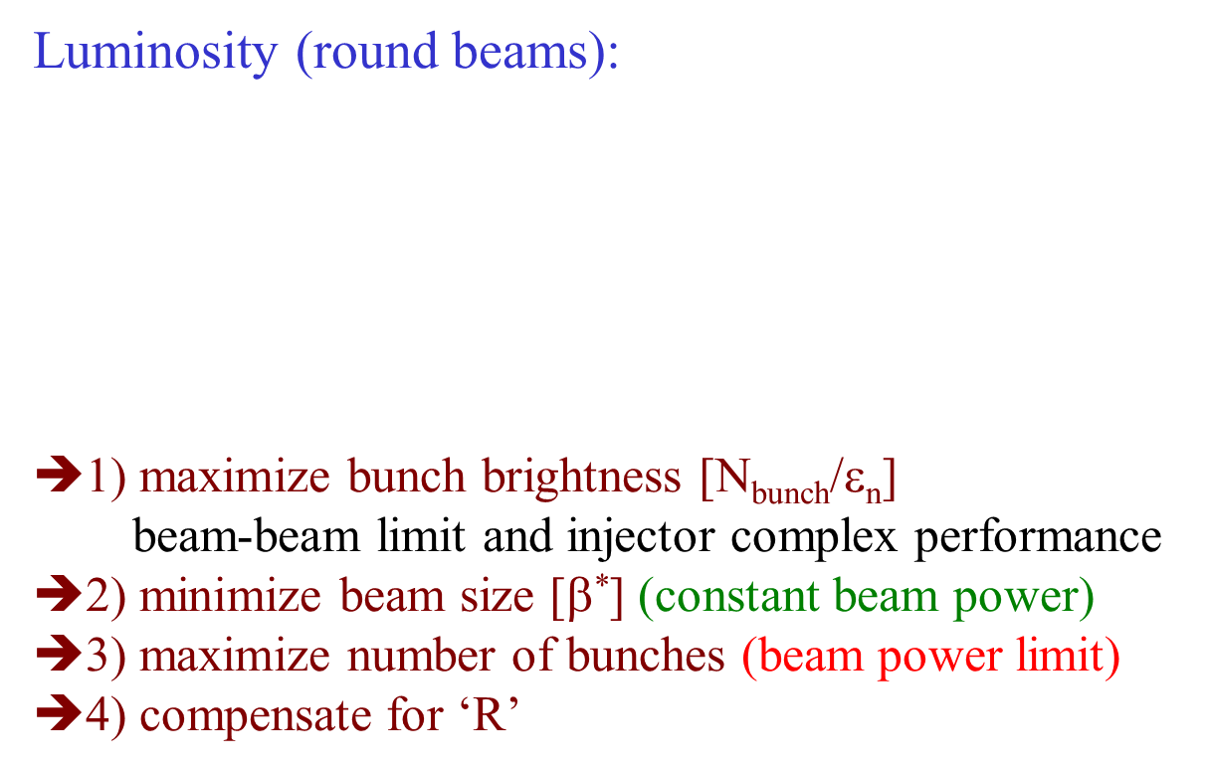

Maximizing the Luminosity

Slide 8
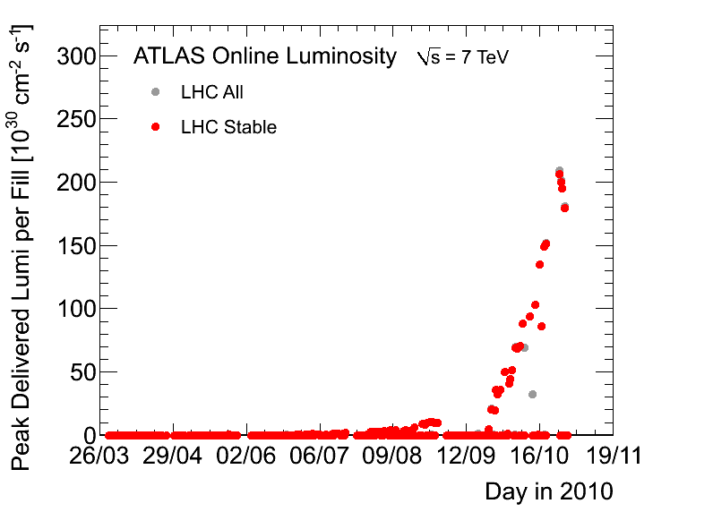
Peak Luminosity 2010
Peak Luminosity 2.2E32
Update needed
Goal for 2010 : 1E32
2010 Goal

Slide 9
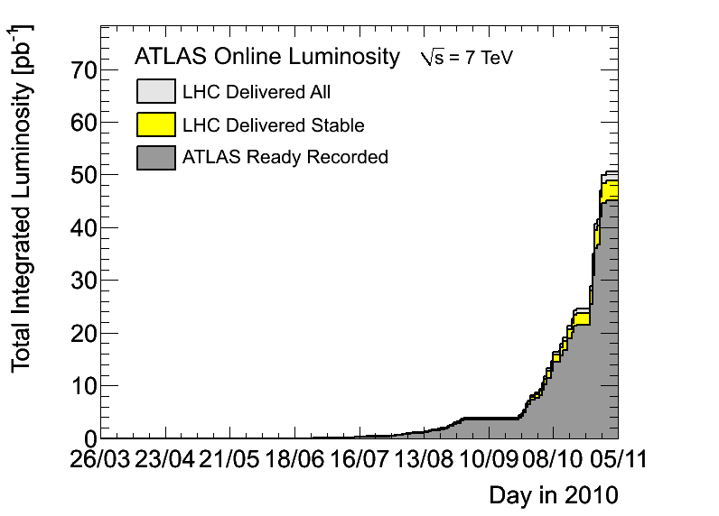
Integrated Luminosity in 2010
45pb-1 recorded

Slide 10
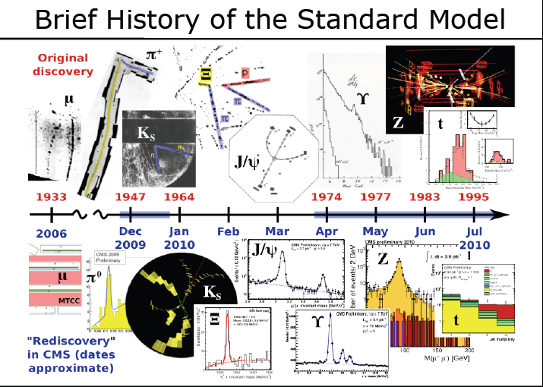

Slide 11
2011 Operation
(Goal for the year was 1000 pb^{-1,} i.e 22 times more than 2010)

Slide 12
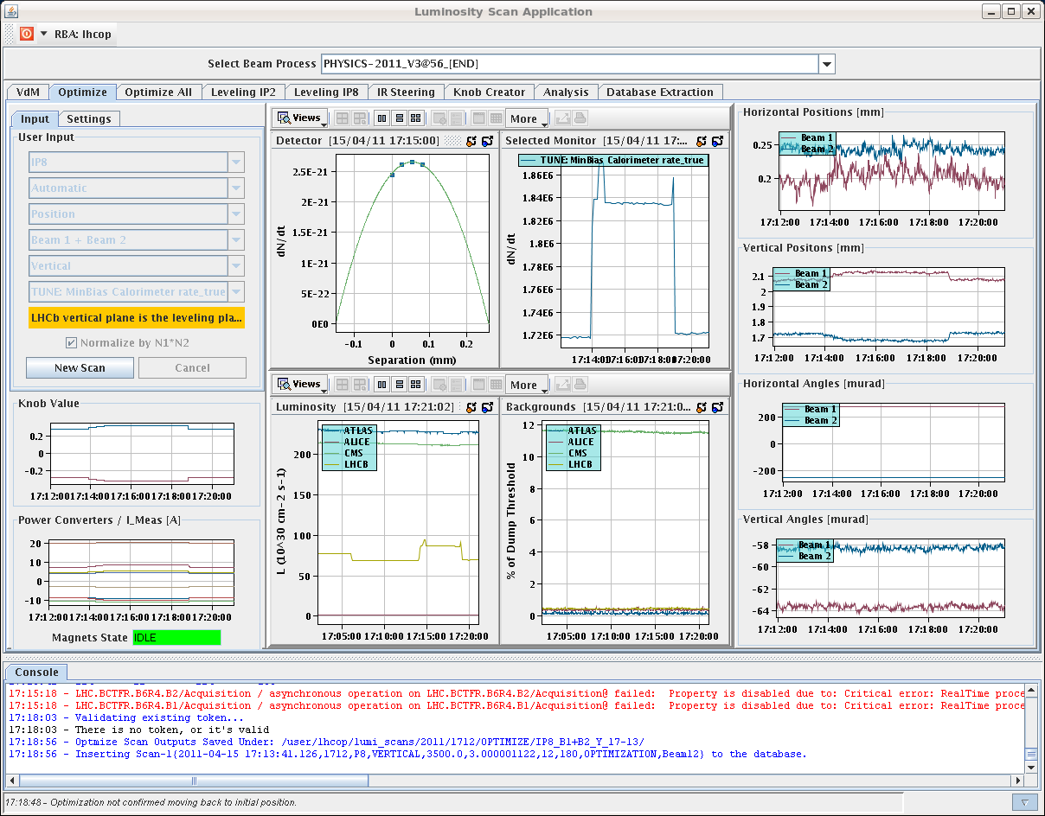
“Lumi leveling” first tested 15th April 2011

Slide 13
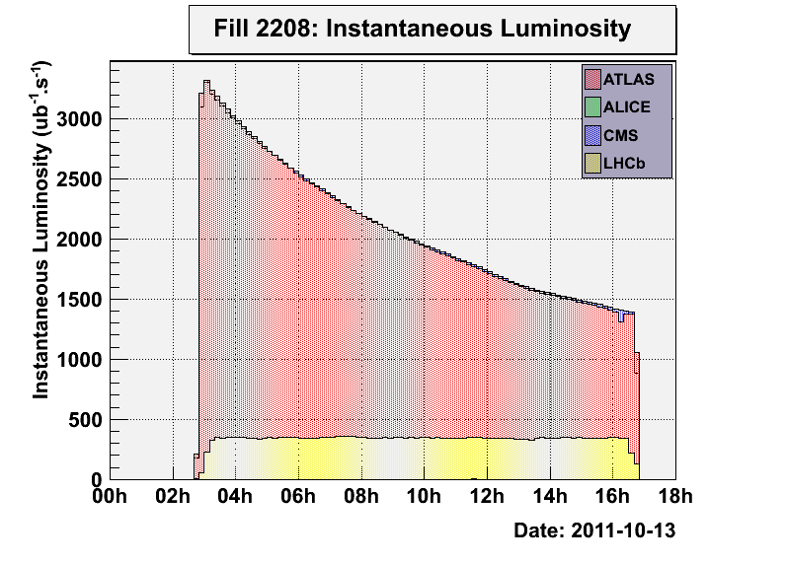
Luminosity Leveling via beam Separation
Introduced luminosity leveling for LHCb → can run at optimal μ and L_{max}
Since end of May running at constant L ~ 3-3.5∙10³² cm⁻²s⁻¹ with μ ~ 1.5
LHCb want maximum time in physics and not an increase in peak performance

Slide 14
History of 2011 Peak Luminosity
β* = 1.5m
50 ns
75 ns
Intensity Ramp Up
Intermediate energy run, technical stop, scrubbing
MD, technical stop
Mini-Chamonix
MD, technical stop
MD, technical stop
Emittance
Reduction
and intensity increase
β* = 1m

Slide 15
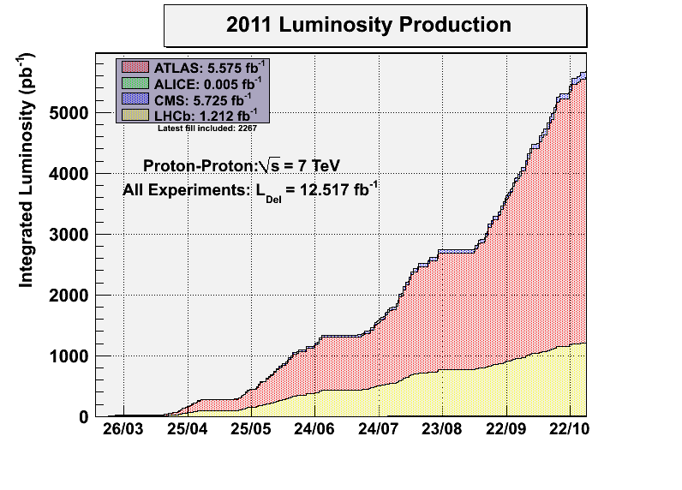
Protons
~ 6000 pb-1
Goal 2011

Slide 16
Heavy Ion Operation

Slide 17
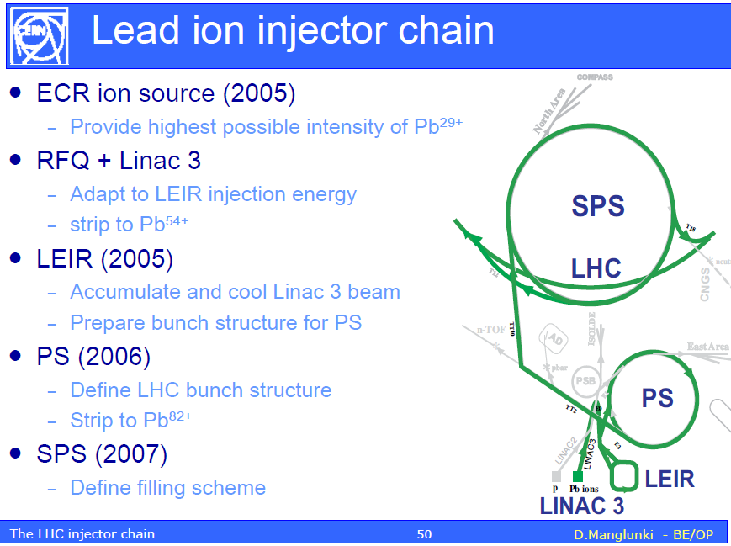
A word from our suppliers

Slide 18
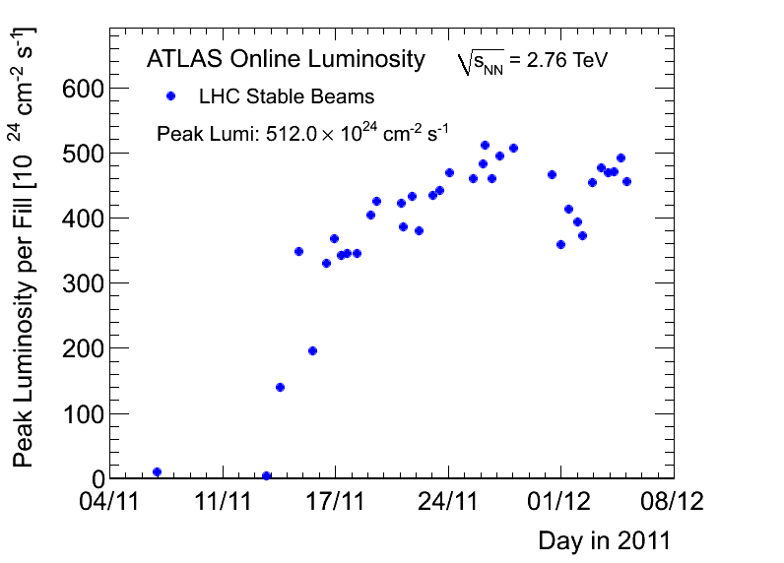
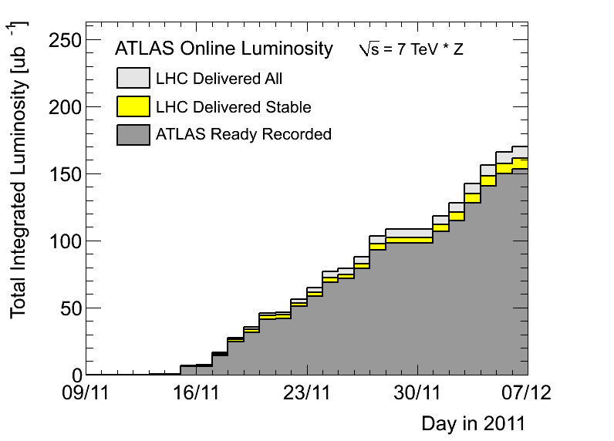
Peak and Integrated luminosity
2010
2010
In 2010:
Peak ~18E24; Integrated ~18ub-1
Max 137 bunches, larger β*, smaller bunch intensities
356 bunches

Slide 19
Running in 2012: boundary conditions
The LHC machine must produce enough integrated luminosity to allow ATLAS and CMS to independently discover/exclude the Higgs before the start of LS1.
We must also prepare for the proton-lead ion run at the end of the year.
We must (in 2012) do the necessary machine experiments to allow high energy, useful high luminosity running after LS1.
Pile up and 25ns

Slide 20
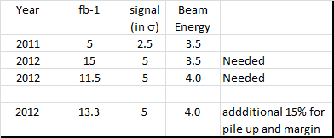
Integrated luminosity needed for Discovery of Higgs

Slide 21
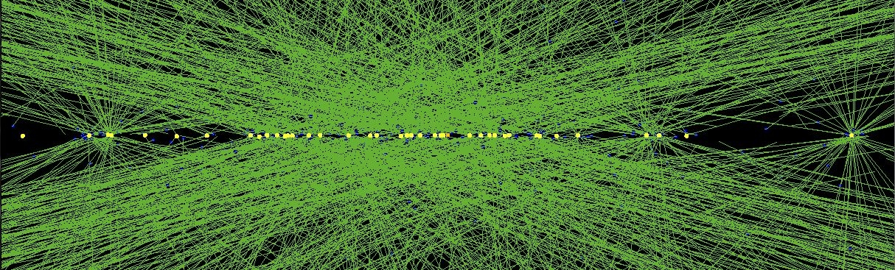
40 reconstructed vertices
High PU run October 25, 2011

Slide 22
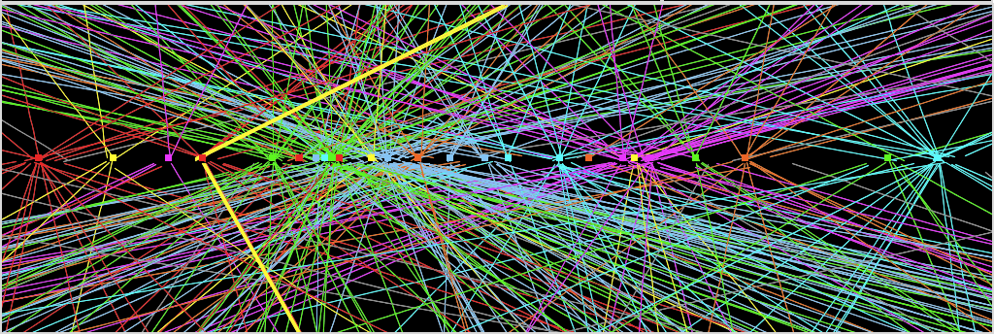
The challenge:
PILE-UP = number of interactions per crossing
2011: average 12, with tails up to ~20 →comparable to what expected at design luminosity
(due to: 50 ns operation; several machine parameters pushed beyond design, etc.)
2012: higher energy, more squeezed beams (β*=0.6m) → already experienced an average
of ~25 events/xing at the beginning of the fill with tails up to ~30.
Z→ μμ event from 2012 data with 25 reconstructed vertices
Z→ μμ
Huge efforts over last months to prepare for high lumi and pile-up expected in 2012:
optimized trigger and offline algorithms (tracking, calo noise treatment, physics objects)
→ mitigate impact of pile-up on CPU, rates, efficiency, identification, resolution
in spite of x2 larger CPU/event and event size → we do not request additional computing
resources (optimized computing model, increased fraction of fast simulation, etc.)

Slide 23
Reminder 2012 run configuration
Real Challenge
2 high luminosity experiments(ATLAS, CMS)
1 mid-luminosity (LHCb) x20 lower
1 low-luminosity (ALICE) x10,000
Also TOTEM and ALFA
Energy – 4 TeV
Bunch spacing - 50 ns
Collimator settings – tight
Atlas and CMS beta* - 60 cm
Alice and LHCb beta* - 3 m
  Natural satellites versus main bunches in Alice

Slide 24
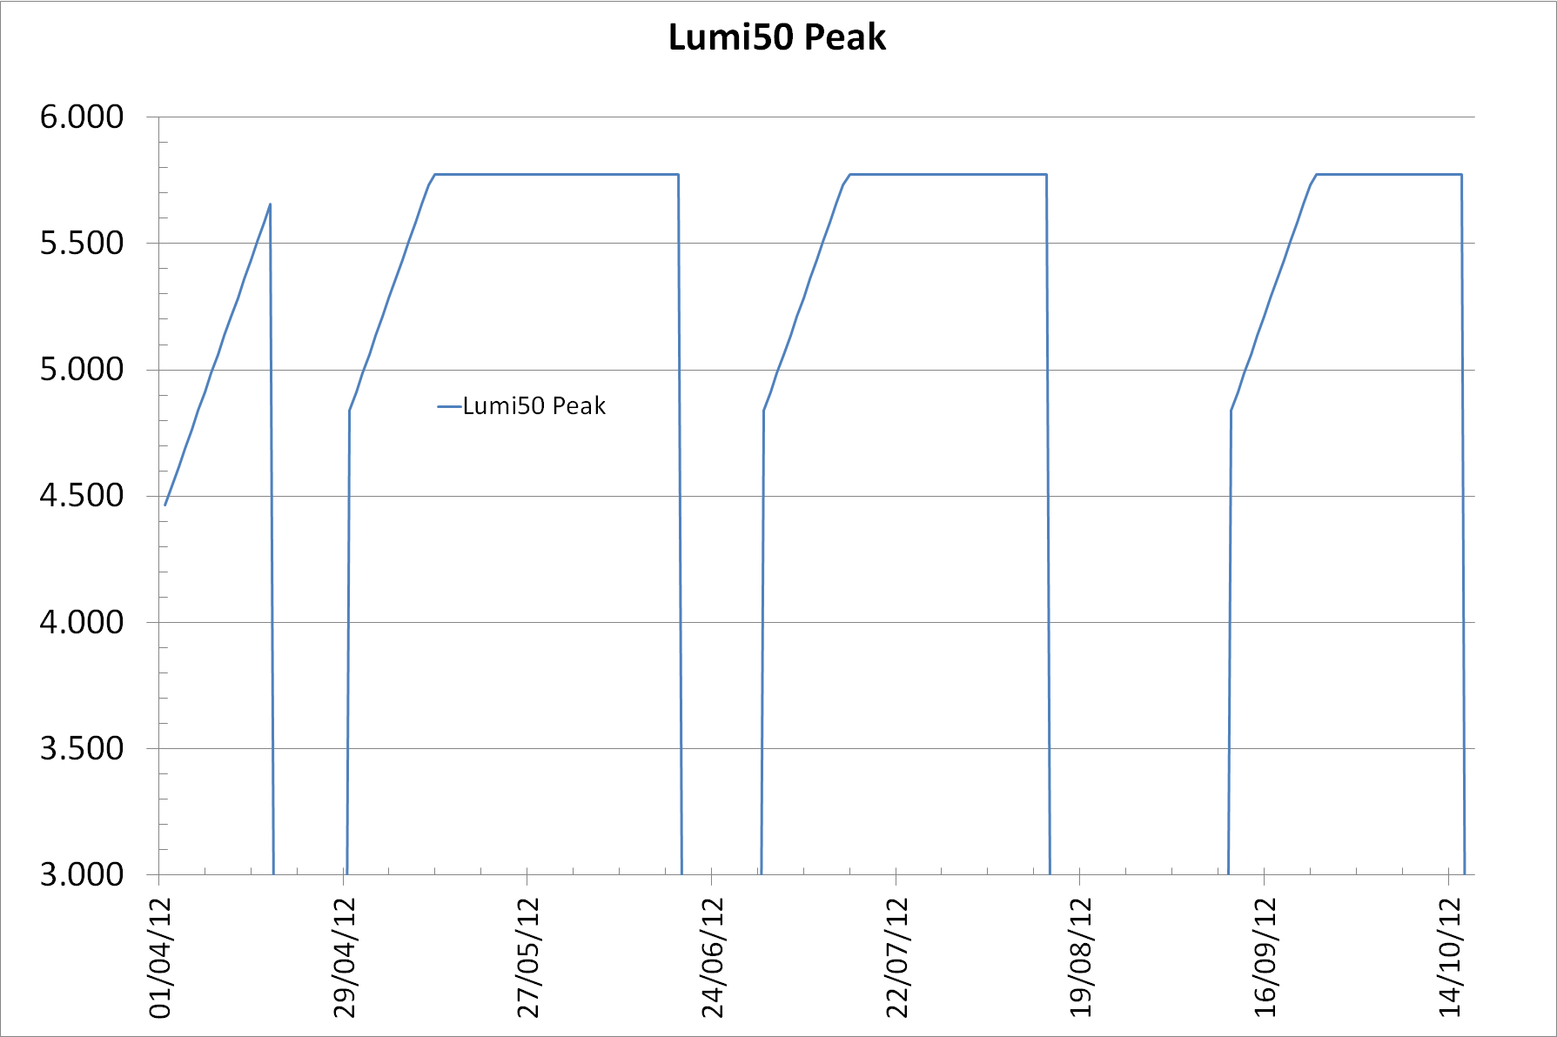
Estimated Peak Luminosity with 50ns (2012)
Estimated Peak Luminosity of 5.8x10³³

Slide 25
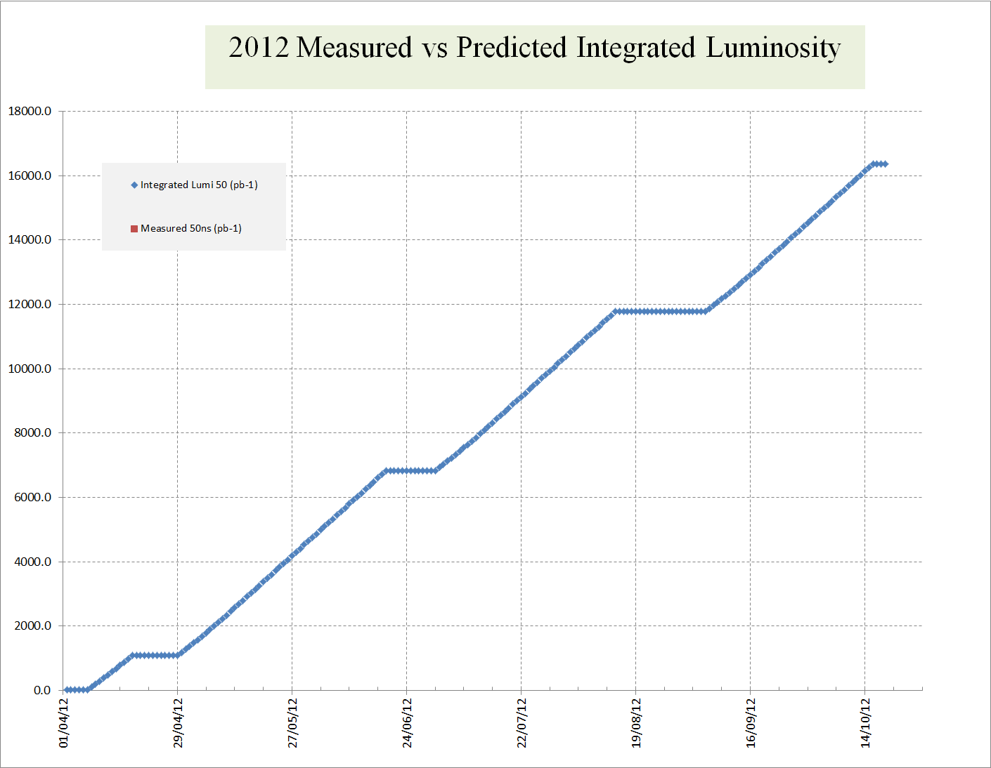

Second Break-point
First (most critical) Break-point
Check if we are on track to produce sufficient integrated luminosity for the Higgs
If needed we can delay the start of LS1 by up to 2 months

Slide 26
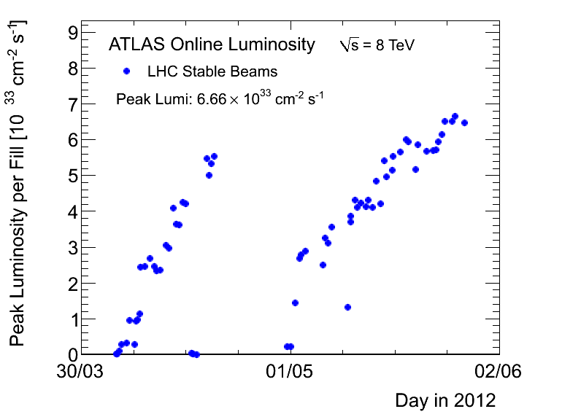
Peak Luminosity (as of today)
Estimated for 2012

Slide 27
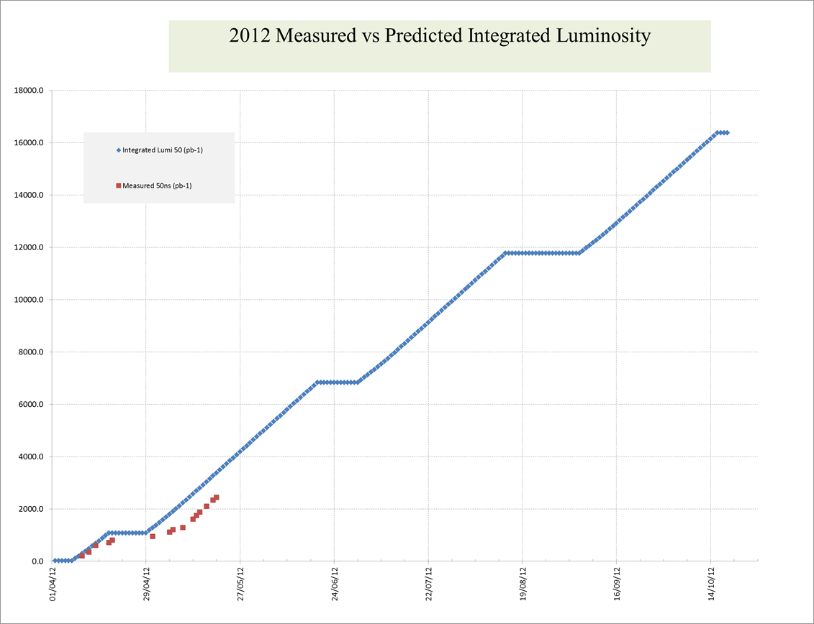
Luminosity Evolution (as of today)
⬆

Slide 28
LS1: towards operation at ~ 7TeV/beam
LS1 Work
  Repair all the defective interconnects
  Consolidate all interconnects with new design
  Finish off pressure release valves (DN200)
  Bring all necessary equipment up to the level needed for 7TeV/beam

Slide 29
LHC MB circuit splice consolidation proposal
Phase I
Surfacing of bus bar and installation of redundant shunts by soldering
Phase II
Application of clamp and reinforcement of nearby bus bar insulation
Phase III
Insulation between bus bar and to ground, Lorentz force clamping

Slide 30
…then operation at 6.5TeV per beam
Assumptions
E=6.5TeV
β* = 0.5m
All other conditions as in 2012 i.e. no improvement (yet) in injector brightness, LHC availability same etc

Slide 31
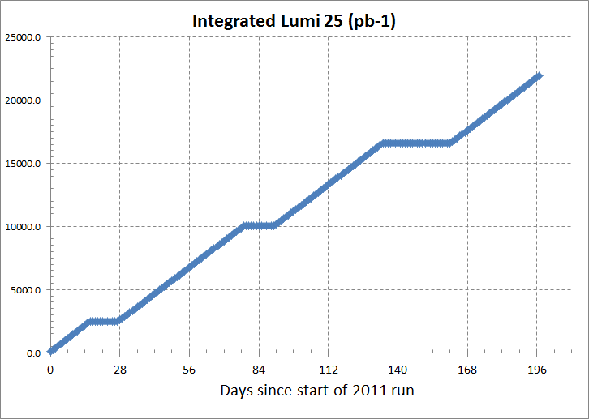
6.5TeV: 25ns
6.5Tev: 25 ns
β* = 0.5m
148 days of physics
L_{peak} ~7.5E33
µ = ~17
Days since start of 2015 run

Slide 32
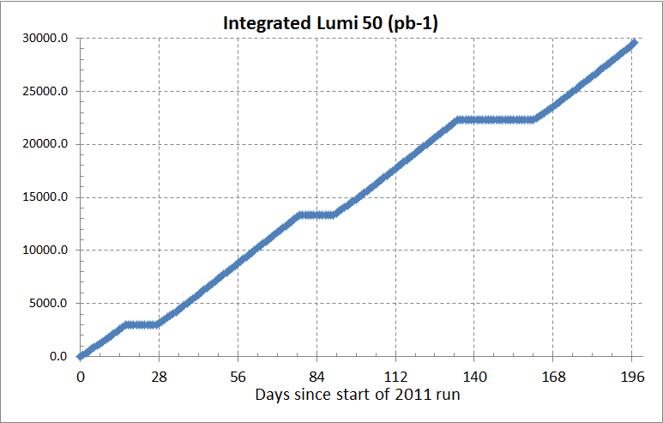
6.5TeV per beam with 50ns
6.5Tev: 50 ns
β* = 0.5m
148 days of physics
L_{peak} ~10.5E33
µ = ~50
Days since start of 2015 run

Slide 33
The LHC Timeline
LHC startup, √s = 900 GeV
4x
, bunch spacing 50 ns
√s=7~8 TeV, L=6x10³³ cm⁻² s⁻¹, bunch spacing 50 ns
~20-25 fb⁻¹
Go to design energy, nominal luminosity
√s=13~14 TeV, L~1x10³⁴ cm⁻² s⁻¹, bunch spacing 25 ns
, bunch spacing 25 ns
~75-100 fb⁻¹
Injector and LHC Phase-1 upgrade to ultimate design luminosity
√s=14 TeV, L~2x10³⁴ cm⁻² s⁻¹, bunch spacing 25 ns
, bunch spacing 25 ns
~350 fb⁻¹
HL-LHC Phase-2 upgrade, IR, crab cavities?
?, IR
√s=14 TeV, L=5x10³⁴ cm⁻² s⁻¹, luminosity levelling

Slide 34
LS2 : 2018, LHC Injector Upgrades
Connect Linac4 to PS Booster, (if not already achieved)
  New PS Booster injection channel
Upgrade PS Booster from 1.4 to 2.0 GeV
  New Power Supplies, RF system etc.
  Upgrade transfer lines, instrumentation etc.
Upgrades to the PS
  New Injection region for 2.0 GeV Injection
  New/Upgraded RF systems
  Upgrades to Feedbacks/Instrumentation etc.
Upgrades to the SPS
  Electron Cloud mitigation – strong feedback system, or coating of the vacuum system
  Impedance reduction, improved feedbacks
  Large-scale modification to the main RF system

Slide 35
The ultimate LHC: HL-LHC Specifications
Leveled peak luminosity: L = 5 10³⁴ cm⁻² sec⁻¹
Virtual peak luminosity: L > 10 10³⁴ cm⁻² sec⁻¹
Integrated luminosity: 200 fb⁻¹ to 300 fb⁻¹ per year
Total integrated luminosity: ca. 3000 fb⁻¹
Chamonix, 9 February 2012
Oliver Brüning BE-ABP
35

Slide 36
HL-LHC Performance Estimates
nominal bunch length and minimum β*: ‘HL-LHC Kickoff+’
minimum β*
5.6 10¹⁴ and 4.6 10¹⁴
p/beam
Parameter | nominal | 25ns | 50ns
N | 1.15E+11 | 2.0E+11 | 3.3E+11
n_{b} | 2808 | 2808 | 1404
beam current [A] | 0.58 | 1.02 | 0.84
x-ing angle [μrad] | 300 | 475 | 520
beam separation [σ] | 10 | 10 | 10
β* [m] | 0.55 | 0.15 | 0.15
ε_{n} [μm] | 3.75 | 2.5 | 3.0
ε_{L} [eVs] | 2.51 | 2.5 | 2.5
energy spread | 1.00E-04 | 1.00E-04 | 1.00E-04
bunch length [m] | 7.50E-02 | 7.50E-02 | 7.50E-02
IBS horizontal [h] | 80 -> 106 | 25 | 17
IBS longitudinal [h] | 61 -> 60 | 21 | 16
Piwinski parameter | 0.68 | 2.5 | 2.5
geom. reduction | 0.83 | 0.37 | 0.37
beam-beam / IP | 3.10E-03 | 3.9E-03 | 5.0E-03
Peak Luminosity | 1 10³⁴ | 7.4 10³⁴ | 8.4 10³⁴
sufficient room for leveling
(with Crab Cavities)
Virtual luminosity (25ns) of
L = 7.4 / 0.37 10³⁴ cm⁻² s⁻¹
= 20 10³⁴ cm⁻² s⁻¹ (‘k’ = 4)
Virtual luminosity (25ns) of
L = 8.4 / 0.37 10³⁴ cm⁻² s⁻¹
= 22.7 10³⁴ cm⁻² s⁻¹ (‘k’ = 4.5)
(Leveled to 5 10³⁴ cm⁻² s⁻¹)
Events / crossing | 19 | 141 | 257 | 95 | 190
Chamonix, 9 February 2012
Oliver Brüning BE-ABP
36
Notes:
50ns beam option provides HL-LHC performance levels at ultimate total beam currents; only the ‘large beta*’ option reaches beam-beam limit; IBS growth rates are a concern!; low beta option has 50% higher performance potential

Slide 37
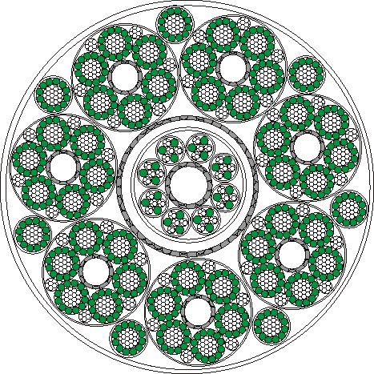
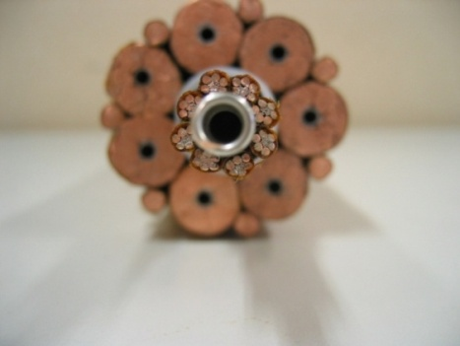
R&D Superconducting Links
Motivated by the need to remove the power converters out of the tunnel, avoiding radiation effects
Φ = 62 mm
MgB2 (or other HTS)
7 × 14 kA, 7 × 3 kA and 8 × 0.6 kA cables – Itot∼120 kA @ 30 K
Also DFs with current leads removed to surface
Definitive solution to R2E problem
Make room for shielding unmovable electronics
Make much easier maintnance and application ALARA

Slide 38
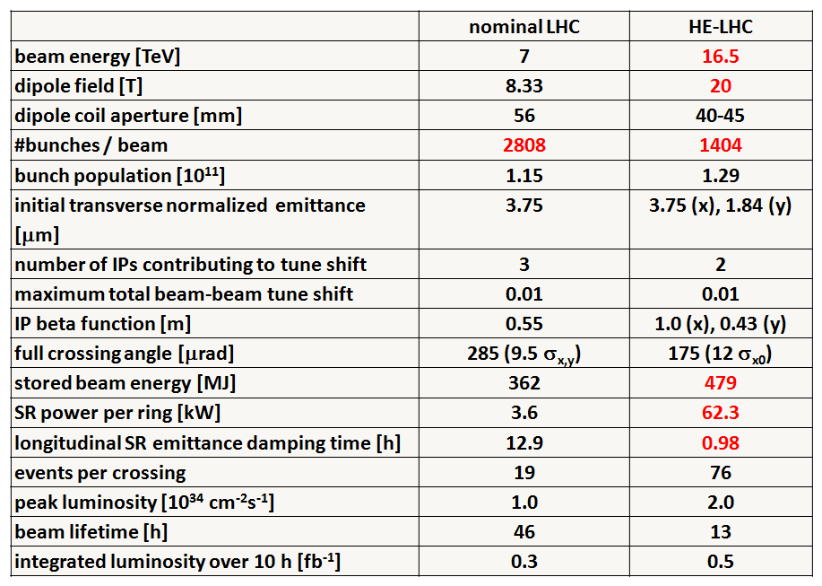
Preliminary HE-LHC - parameters
Not only luminosity: High Energy LHC
Very preliminary with large error bars

Slide 39
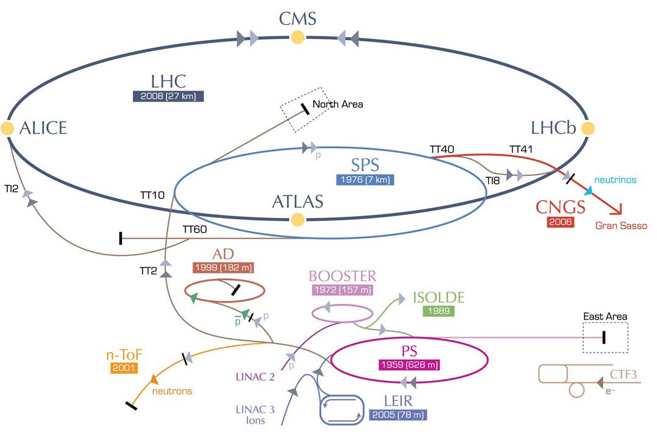
HE-LHC – LHC modifications
HE-LHC
2030-33
SPS+,
1.3 TeV, 2030-33
2-GeV Booster
Linac4

Slide 40
HE-LHC – main issues and R&D
High-field 20T dipole magnets based on Nb3Sn, Nb3Al, and HTS
High-gradient quadrupole magnets for arc and IR
Fast cycling SC magnets for ~1.3TeV injector
Emittance control in regime of strong SR damping and IBS
Cryogenic handling of SR heat load (first analysis; looks manageable)
Dynamic vacuum

Slide 41

Summary
The First two years of LHC operation have produced sensational performance: well beyond our wildest expectations
The combination of the performance of the LHC machine, the detectors and the Grid have proven to be a terrific success story in particle physics.
However, we must remain extremely vigilant with respect to the protection of the machine (120MJ of stored energy) and hope that there are no old “unexploded bombs” in the hardware!!
In the absence of any major technical failure, the LHC machine WILL produce enough integrated luminosity in 2012 to allow the detectors to discover or exclude the Higgs Boson.
The high energy operation after the Long Shutdown will be another exciting era in discovery physics

Slide 42
Thank you!

