Slide 1
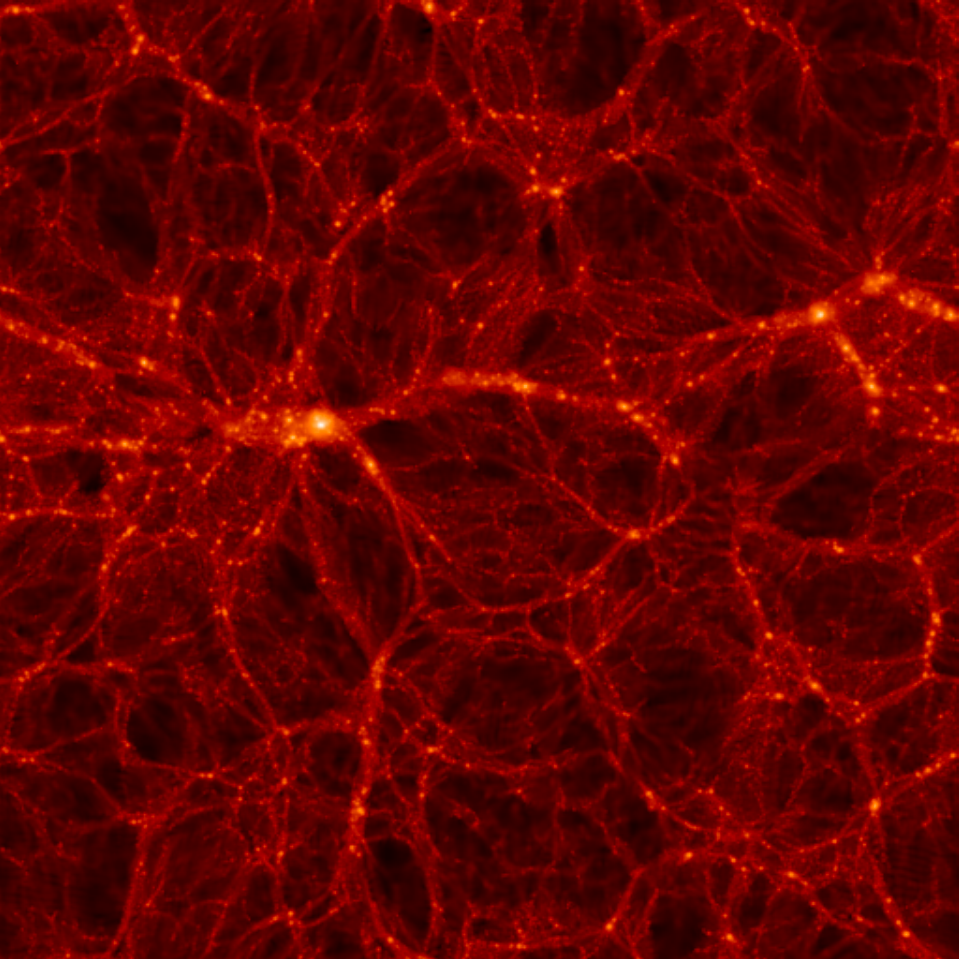
NEUTRINO PHYSICS AND COSMOLOGY
ν_{e} ν_{μ}
ν_{τ}
STEEN HANNESTAD, Aarhus University
BLOIS, 31 MAY 2012

Slide 2
FLAVOUR STATES
PROPAGATION STATES
MIXING MATRIX (UNITARY)
LATE-TIME COSMOLOGY IS (ALMOST)
INSENSITIVE TO THE MIXING STRUCTURE

Slide 3
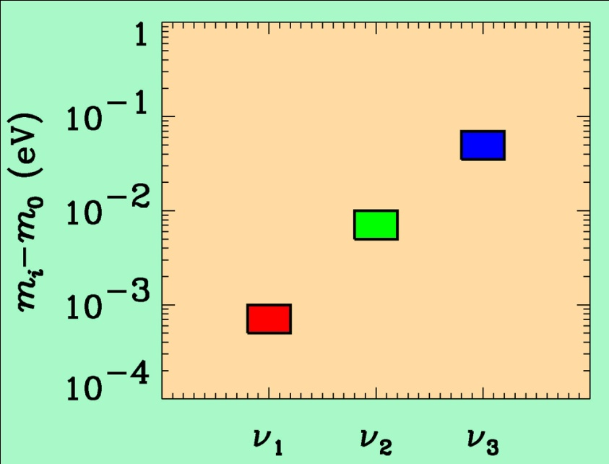
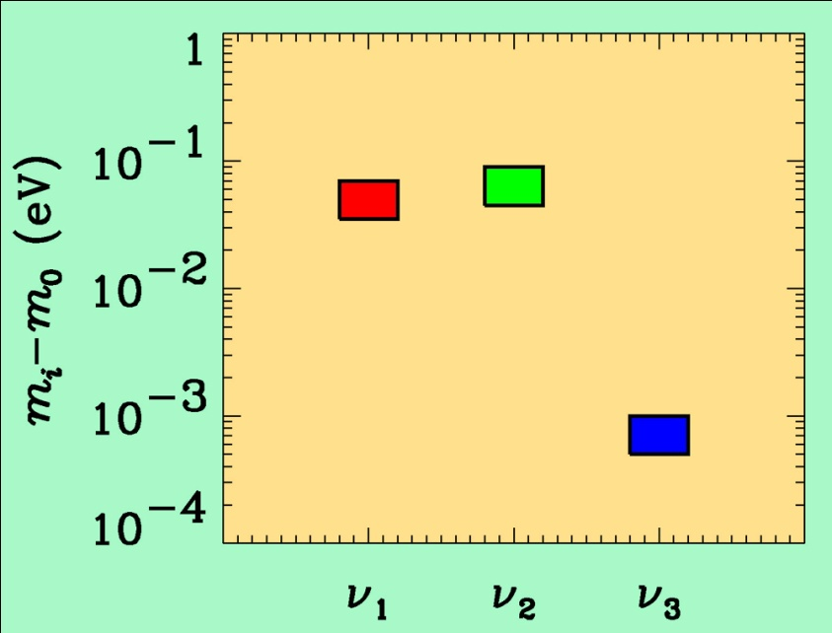
If neutrino masses are hierarchical then oscillation experiments
do not give information on the absolute value of neutrino masses
ATMO. ν
K2K
MINOS
SOLAR ν
KAMLAND
Normal hierarchy
Inverted hierarchy
However, if neutrino masses are degenerate
no information can be gained from such experiments.
Experiments which rely on either the kinematics of neutrino mass
or the spin-flip in neutrinoless double beta decay are the most
efficient for measuring m₀

Slide 4
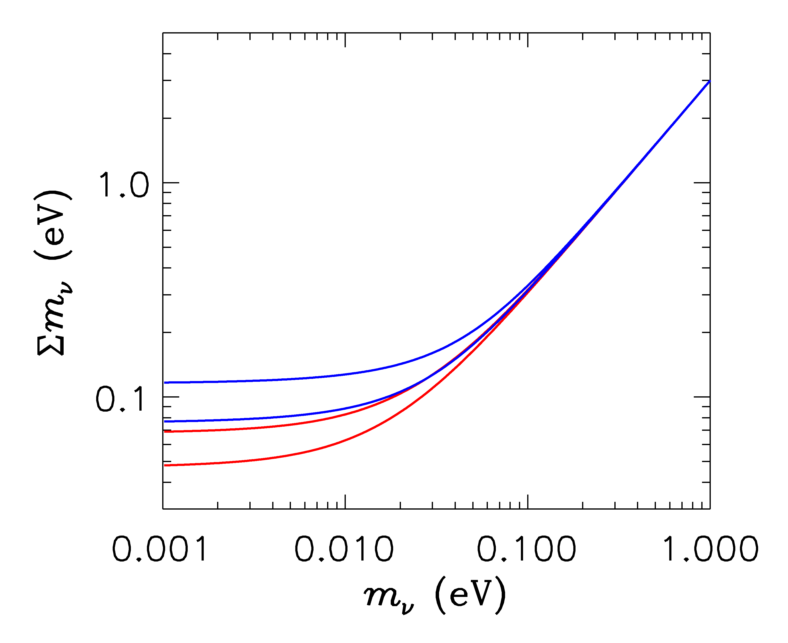
HIERARCHICAL
DEGENERATE
INVERTED
NORMAL
LIGHTEST

Slide 5
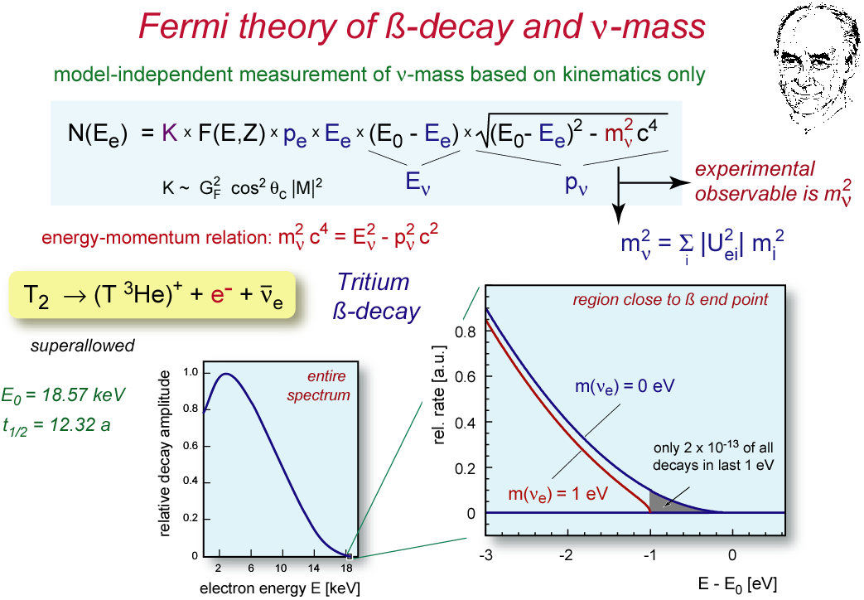
ß-decay and neutrino mass
model independent neutrino mass from ß-decay kinematics
only assumption: relativistic energy-momentum relation
experimental observable is m_{ν}²
T₂:
E₀ = 18.6 keV
T_{1/2} = 12.3 y

Slide 6
Tritium decay endpoint measurements have provided limits
on the electron neutrino mass
Mainz experiment, final analysis (Kraus et al.)
This translates into a limit on the sum of the three mass
eigenstates

Slide 7
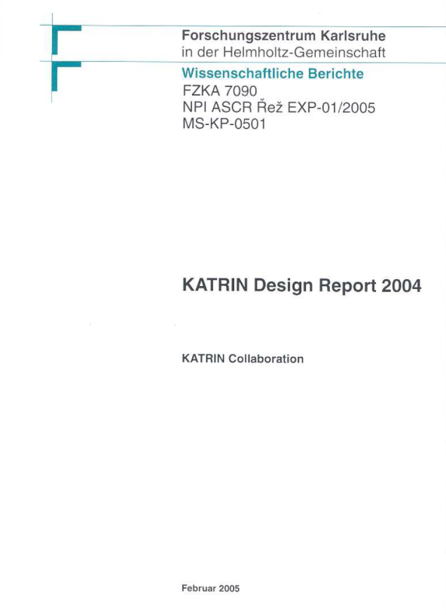
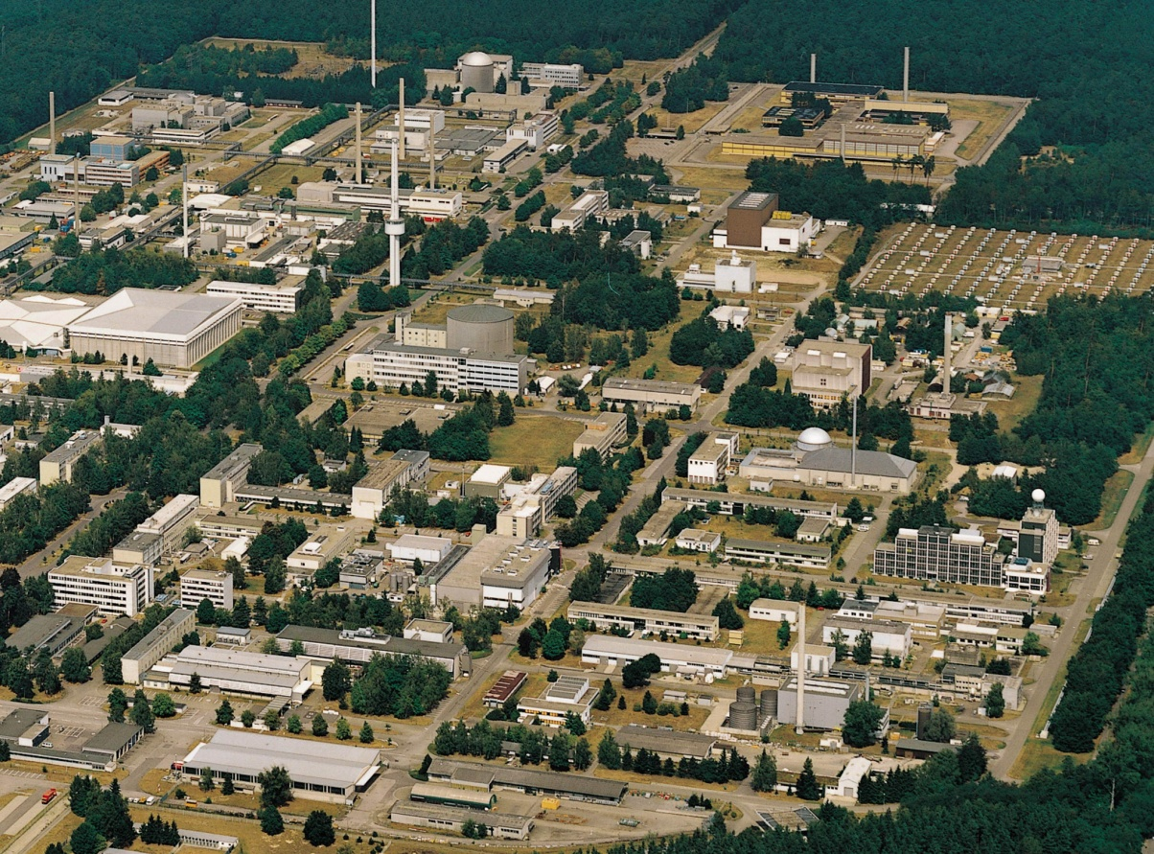
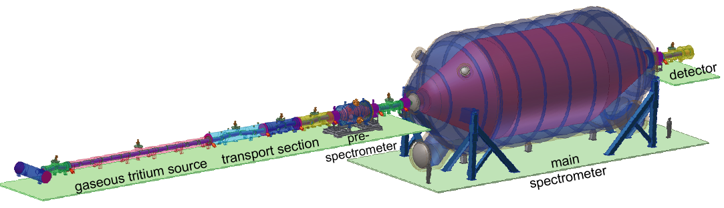
KATRIN experiment
Karlsruhe Tritium Neutrino
Experiment
at Forschungszentrum Karlsruhe
Data taking starting 2013
TLK
25 m

Slide 8
NEUTRINO MASS AND ENERGY DENSITY
FROM COSMOLOGY
NEUTRINOS AFFECT STRUCTURE FORMATION
BECAUSE THEY ARE A SOURCE OF DARK MATTER
(n ~ 100 cm⁻³)
FROM
HOWEVER, eV NEUTRINOS ARE DIFFERENT FROM CDM
BECAUSE THEY FREE STREAM
SCALES SMALLER THAN d_{FS} DAMPED AWAY, LEADS TO
SUPPRESSION OF POWER ON SMALL SCALES

Slide 9
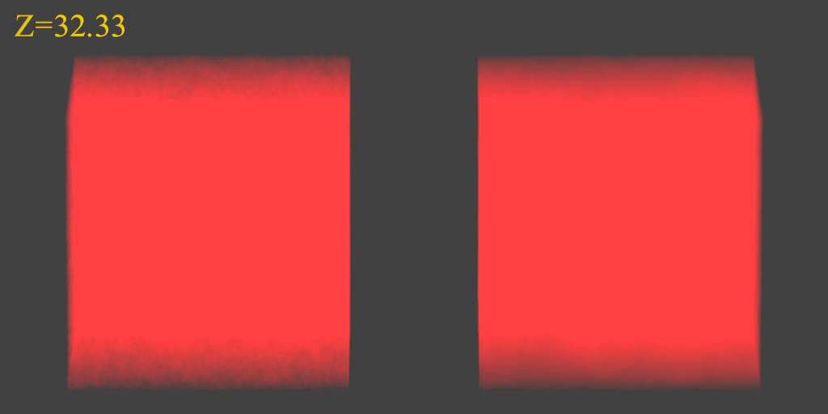
N-BODY SIMULATIONS OF ΛCDM WITH AND WITHOUT
NEUTRINO MASS (768 Mpc³) – GADGET 2
256
Mpc
T Haugboelle, University of Aarhus

Slide 10
AVAILABLE COSMOLOGICAL DATA

Slide 11
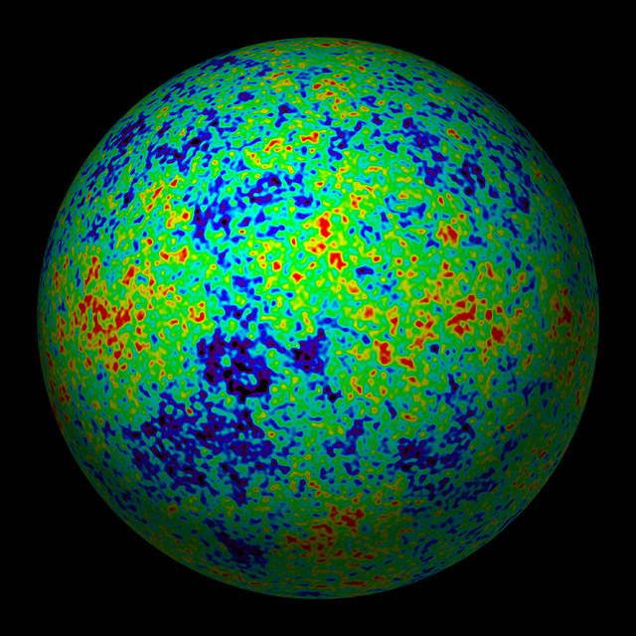
THE COSMIC MICROWAVE BACKGROUND
WMAP TEMPERATURE MAP

Slide 12
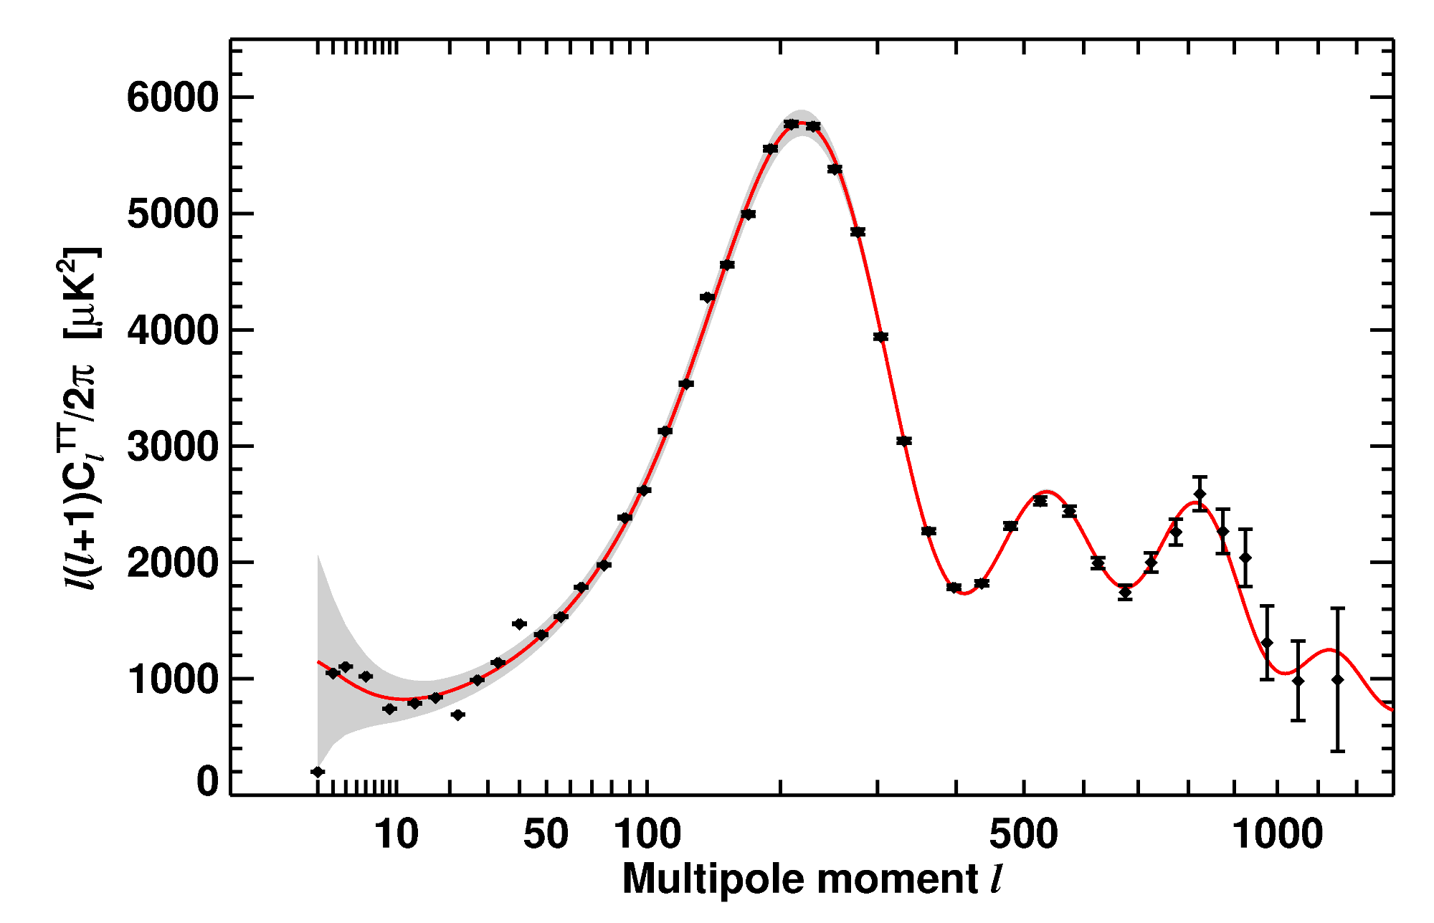
WMAP-7 TEMPERATURE POWER SPECTRUM
LARSON ET AL, ARXIV 1001.4635
ADDITIONAL DATA ON SMALLER SCALES FROM
ATACAMA COSMOLOGY TELESCOPE (Dunkley et al. 2011)
SOUTH POLE TELESCOPE (Keisler et al. 2011)

Slide 13
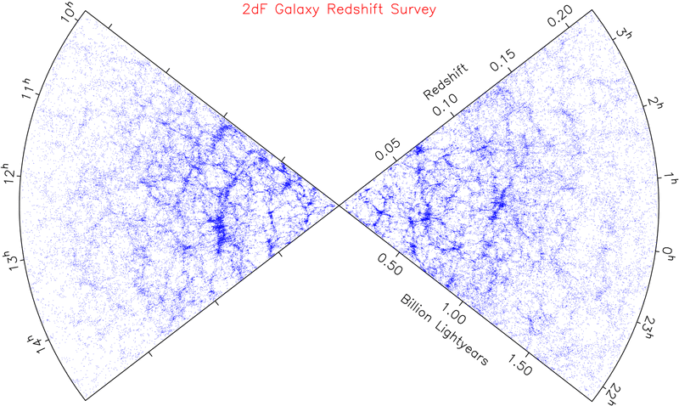
LARGE SCALE STRUCTURE SURVEYS - 2dF AND SDSS

Slide 14
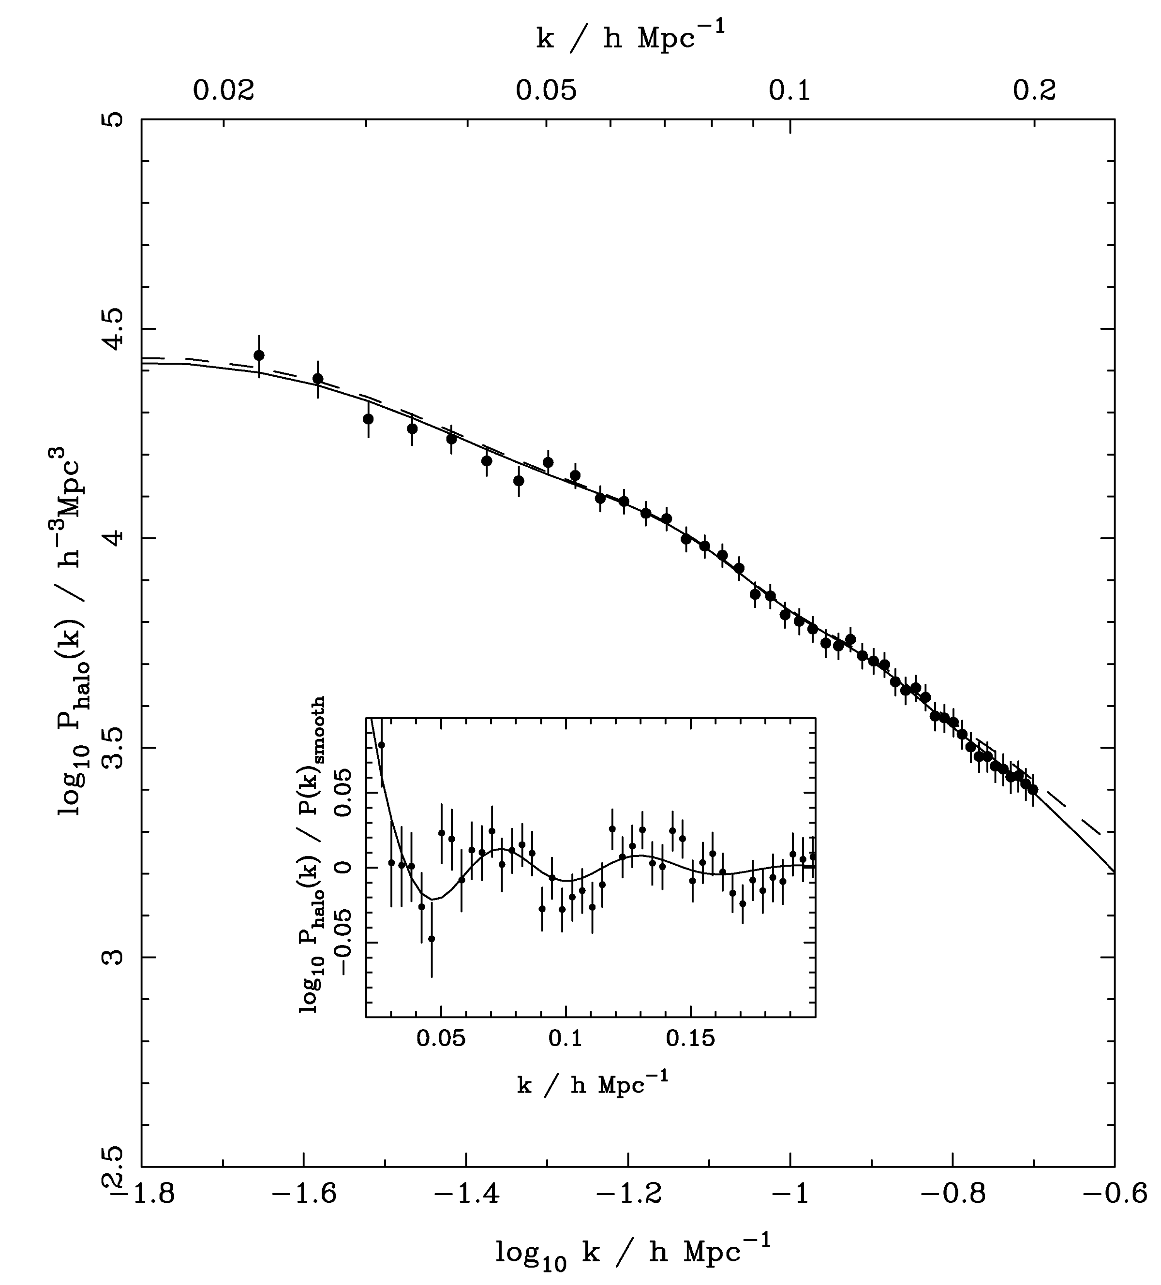
SDSS DR-7
LRG SPECTRUM
(Reid et al ’09)

Slide 15
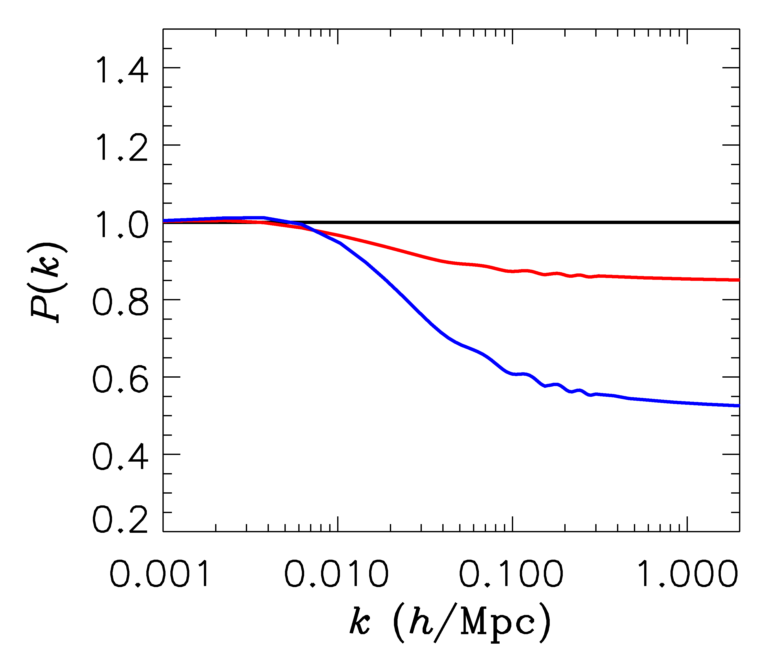
FINITE NEUTRINO MASSES SUPPRESS THE MATTER POWER
SPECTRUM ON SCALES SMALLER THAN THE FREE-STREAMING
LENGTH
Sm = 0 eV
P(k)/P(k,m_{ν}=0)
Sm = 0.3 eV
Sm = 1 eV

Slide 16
NOW, WHAT ABOUT NEUTRINO
PHYSICS?

Slide 17
WHAT IS THE PRESENT BOUND ON THE NEUTRINO MASS?
DEPENDS ON DATA SETS USED AND ALLOWED PARAMETERS
THERE ARE MANY ANALYSES IN THE LITERATURE
USING THE MINIMAL COSMOLOGICAL
MODEL
STH, MIRIZZI, RAFFELT, WONG (arxiv:1004:0695)
HAMANN, STH, LESGOURGUES, RAMPF & WONG (arxiv:1003.3999)
JUST ONE EXAMPLE

Slide 18

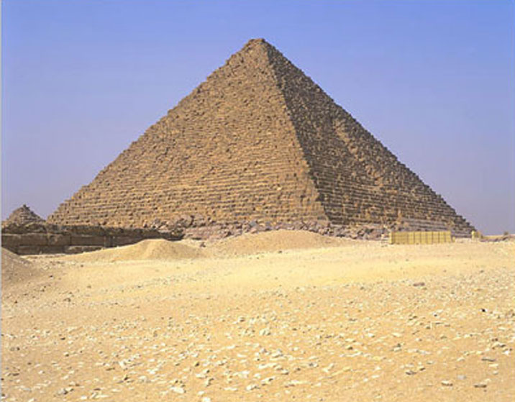
THE NEUTRINO MASS FROM COSMOLOGY PLOT
More data
+Ly-alpha
~ 0.2 eV
0.2-0.3 eV
0.2-0.3 eV
+ SNI-a
+WL
~ 0.5 eV
0.5-0.6 eV
0.5-0.6 eV
+ SDSS
0.6 eV
~ 1 eV
1-2 eV
CMB only
1.1 eV
~ 2 eV
2.? eV
??? eV
Minimal
ΛCDM
+N_{ν}
+w+……
Larger model
space

Slide 19
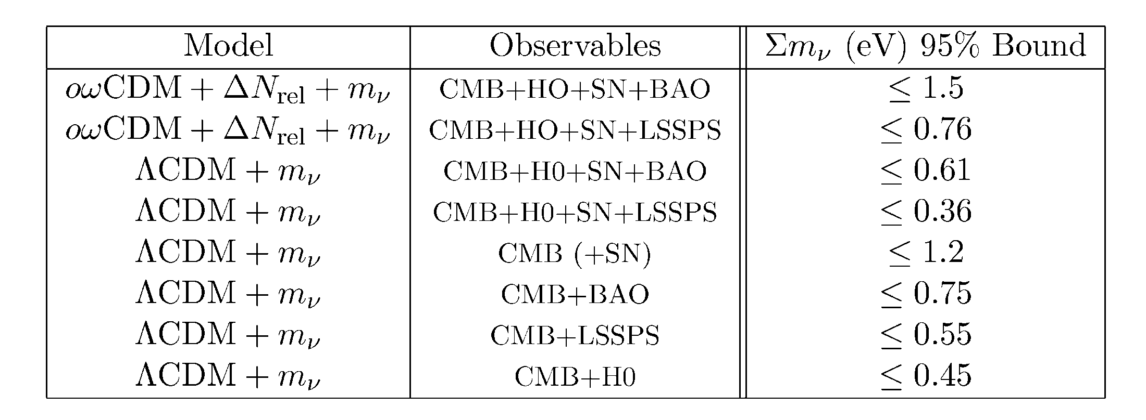
Gonzalez-Garcia et al., arxiv:1006.3795

Slide 20
WHAT IS N_{ν}?
A MEASURE OF THE ENERGY DENSITY IN NON-INTERACTING
RADIATION IN THE EARLY UNIVERSE
THE STANDARD MODEL PREDICTION IS
Mangano et al., hep-ph/0506164
BUT ADDITIONAL LIGHT PARTICLES (STERILE NEUTRINOS,
AXIONS, MAJORONS,…..) COULD MAKE IT HIGHER

Slide 21
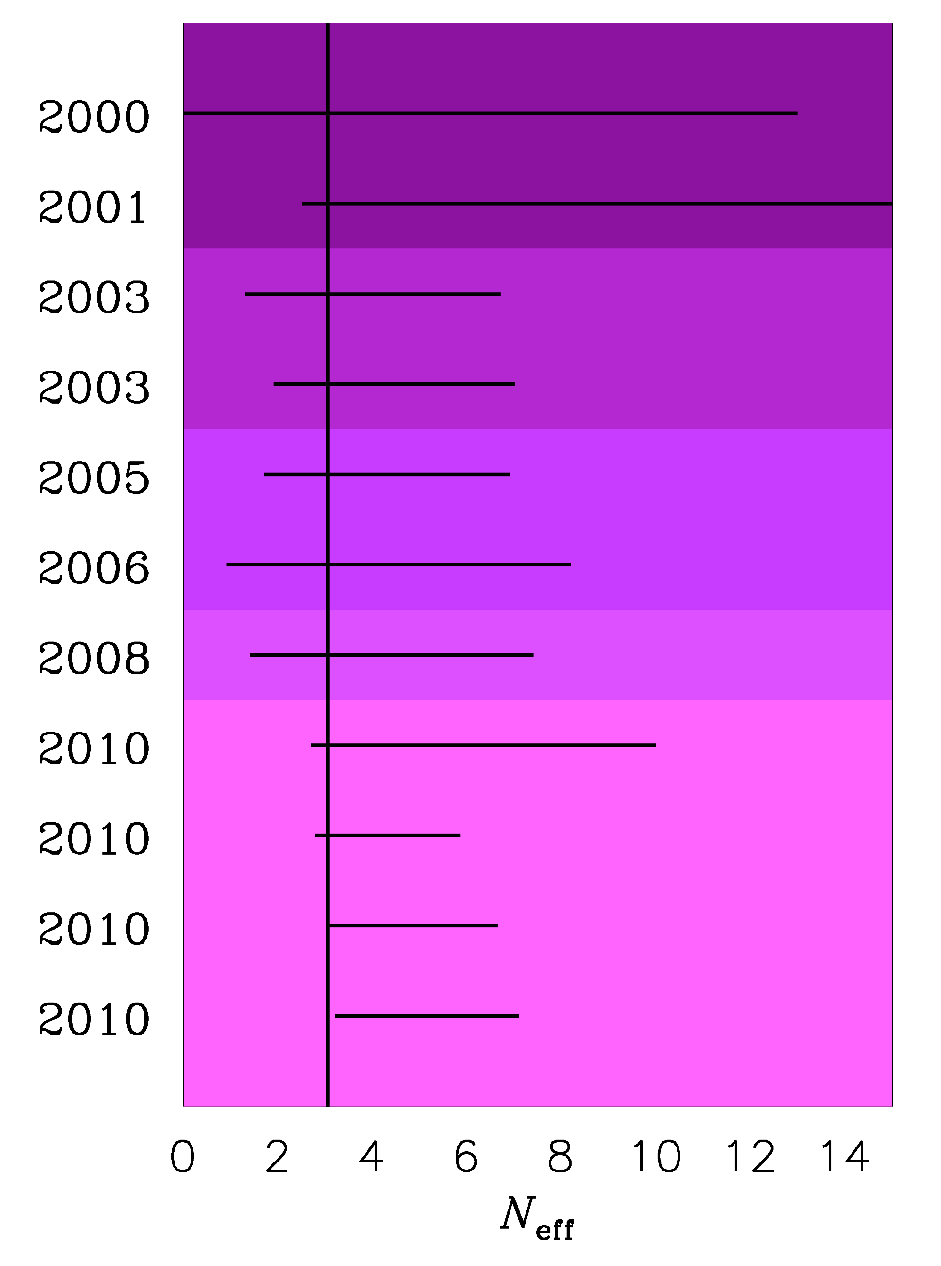
TIME EVOLUTION OF
THE 95% BOUND ON
N_{ν}
Pre-WMAP
WMAP-1
WMAP-3
WMAP-5
WMAP-7
ESTIMATED PLANCK
SENSITIVITY

Slide 22
A STERILE NEUTRINO IS PERHAPS THE MOST OBVIOUS CANDIDATE
FOR AN EXPLANATION OF THE EXTRA ENERGY DENSITY
ASSUMING A NUMBER OF ADDITIONAL STERILE STATES OF
APPROXIMATELY EQUAL MASS, TWO QUALITATIVELY DIFFERENT
HIERARCHIES EMERGE
ν_{s}
ν_{A}
ν_{A}
ν_{s}
3+N
N+3

Slide 23
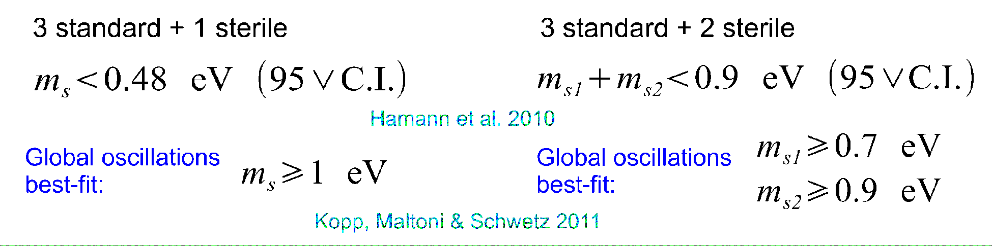
HOW DO THESE TWO HINTS FIT TOGETHER? CAN THEY BE
EXPLAINED BY THE SAME PHYSICS?
SHORT ANSWER: IT IS DIFFICULT WITHOUT MODIFYING COSMOLOGY
MODIFYING FOR EXAMPLE THE DARK ENERGY EQUATION OF
STATE CAN HELP, BUT THE 3+2 MODEL IS STRONGLY DISFAVOURED
THE 3+1 MODEL PROVIDES AS GOOD A FIT AS STANDARD ΛCDM
(Hamann, STH, Raffelt, Wong 2011)

Slide 24
WHAT IS IN STORE FOR THE FUTURE?
BETTER CMB TEMPERATURE AND POLARIZATION
MEASUREMENTS (PLANCK)
LARGE SCALE STRUCTURE SURVEYS AT HIGHER
REDSHIFT AND IN LARGER VOLUMES
MEASUREMENTS OF WEAK GRAVITATIONAL LENSING
ON LARGE SCALES

Slide 25
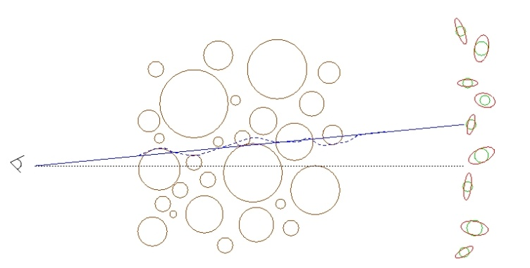
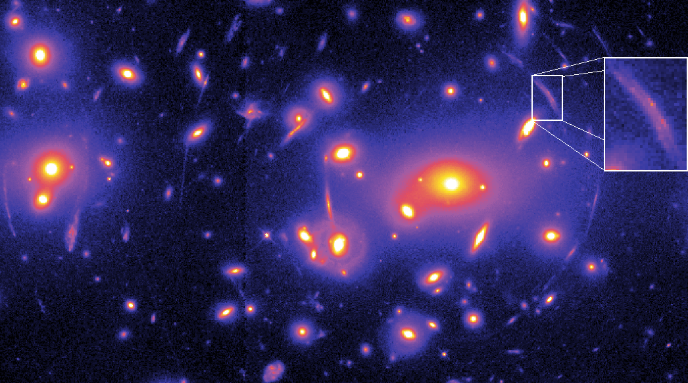
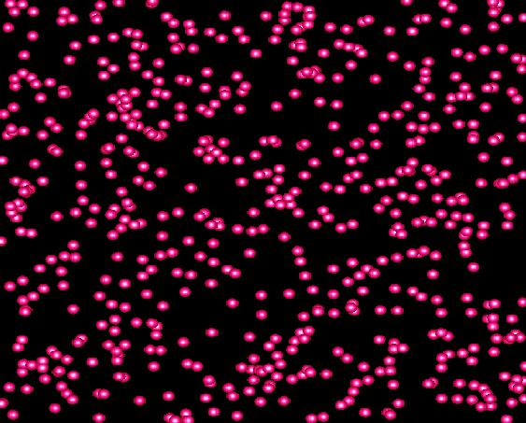
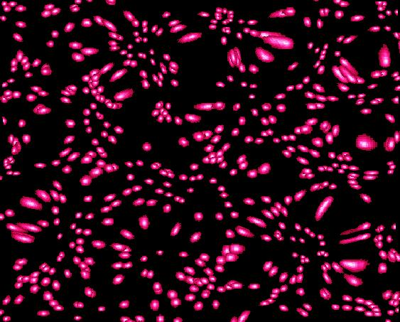
WEAK LENSING – A POWERFUL PROBE FOR THE FUTURE
Distortion of background images by foreground matter
Unlensed Lensed

Slide 26
FROM A WEAK LENSING SURVEY THE ANGULAR POWER SPECTRUM
CAN BE CONSTRUCTED, JUST LIKE IN THE CASE OF CMB
MATTER POWER SPECTRUM (NON-LINEAR)
WEIGHT FUNCTION
DESCRIBING LENSING
PROBABILITY
(SEE FOR INSTANCE JAIN & SELJAK ’96, ABAZAJIAN & DODELSON ’03,
SIMPSON & BRIDLE ’04)

Slide 27
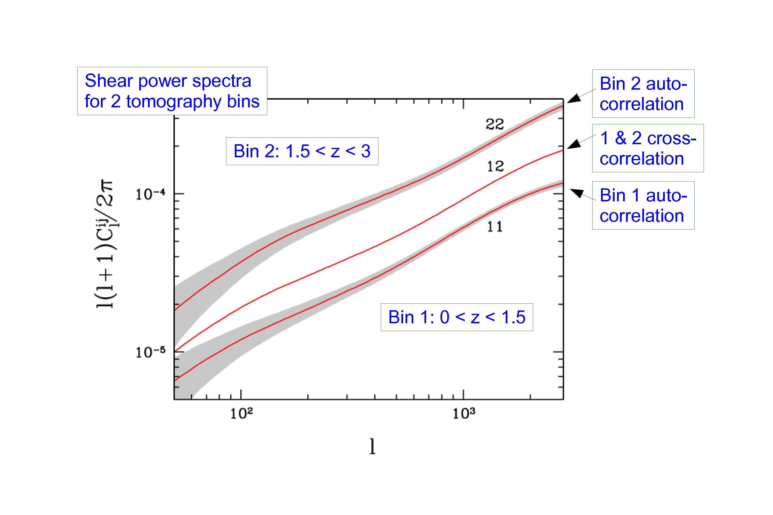
STH, TU, WONG 2006

Slide 28
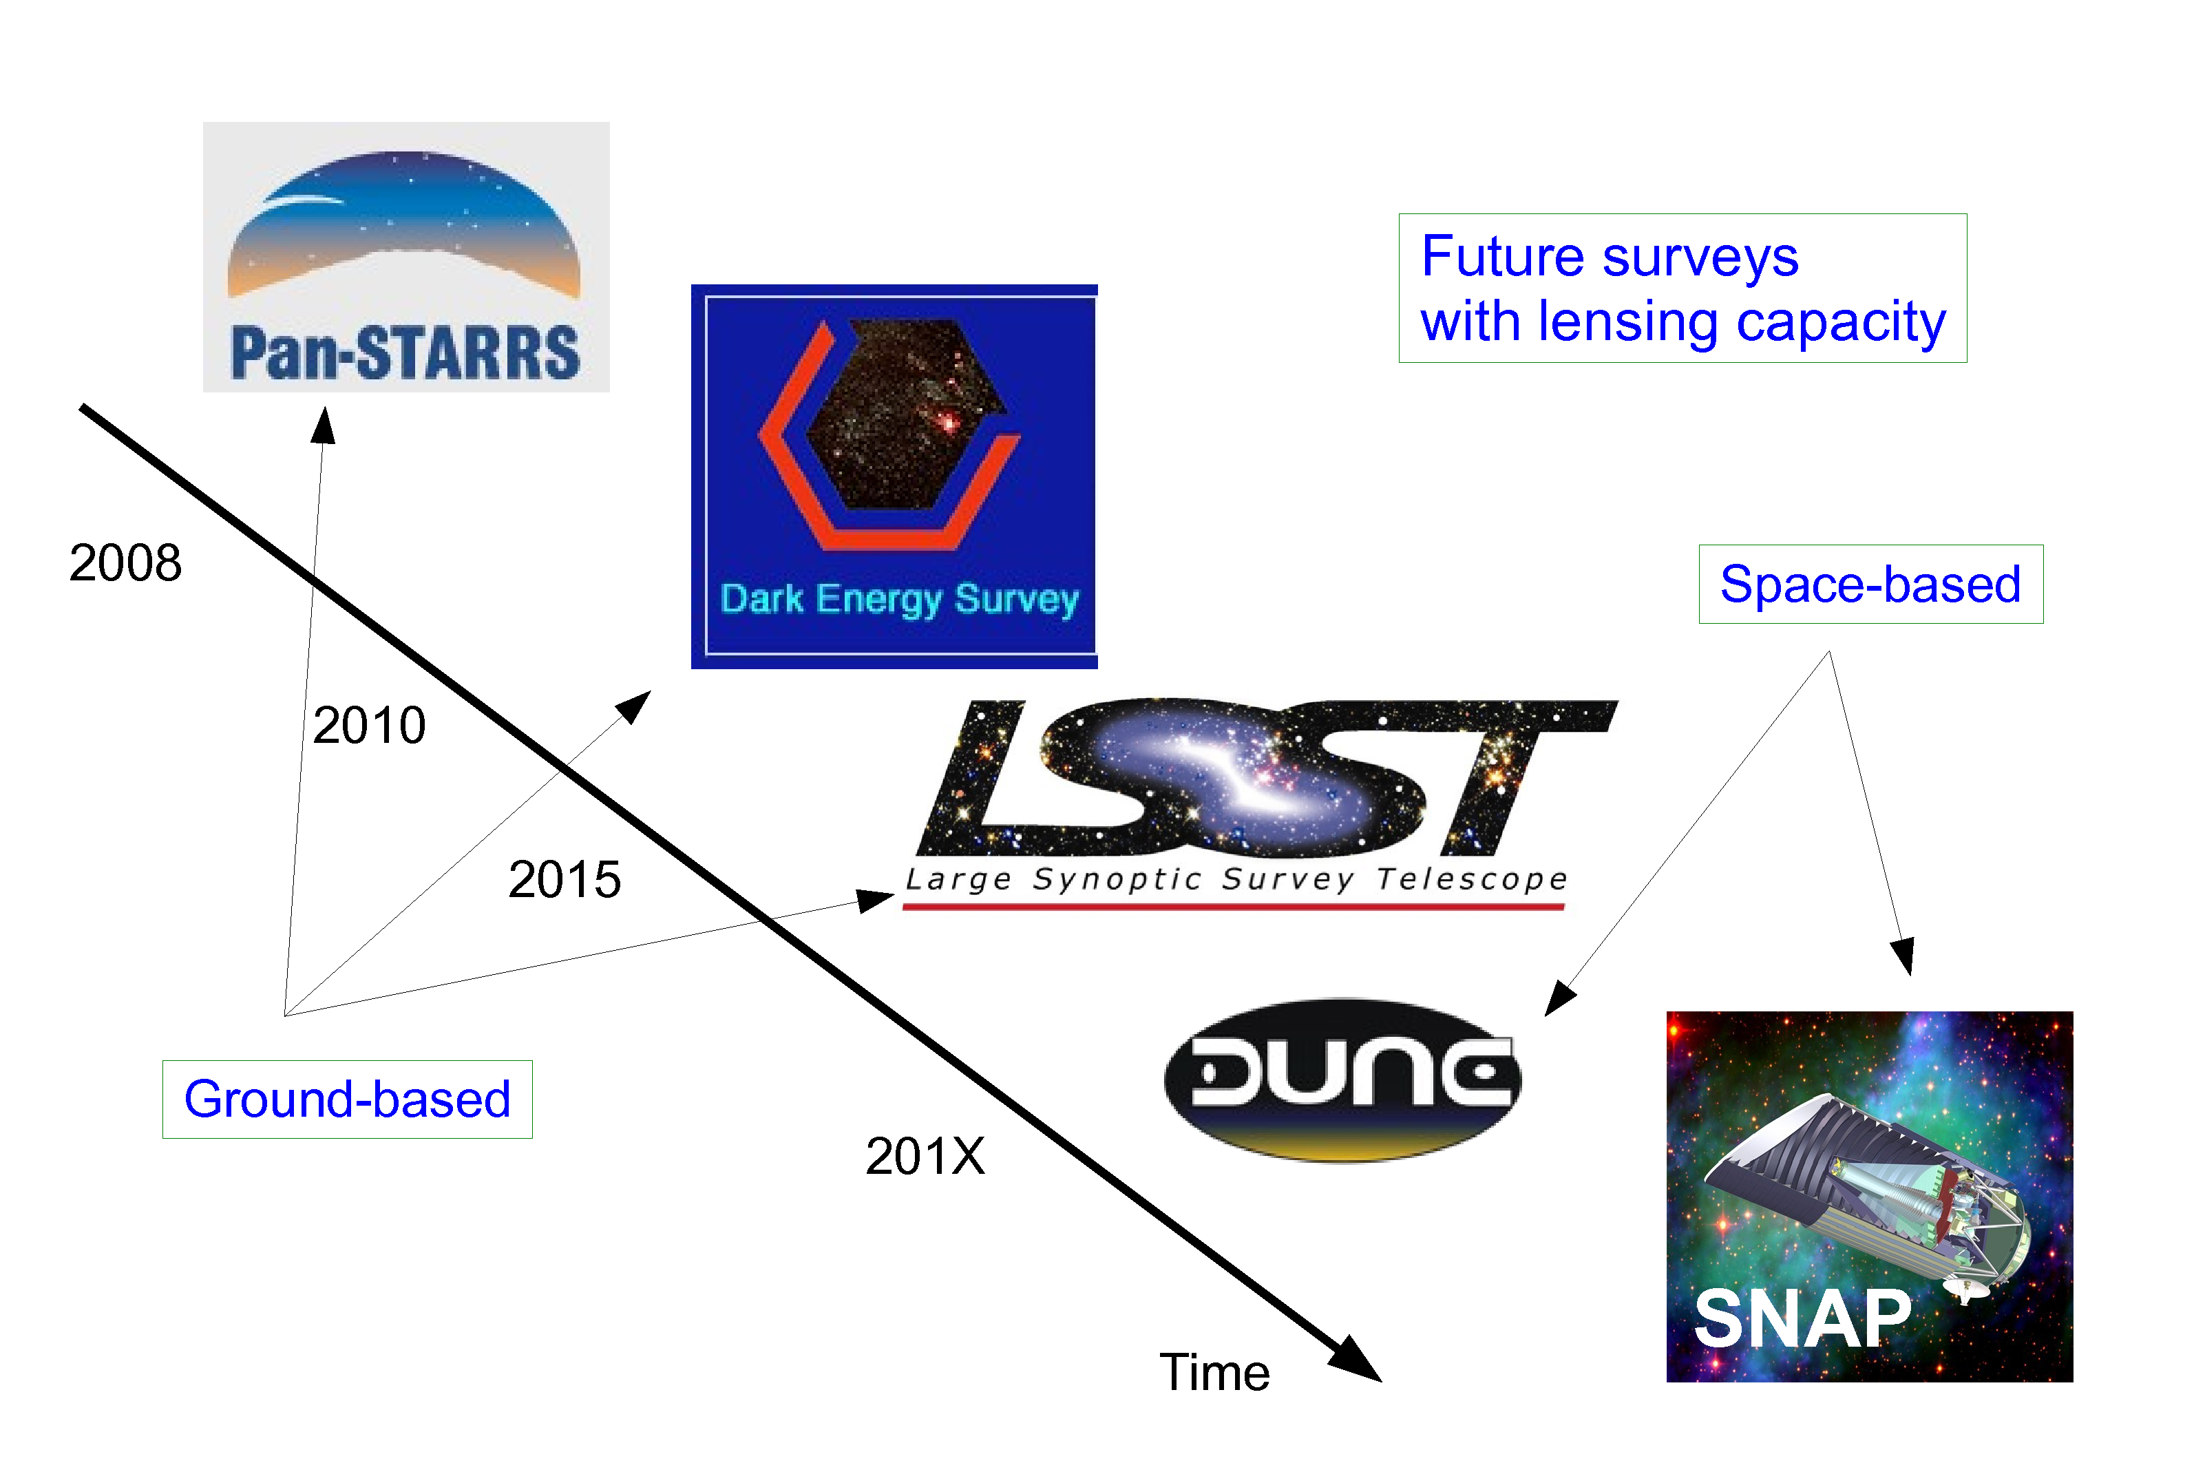
EUCLID
ESA M-CLASS MISSION
2019
SELECTED OCTOBER 2011

Slide 29
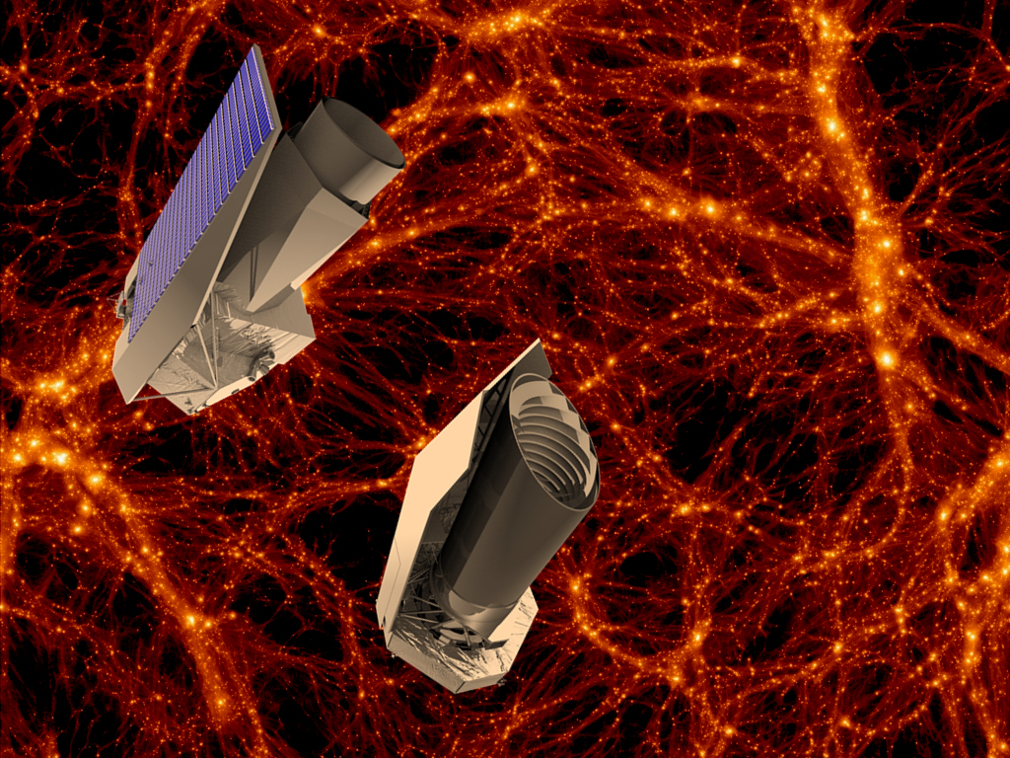
THE EUCLID MISSION

Slide 30
EUCLID WILL FEATURE:
A WEAK LENSING MEASUREMENT OUT TO z ~ 2, COVERING
APPROXIMATELY 20,000 deg²
(THIS WILL BE MAINLY PHOTOMETRIC)
A GALAXY SURVEY OF ABOUT few x 10⁷ GALAXIES (75 x SDSS)
A WEAK LENSING BASED CLUSTER SURVEY

Slide 31
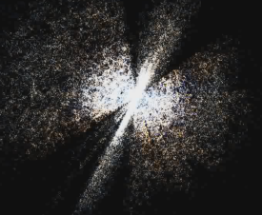
z~1100
z~2
z~0.35

Slide 32
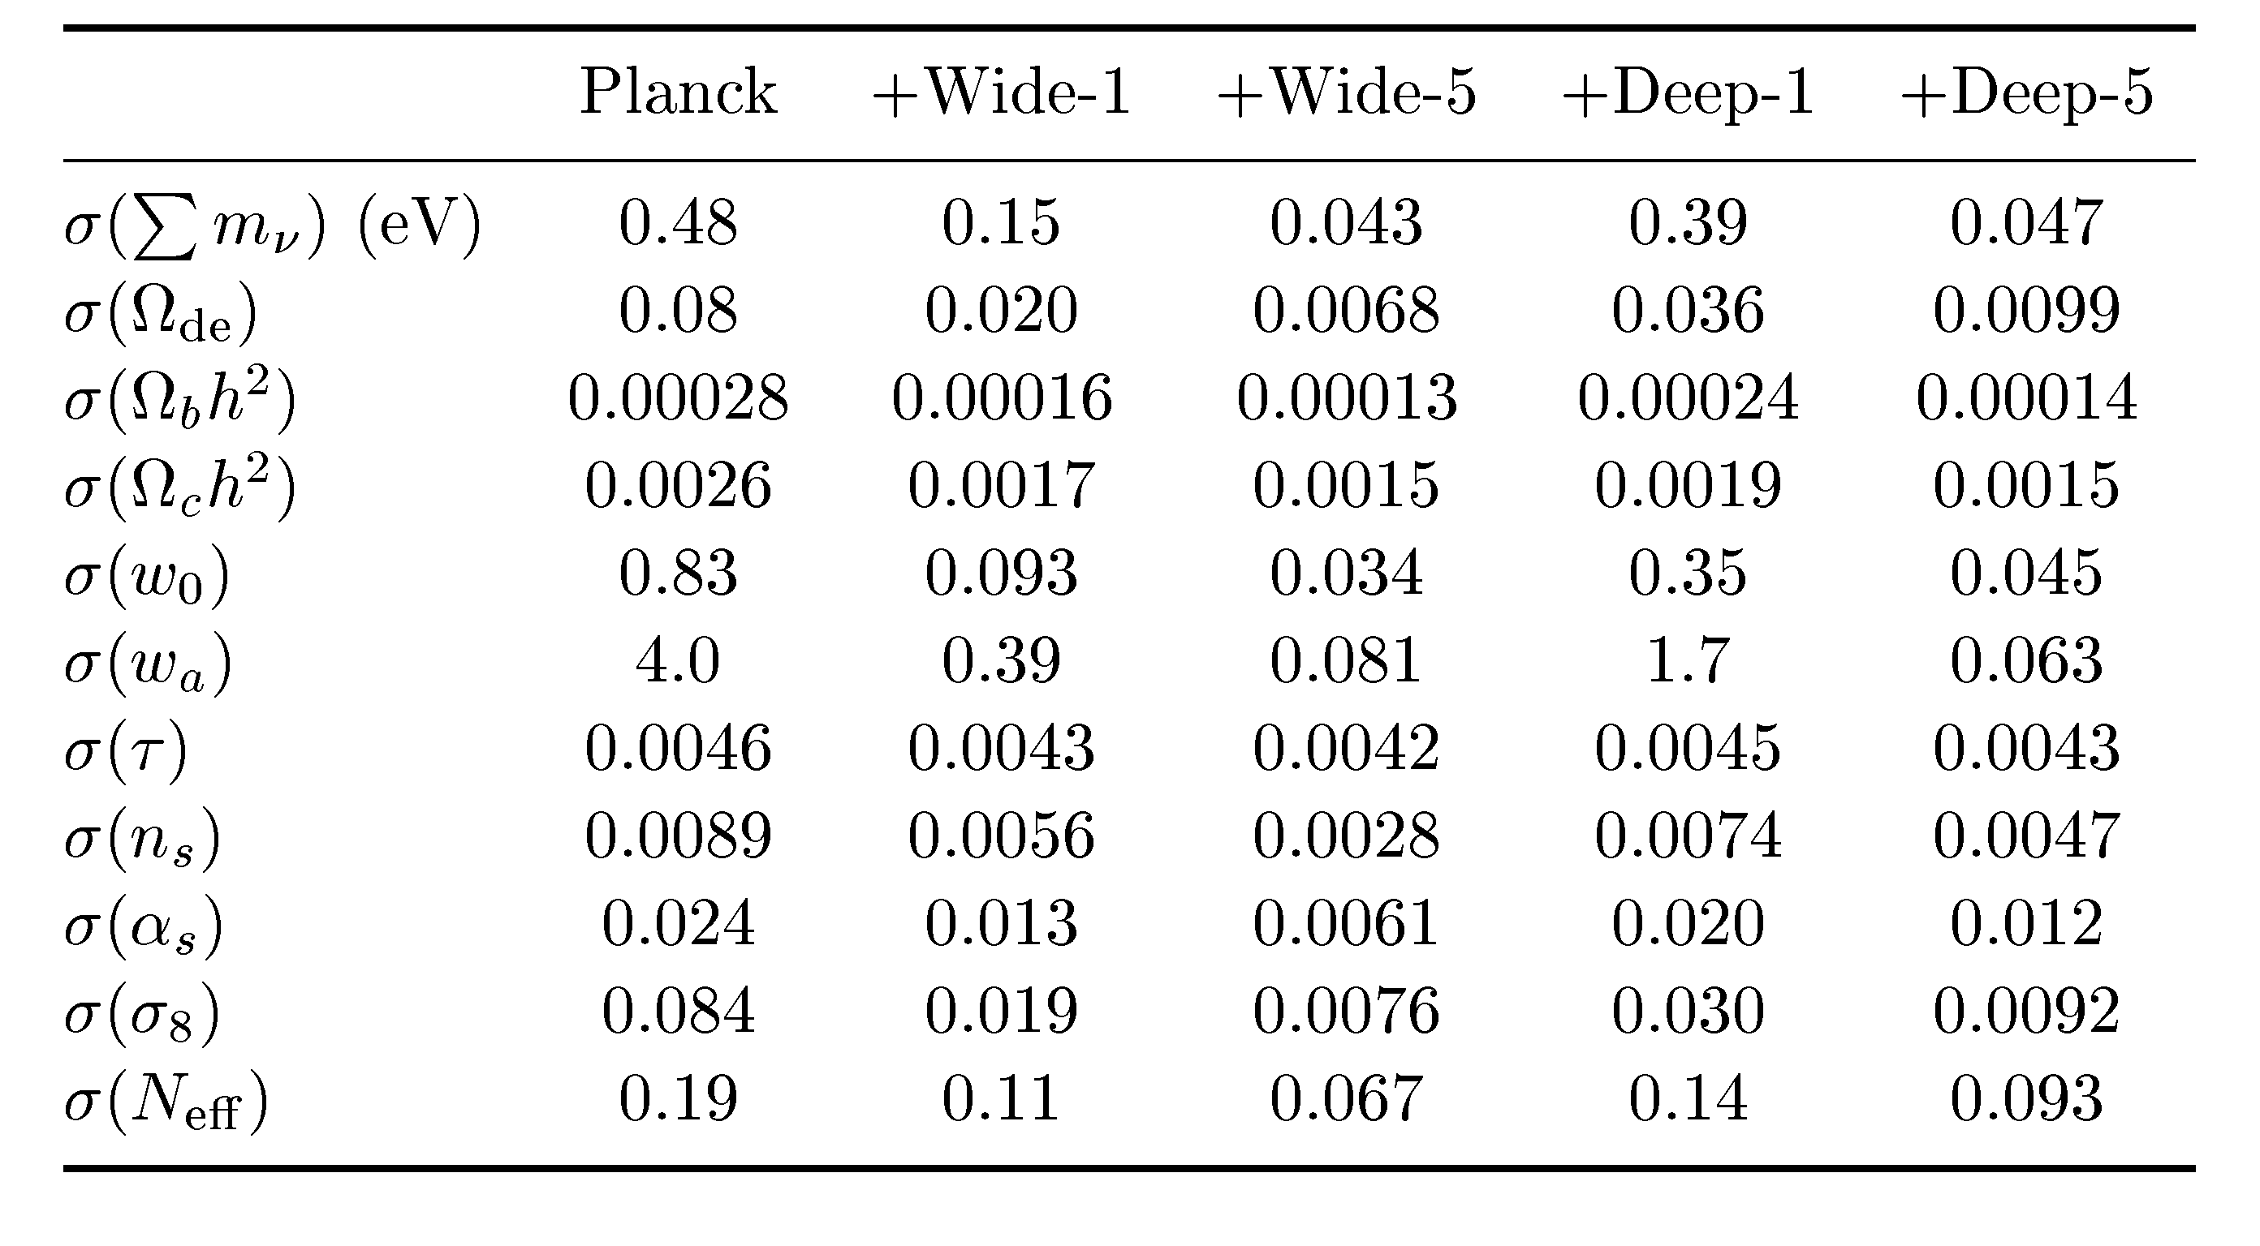
EUCLID WL
STH, TU & WONG 2006
HAMANN, STH, WONG 12: COMBINING THE EUCLID WL AND GALAXY
SURVEYS WILL ALLOW FOR A 3-4σ DETECTION OF THE NORMAL HIERARCHY

Slide 33
THIS SOUNDS GREAT, BUT UNFORTUNATELY THE THEORETICIANS
CANNOT JUST LEAN BACK AND WAIT FOR FANTASTIC NEW DATA
TO ARRIVE…..

Slide 34
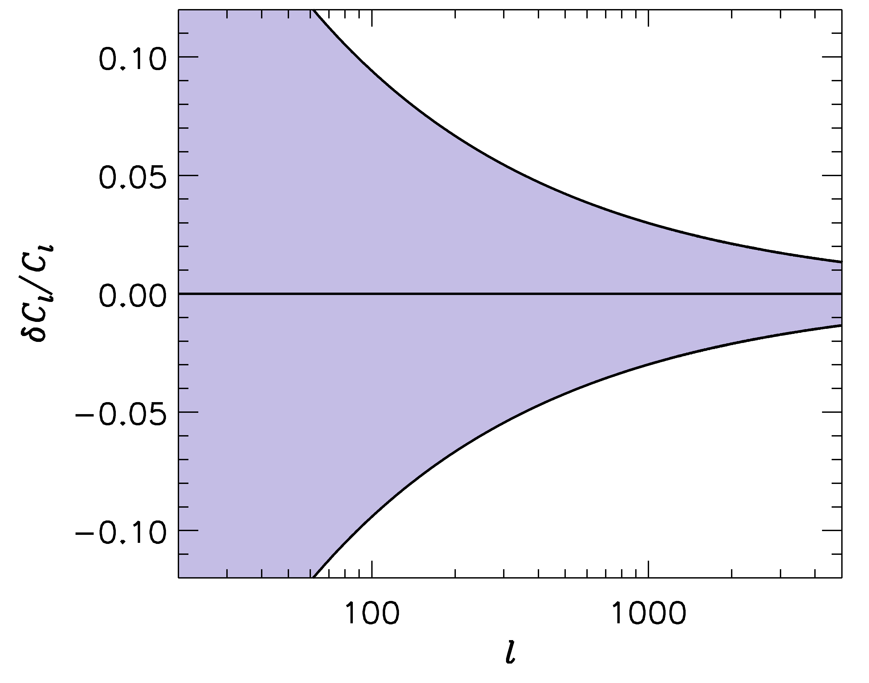
FUTURE SURVEYS LIKE EUCLID WILL PROBE THE POWER SPECTRUM
TO ~ 1-2 PERCENT PRECISION
-1
”LSST” ERROR BARS
WE SHOULD BE ABLE TO CALCULATE THE POWER SPECTRUM
TO AT LEAST THE SAME PRECISION!

Slide 35
IN ORDER TO CALCULATE THE POWER SPECTRUM TO 1%
ON THESE SCALES, A LARGE NUMBER OF EFFECTS MUST
BE TAKEN INTO ACCOUNT
BARYONIC PHYSICS – STAR FORMATION, SN FEEDBACK,…..
NEUTRINOS, EVEN WITH NORMAL HIERARCHY
NON-LINEAR GRAVITY
……………………..

Slide 36
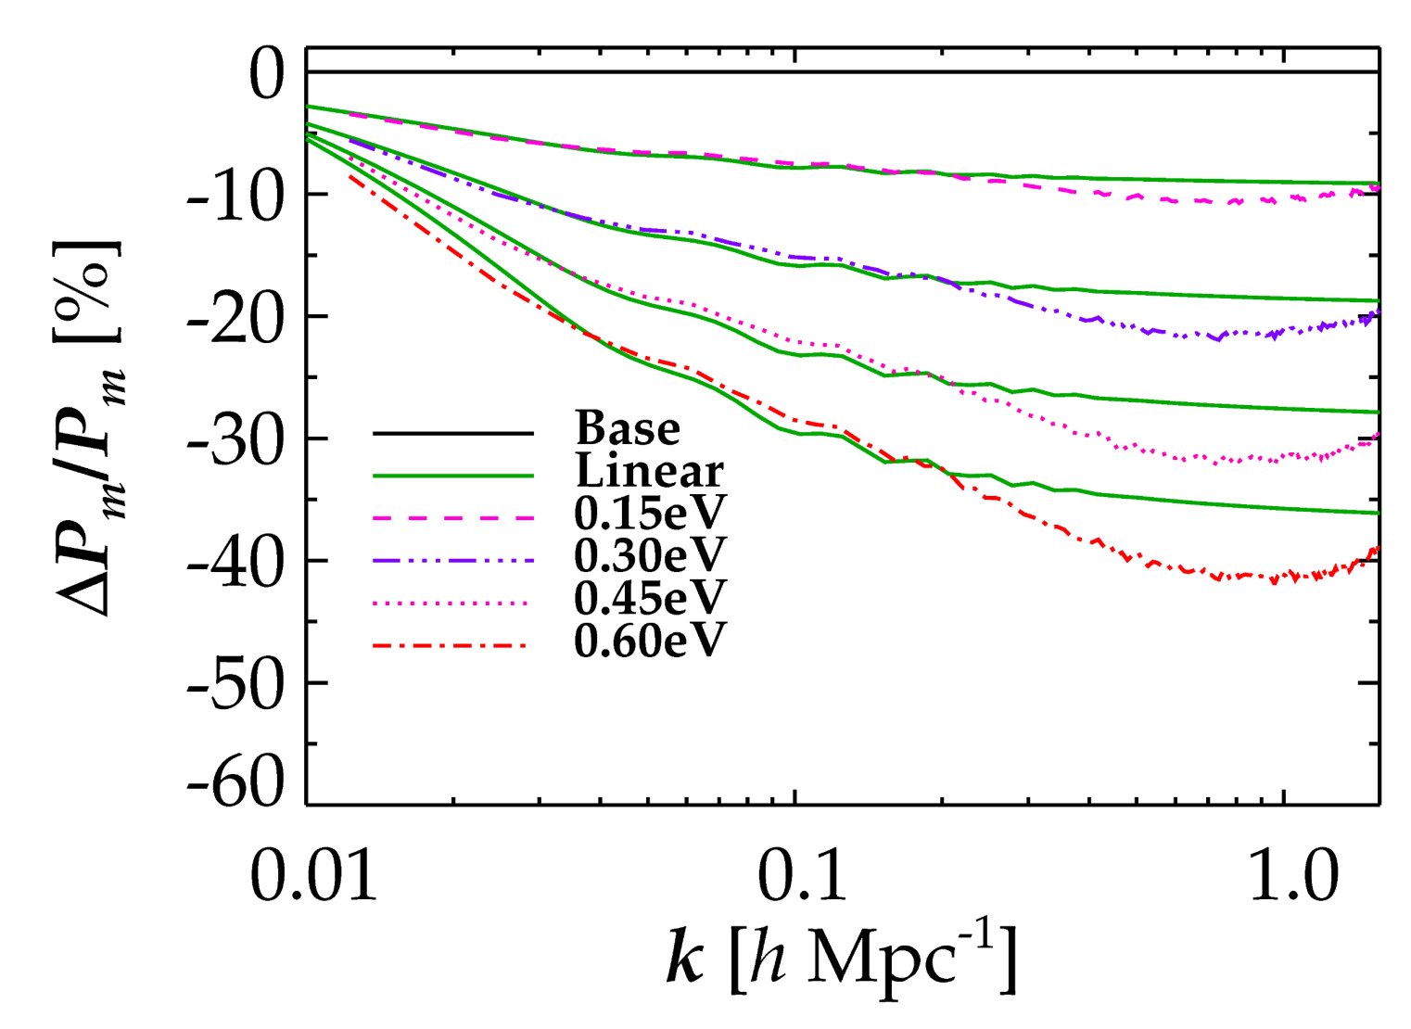
NON-LINEAR EVOLUTION PROVIDES AN ADDITIONAL SUPPRESSION OF
FLUCTUATION POWER IN MODELS WITH MASSIVE NEUTRINOS
LINEAR THEORY
FULL NON-LINEAR
Brandbyge, STH, Haugbølle, Thomsen ’08
Brandbyge & STH ’09, ’10, Viel, Haehnelt, Springel ’10
STH, Haugbølle & Schultz ’12, Wagner, Verde & Jimenez ’12

Slide 37
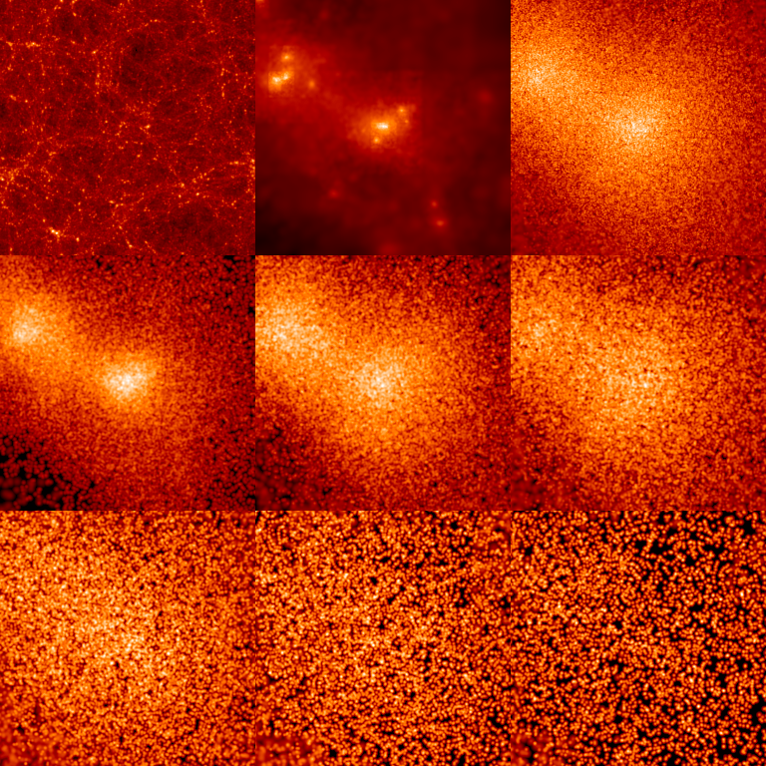
INDIVIDUAL HALO PROPERTIES
CDM
ν
512 h⁻¹ Mpc
0 < p/T < 1
1 < p/T < 2
2 < p/T < 3
3 < p/T < 4
4 < p/T < 5
5 < p/T < 6

Slide 38
CONCLUSIONS
NEUTRINO PHYSICS IS PERHAPS THE PRIME EXAMPLE OF HOW
TO USE COSMOLOGY TO DO PARTICLE PHYSICS
THE BOUND ON NEUTRINO MASSES IS SIGNIFICANTLY
STRONGER THAN WHAT CAN BE OBTAINED FROM DIRECT
EXPERIMENTS, ALBEIT MUCH MORE MODEL DEPENDENT
COSMOLOGICAL DATA MIGHT ACTUALLY BE POINTING TO
PHYSICS BEYOND THE STANDARD MODEL IN THE FORM OF
STERILE NEUTRINOS
NEW DATA FROM PLANCK AND EUCLID WILL PROVIDE A
POSITIVE DETECTION OF A NON-ZERO NEUTRINO MASS

