Slide 1

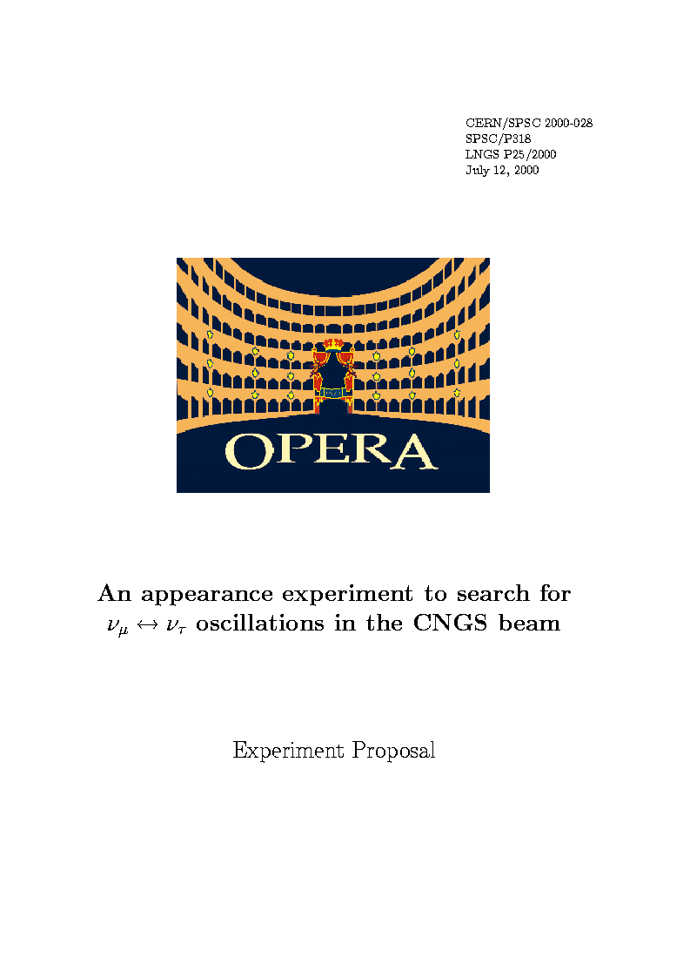
Status and oscillation results of the OPERA experiment
Florian Brunet
LAPP - Annecy
24th Rencontres de Blois 29/05/2012

Slide 2
Outline
Goal & principle of the OPERA experiment
Description of the OPERA detector
Status of OPERA
Oscillation results

Slide 3
Outline
Goal & principle of the OPERA experiment
Description of the OPERA detector
Status of OPERA
Oscillation results

Slide 4
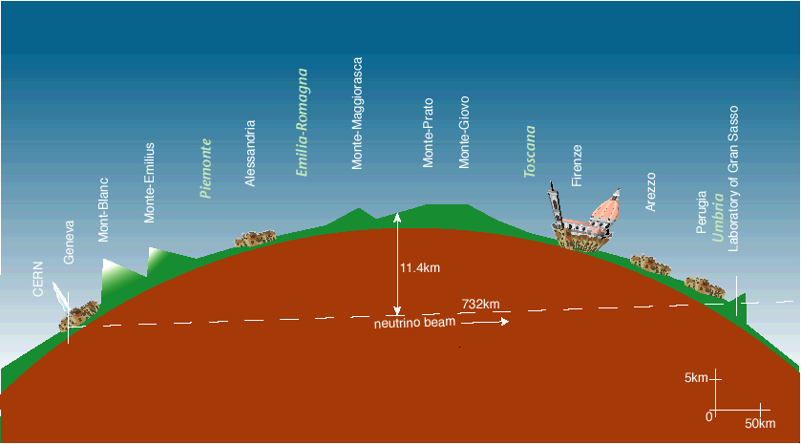
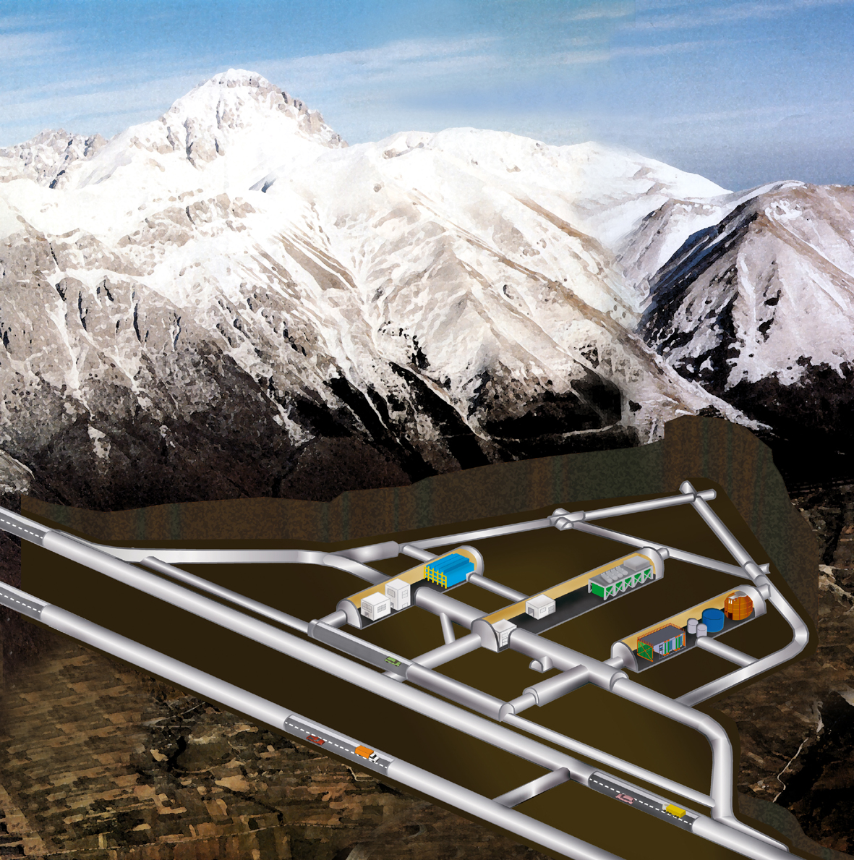
OPERA: first direct detection of neutrino oscillations in appearance mode
Super- Kamiokande → oscillations with atmospheric neutrinos
Oscillation phenomenon confirmed with solar neutrinos
Hints for appearance with recent T2K/MINOS results
The direct observation of the oscillation appearance with accelerator beams needs to be proven in the atmospheric sector
The PMNS 3-flavor oscillation formalism predicts:
OPERA requires :
1) long baseline, 2) high neutrino energy, 3) high beam intensity 4) detection of short lived τ’s
P(ν_{μ}→ν_{τ}) ~ sin²2θ₂₃cos⁴θ₁₃sin²(Δm²₂₃L/4E)
LNGS under 1400m of rock
CNGS
L = 730 km
OPERA

Slide 5

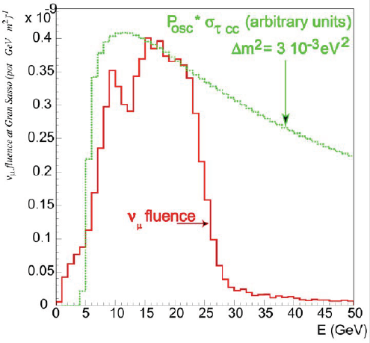
CNGS ντ appearance potential
The beam is optimized for ν_{τ} appearance in the atmospheric oscillation region. The present best fit is now:
Although the maximum of oscillation probability at 730 km is at about 1.5 GeV, the ν_{τ} CC cross section and the production threshold of 3.5 GeV should be taken into account
G. L. Fogli, E. Lisi, A. Marrone, A. Palazzo, A. M. Rotunno, arXiv:1106.6028 [hep-ph]
<Eν_{μ}> | 17 Gev
(ν_{e} +‾ν_{e})/ ν_{μ} | 0.87%
‾ν _{μ} / ν_{μ} | 4 %
ντ prompt | negligible
Total p.o.t | 22.5x 10¹⁹
ν_{μ} CC + NC | ~23600
ν_{e} +‾ν_{e} CC | ~160
ντ | ~115
with the OPERA target mass of 1.25kt

Slide 6


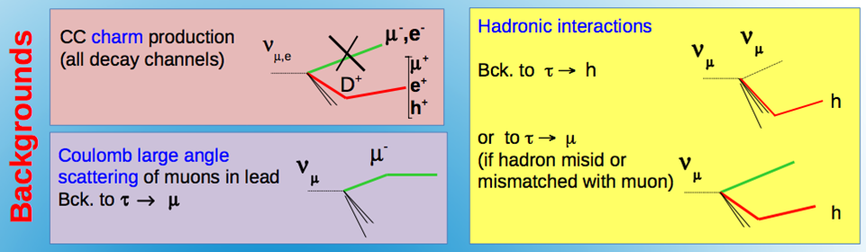
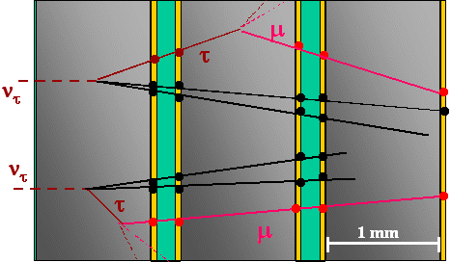
Detection principle
The detector must fulfil the following requests:
1. Small ν cross section → large fiducial mass (lead target)
2. Kink topology detection → micrometric and milliradian resolution (emulsions)
3. Select neutrino interactions → electronic detectors (trigger efficiency ~ 99%)
4. μ-ID and charge to reduce charm background (precision tracker & spectrometer)
τ⁻
3h
τ⁻
ν_{τ}
τ → e (17.9%)
τ → μ (17.4%)
τ → h (49.2%)
ν_{τ}
e⁻, μ⁻, h⁻
τ → 3h (15.2%)
Long
decay
Short
decay
➔ OPERA: hybrid detector (emulsions + electronic detectors)

Slide 7
Outline
Goal & principle of the OPERA experiment
Description of the OPERA detector
Status of OPERA
Oscillation results

Slide 8
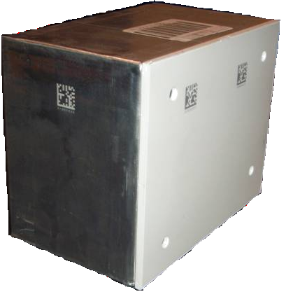

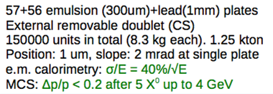
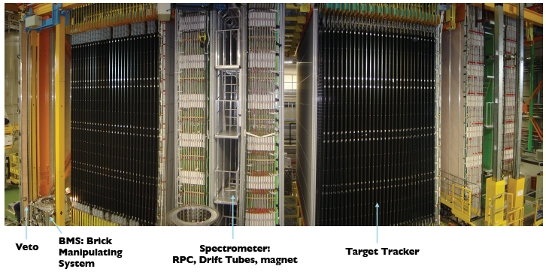
THE IMPLEMENTATION OF THE PRINCIPLE
ν
10.3 cm
7.5 cm = 10 X₀
12.8 cm
Extract 25-50 bricks per day
22 RPC + 6 Drift Tubes planes
magnetic field (1.5 T)
27 brick walls alternated with
scintillator planes
mip : detection efficiency of ~ 99%.

Slide 9
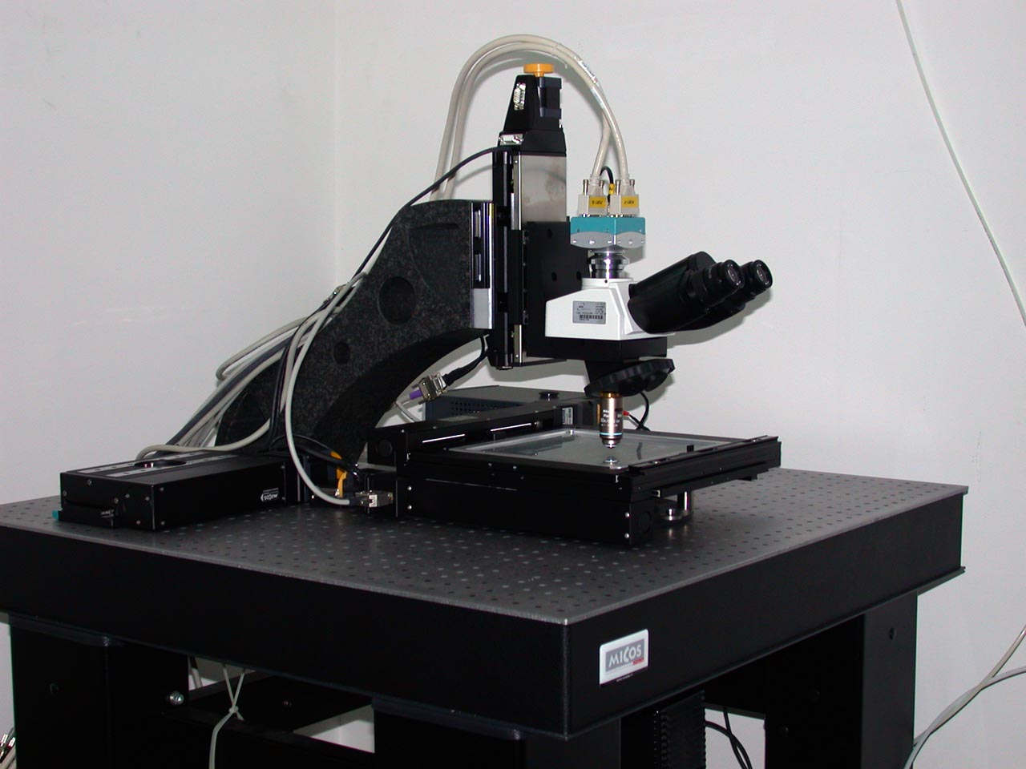
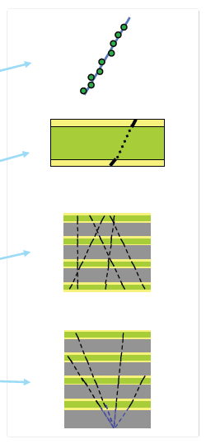
OPERA : A HYBRID DETECTOR (ELECTRONIC + EMULSIONS)
Trigger on event “on time” with CNGS and selection of the brick using electronic detectors information
Brick extracted by BMS
Electronic tracks validated with CS
Brick is sent to one of 12 scanning labs in Europe and Japan.
Hybrid target structure.
(CS)
microtracks
basetracks
tracks
vertices
Scanning : Determine the topology of the event to possibly find a kink
45μm
300μm
4.2 cm
5.2 cm

Slide 10
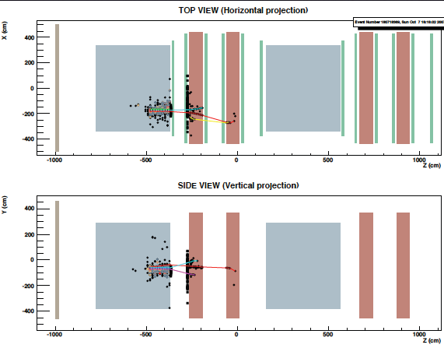
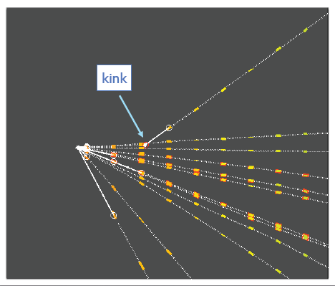
OPERA data : an example of ν_{μ} CC interaction : charm event
Reconstruction in electronic detectors
Reconstruction in emulsions

Slide 11
Outline
Goal & principle of the OPERA experiment
Description of the OPERA detector
Status of OPERA
Oscillation results

Slide 12
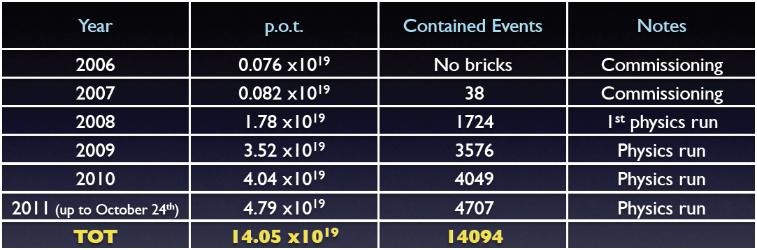

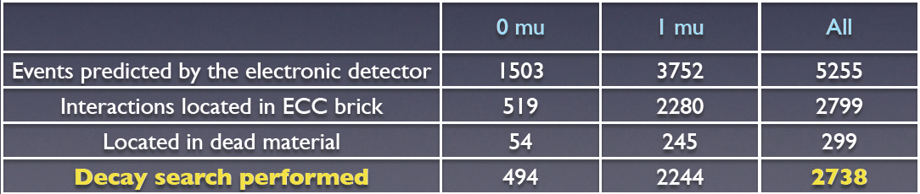
Data taking
We collected a large sample of events and since march 2012 run is on going.
The analysis of 2008 and 2009 data is complete (New J.Phys. 14 (2012) 033017)
).
2008-2009 : 5.3 x 10¹⁹ p.o.t.

Slide 13
Outline
Goal & principle of the OPERA experiment
Description of the OPERA detector
Status of OPERA
Oscillation results

Slide 14
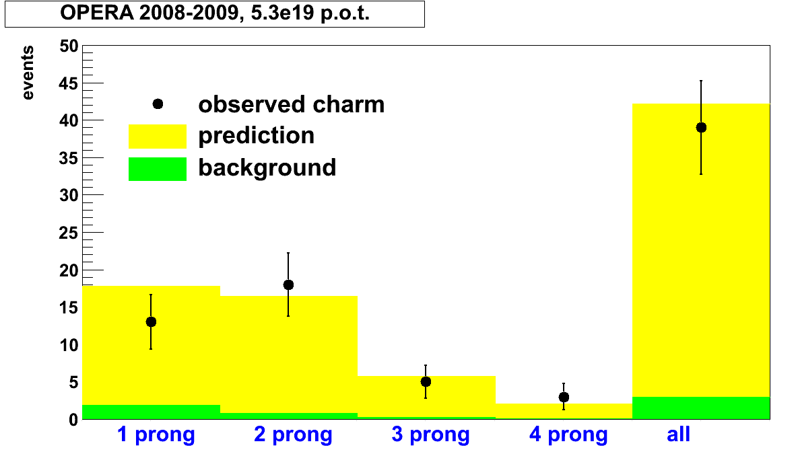
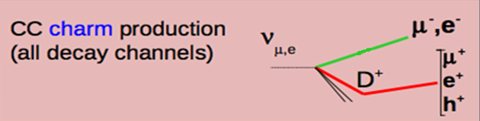
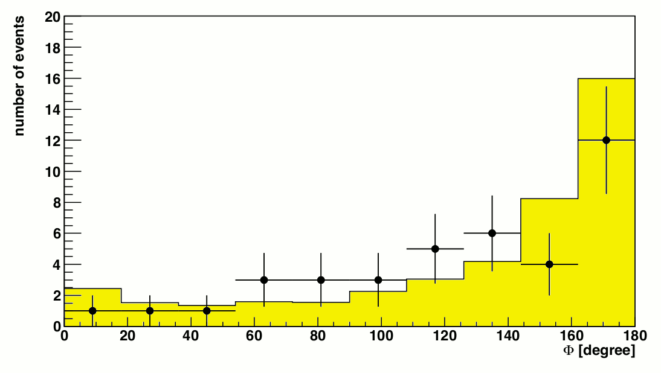
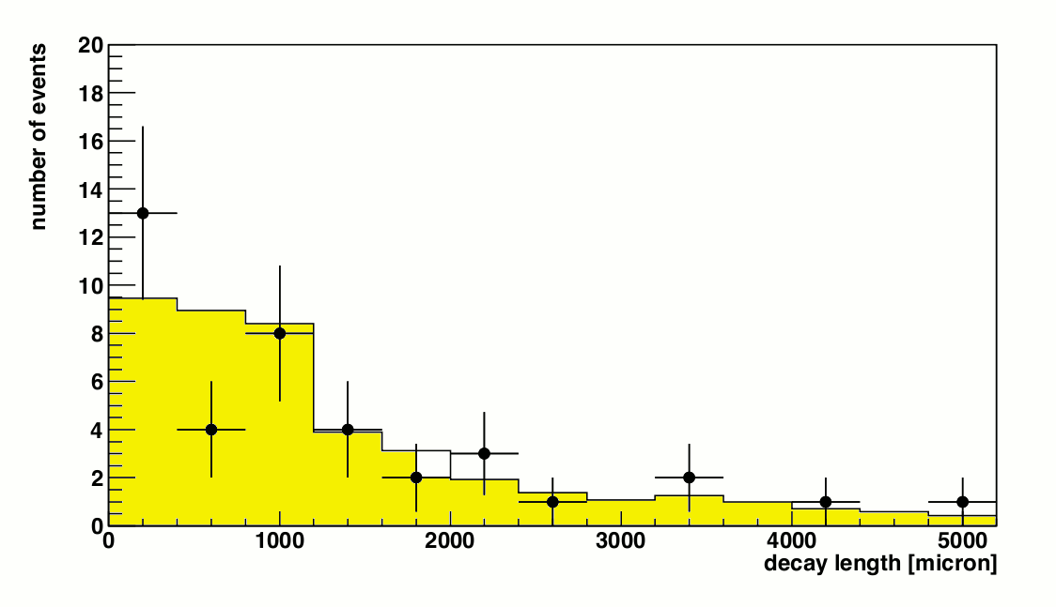
Charm sample 2008-2009
The charm sample offers the opportunity to benchmark the τ efficiency thanks to the similar topologies
● OPERA 2008-09
■ MC
● OPERA 2008-09
■ MC
Angle in the transverse plane
between charmed hadron and primary µ
Decay length

Slide 15
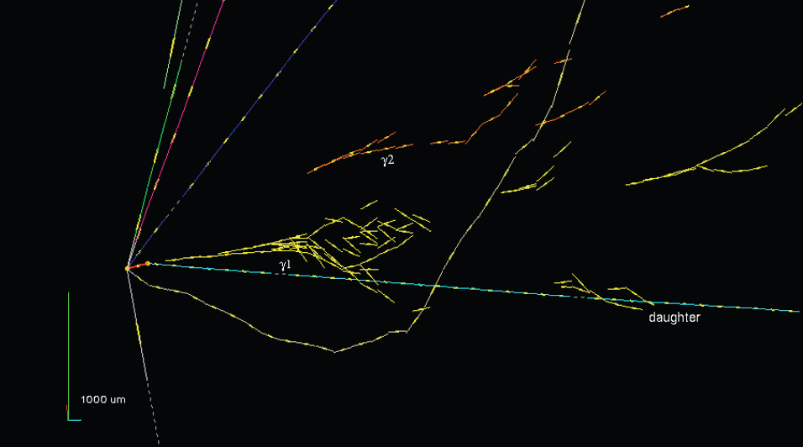
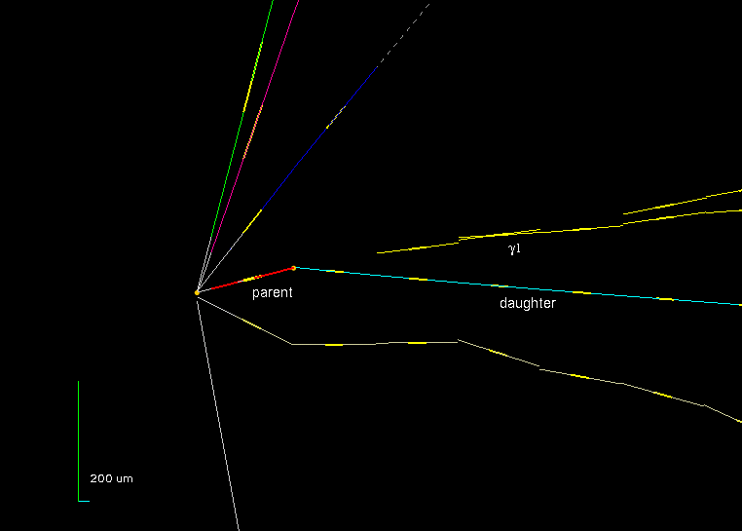
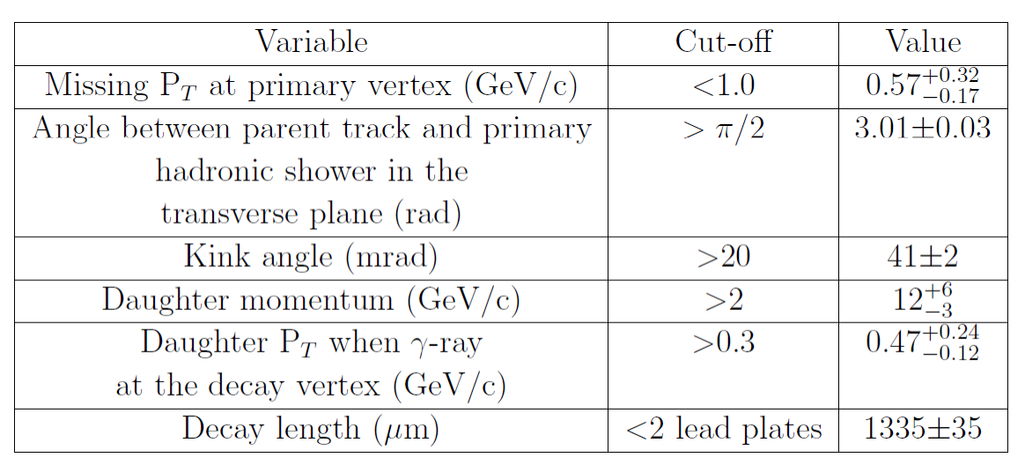
ν_{τ} Oscillation signal
• In the 2008-2009 data we found a ν_{τ} candidate (Phys. Lett. B 691 (2010) 138 ).
Background estimation improvements
Reduction by the systematical tracks follow down for the candidate events to improve
the muon identification
→ Reduce charm background & hadronic background from ν_{μ}^{CC} with μ misID
Evaluate the hadronic reinteraction using MC simulations. (MC validated by analysing pion test beam data & 14m of hadron tracks in OPERA data)
Implementation of state-of-the art charm cross section from CHORUS

Slide 16
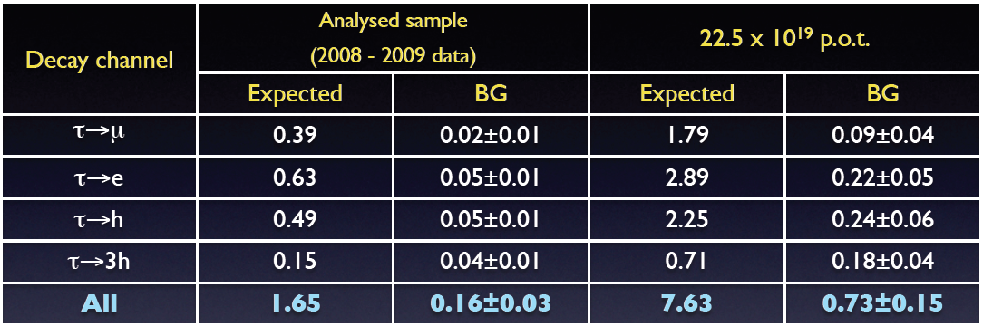
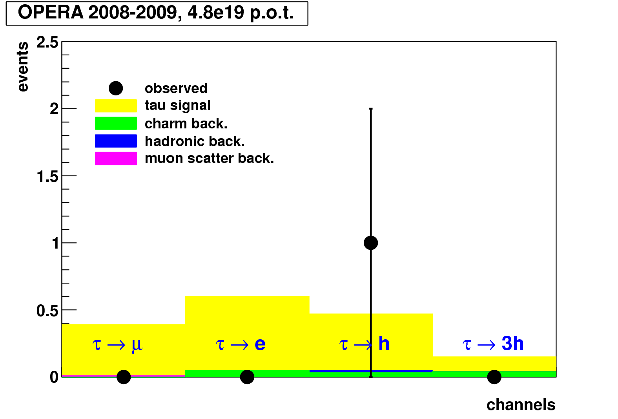
Significance of this result
5.3e19 pot
• In the analyzed sample one ν_{τ} observed in the τ → h channel compatible with the expectation
of 1.65 signal events.
The statistical significance of the observation (i.e. the probability of not being a
fluctuation of the background) is 95%.

Slide 17
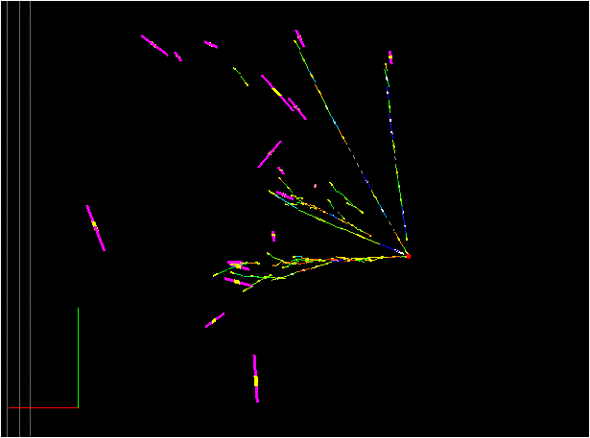
The additional oscillation study : ν_{μ}→ν_{e} channel
Physics motivation
Signal ν_{μ} ↔ ν_{e} : ν_{e}^{CC} interaction → e + hadronic shower
Background : Processes which contain electrons
  ν_{e} beam: ν_{e}^{CC} interaction → e + hadronic shower
  ν_{τ}^{CC} interaction → τ + hadronic shower & τ→eνν
  ν_{μ} beam : ν_{μ}^{NC} interaction → ν + hadronic shower with π⁰ & π⁰ →γγ
  ν_{μ} beam : ν_{μ}^{CC} interaction → μ missed → ν_{μ}^{NC} interaction
We have detected 19 ν_{e} candidate events in the 2008-09 analyzed sample.
OPERA target mass hypothesis = 1.25kt | 2008-2009 : 5.3e19 pot | 5 years : 22.5e19 pot
ν_{e} (prompt) | 1.6 | 6.7
(τ→ e)+NCπ⁰ | 0.6 | 2.6
sin²2θ₁₃ = 0.11 | 0.7 | 3.1
Preliminary
estimation
Efficiencies taken from : M. Komatsu, P. Migliozzi, F. Terranova, J. Phys. G G29 (2003) 443
Electron energy = 7.4 GeV

Slide 18
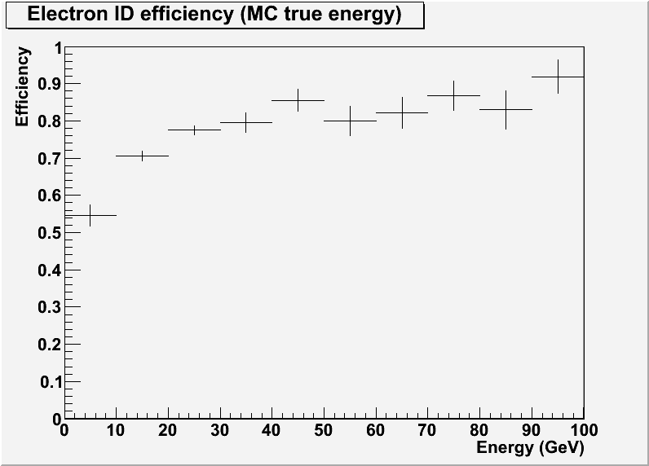
ν_{e} study : electromagnetic shower reconstruction
An energy estimation of electromagnetic showers is available by using OPERA bricks as a calorimeter and the following improvements are under finalization :
  A recalibration with a full MC simulation
  A recalibration with OPERA bricks exposed to an electron beam at CERN (4GeV & 2 GeV, 100mrd angle)
  An updated systematic errors estimation
  An updated efficiency estimation with the full MC simulation
Preliminary
Developments in progress about energy estimation
  Due to relative small size of bricks, an extended shower reconstruction with one adjacent or downstream brick to achieve a better estimation of the energy is on going
Notes:
Mention that is my personal work

Slide 19
Summary
• The OPERA detector has been taking physics data successfully since 2008.
• The electronic detector response is well understood and the agreement between data and simulation is quite good.
• 2008 and 2009 data analysis is finished and one ν_{τ} candidate has been observed and 19 ν_{e} candidates.
• We have already collected data to increase the statistics by a factor of 2.7: the vertex location is being performed on the 2010 data and on the 2011 data.
• The τ search goes on and OPERA will present an update of all its studies at the Neutrino 2012 conference.
• Knowing recent results about θ₁₃, a specific search for ν_{e} candidates is on-going, since OPERA could contribute to the numu-nue oscillation study at high ∆m².

Slide 20
Backup slides

Slide 21
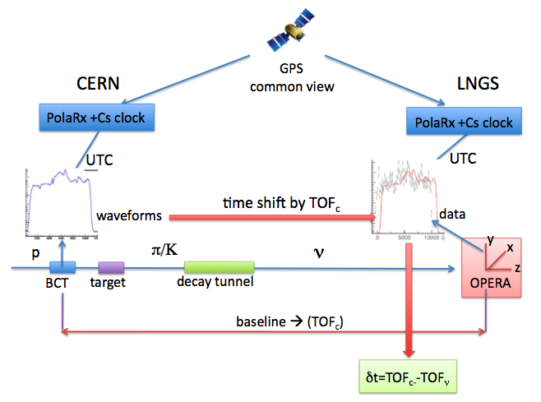
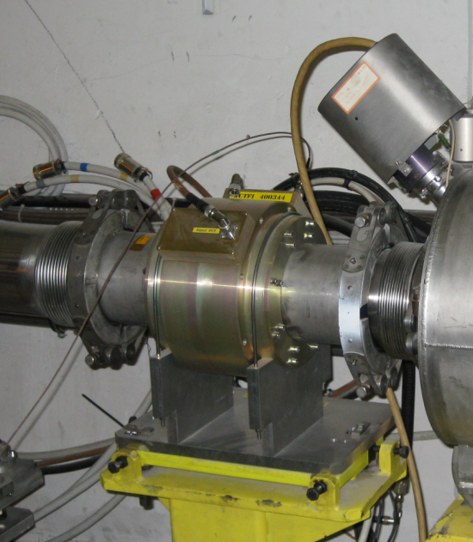
ν-TOF
Basic ingredients:
  CNGS-OPERA synchronization at ~1ns (GPS common view mode)
  Calibrations of the timing chains at CERN and OPERA
  ν time distribution at CERN through proton waveforms with BCT
  High n energy - high statistics (~ 15k events) or beam with fine time structure
  Geodesy: L= 731278.0 ± 0.2 m (error dominated by extrapolation to underground)
arXiv:1109.4897

Slide 22
ν-TOF:
An experimental setup and analysis method has been used to estimate the neutrino time of flight CERN-LNGS
BUT, two issues that could significantly affect the reported TOF anomaly have been identified recently
The new bunched beam analysis will provide a clarified picture and possibly a limit on the departure of neutrino velocity from the speed of light.

