Slide 1
Dark Matter Results from CDMS Joel Sander Blois 2012

Slide 2
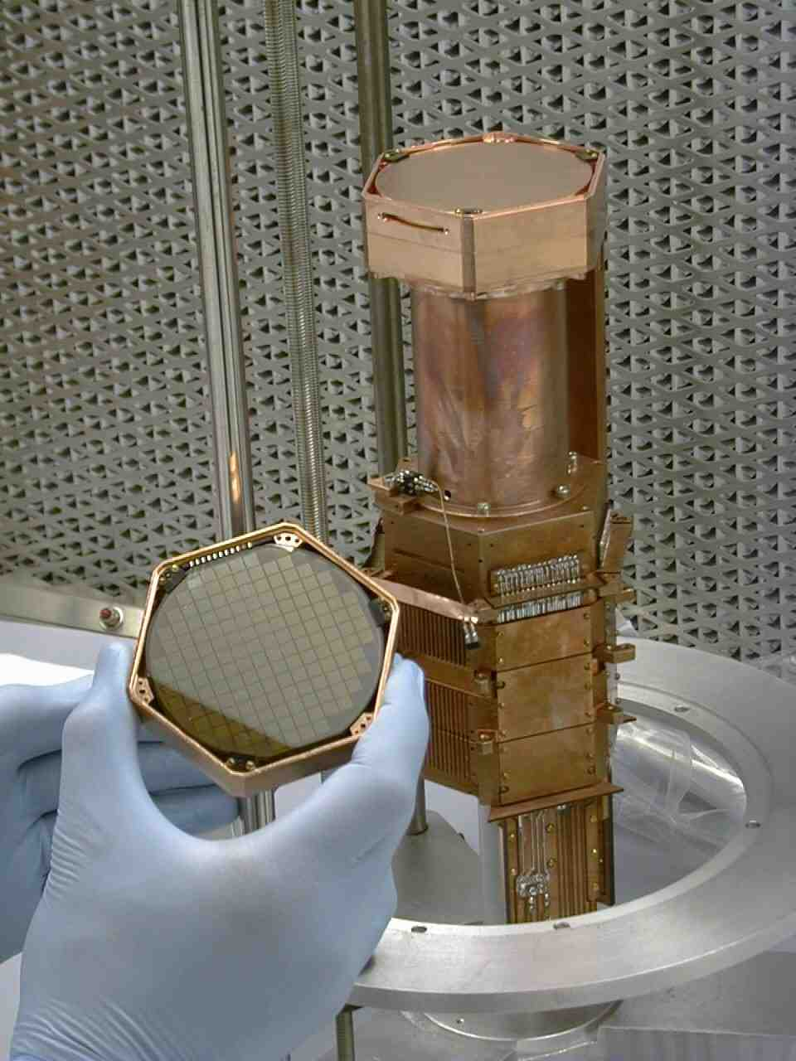
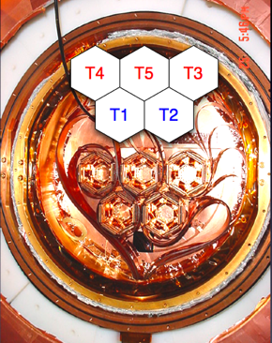
Experimental Setup
30 Ge & Si Crystals
Arranged in verticals stacks of 6 called “towers”
Shielding composed of lead, poly, and a muon veto not described.
7.6 cm diameter
1.0 cm thick
The name of the game is background reduction (shielding) and rejection.

Slide 3
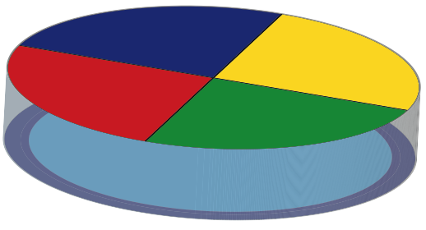
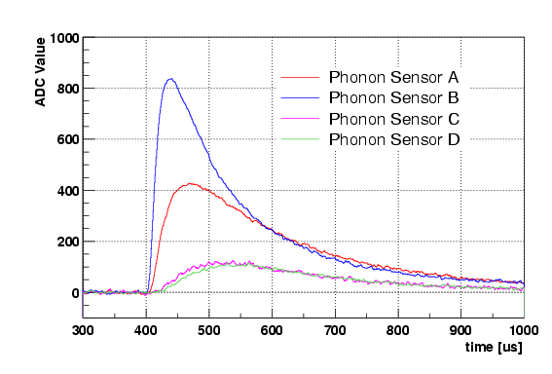
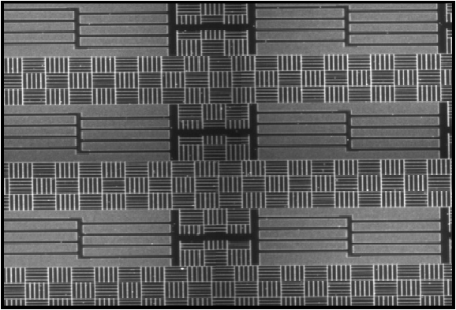
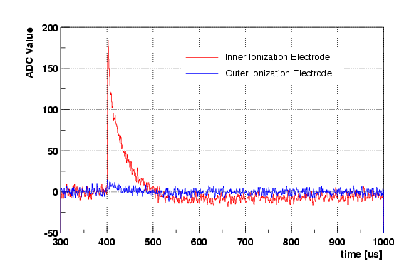
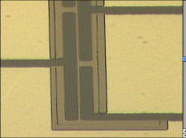
Experimental Setup
30 Ge & Si Crystals
Detector dimensions 7.6cm diameter, 1cm height
Each has 4 phonon sensors; inner and outer ionization electrodes
Phonons
Phonon Pulses
300 400 500 600 700 800 900 1000
V⁻
Time (μs)
Ionization Pulses
Ionization
300 400 500 600 700 800 900 1000
Time (μs)
The name of the game is background reduction and rejection (detectors).

Slide 4
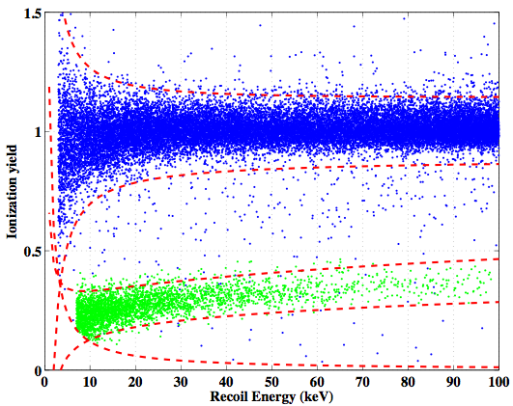
Experimental Setup
30 Ge & Si Crystals
Detector dimensions 7.6cm diameter, 1cm height
Each has 4 phonon sensors; inner and outer ionization electrodes
Phonons
¹³³Ba
²⁵²Cf
Electron Recoils
V⁻
Ionization / Phonon
Ionization
Nuclear Recoils
Recoil Energy (keV)
The name of the game is background reduction and rejection (detectors).

Slide 5
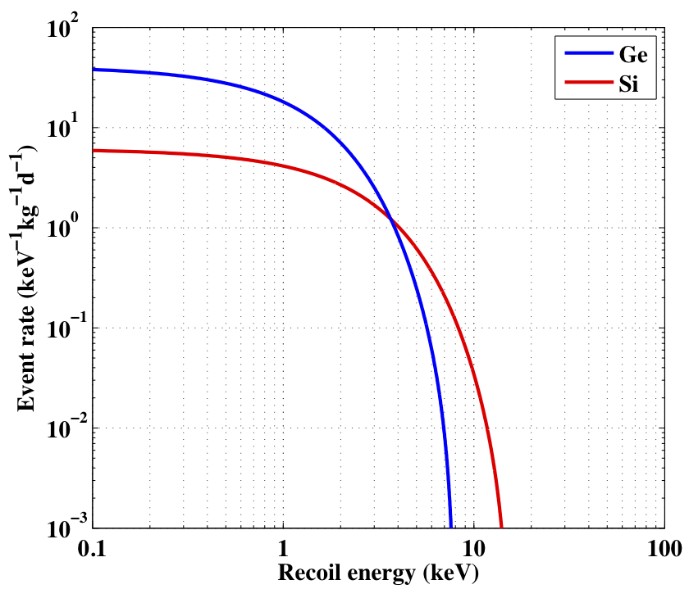
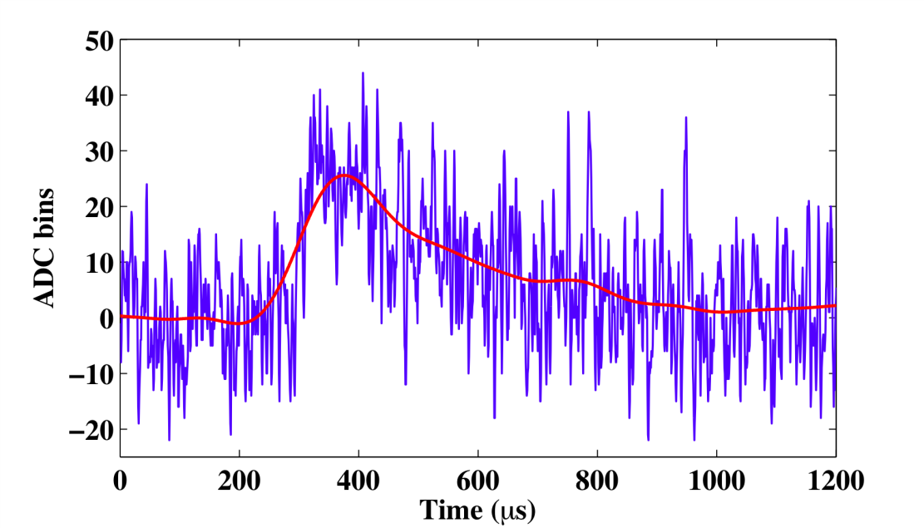
Low Mass WIMP Detection
Results from DAMA/LIBRA, CoGeNT and others have been interpreted as possible evidence for elastic scatters from WIMPs with m_{x}~7 GeV and σ_{SI}~10⁻⁴⁰ cm²
Previous CDMS Ge results not sensitive to these models since thresholds were ~10 keV (to maintain expected backgrounds <1 event)
Can lower thresholds
Tradeoff: higher backgrounds
₆
v_{esc}=544 km/s
2.0 keV nuclear recoil phonon pulse, T1Z5
_{i=1}
20 kHz low-pass filter
5

Slide 6
Low Threshold Analysis
Soudan data from Oct. 2006-Sept. 2008 reanalyzed with 2 keV recoil energy threshold
Used 8 Ge detectors with lowest trigger thresholds (1.5-2.5 keV)
Small subset (1/4 of the data) used to study backgrounds at low energy
Limits calculated from remaining 241 kg-day raw exposure
Results driven by detector with best resolution (T1Z5)

Slide 7
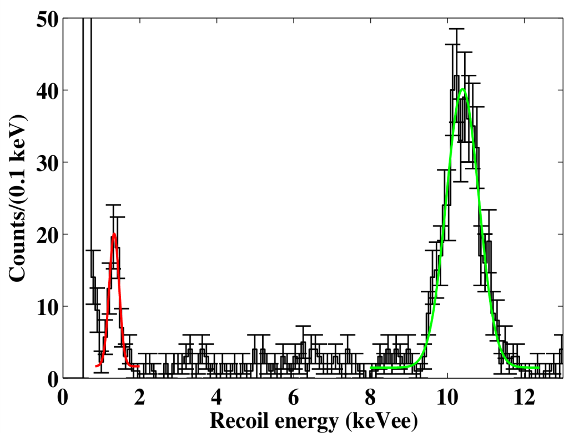
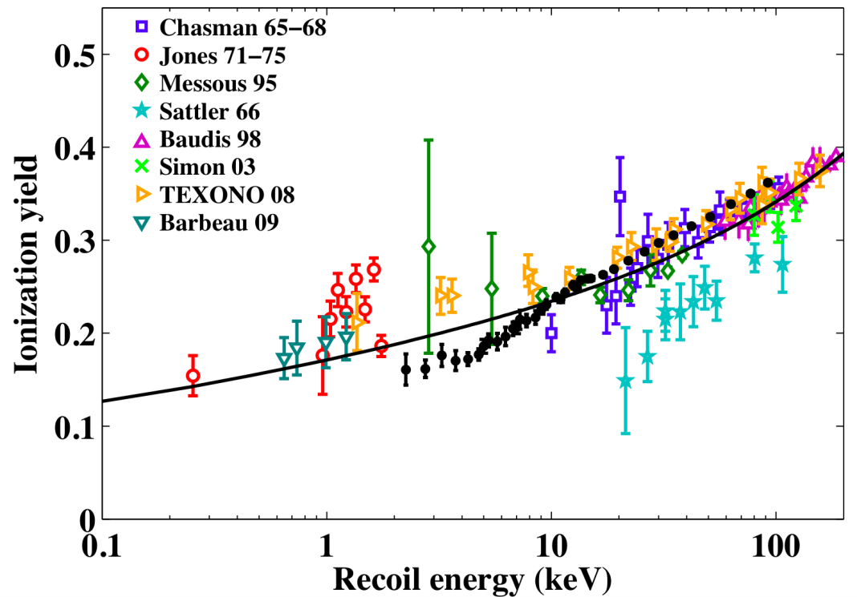
Energy Calibration
Phonon energy scale calibrated with electron recoil lines at 1.3 keV and 10.37 keV
Nuclear recoil energy reconstructed from phonon signal alone after subtracting Luke-Neganov phonons (~15% of signal)
Ionization / Phonon
Electron recoil phonon spectrum, T1Z5
Nuclear recoil ionization yield:
Recoil Energy (keV)
10.39±0.022 keVee
1.333±0.025 keVee
Lindhard (k=0.157)
CDMS

Slide 8
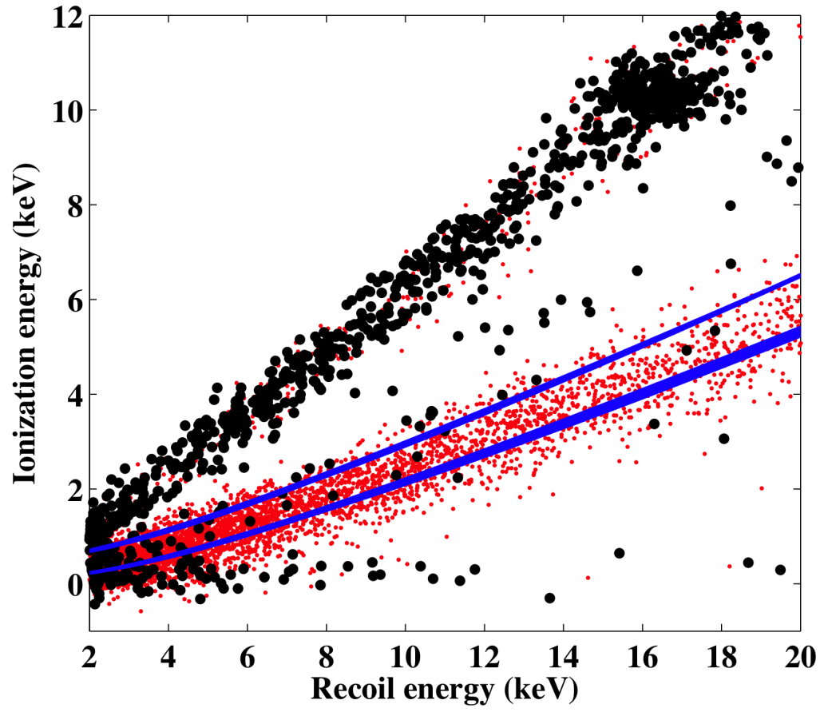
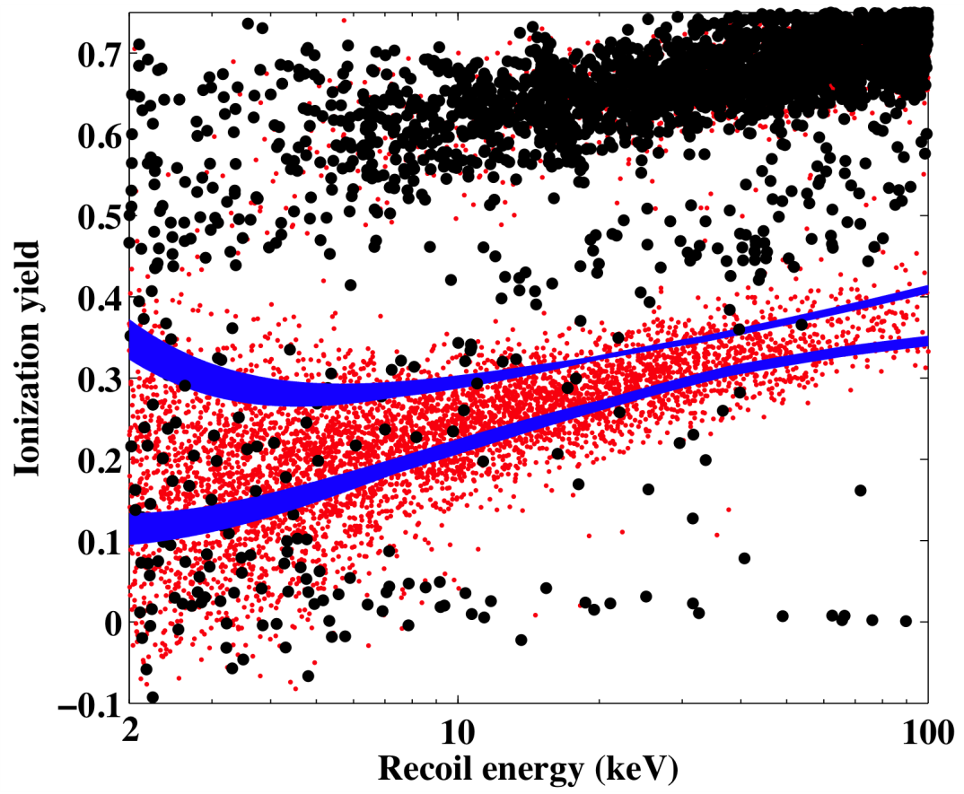
Nuclear Recoil Region
Nuclear recoil acceptance region defined as (+1.25,-0.5)σ band in ionization energy
Maximizes sensitivity to nuclear recoils while minimizing expected backgrounds

Slide 9
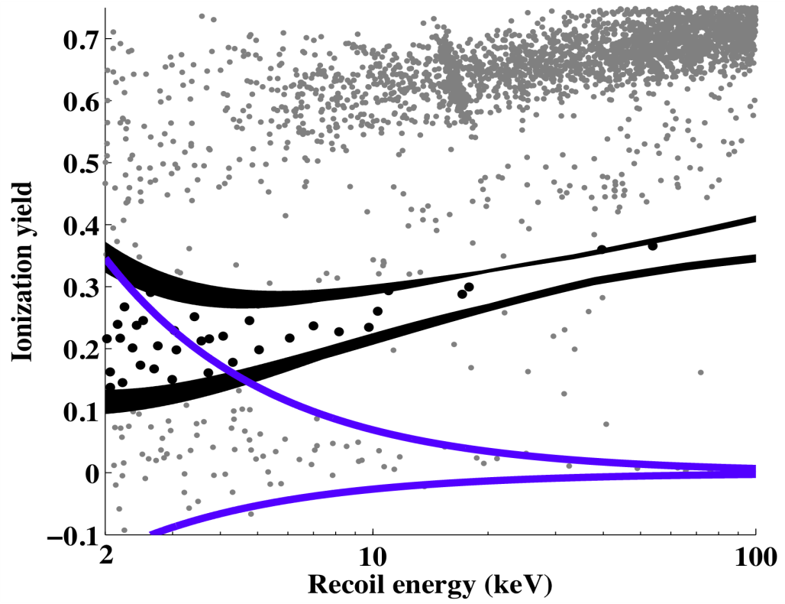
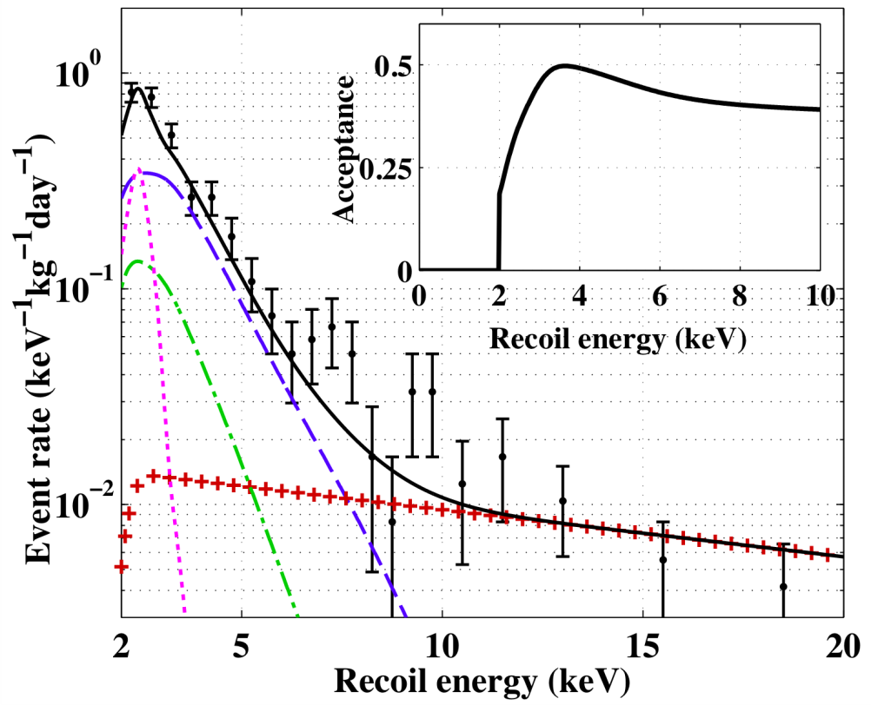
Signal Region & Backgrounds
1.3 keV line
Sidebands for background estimate:
Expected background spectra:
Compton
Surface
2σ zero charge band
Expected background from background extrapolations reasonably consistent with observed candidates
Possibly significant systematic errors due to extrapolations to low energy

Slide 10
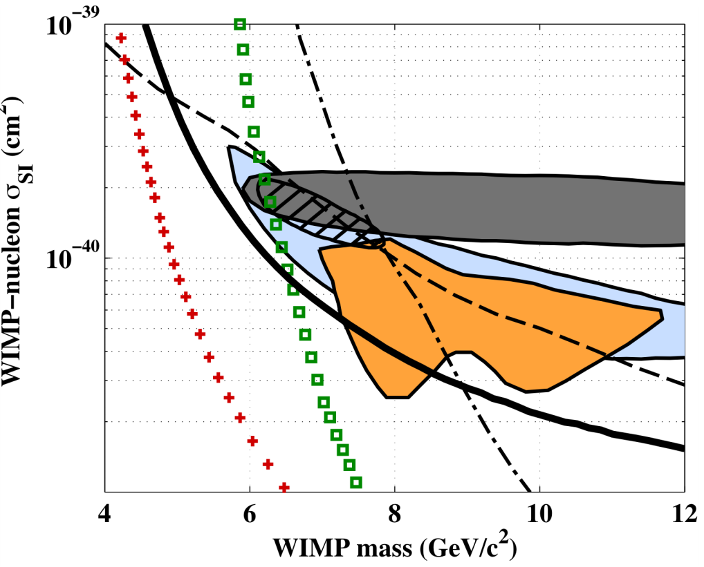
Results
No background subtraction, ie assume all events could be WIMPs
For spin-independent, elastic scattering, 90% CL limits incompatible with DAMA/LIBRA and entire CoGeNT excess
CDMS SUF
(1 keV thresh)
CDMS Soudan
(10 keV thresh)
DAMA/LIBRA
DAMA/LIBRA
These
results
CoGeNT
XENON10
(arXiv:1104.3088)
XENON100
(arXiv:1104.2549)
Some parameter space for CoGeNT remains if majority of excess events not due to WIMPs

Slide 11
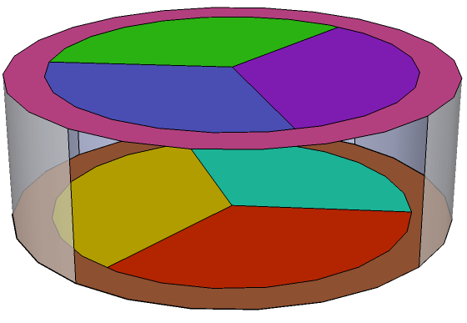
The Present Future
Improved detectors (iZIPs)
2.5 times Larger
Better surface event background rejection
Currently taking science data using 15 iZIP detectors

Slide 12
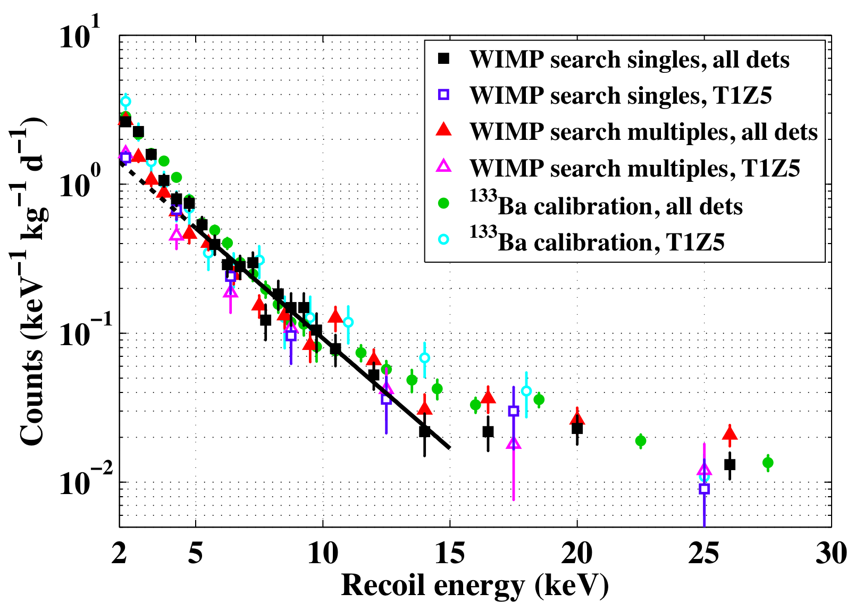
Zero Charge Events
Zero charge events seen in WIMP search singles, WIMP search multiples, and Ba calibration data with similar spectra

Slide 13
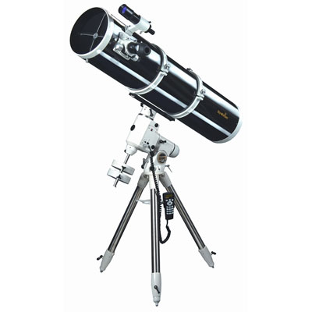
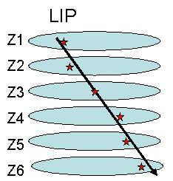
Other Physics?
Lightly Ionizing Particles (LIPs)
Anything not forbidden is required. – Murray Gell-Mann
A “tower” of 6 detectors like a LIP telescope

Slide 14
LIP Detection Fundamentals
Cross-section and hence # of interactions scale with f²
Each interaction samples same energy spectrum
Lowest detectible fractional charge is proportional to the Threshold^{1/2}
Typical muon leaves 8MeV (4MeV) in a germanium (silicon) detector
Few keV threshold give sensitivity to f ~= 1/30th
Six detector requirement makes analysis efficiency key:
ε_{anal} = Πε_{i}
₆
_{i=1}

Slide 15
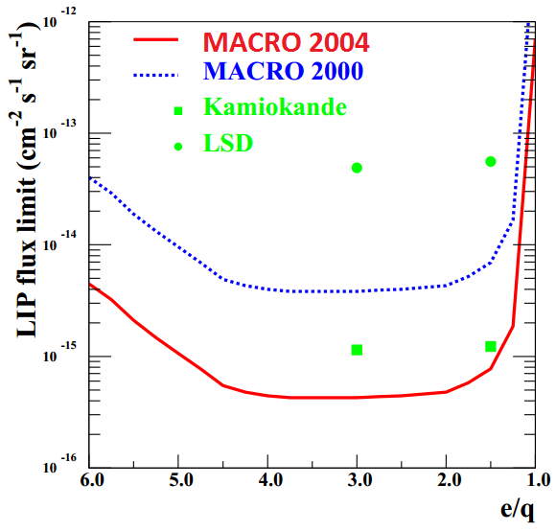
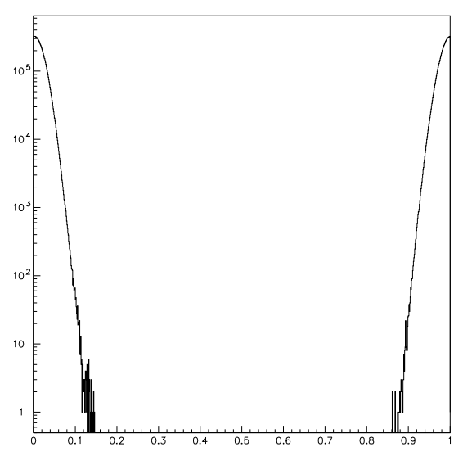
Past LIP Searches
Three types of searches:
Examine cosmic ray (or cosmically produced) LIPs
Insensitive below f=1/6th
Production in accelerators
Multiple modes: e⁺ e⁻ → f⁺ f⁻, etc
Search in normal matter,
Millikan oil drop
Exclude 0.18 < f < .82
0 0.2 0.4 0.6 0.8 1
f

Slide 16
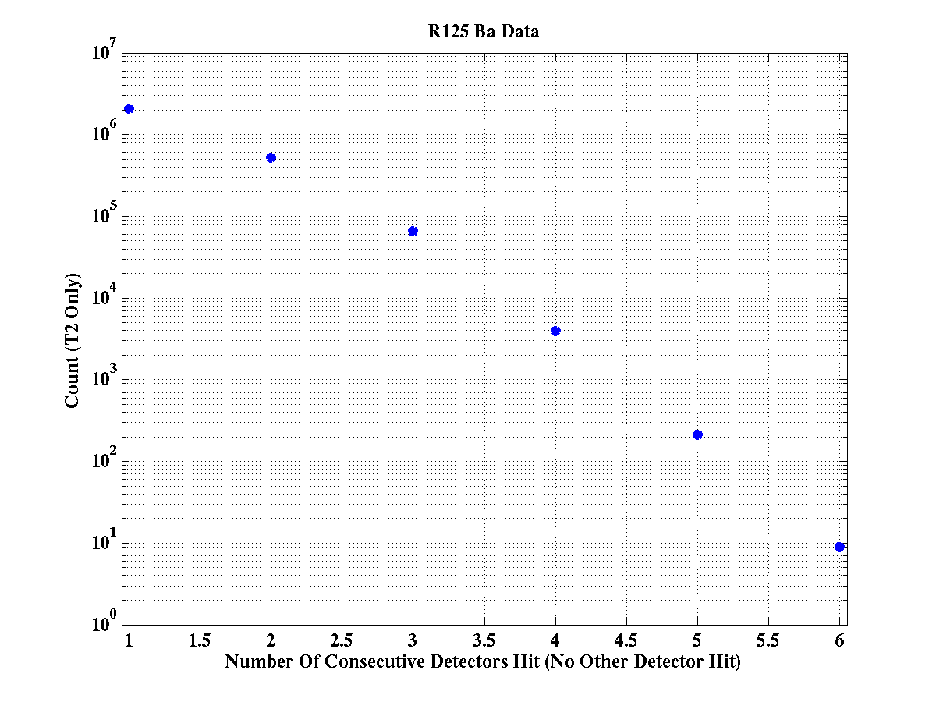
Hit Pattern
5x10⁷ total gamma events in subset, or more than an order of magnitude more than low background data
Require all 6 detectors in a tower hit
All other detectors consistent with noise
Loose ionization cut
Subset Of Gamma Calibration Data
10⁷
10⁶
10⁵
Count
Preliminary
10²
10¹
10⁰
1 2 3 4 5 6
Number Of Consecutive Detectors Hit

Slide 17
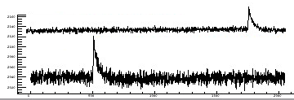
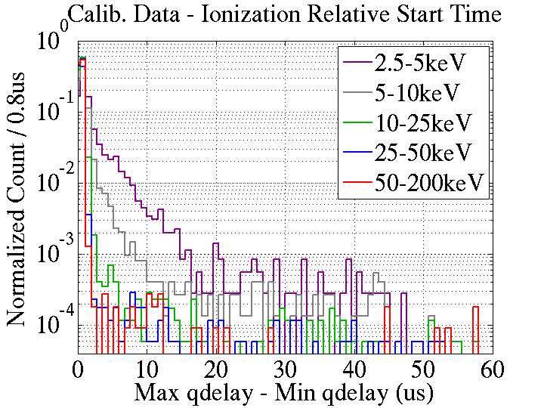
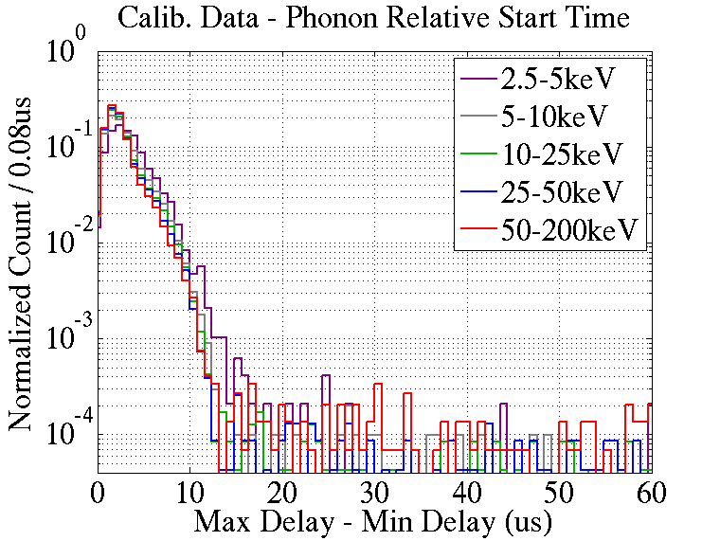
Similar Start Times
Slowest Det.
Δt
Fastest Det.
Preliminary
Preliminary

Slide 18
Energy Consistency
Assume LIPs to be minimum ionizing
Model interactions using the Photo-Absorption-Ionization (PAI) model
Compute single-interaction spectrum
Estimate the probability of n interactions given a fractional charge and incident angle θ
Convolute, convolute, convolute
Compare any observed events to the expected energy distribution

Slide 19
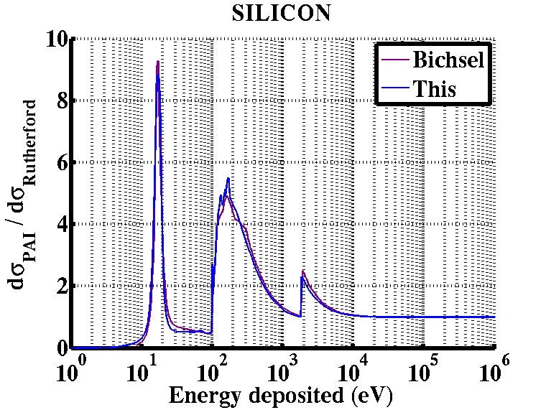
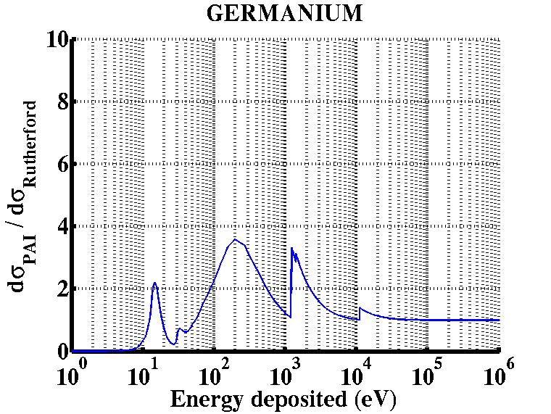
Energy Consistency
Single interaction spectrums for silicon and germanium using the PAI model
Preliminary
Preliminary

Slide 20
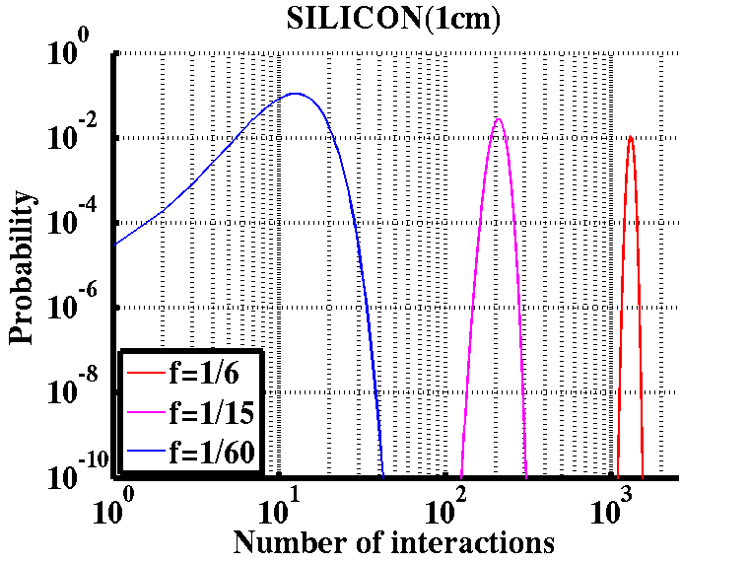
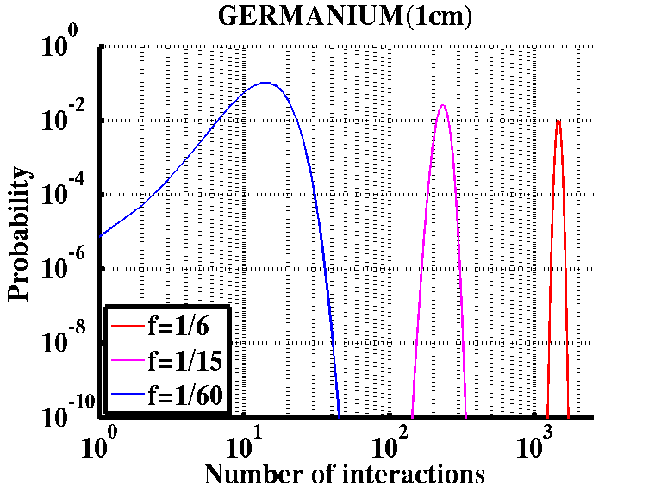
Energy Consistency
Expected number of interactions for normally incident LIPs (θ equals zero).
Preliminary
Preliminary

Slide 21
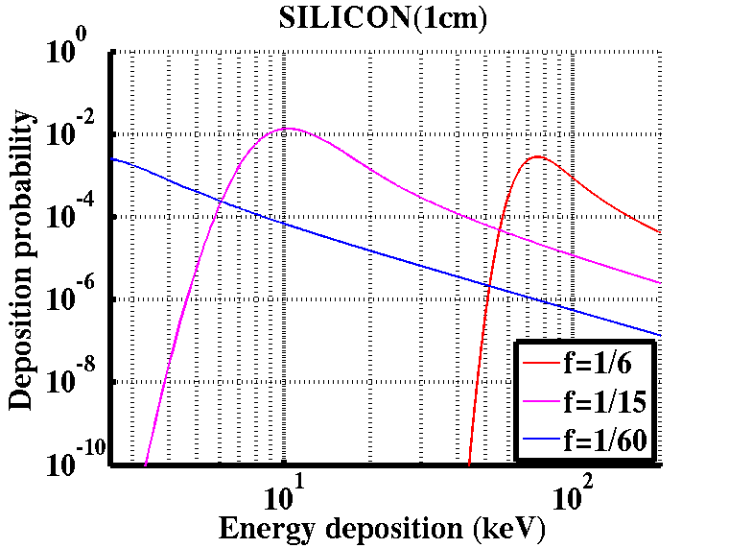
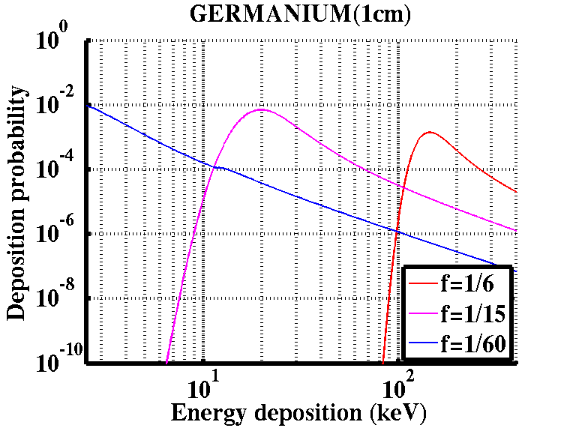
Energy Consistency
The 6 hit detectors should have energy depositions consistent with a LIP hypothesis
1
2
4
6
3
5
Preliminary
Preliminary
Illustrative sample distribution more consistent with f=1/15th than f=1/6th or f=1/60th.

Slide 22
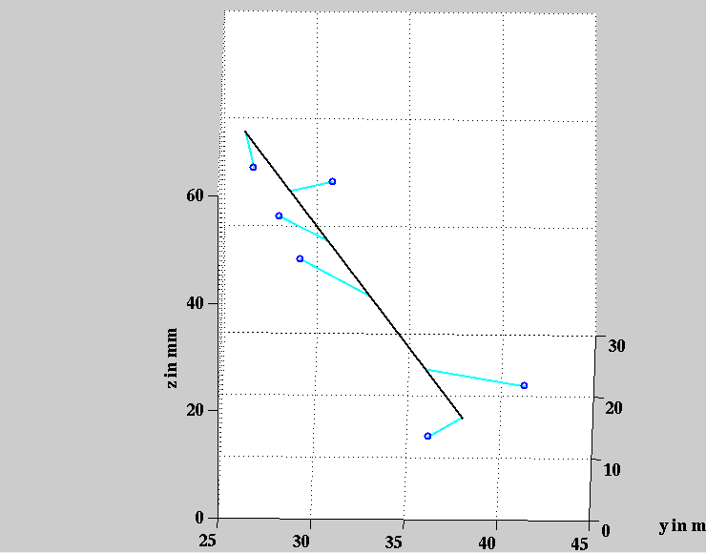
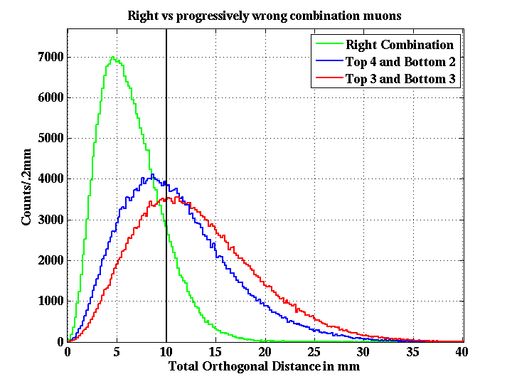
Track Linearity
Through-going muons demonstrate that the degree of deviation from a linear track provides a handle to rejecting gamma-induced backgrounds.
Preliminary

Slide 23
That’s all folks….

