Slide 1
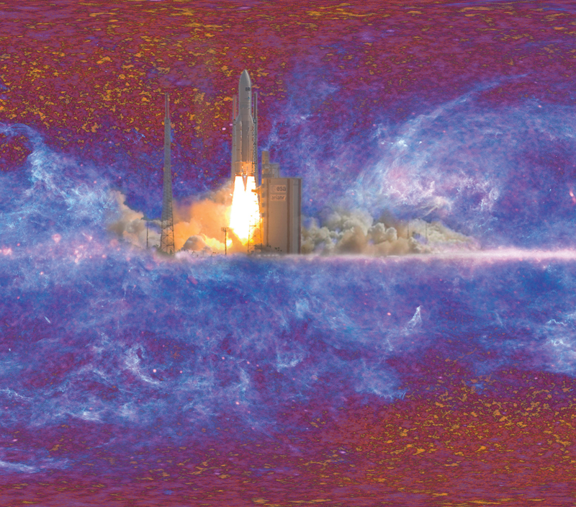
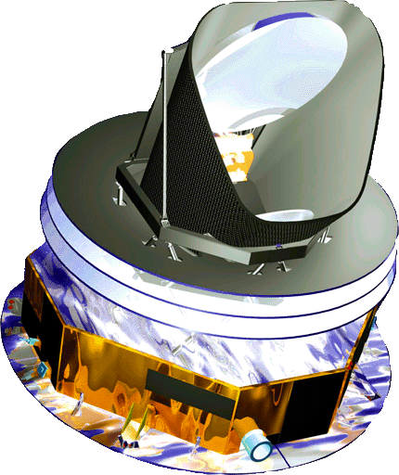
PLANCK: Status & Prospects
Launched 3 years ago
(May 16th 2009)
Early papers Jan. 2011
First set of CMB Cosmology papers Spring 2013
F. Couchot (CNRS-LAL), on behalf of the Planck Collaboration
24^{èmes} Rencontres de Blois
May 30th 2012

Slide 2
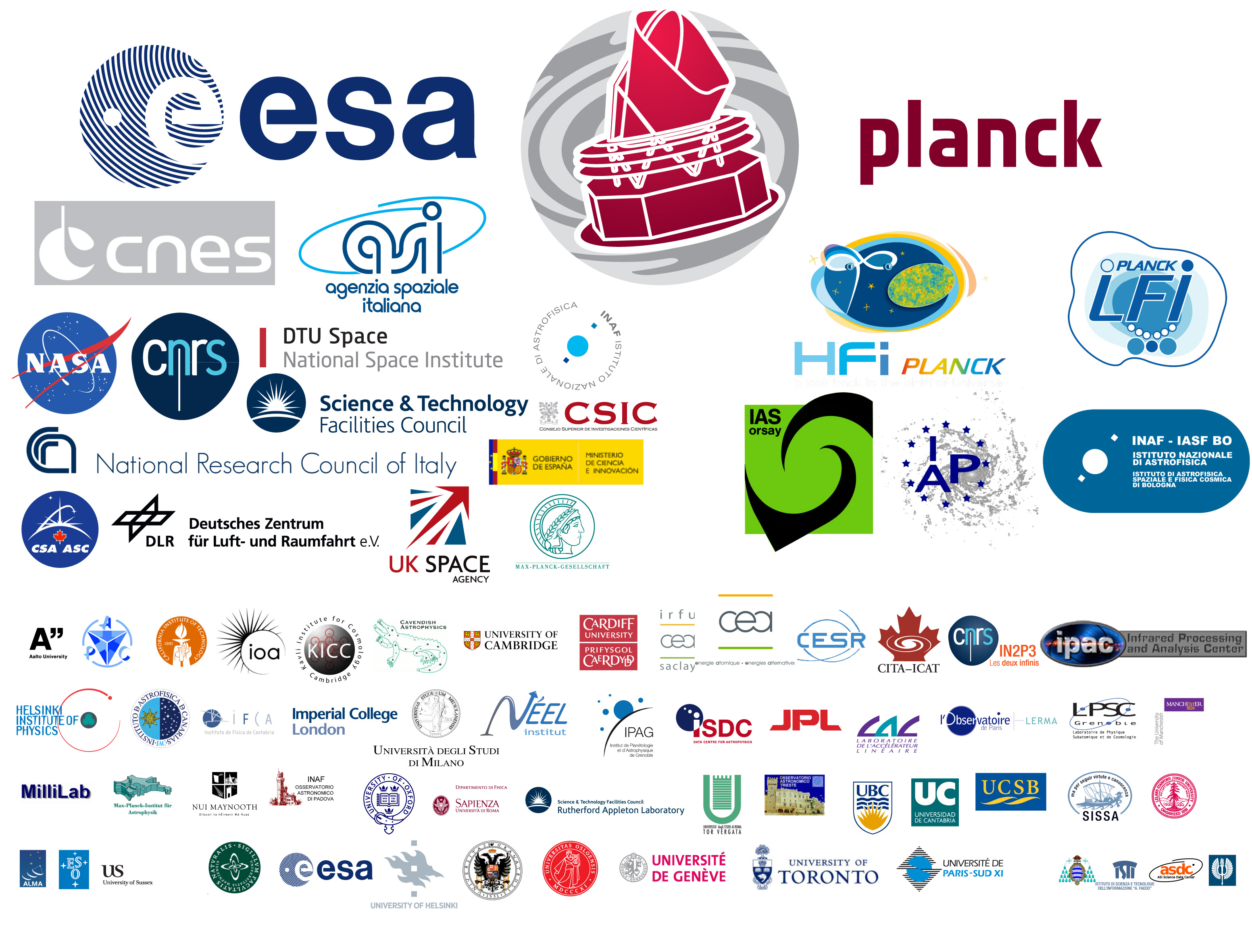
PLANCK is a European Space Agency (ESA) project with Instruments provided by two scientific consortia funded by ESA member states (in particular the lead countries: France and Italy) with contributions from NASA (USA), and telescope reflectors provided by a collaboration between ESA and a Scientific Consortium led and funded by Denmark.
Notes:
logos

Slide 3
(Planck) Scale

Slide 4
Mission main Characteristics
Optimized for Cosmic Microwave Background physics – Temperature & Polarization anisotropies – angular resolution ~ 5'
Full sky coverage
Low noise detectors
Stabilized thermal environment
High redundancy
same pixel observed again and again with different characteristic time scales
same pixel observed by different channels
same pixel observed in different (9) frequency bands

Slide 5
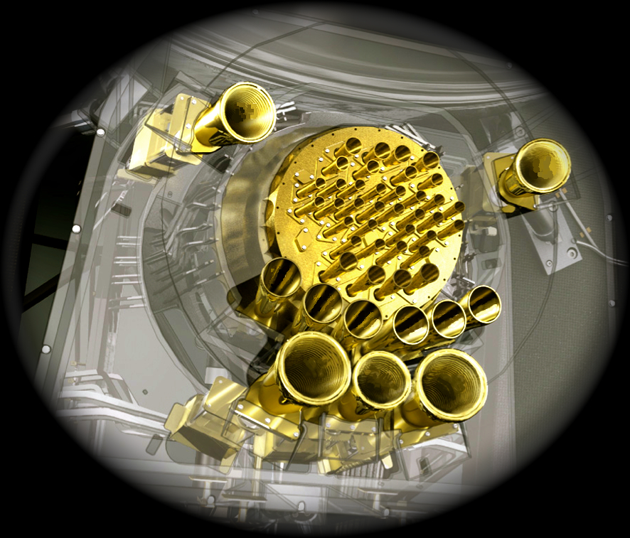
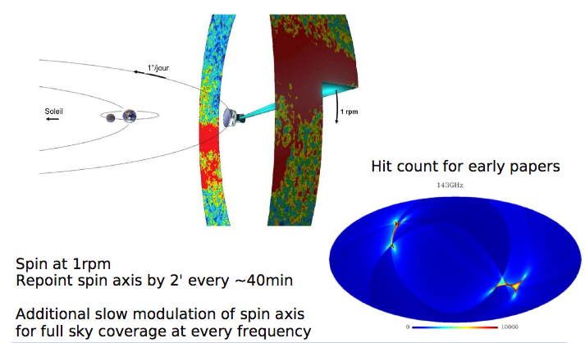
Planck sky scan

Slide 6
Planck Spectral Range
CMB stands for Cosmic Microwave Background

Slide 7
Planck Foreground Maps from first year
30 GHz
44 GHz
70 GHz
LFI
100 GHz
143 GHz
217 GHz
––HFI––
353 GHz
545 GHz
857 GHz
(WMAP covers 22 – 30 – 40 – 60 – 90 GHz)

Slide 8
The whole history of our universe is hidden in the Planck sky maps !
Emissions from our Galaxy
Large Scale Structure Formation
Emissions from the solar system
Reionization
Planck - F.C. - BLOIS 2012
Recombination
Inflation
Notes:
publications passées et à venir

Slide 9
Component separation
Planck - F.C. - BLOIS 2012
Every component has its own specific spectral and space properties
Notes:
publications passées et à venir

Slide 10
Inside HFI
Bolo 100 mK plate
4K box
Light in
1.6 K box

Slide 11
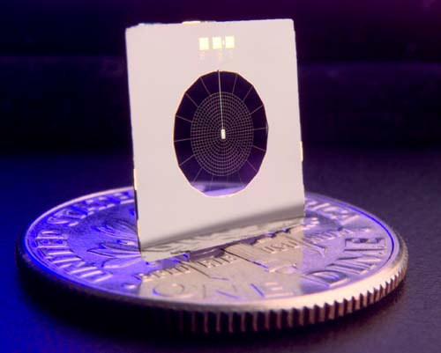
High Frequency Instrument based on .1 K dilution cooled bolometers
11
http://hfi.planck.fr/article227.html

Slide 12
What's new since last year ? a selection
HFI stopped taking data (on last Jan 14th)
A few snapshots on present outputs
Quality of component separation
galactic CO (with Dame, NANTEN, CfA CO survey)
galactic "haze" (with Fermi)
Large Scale Structures evolution
CIB (with Herschel and SPT)
S/Z clusters (with XMM and HST)
CMB Hot/Cold spots stacking
Planck - F.C. - BLOIS 2012
12
Notes:
plan

Slide 13
Message from the HFI P.I. on Jan. 14th 2012
[...] Up to this day, 976 days after the Planck-Herschel launch, the dilution cooler has operated flawlessly for 885 days of sky survey, cooling the detectors at 103 mK with
an amazing stability.[...] today (Saturday 14 January) at noon
[...] the flow decreased to the point at which the nominal
temperature of the bolometer plate could not be maintained.
Thus, this is the end of the nominal operations of HFI. It is interesting to recall the predictions for this end of life: [...] The prediction on the 5th of July 2009 was 24th of January 2012 In mid 2011 the end of life date was predicted to be 15th of January 2012.
Planck - F.C. - BLOIS 2012
Notes:
logos

Slide 14
...continued
We observed Jupiter for the 5th time in the last few days [...]. Although expected, the end of HFI observing
is a sad point in the Planck mission history. HFI started with the SAMBA proposals in 1992-93 to CNES
and then to ESA almost 20 years ago. But at the same time it brings the good news of
the confirmation that we got uninterrupted nominal
sensitivity survey data for 30.5 months. This allows us to do
significantly more science than what was described
in the blue book assuming the nominal 14 months mission.
[...] Happy new year and happy data analysis! Jean-Loup Puget HFI Principal Investigator
Planck - F.C. - BLOIS 2012
Notes:
logos

Slide 15
From CO contamination to the first full sky CO map
Rotational transition lines in HFI spectral range
Planck - F.C. - BLOIS 2012
Notes:
publications passées et à venir

Slide 16
CO separation
Use of the difference in response to a given line for different HFI channels
Use of known ratios of different line emissions
Calibration on CO data on some sky areas
Check on other CO data
Excellent agreement
First all sky CO emission map
Planck - F.C. - BLOIS 2012
Notes:
publications passées et à venir

Slide 17
Planck - F.C. - BLOIS 2012
Notes:
publications passées et à venir

Slide 18
Planck - F.C. - BLOIS 2012
Notes:
publications passées et à venir

Slide 19
Free electrons
Seen in WMAP and Planck LFI bands due to synchrotron radiation in galactic magnetic field
Seen by Fermi due to inverse Compton effect of photons from the InterStellar Radiation Field (ISRF) on the same electrons
Confirmation of galactic haze already seen by WMAP and Fermi (see Gregory Dobler arXiv:1109.4418v2)
Planck - F.C. - BLOIS 2012
Notes:
publications passées et à venir

Slide 20
Slide taken from Planck Paris 2011
Planck - F.C. - BLOIS 2012
Notes:
publications passées et à venir

Slide 21
Planck - F.C. - BLOIS 2012
Borrowed from Planck 2012 – Bologna – K. Gorski
Notes:
publications passées et à venir

Slide 22
Cosmic Infrared Background
z > 2
Maps dominated by dusty galaxies emission.
Power spectrum excludes simplest LSS formation models
Results expected from correlation CIB – CMB lensing
Planck - F.C. - BLOIS 2012
Notes:
publications passées et à venir

Slide 23
S/Z clusters
Confirmation by XMM observations. One z~1 found
HST preview
Planck - F.C. - BLOIS 2012
Borrowed from Planck 2012 – Bologna – M. Arnaud
Notes:
publications passées et à venir

Slide 24
Hot/Cold spot stacking
Polar measurement in good shape:
polarization aligned on or perp. to isotherms, as expected from CMB Thomson scattering on plasma electrons
Planck - F.C. - BLOIS 2012
Notes:
publications passées et à venir

Slide 25
Conclusions
After a 885 day long exposure, the HFI shutter closed. Teams need a few more months to develop the pictures.
The CMB spectra will allow us to constrain cosmological models better than expected before flight (cf. Blue Book)!
Cosmology results will come also from the lensing and CIB analyses.
Planck - F.C. - BLOIS 2012
Notes:
publications passées et à venir

