Slide 1
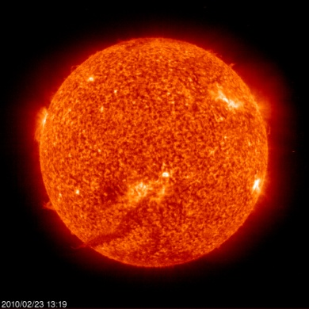
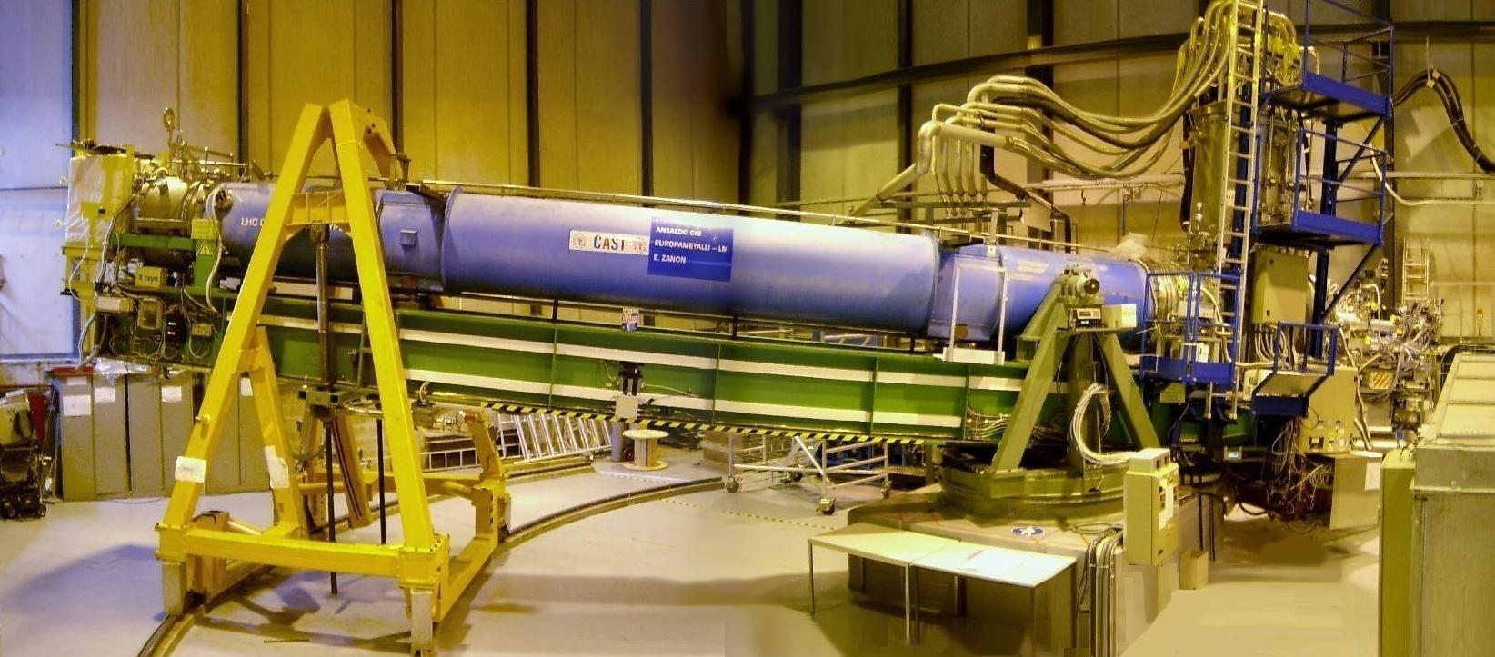
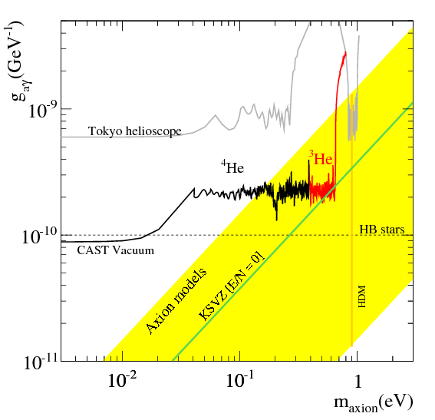
Results and perspectives of the solar axion search with the CAST experiment
Esther Ferrer Ribas
IRFU/CEA-Saclay
For the CAST Collaboration
Rencontres de Blois
30th May 2012

Slide 2
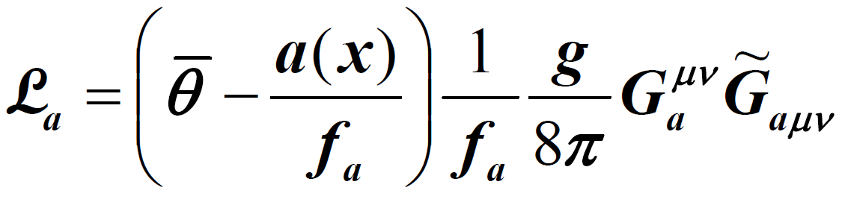
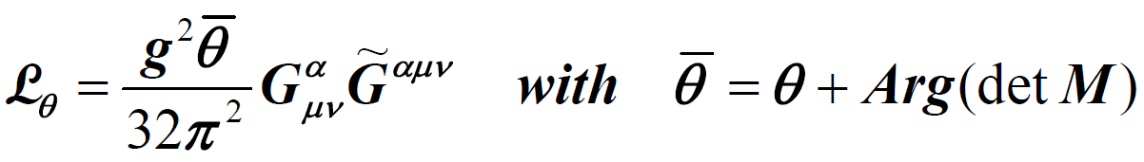
Motivation for Axions
CP violation is necessary in the SM➔matter-antimatter asymmetry
CP violation observed in the weak interactions
QCD predicts violation in the strong interactions
However no experiment has observed this violation of CP in QCD!
A possible solution to the strong CP-problem
Elimination of CP-violating term in QCD Lagrangian by introduction of ne additional global U(1) symmetry
New pseudo-scalar field : AXION
First proposed by Peccei & Quinn (1977)
Particle interpretation by Weinberg, Wilczek (1978)

Slide 3
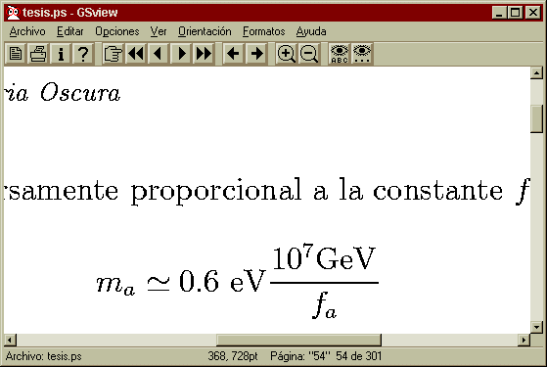
Axion properties
Neutral Pseudoscalar
Pratically stable
Very low mass
Very low cross-section
Coupling to photons
Possible dark matter candidates

Slide 4
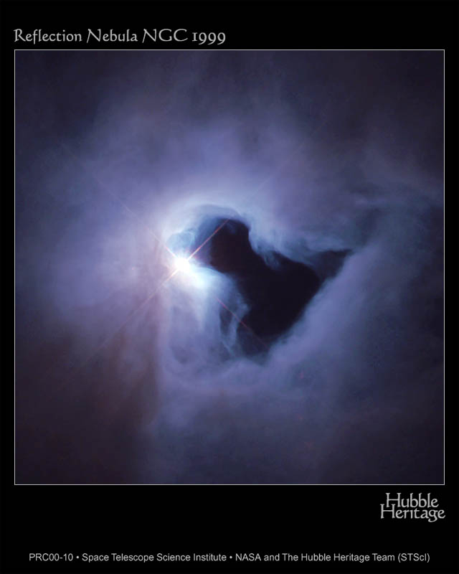
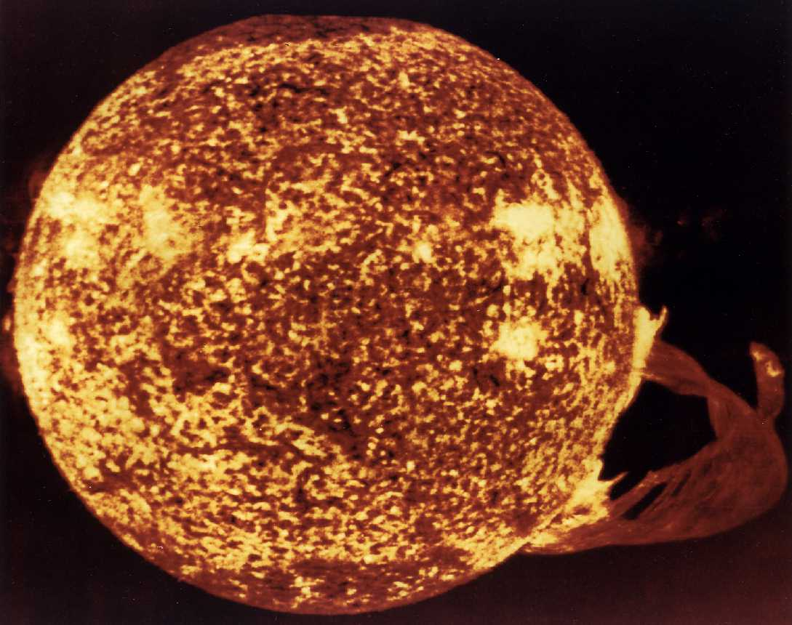
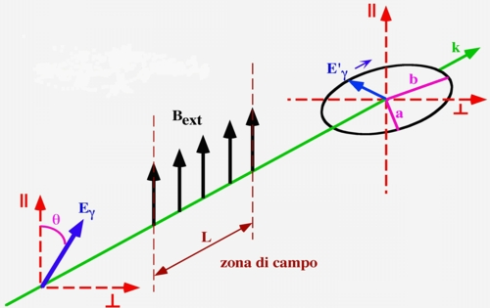
Search strategies
Relic Axions
  Axions that are part of galactic dark matter halo:
    Axion Haloscopes
Solar Axions
  Emitted by the solar core.
    Axion Helioscopes (CAST → IAXO)
Axions in the laboratory
    “Light shinning through wall” experiments
    Vacuum birefringence experiments
See Pierre Sikivie’s talk

Slide 5
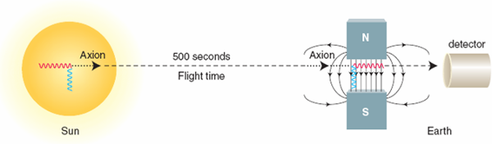
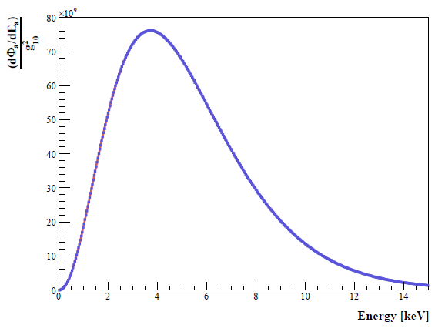
CAST Physics
Production in the Sun
Conversion of thermal photons into axions via Primakoff effect in the solar core
Detection inCAST
Conversion of axions into photons via the inverse Primakoff effect in a strong magnetic field
Expected number of photons:
≈ 0.3 evts/hour
with g_{aγ}= 10⁻¹⁰ GeV⁻¹ and A = 14 cm²

Slide 6
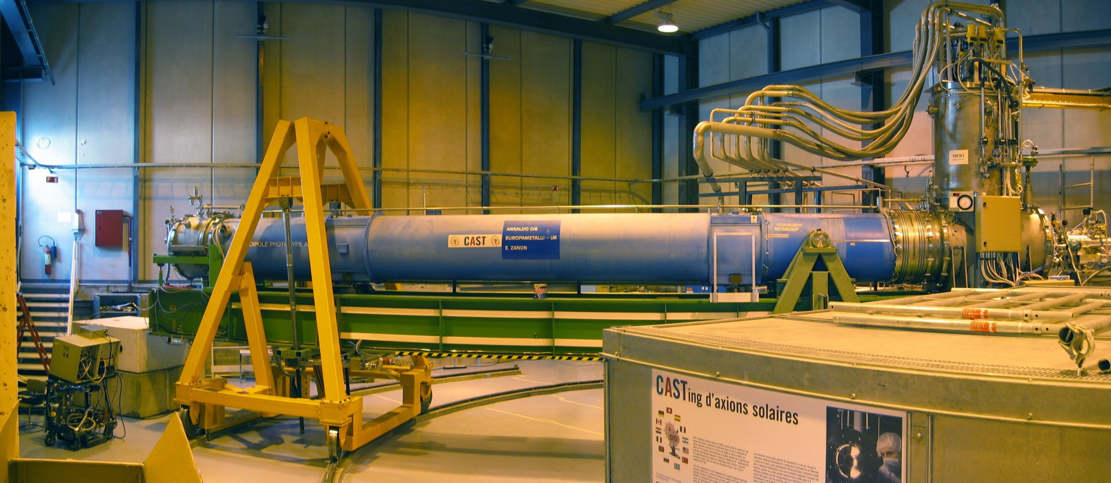
CAST: CERN Axion Solar Telescope
Sunset Detectors:
2 Micromegas
Sunrise Detectors:
1 CCD+telescope
1 Micromegas
Signal: excess of x-rays while pointing at the sun
LHC dipole : L = 9.3 m, B = 9 T
Rotating platform : vertical mouvement 16°
horizontal mouvement 100°
Solar « Tracking » ~3 h/day, background data rest of the day
4 X-rays detectors

Slide 7
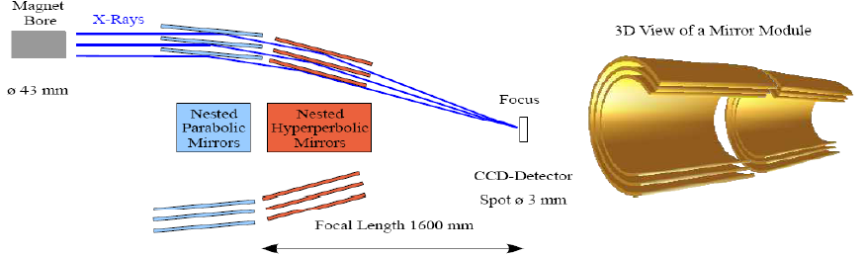
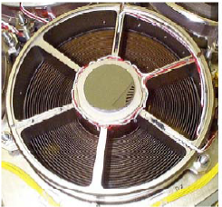
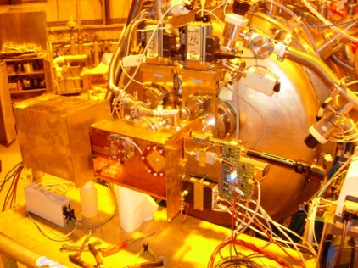
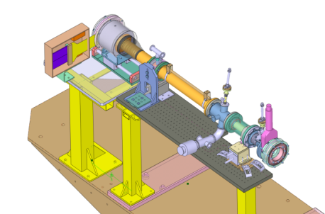
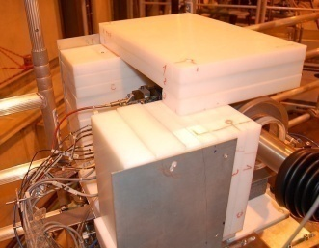
Originalities of CAST
Use of X-ray telescope ➔ increase S/B noise➔ sensitivity improved by a factor 150 by focusing a ø43 mm x-ray beam to ø3mm
Low background techniques➔ shieldings, low radioactive materials, simulation and modeling of backgrounds….

Slide 8
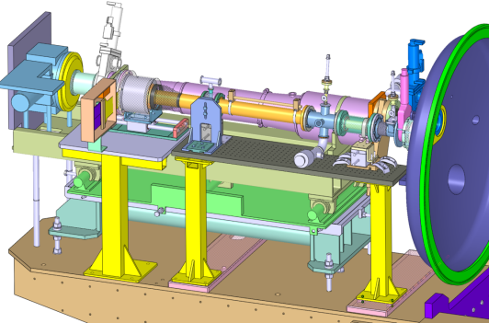
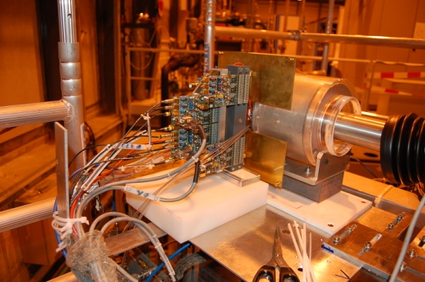
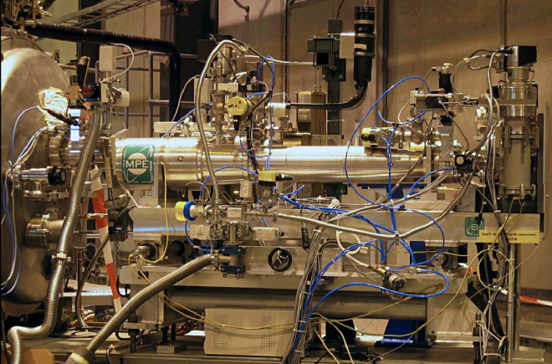
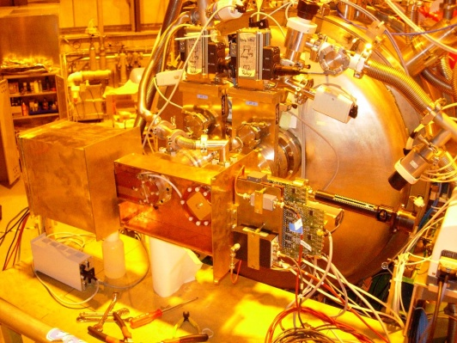
Detectors
Before 2006 | Typical rates
TPC | 17 ×10⁻⁴c KeV⁻¹ cm⁻² s⁻¹ (2-10 keV)
MM | 5 ×10⁻⁴c KeV⁻¹ cm⁻² s⁻¹ (2-10 keV)
CCD+telescope | 8 ×10⁻⁵c KeV⁻¹ cm⁻² s⁻¹ (1-7 keV)
After 2006 | Typical rates
2 MM | 6 ×10⁻⁵c KeV⁻¹ cm⁻² s⁻¹ (2-10 keV)
CCD+telescope | 8 ×10⁻⁵c KeV⁻¹ cm⁻² s⁻¹ (1-7 keV)
SUNRISE SIDE
Shielded Micromegas last generation-Microbulk type
SUNSET SIDE: two shielded Micromegas last generation-Microbulk type
CCD +telescope

Slide 9
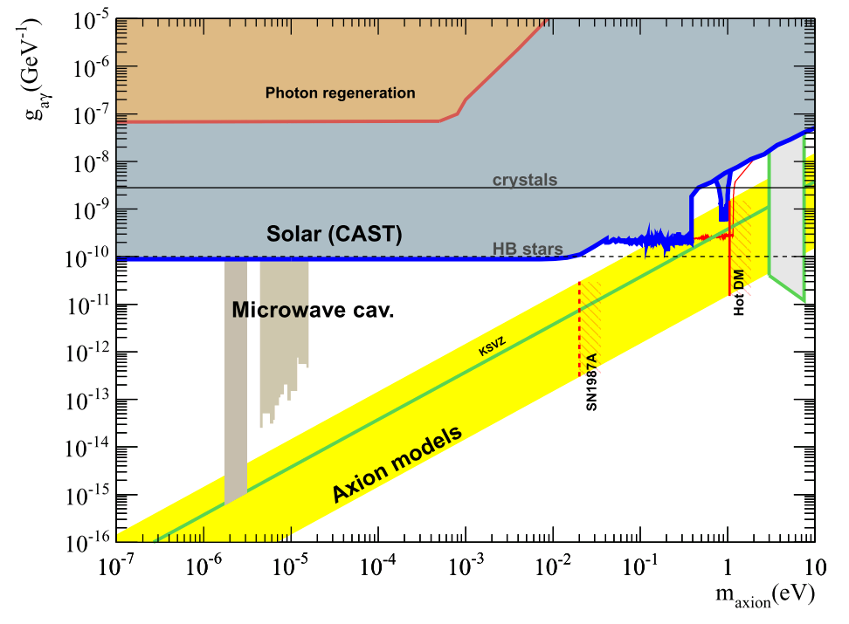
CAST PROGRAM AND SENSITIVITY
CAST Phase I: (vacuum operation 2003-2004)
completed (2003 - 2004), m_{a} < 0.02 eV
JCAP 0704(2007) 010, CAST Coll.
PRL (2005) 94, 121301, CAST Coll.
CAST Phase II: (buffer gas operation 2005-2011)
⁴He completed (2005 -2006) , 0.02 eV < m_{a} < 0.39 eV
JCAP 0902 (2009) 008, CAST Coll.
³He run completed (2007-2011),0.39 eV < m_{a} < 1.18 eV
First part ³He run analysis PRL (2011) 1087 261302.
Original aims of CAST reached!
Short term plans for 2012-2015 later in this talk
CAST byproducts:
High Energy Axions: Data taking with a HE calorimeter JCAP 1003:032,2010
14.4 keV Axions: TPC data (before 2006) JCAP 0912:002,2009
Low Energy (visible) Axions: Data taking with a PMT/APD arXiv:0809.4581

Slide 10
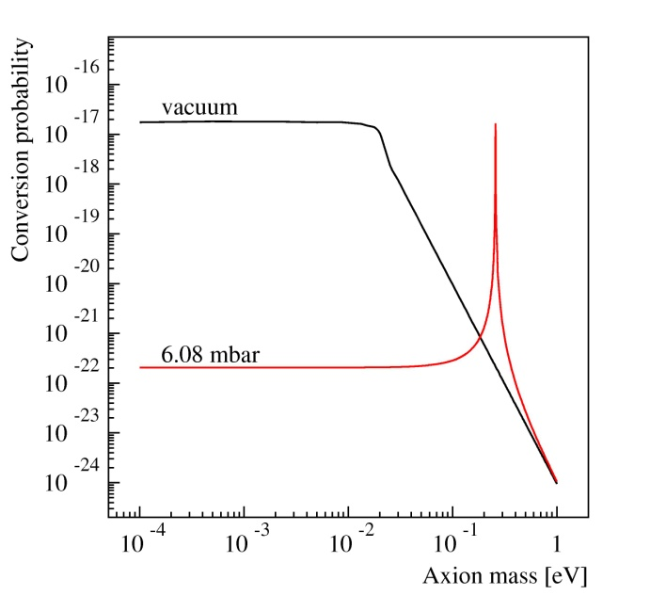
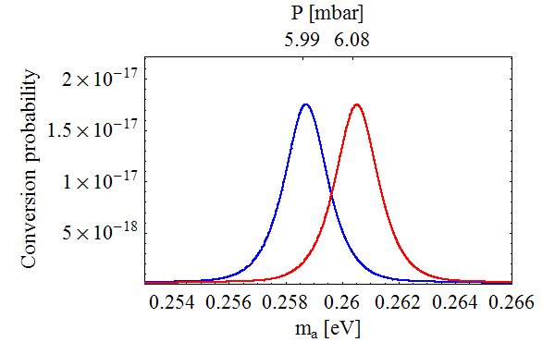
Extending sensitivity to higher masses
Axion to photon conversion probability:
Vacuum:
Γ=0, m_{γ}=0
with
Coherence condition: qL < π
For CAST phase I conditions (vacuum), coherence is lost for m_{a} > 0.02 eV
With the presence of a buffer gas it can be restored for a narrow mass range:
1.0 dP
e.g. for 50 mbar Δm_{a} ~ 10⁻³ eV
10

Slide 11
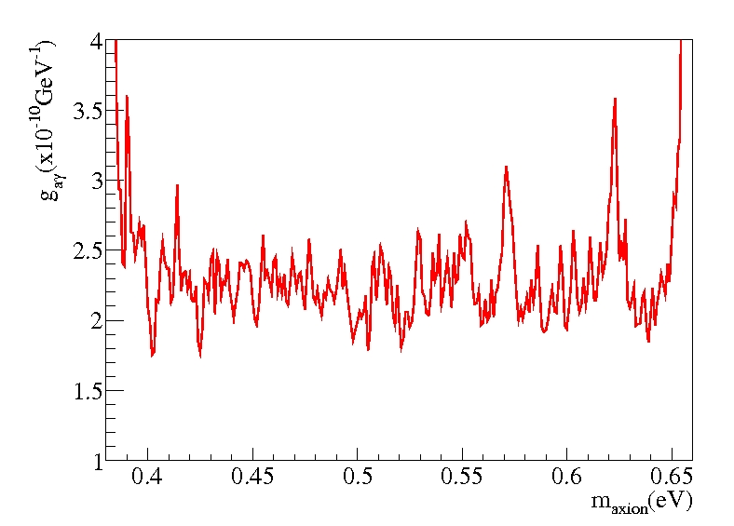
Latest CAST results
Latest CAST results
S. Aune et al. (CAST collaboration)
PRL 1087 (2011) 261302
arXiv:1106.3919.
First ³He data (2008) shown in red
Masses 0.39-0.65 eV excluded down to 2-2.5×10⁻¹⁰ GeV⁻¹
Touching KSVZ benchmark models for the first time

Slide 12
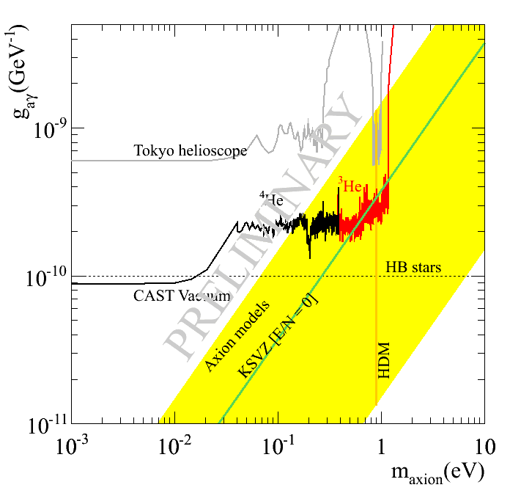
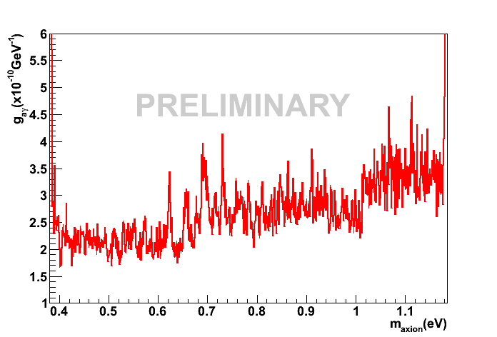
Latest preliminary CAST results (2009-2011)
2009-2011
Data analysis 2009-2011
Analysis in progress
Masses up to 1.15 eV
Final He3 result paper in preparation

Slide 13
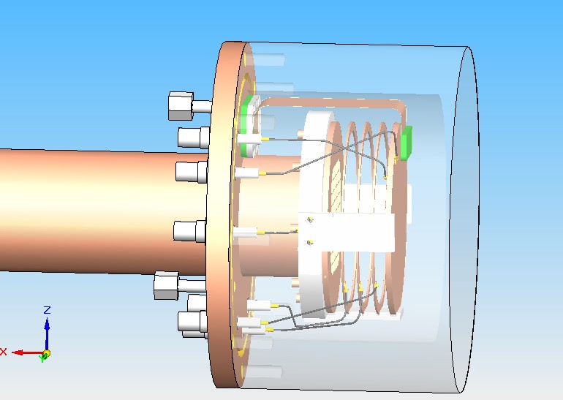
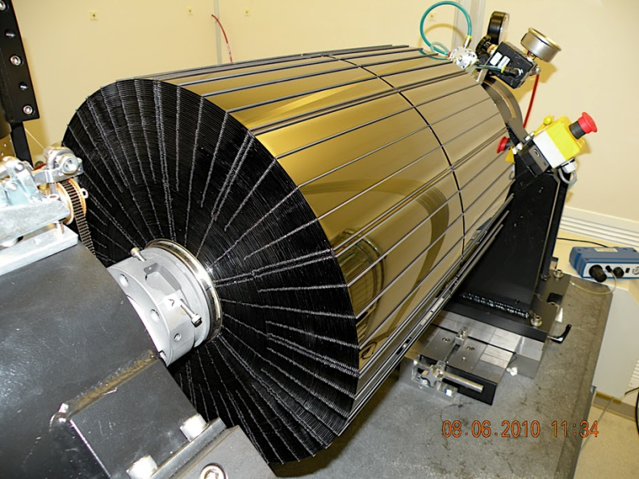
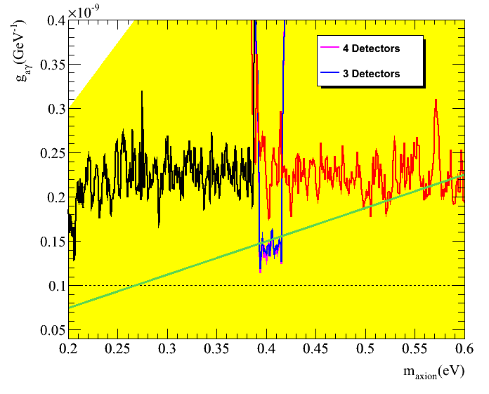
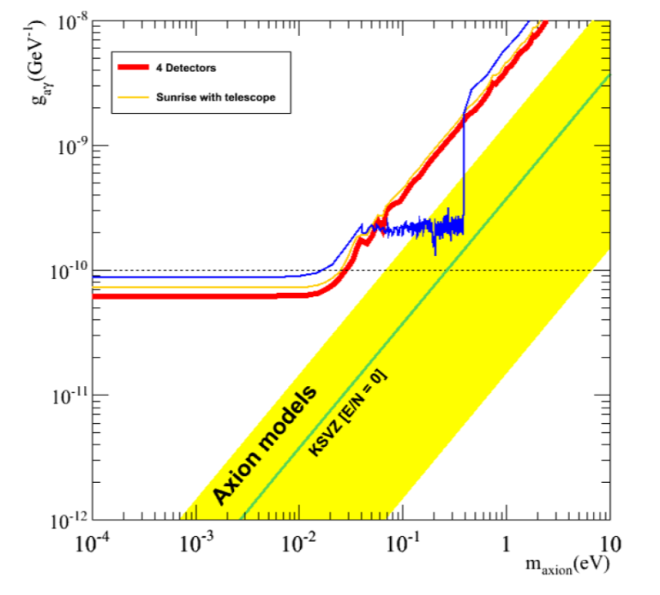
Future prospects: short term 2012-2014
2012 : revisit phase II ⁴He
2013-2014 : vacuum phase with improved
detectors (low background improved threshold)
and new telescope

Slide 14
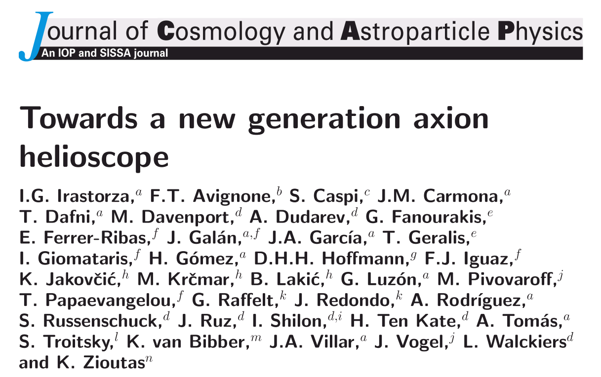
Future prospects long term: IAXO
(International AXion Observatory)
  New generation axion helioscope (>1 order of magnitude more sensitive than CAST)
JCAP 06 (2011) 013
LOW
BACKGROUND
DETECTORS
X RAYS
OPTICS
MAGNET

Slide 15
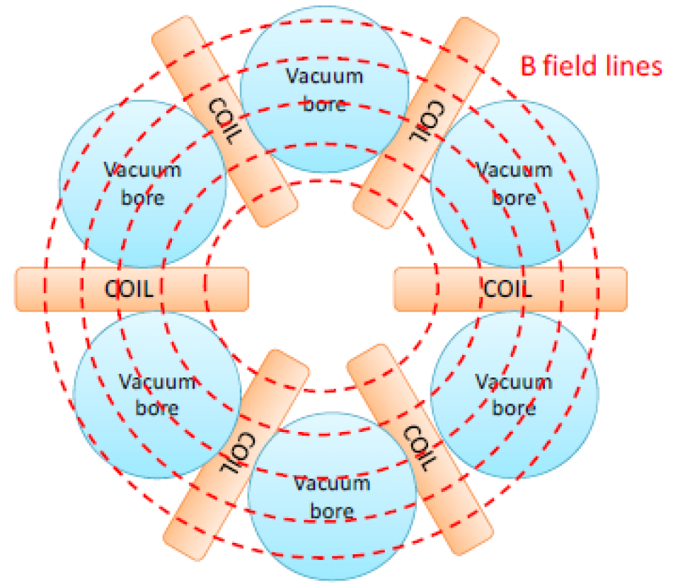
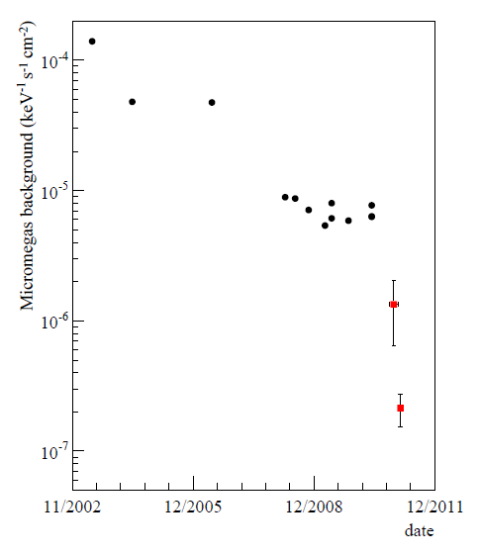
IAXO
DEDICATED MAGNET
Best option toroidal configuration:
Much bigger aperture than CAST: ~0.5-1 m per bore
Relatively Light (no iron yoke)
Bores at room temperature (?)
X-RAY OPTICS
Thermally-formed glass substrates optics
  Successfully used in NUSTAR
  Leverage existing infrastructure. Minimize costs & risks
History of background improvement of Micromegas detectors at CAST
ULTRA LOW BACKGROUND DETECTORS
  Goal: 10⁻⁷ c/keV/s/cm2 or better
Apply what have been learned in CAST: compactness, radiopurity, better shielding

Slide 16
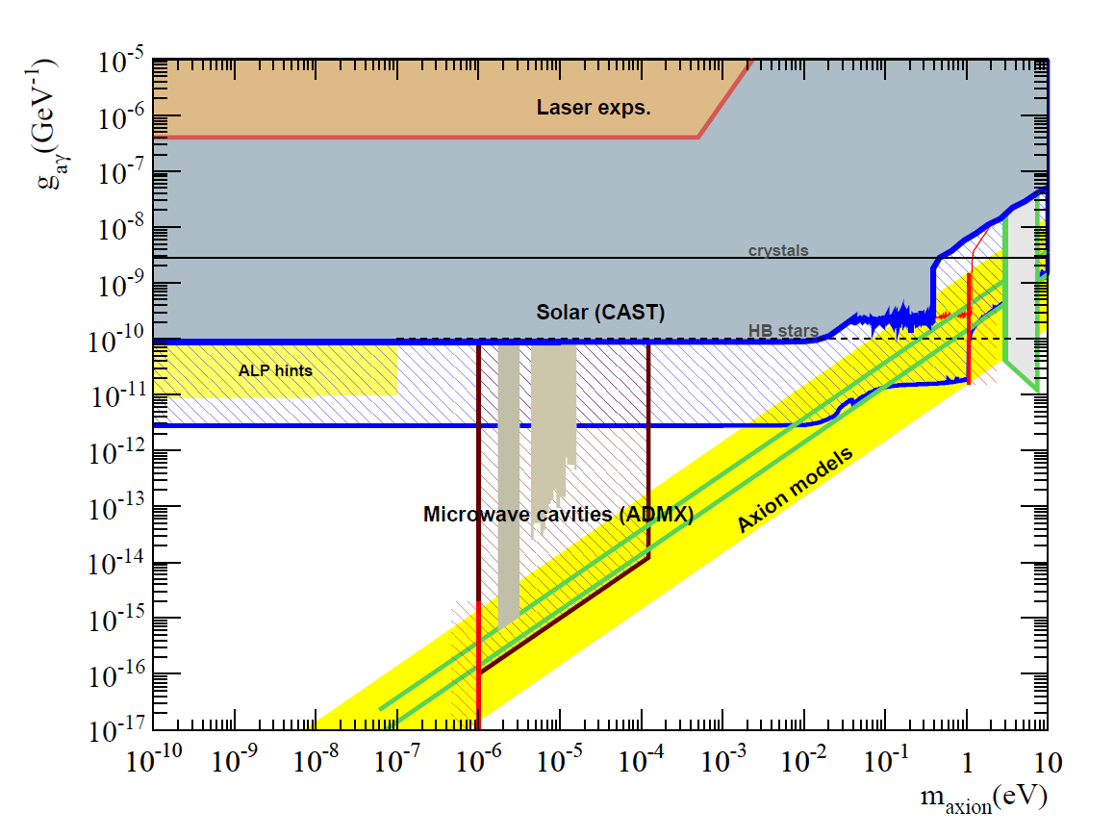
Conclusions & Perspectives
CAST
Strictest experimental limit on axion searches for a wide m_{a} range entering the region most favoured by QCD models
From 2012-2014
Run enhance the sensitivity in the mass region ≈ 0.4 eV
Vacuum phase revisited with improved detectors and new telescope
IAXO: International Axion Observatory
  A new generation axion helioscope
  First results (JCAP 016) show good prospects to improve CAST 1-1.5 orders of magnitude in g_{aγ}.
  First solid steps towards conceptual design
IAXO Prospects

