Slide 1
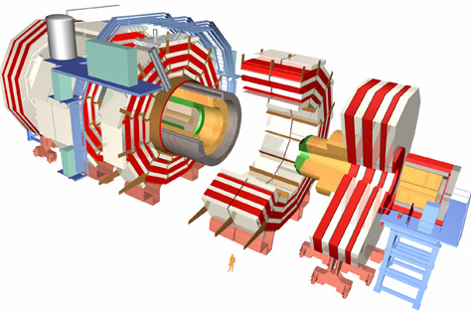
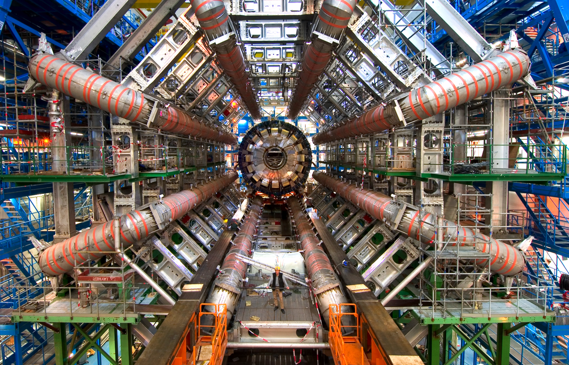
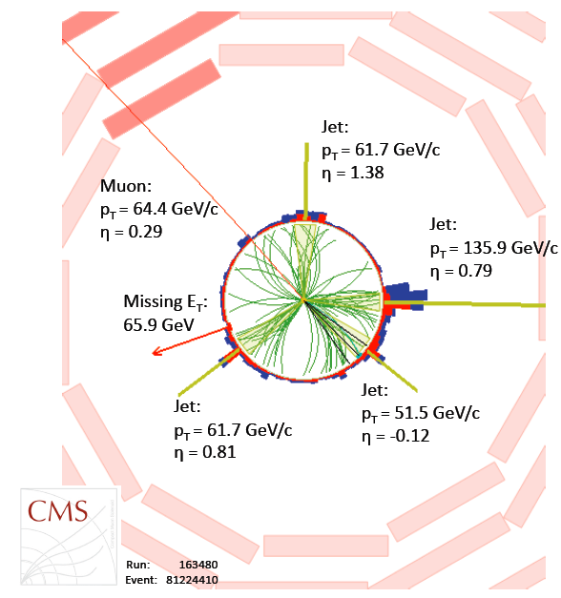
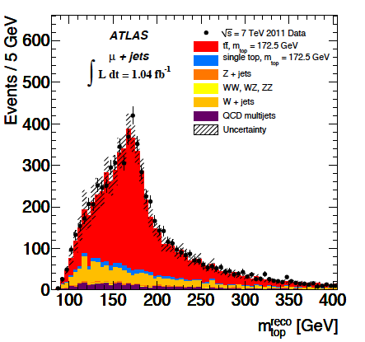
Top Quark Properties at LHC with ATLAS and CMS On behalf of the ATLAS and CMS Collaboration
XXIV Rencontres de Blois: Particle Physics and Cosmology
30th May 2012
Regina Moles-Valls
IFIC – Universitat de València

Slide 2
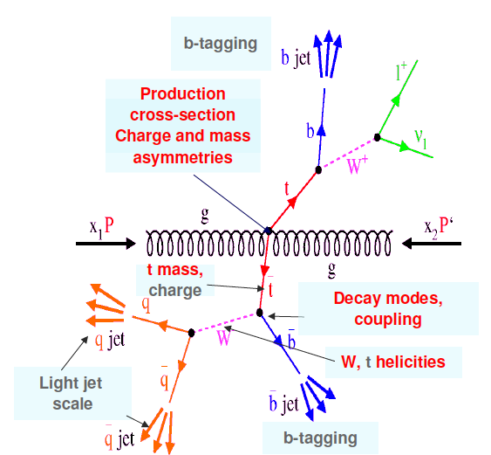
Top Properties Outline
The top physics results in ATLAS and CMS presented in this talk:
Top quark charge
Spin correlation
Top mass
Top mass difference

Slide 3
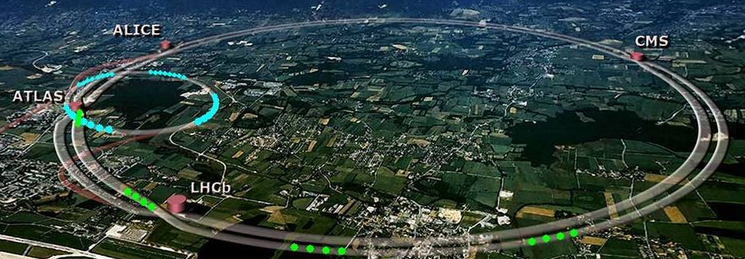
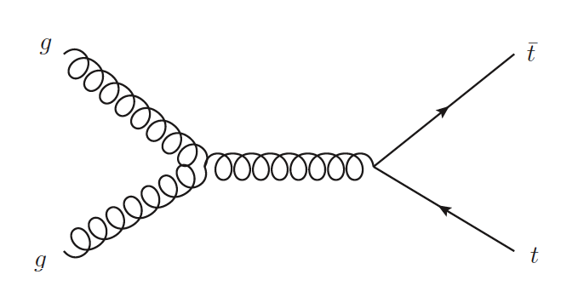
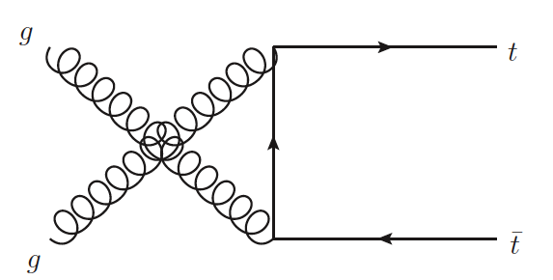
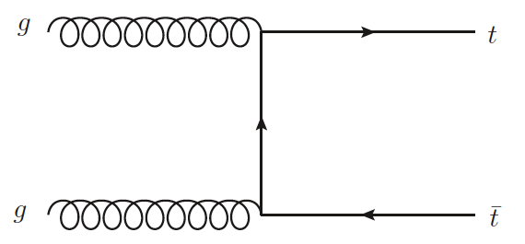
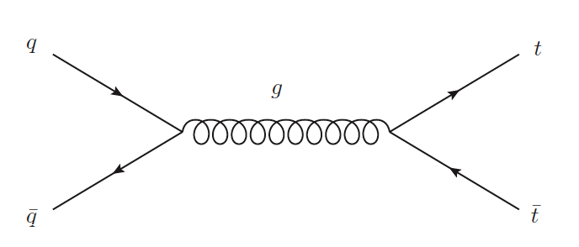
Top quark physics at LHC
Top pair production
Strong interaction
Single top production
Weak interaction
Gluon fusion ~ 85%
Wt
production
15.74^{1.17}_{-1.21} pb
t-channel
64.57^{+2.63}_{-1.74} pb
Quark scattering ~ 15%
σ_{top} (7 TeV)= 165⁺¹¹₋₁₆ pb (approximate NNLO QCD calculation)
s-channel
4.63^{+0.20}_{-0.18} pb
( approximate NNLO QCD calculation)

Slide 4
Top quark Physics with ATLAS & CMS
Top quark decay takes place almost exclusively:
t W+b
tt
Channel | All Hadronic (quark:~45%) (τ^{had}:~12.3) | Lepton+jets (l=e or μ → ~30%) (l= τ^{lep} →6.1%) | Dilepton (ee,μμ,eμ →~4.5%) (eτ^{lep},μτ^{lep},τ^{lep}τ^{lep} →~1.9%)
Products | 6 jets | l+E_{T}^{miss}+4jets l=(e,μ,τ^{lep}) | 2l+E_{T}^{miss}+2jet l=(e,μ,τ^{lep})
Background
Single top
Channel | t-channel | Wt production | s-channel
Products | l+E_{T}^{miss}+2jets | 2l+E_{t}^{miss}+1jets | l+E_{t}^{miss}+2jet
Background

Slide 5
Top quark charge
Spin correlation
Top mass
Top mass difference

Slide 6
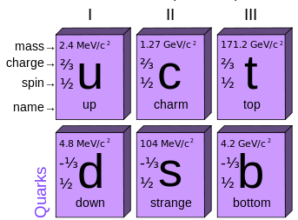
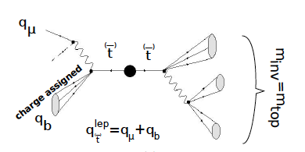
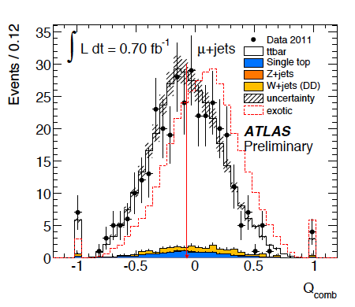
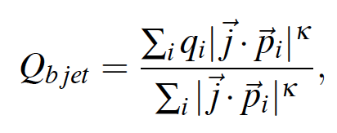
Top Quark Charge
(CMS-PAS-TOP-11-031)
(ATLAS-CONF-2011-141)
Top quark is the electroweak partner of the bottom quark:
Q_{t}= +2/3e Standard model prediction
Q_{t}= -4/3e Exotic scenario
l+jets channel
Top quark charge measurement is based
on the quark decay products:
b
W
ν
W: charge determined with lepton charge
b-jet: Charge is not directly measured:
Tracks charge weighting technique
Semi-leptonic b hadron decay
W
q
q
Tracks charge weighting technique
Weighted sum of the particles’ electric charge
in the b-jet:
Statistical method to exclude the exotic top quark
has been performed
ATLAS RESULTS
SM value
Exotic scenario is excluded with more than 5σ

Slide 7
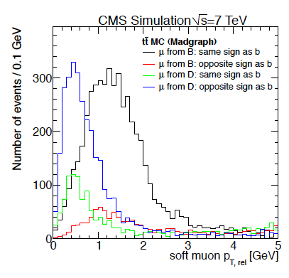
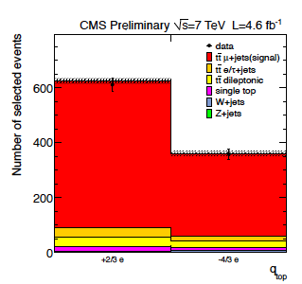
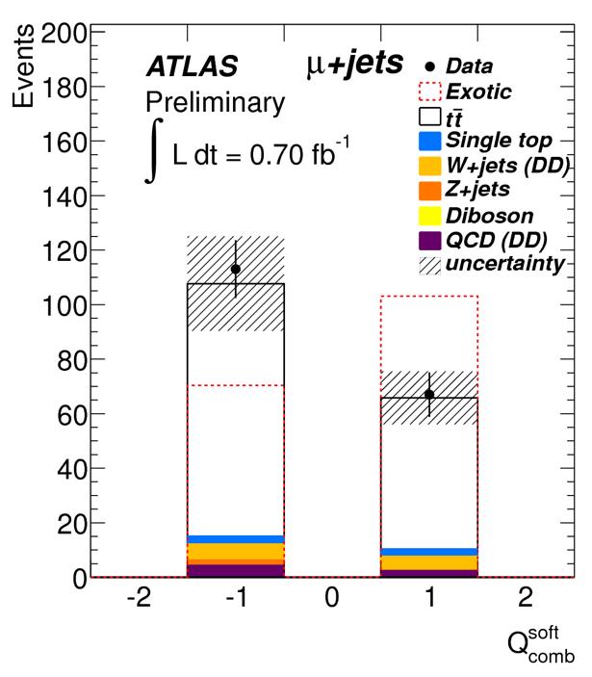
Top Quark Charge
(CMS-PAS-TOP-11-031)
(ATLAS-CONF-2011-141)
Semi-leptonic b hadron decay
Soft muon technique:
b quark and μ have the same sign (BR(b→μ+ν+X)≈11%)
Wrong association from D-hadrons
b and μ have opposite sign (BR(b→ c →μ+ν+X)≈10% )
p_{T} of the soft muon with respect to the jet axis is used to
reduce the background
Kinematic methods to get the correct topology
ATLAS:
CMS:

Slide 8
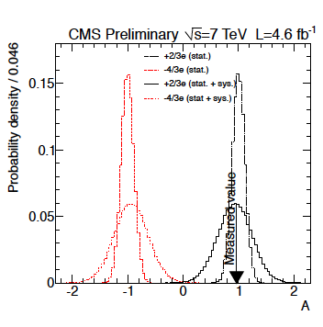
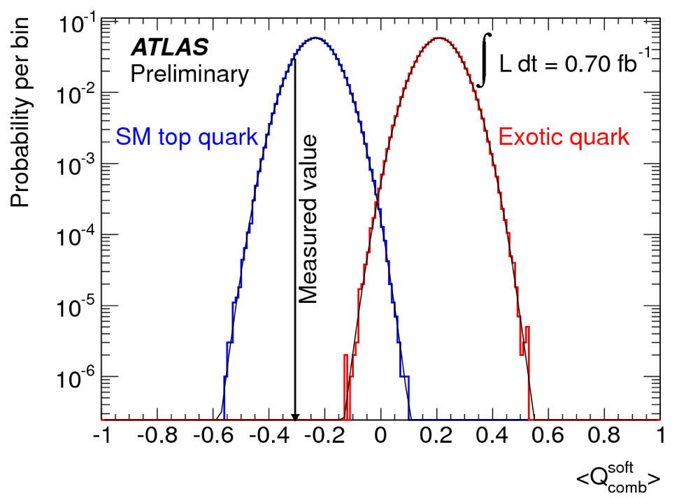
Top Quark Charge
(CMS-PAS-TOP-11-031)
(ATLAS-CONF-2011-141)
Charge distributions present a good agreement with the SM prediction
Statistical methods to exclude top quark with exotic charge have been performed
ATLAS:
Charge: <Q_{soft}> = <Q_{bjet}·Q_{lep}>
CMS:
Asymmetry:
Q: charge → Q_{bjetl} ; Q_{lepton}
D: Dilution (N_{correct}-N_{wrong}/N_{correct}+N_{wrong}) → N_{signal} ; N_{background}
N : Number of events → N_{SM} with SM charge; N_{XM} : with exotic charge
<Q_{soft}>_{μ+jets} = -0.31±0.07(stat) ±0.14(syst)
A_{meas}= 0.97±0.12(stat)±0.31(syst)
ATLAS RESULTS
Both experiments exclude exotic scenarios at > 5σ
CMS RESULTS

Slide 9
Top quark charge
Spin correlation
Top mass
Top mass difference

Slide 10
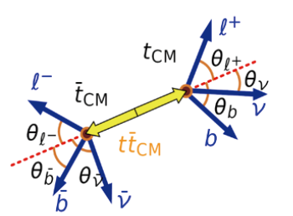
Spin Correlations
(ATLAS: arXiv:1203.4081)
Top quark has short lifetime (≈ 5·10⁻²⁵ s)
It decays before spin can flip by the strong interaction
Spin information is contained in the decay product
Spin correlation differs form the SM → BSM scenarios
The angular distribution of the top quark decay is fixed
Correlation coefficient: fractional difference in the number of events with top and anti-top quark where spins are aligned (N_{like}) and those where the top quark spins have opposite alignment (N_{unlike})
The helicity basis uses the direction of flight of the top quark in the centre of mass frame:
α_{i}: spin analysing power
θ_{i}: angle between the direction of the decay particle I in the top quark rest frame and the spin quantization direction
Dilepton topology used

Slide 11
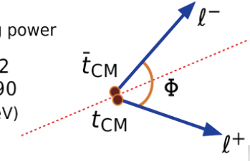
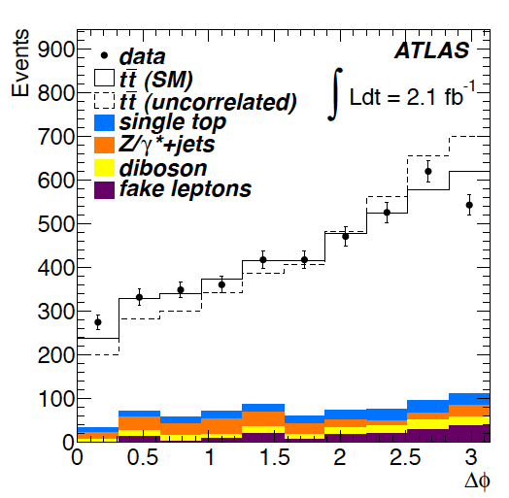
Spin Correlations
(ATLAS: arXiv:1203.4081v1)
Δϕ distribution between the two lepton in the lab frame is
sensitive to the spin correlation
Two hypothesis have been tested:
Correlated spins (SM)
Uncorrelated spins
A is obtained by fitting the observed Δϕ
distribution to a linear superposition of correlated
uncorrelated hypothesis
ASM_{helicity}= 0.32
Evidence of spin correlation in agreement with SM
Hypothesis of zero spin correlations is excluded at
5.1 standard deviations
ATLAS RESULTS
A_{helicity}=0.40±0.04(stat)^{+0.08}_{0.07}(syst)

Slide 12
Top quark charge
Spin correlation
Top mass
Top mass difference

Slide 13
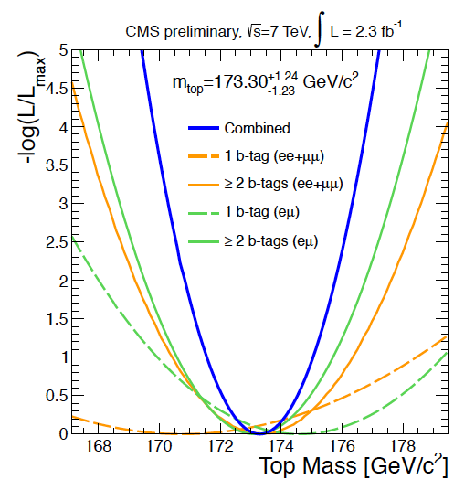
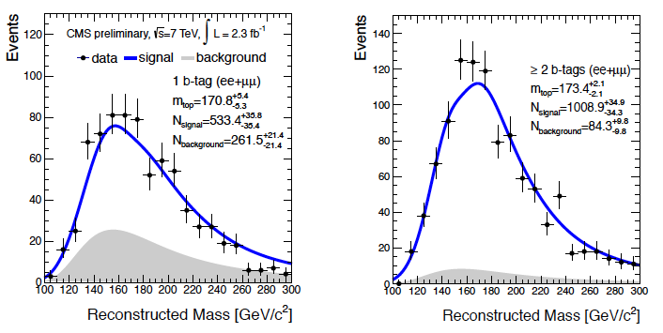
Top Quark Mass: dilepton (CMS-PAS-TOP-11-016)
KINb method (kinematic equation describing tt system):
Solved many times per event, for all lepton+jets combination
jet p_{T}, E_{T}^{miss} and p_{z}^{tt} are varied independently according to their resolutions
Solutions with lower mass of tt and m_{top}-m_{anti-top} are chosen
Most probable combination is chosen
Unbined likelihood fit of the m_{KINb} using templates at different masses
Measurement dominated by Jet Energy Scale (JES) and flavor-JES
b-tagging information reduce background considerably
CMS RESULTS
m_{top}= (173.3 ± 1.2_{stat} ± 2.5_{syst})GeV
Most precise up-to-date in the dilepton channel !!

Slide 14
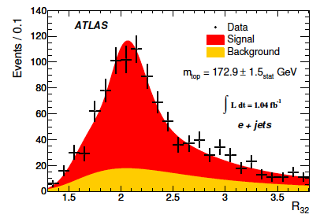
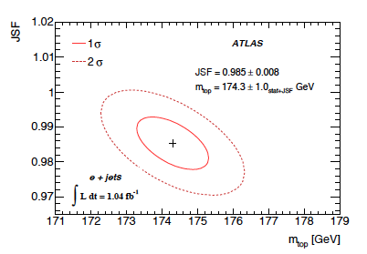
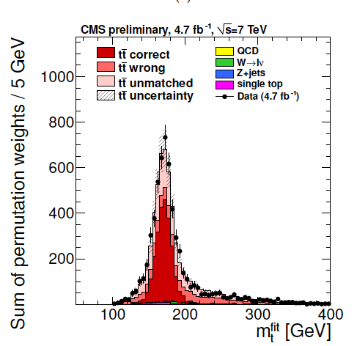
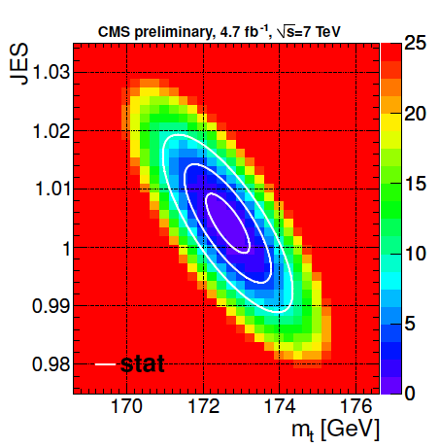
Top Quark Mass: lepton+jets
(CMS-PAS-TOP-11-015)
( ATLAS: arXiv.1203.5755)
ATLAS: Templates methods have been used to determine m_{top} in μ/e+jets
1D template:
2D template:
Based on the variable R₃₂ =m_{top}/m_{W}
Determine m_{top} and a global jet energy scale factor (JSF) simultaneously
ATLAS RESULTS
m_{top}^{l+jets} = (174.5 ± 0.6_{stat}
± 2.3_{syst})GeV
Measurement is dominated by
JES, and ISR-FSR systematic errors
CMS: Kinematic fit + Ideogram is used to determine m_{top} in μ+jets
Kinematic fit exploits the compatibility with tt hypothesis
CMS RESULTS
m_{top}^{μ+jets} = (172.64 ± 0.57_{stat+JES} ± 1.18_{syst})GeV
Some systematics are still
being evaluated by CMS

Slide 15
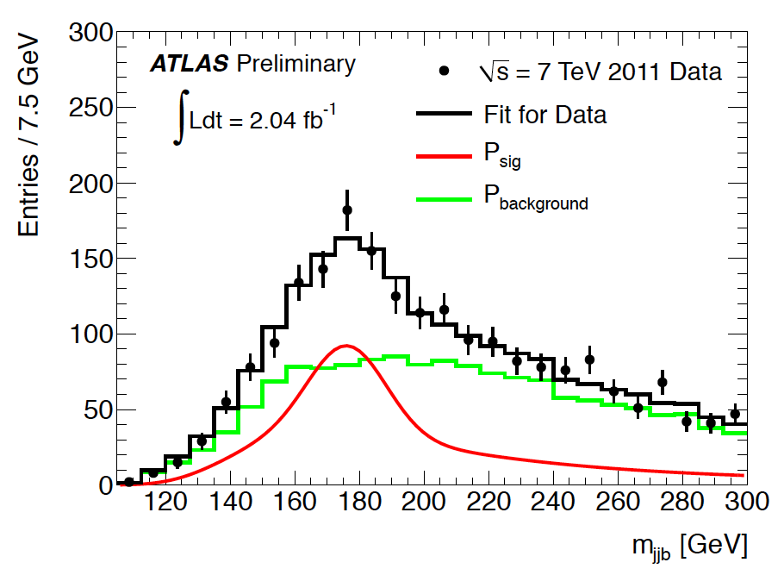
Top Quark Mass: Full Hadronic (ATLAS-CONF-2011-030)
m_{top} extracted with a template method (m_{top}^{gen} from 160 to 190 GeV )
Jet assignment done with a Kinematic fit
More than 6 jets involved in the analysis (2 b-tagged jets)
Lower χ² is kept ( χ²<8 )
Main background: Multi-jet sample
Template parametrization for the background directly from data
Dominating uncertainties are JES, Radiation
and modelling of the background
ATLAS RESULTS
m_{top}= (174.9 ± 2.1_{stat} ± 3.8_{syst})GeV

Slide 16
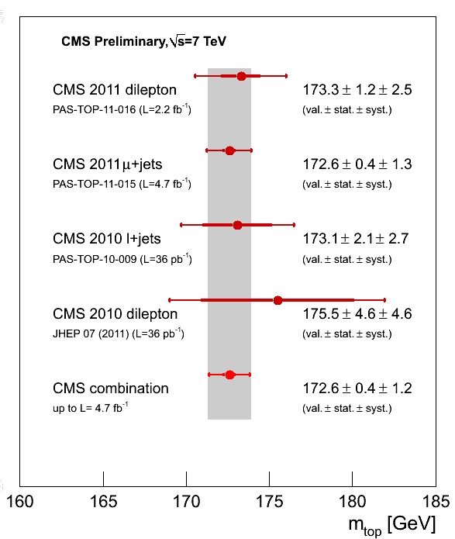
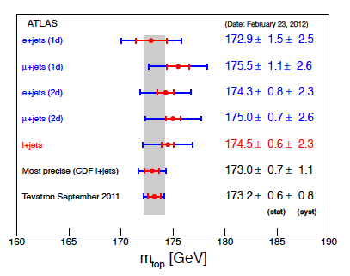
Top Quark Mass: Combination
m_{top} LHC combination is ongoing …
The ATLAS hadronic top mass measurement has not been included in the plot yet

Slide 17
Top quark charge
Spin correlation
Top mass
Top mass difference

Slide 18
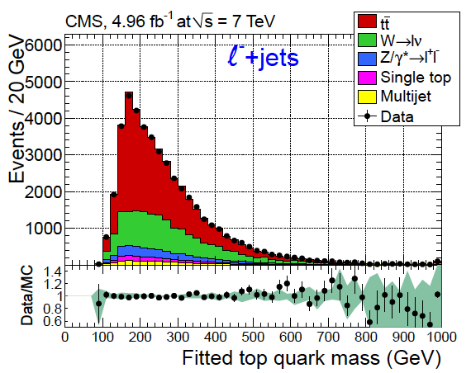
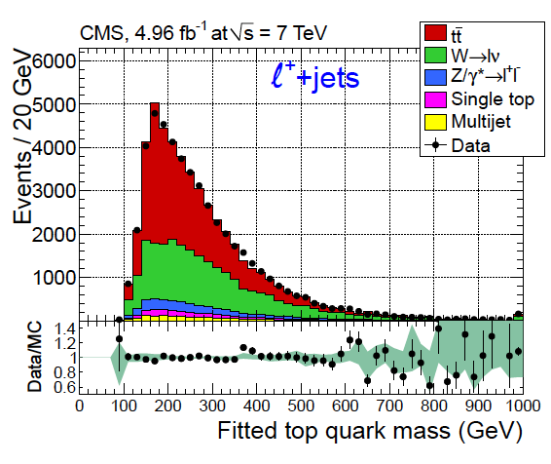
Top Quark Mass difference (CMS-TOP-11-19)
SM of particle physics is a local gauge invariant quantum field theory → symmetries
Conservation of C(Charge conjugation)P(Parity)T(Time reversal)
m_{top} = m_{anti-top}?
Sample divided in l⁺+jets and l⁻+jets
Top mass is reconstructed using hadronic side information (Wb → qqb)
Kinematic fit to perform jet association:
Lowest Χ²
Final measurement from ideogram method:
Likelihood for l⁺ l⁻ separately
Many of the main systematic uncertainties for m_{top} are cancelled in this analysis
CMS RESULTS
Δm_{top}= (-0.44 ± 0.46_{stat} ± 0.27_{syst})GeV

Slide 19
Conclusions
LHC is working really well
Excellent detector operation for ATLAS and CMS allows to record an impressive amount of data
Many top properties analyses have been studied at LHC
Top quark charge agrees with the SM prediction.
Exotics scenarios are excluded with 5σ
Spin correlation measurement in agreement with the SM. Uncorrelated spin hypothesis excluded at 5.1σ
Many measurements of the top mass have been done using all channel topologies. The ATLAS+CMS result combination is ongoing
Top quark mass difference is consistent with the equality of particle and antiparticle masses
m_{top}^{ATLAS} (l+jets)= (174.5± 0.6_{stat} ± 2.3_{syst})GeV
m_{top}^{CMS} (all channel)= (172.6± 0.4_{stat} ± 1.2_{syst})GeV
Δm_{top} =(-0.44± 0.46_{stat} ± 0.27_{syst})GeV

Slide 20
Thank you very much

Slide 21
Top quark Physics with ATLAS & CMS
Top quark decays take place almost exclusively:
t W+b
tt
Channel | All Hadronic (quark:45%) (τ^{had}:12.3) | Single lepton (l=e or μ → ~30%) (l= τ^{lep} →6%) | Dilepton (ee,μμ,eμ →~4.5%) (eτ^{lep},μτ^{lep},τ^{lep}τ^{lep} →~1.9%)
Products | 6 jets | l+E_{T}^{miss}+4jets l=(e,μ) | 2l+E_{T}^{miss}+2jet l=(e,μ,τ)
Background
Single Lepton
( 36% )
Full hadronic
( 45% )
Single top
Channel | t-channel | Wt production | s-channel
Products | l+E_{T}^{miss}+2jets | 2l+E_{t}^{miss}+1jets | l+E_{t}^{miss}+2jet
Background
τ ^{had} +jets
τ ^{had} +l
τ ^{had}
τ ^{had} +jets
Dilepton
e, μ, τ^{lep}
( 6.4% )
Single Lepton
( 36% )
τ ^{had} +l

Slide 22
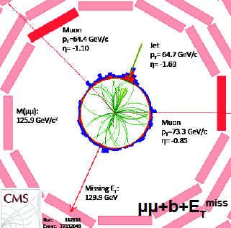
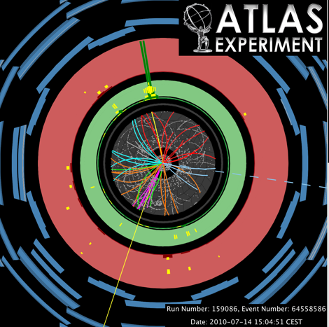
Detector Performance for Top Physics
General top quark selection at LHC
Trigger | Double isolated leptons (dileptonic channel) Single isolated lepton (semileptonic channel) Required at least 5 jets (full hadronic)
Electron | Isolation requirements Energy deposits in the electro magnetic calorimeter is associated with charge particle in the silicon tracker p_{T}~20GeV and |η|<2.5 (analysis dependent)
Muon | Isolation requirement Tracks segments in muon chamber matched with the tracker information Reconstruction quality based on X² p_{T}~20GeV and |η|<2.5 (analysis dependent)
Jets | Anti-kt algorithm (Cone radius of 0.4 or 0.5) p_{T}>20 GeV and |η|<5 (analysis dependent) b tagging optional
E_{T}^{miss} | Range from 20 to 60 GeV
Top quark physics needs:
Efficient lepton reconstruction
Good jet reconstruction
b-jet tagging capability
B-jet
E_{T}^{miss}
Muon
Top physics Full detector working!!!

Slide 23
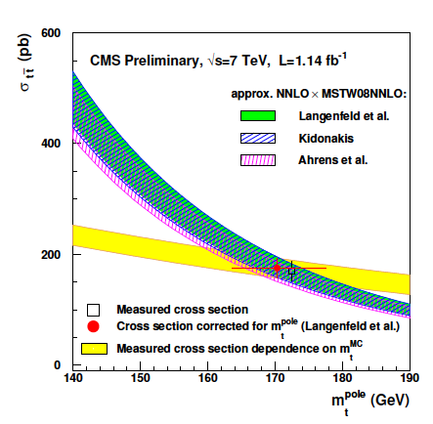
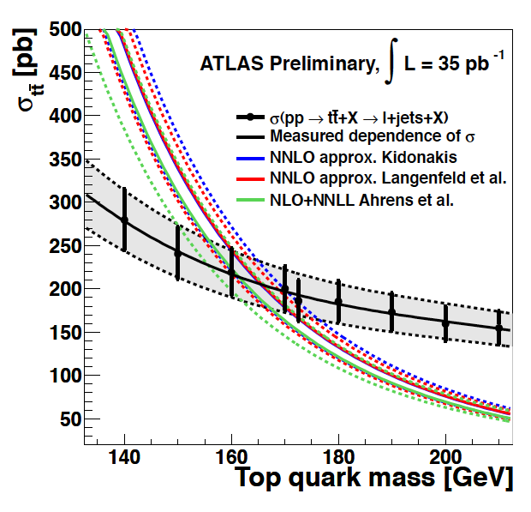
Top Quark Mass from Cross Section
(CMS-PAS-TOP-11-008)
(ATLAS-CONF-2011-054)
Top mass value depends on the renormalization scheme
Extraction of the m^{top}_{pole} from the measurement of σ_{tt}
Different theoretical approaches to calculate σ_{tt} with higher NLO corrections are used
m^{top}_{pole} (well defined top mass independent of MC)
CMS RESULTS
ATLAS RESULTS
m_{top}^{pole}= 170.3 ^{+7.3}_{6.7} GeV NNLO-Langenfeld
m_{top}^{pole}= 170.0 ^{+7.6}_{-7.1} GeV NNLO-Kidonakis
m_{top}^{pole}= 167.6 ^{+7.6}_{-7.1} GeV NNLL-Ahrens
m_{top}^{pole}= 166.4 ^{+7.8}_{-7.3} GeV NNLO-Langenfeld
m_{top}^{pole}= 166.2 ^{+7.8}_{-7.4} GeV NNLO-Kidonakis
m_{top}^{pole}= 162.2 ⁺⁸₋₇ GeV NNLL-Ahrens

Slide 24
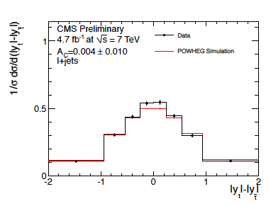
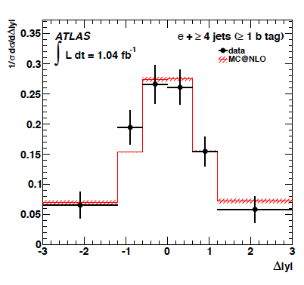
Top Quark Charge Asymmetry
(CMS-PAS-TOP-11-030
(ATLAS: arXiv:1203.4211v1)
SM expects ttbar production to be symmetric
under charge conjugation at LO and small
asymmetry due to the ISR and FSR at NLO:
gg ttbar: symmetric
qq ttbar: top quarks emitted in the direction
of the incoming quark, anti-top quarks in
the direction of the incoming anti-quark
Tevatron (proton-antiproton): forward-backward asymmetry
qq ttbar (90%)
LHC (proton-proton): top goes into forward regions whereas anti-top keeps more in the central region qq ttbar (15%)
Several processes BSM can alter this asymmetry
A_{C}^{theory}= 0.0115±0.0006
CMS RESULTS
ATLAS RESULTS
A_{C}= -0.004±0.010(stat)±0.012(syst)
A_{C}= -0.018±0.028(stat)±0.023(syst)

Slide 25
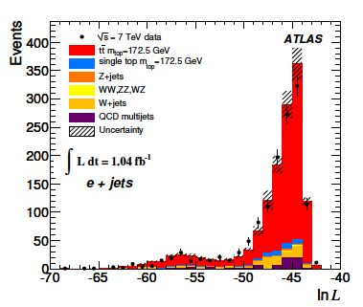
Top Quark Mass: lepton+jets
(CMS-PAS-TOP-11-015)
( arXiv.1203.5755.v1)
ATLAS: Templates methods have been used to determine m_{top} in μ/e+jets
1D template:
Based on the variable R₃₂ =m_{top}/m_{W}
Event likelihood to select the jet triplet assigned to the hadronic decay
2D template: (plots on the next slide)
Determine m_{top} and a global jet energy scale factor (JSF) simultaneously
X² that constrains the reconstructed m_{W} to the world average measurement
ATLAS RESULTS
Measurement is dominated by JES,
bJES and ISR-FSR systematic errors
M_{top}^{e+jets} = (172.9 ± 1.5_{stat} ± 2.5_{syst}) GeV

Slide 26
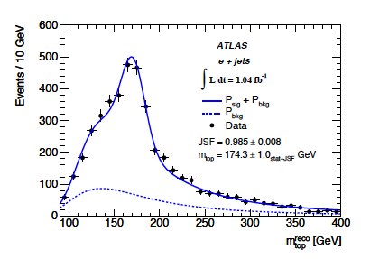
Top Quark Mass: lepton+jets
(CMS-PAS-TOP-11-015)
( arXiv.1203.5755.v1)
ATLAS RESULTS
M_{top}^{e+jets} = (174.3 ± 0.8_{stat}
± 2.3_{syst}) GeV
Measurement is dominated by
JES, and ISR-FSR systematic errors
CMS: Kinematic fit + Ideogram is used to determine m_{top} in μ+jets
Kinematic fit exploits the compatibility with ttbar hypothesis → Probability fit < 0.2
ATLAS RESULTS
M_{top}^{μ+jets} = (172.64 ± 0.57_{stat+JES} ± 1.18_{syst}) GeV
Some systematics are still
being evaluated by CMS

