Slide 1
The LHC: Past, Present and Future
Dan Tovey
University of Sheffield

Slide 2
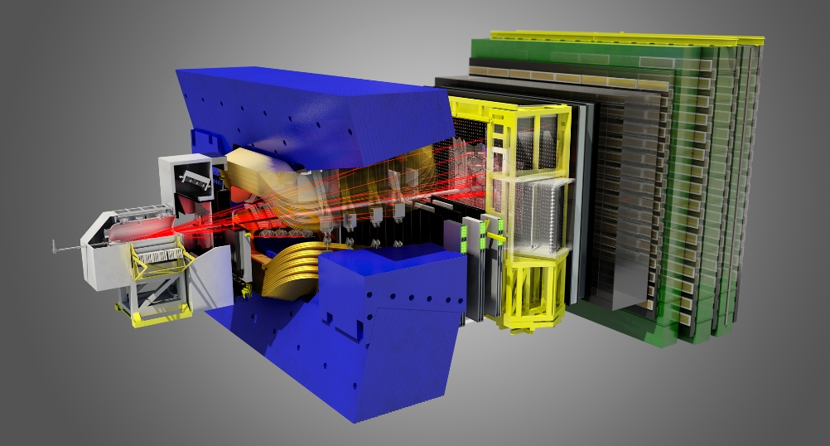
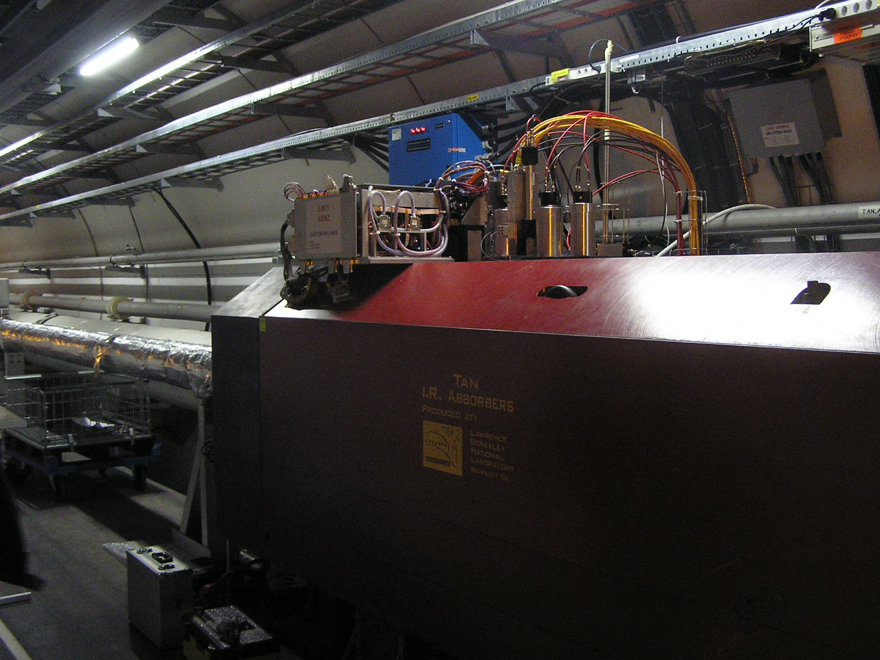
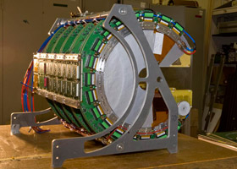
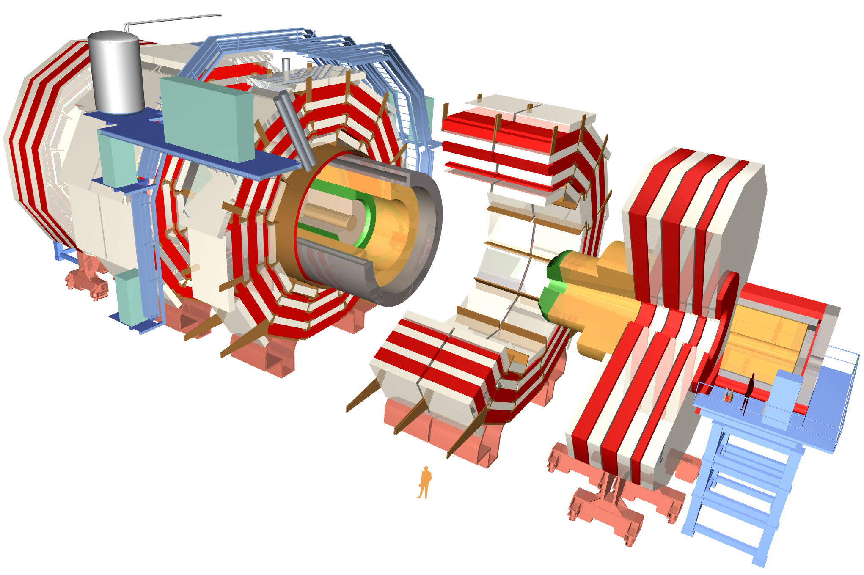
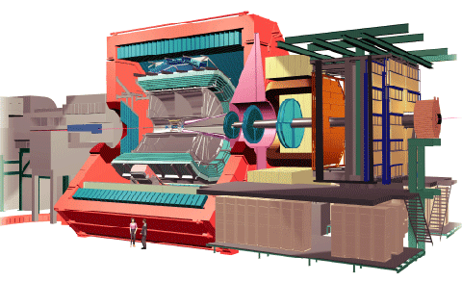

Slide 3
Les Chateaux de l’AOC LHC

Slide 4
Outline
Overview of Run-1 Performance
Recent physics highlights
LS1 Status
Physics prospects for Run-2 and beyond
High-luminosity LHC and experiment upgrades
B-
physics
Heavy
Ions
SM
BSM
Higgs

Slide 5
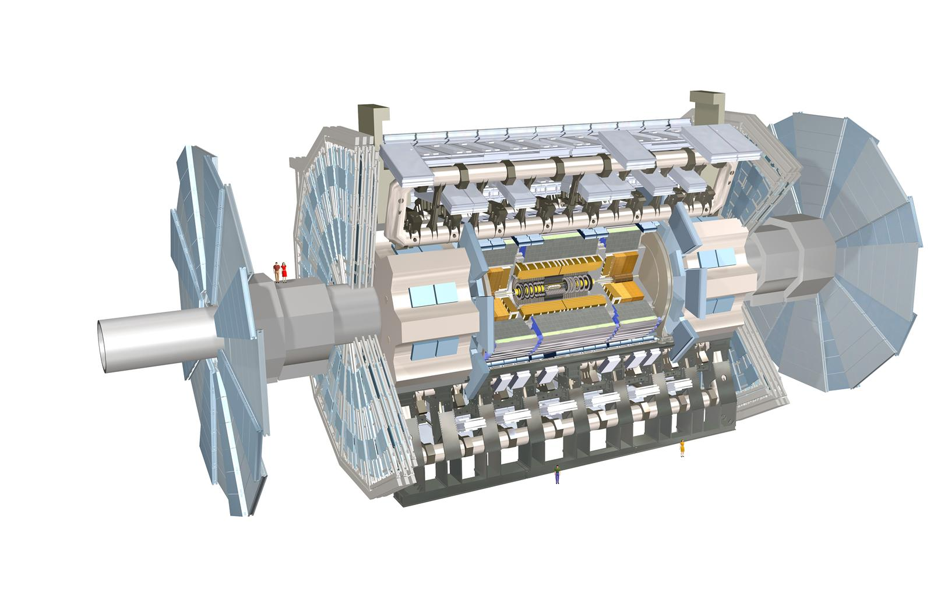
Experiments
Plus dedicated experiments: LHCf and Totem (forward physics) and Moedal (monopoles)
NB: Brief selection of results from experiments shown. Similar results from other experiments also available in most cases.

Slide 6
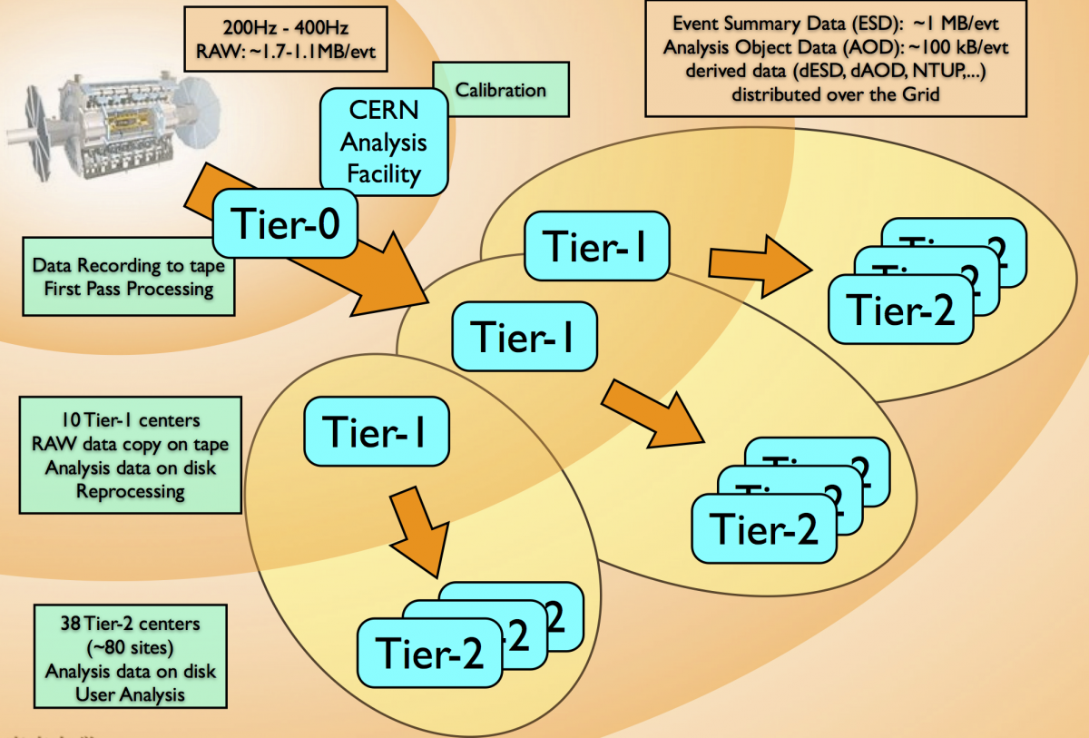
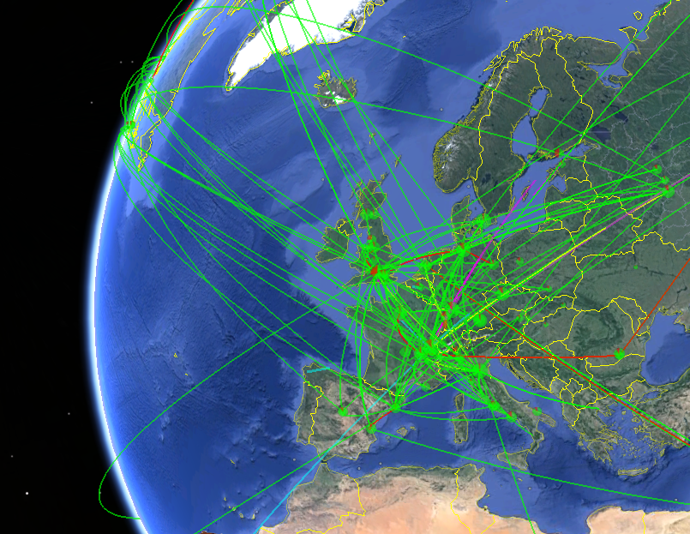
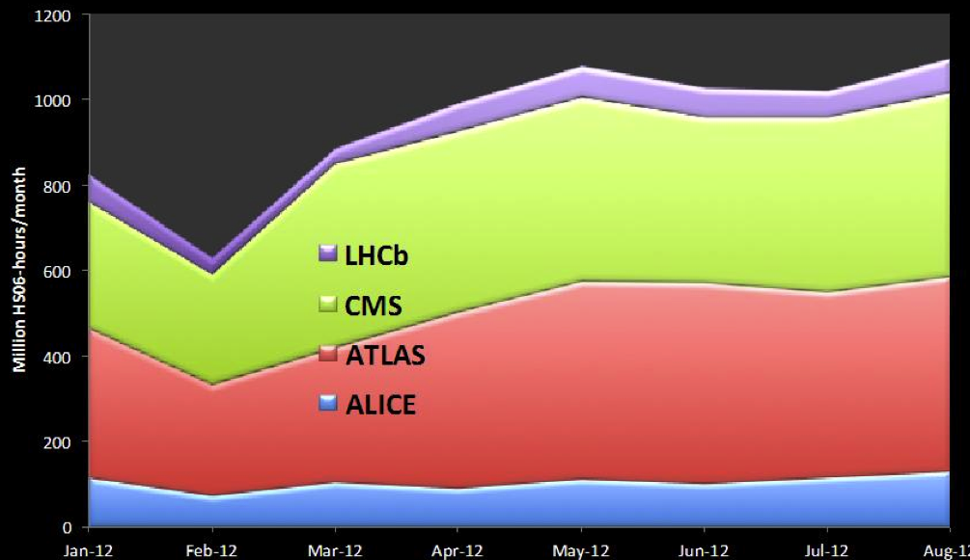
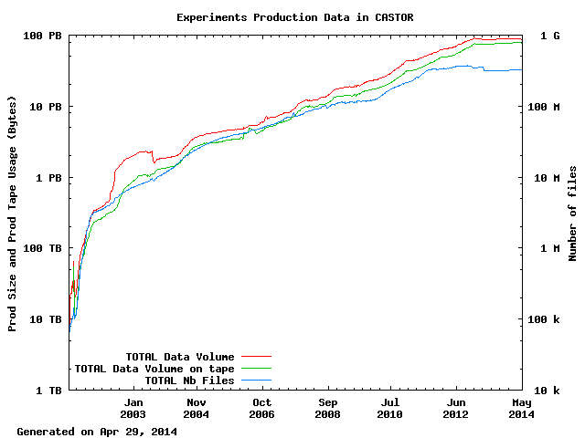
Data Processing
Equivalent to 200k top-end processors
Tier-0 storage
~ 1PB/week stored when LHC running
CPU Workload

Slide 7
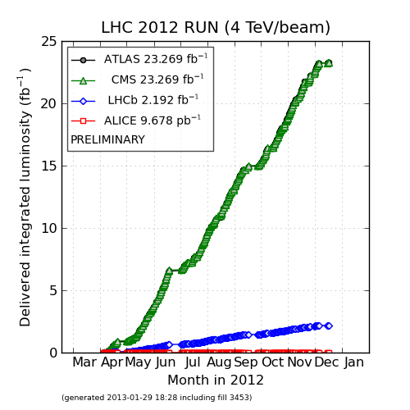
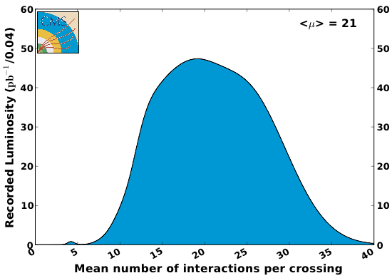
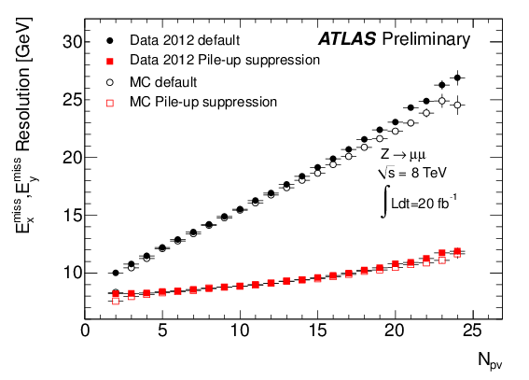
Big Data, Big Challenges
2012
50 ns bunch spacing
MET resolution
7

Slide 8
Standard Model Measurements
Plenary talks by A. Glazov, S. Tkaczyk, M. Ubiali

Slide 9
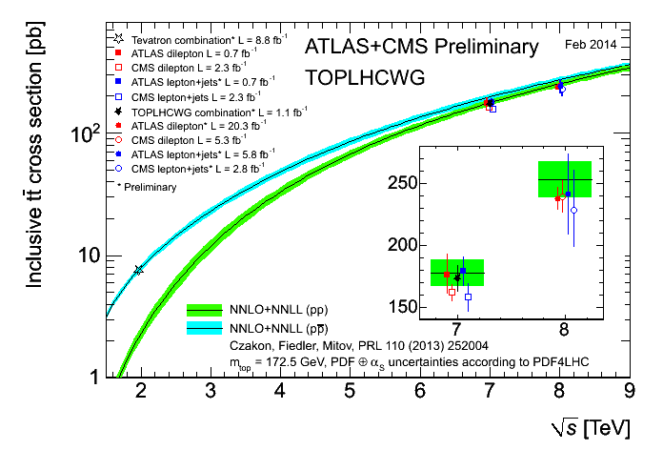
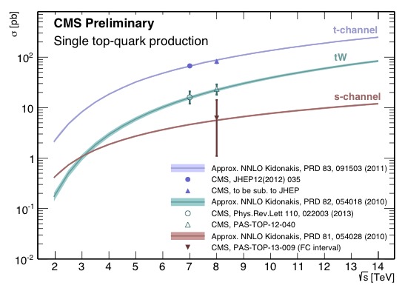
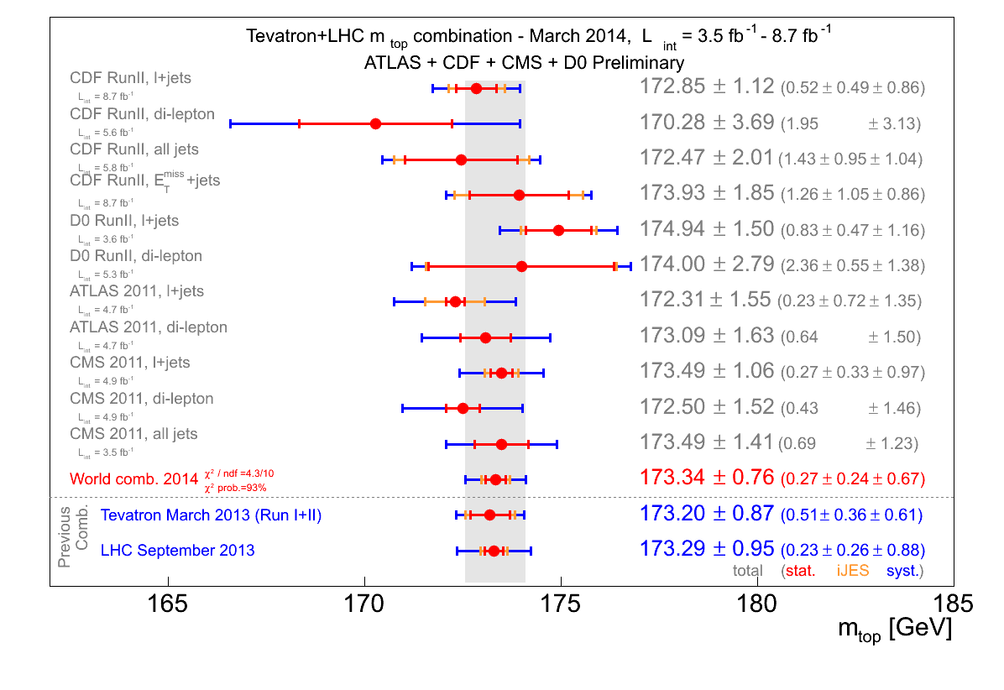
The View From The Top
Plenary talk by J. D’Hondt
Single-top cross-section
Top-pair cross-section
Top mass
NB: also new CMS
combination (2014):
172.2 ± 0.1 ± 0.7 GeV

Slide 10
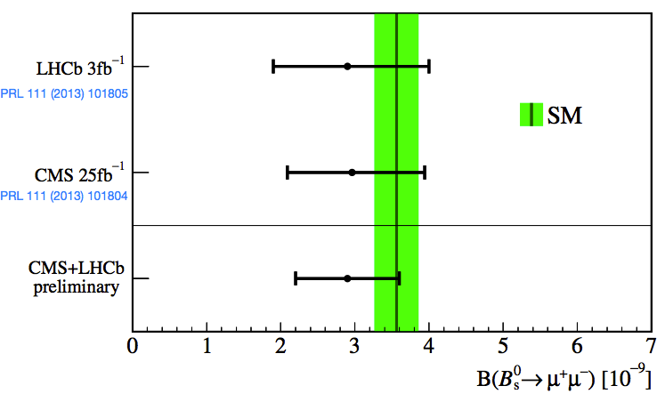
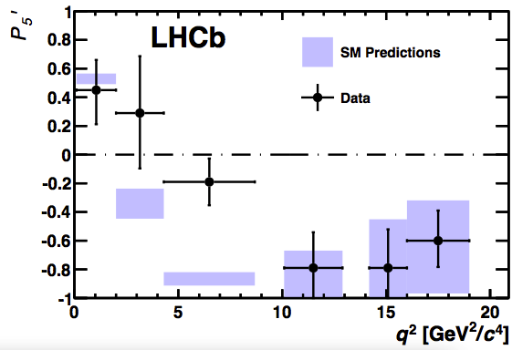
Heavy Flavour: Rare Decays
Plenary talk by P. Koppenburg
First observation of B⁰_{s}→μ⁺μ⁻ from LHCb+CMS combination.
Consistent with SM expectation
Strong constraints on BSM physics, e.g. SUSY with large tanβ and small m_{A}
b→sμ⁺μ⁻ rare processes sensitive to BSM couplings
LHCb study e.g. B⁰→K*⁰μ⁺μ⁻: measure angular variables as well as differential cross-section
Range of measurements mostly in excellent agreement with SM
Some tension in amplitude observable P5’ at low q² in 7 TeV data
Analysis of 8 TeV data underway
3.7σ local excess
arXiv:1308.1707

Slide 11
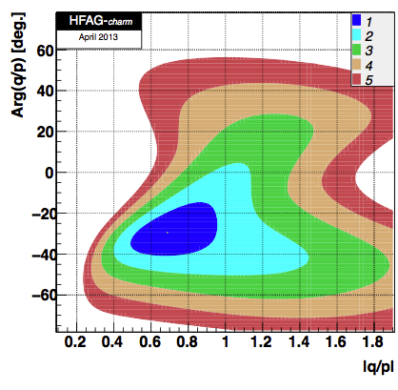
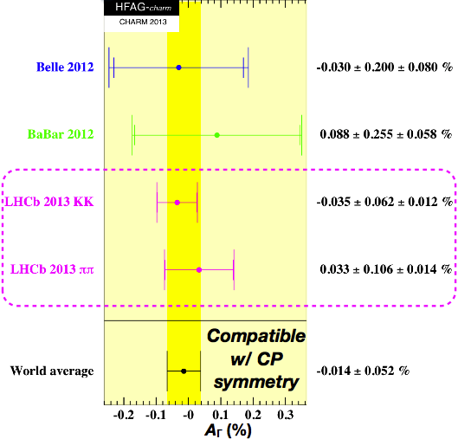
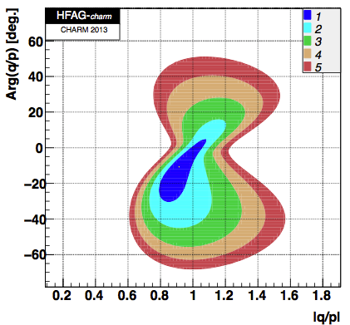
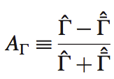
CP Violation in Neutral D-Mesons
Parallel talk by E. Gersabeck
Highly suppressed in SM
Unique tool for seeking BSM physics coupling to up-quark sector
Measurements of lifetime asymmetries A_{Γ} from LHCb with D⁰→K⁺K⁻ or D⁰→π⁺π⁻
With addition of LHCb 2013 measurements
LHCb-PAPER-054
|q/p|, Arg(q/p): indirect CP-violating amplitude and phase

Slide 12
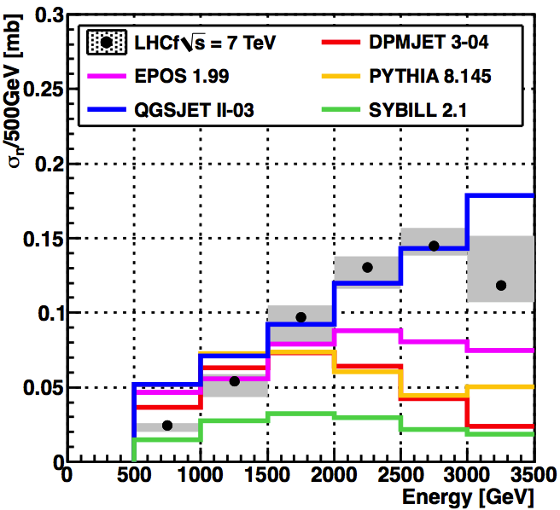
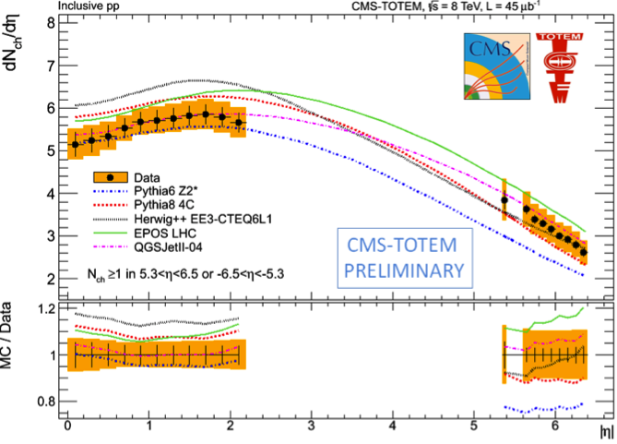
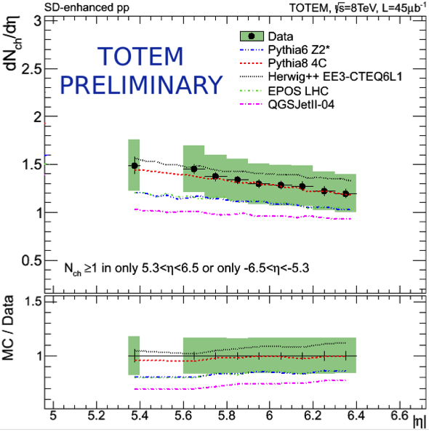
Forward Physics
LHCf: particle production in far forward region (8<y<15)
Input to cosmic ray shower models
Recent results on e.g. n production for y>10.76 in 7 TeV pp collisions reproduced by QGSJET2
TOTEM: elastic, inelastic and total cross-section measurements
8<y<15
Inclusive (CMS+TOTEM)
Single diffractive (TOTEM)

Slide 13
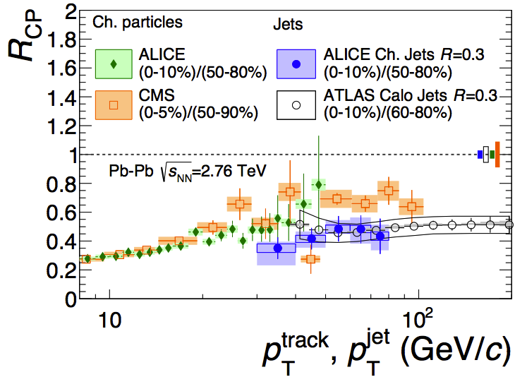
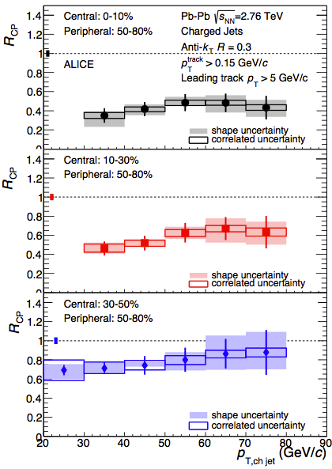
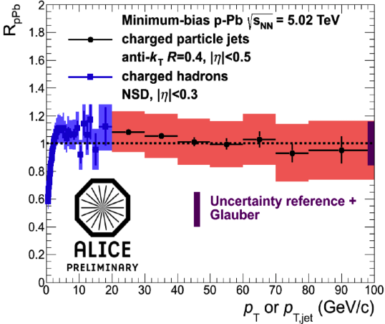
Heavy Ions
Centrality-dependent suppression of jets observed in 2.76 TeV Pb-Pb collisions (e.g. ALICE) ➔ evidence for jet quenching in QGP
R_{CP} ratio of differential cross-sections for central (head-on) and peripheral (glancing) collisions
arXiv:1311.0633
arXiv:1311.0633
Centrality dependent suppression not observed in 5 TeV p-Pb collisions

Slide 14
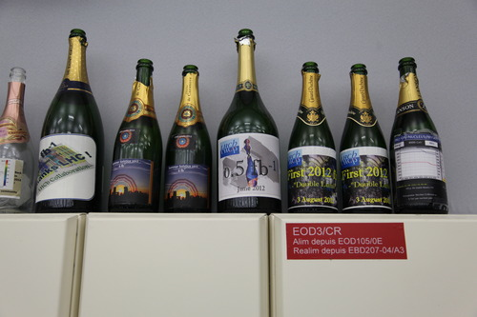
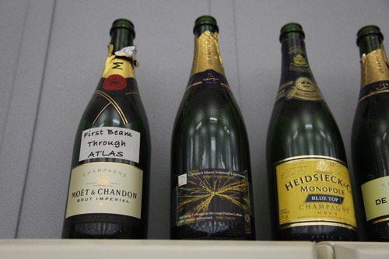
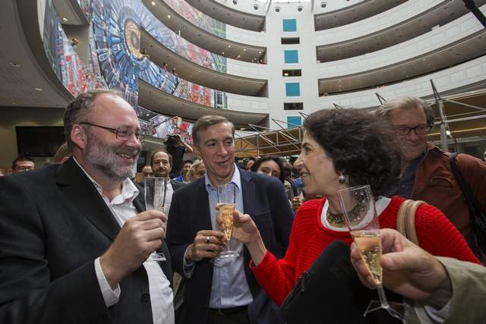
2012: A Vintage Year

Slide 15
2012: A Vintage Year

Slide 16
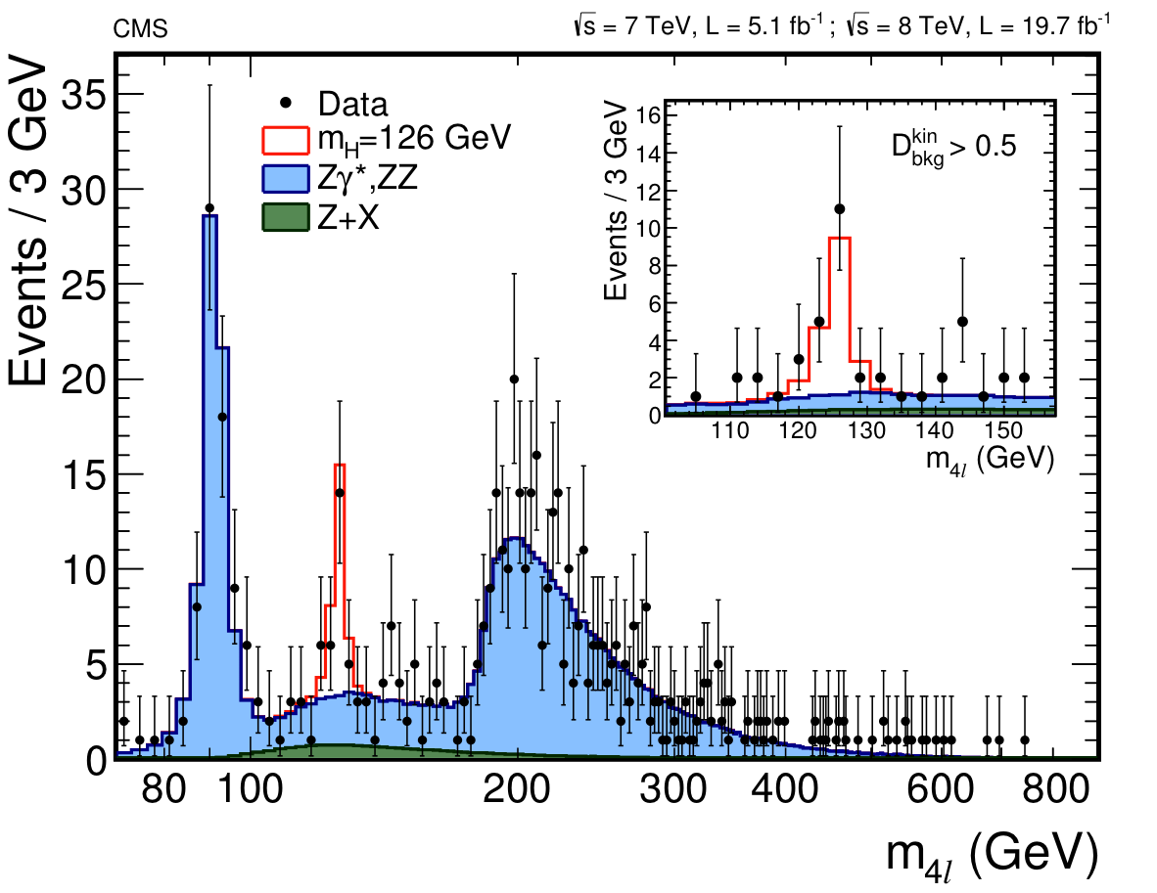
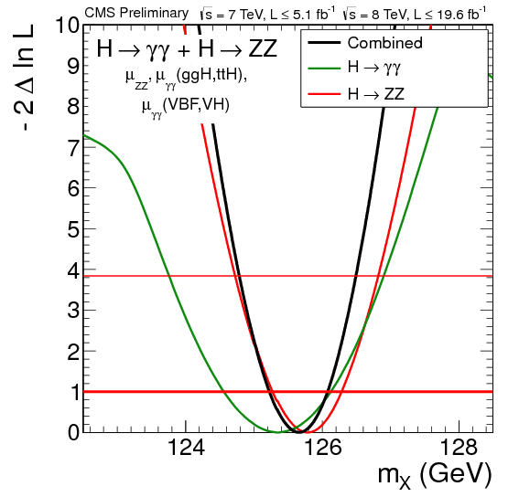
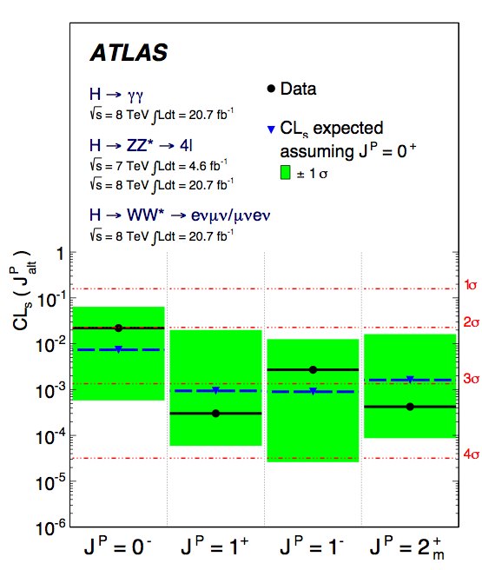
Higgs Mass and Spin-CP
Plenary talk by L. Fayard
Significance in 4-lepton channel now ~7σ per experiment
Higgs mass already measured more precisely than top quark
ATLAS: m(H) = 125.5 ± 0.2 ^{+0.5}_{– 0.6} GeV
CMS: m(H) = 125.5 ± 0.3 ± 0.3 GeV
J^{PC} = 0⁺⁺ strongly favoured over alternative hypotheses
arXiv:1312.5353
arXiv:1307.1432
CMS-PAS-HIG-13-005

Slide 17
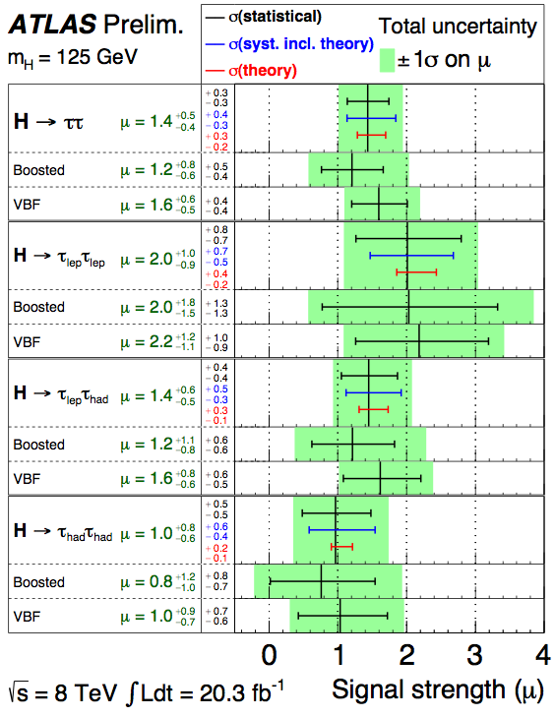
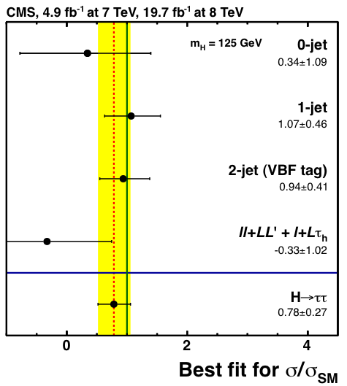
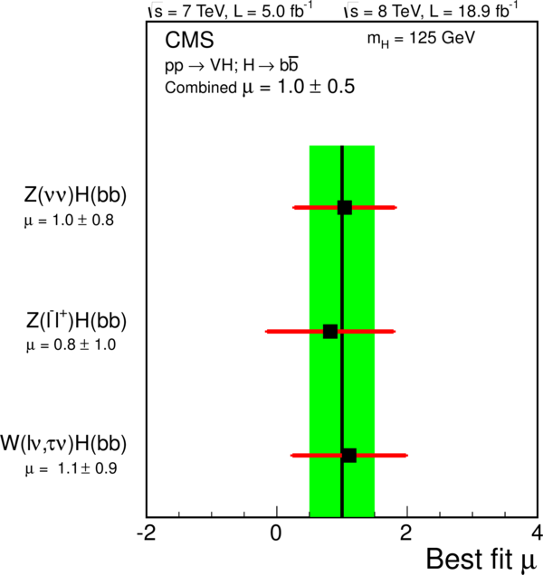
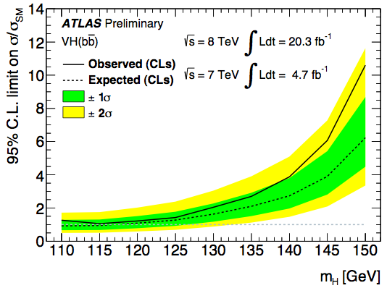
Higgs Decays to Fermions
Plenary talk by J. Olsen
Evidence for H→τ⁺τ⁻ at 4.1σ (ATLAS) / 3.3σ (CMS)
μ=1.4±0.5 (ATLAS) / 0.8±0.3 (CMS)
H→bb: CMS sees 2.1σ excess; ATLAS sets limit μ < 1.4μ_{SM}
μ=1.0±0.5 (CMS)
arXiv:1401.5041
ATLAS-CONF-2013-108
ATLAS-CONF-2013-079
arXiv:1310.3687

Slide 18
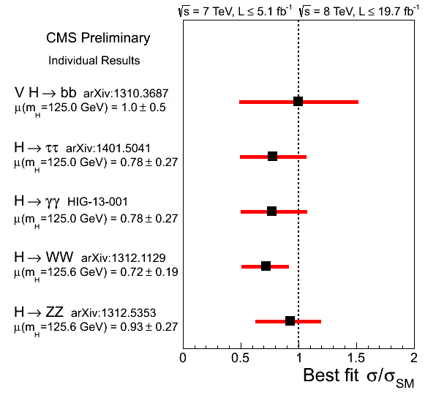
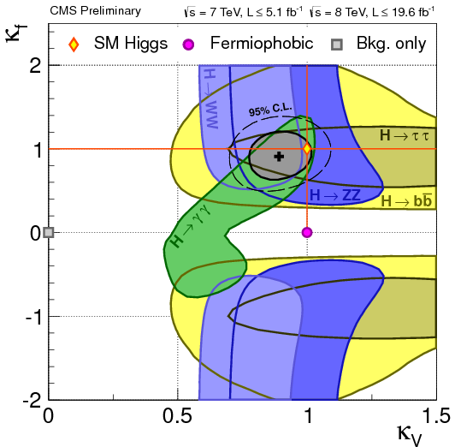
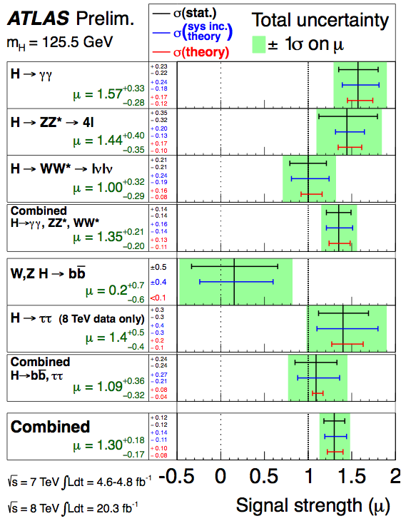
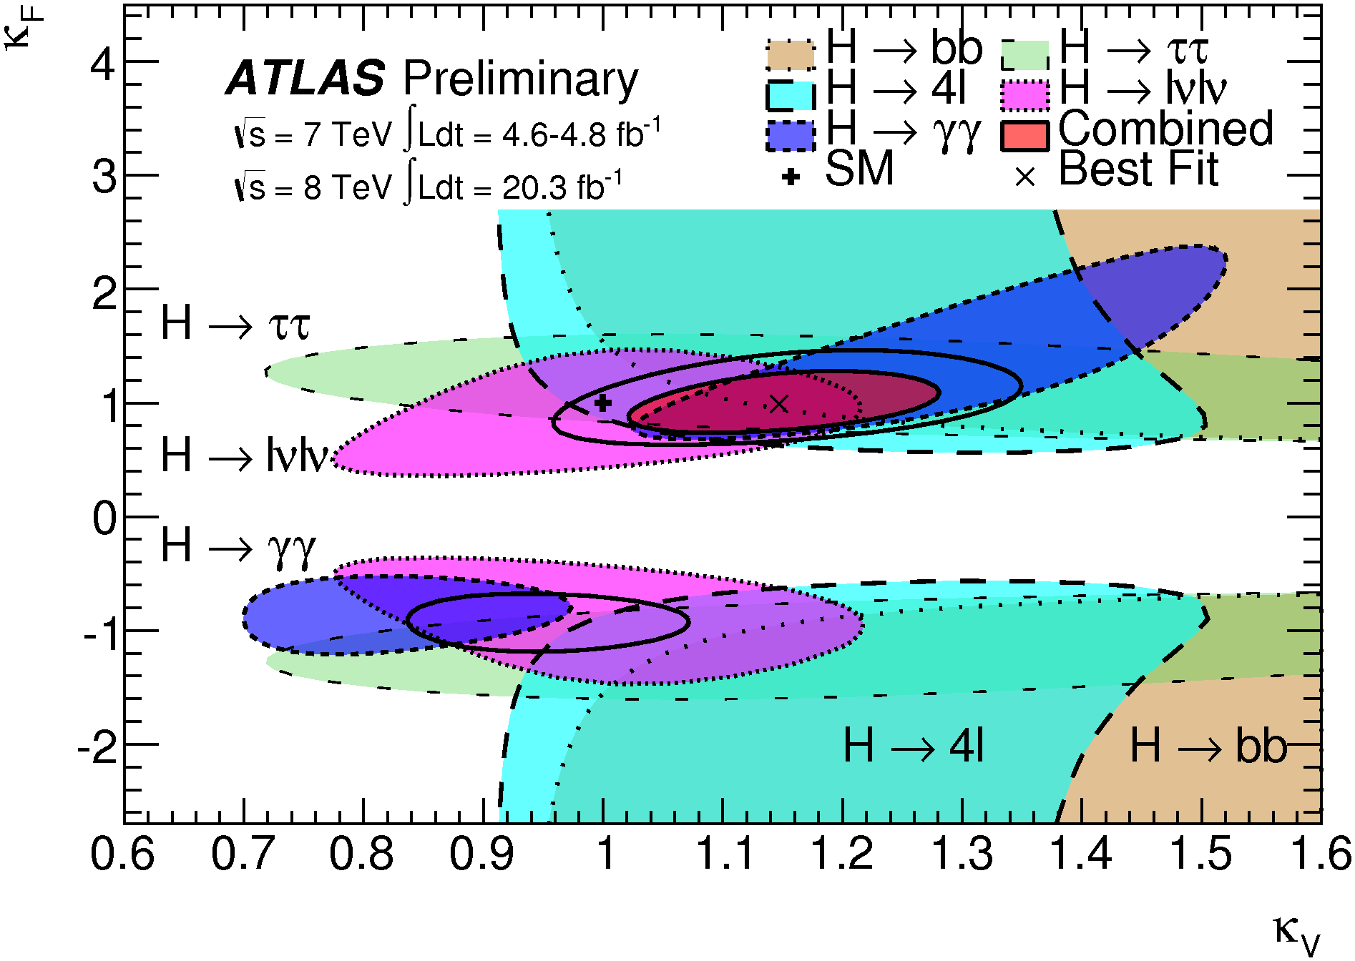
Higgs Couplings
Plenary talk by K. Cranmer
Excellent agreement with SM
ATLAS combined fit with direct search sets limit BR<0.37 (95% CL) on invisible branching ratio of Higgs
ATLAS-CONF-2014-009
κ_{F} < 0 excluded at ~2σ
μ=1.30±0.18

Slide 19
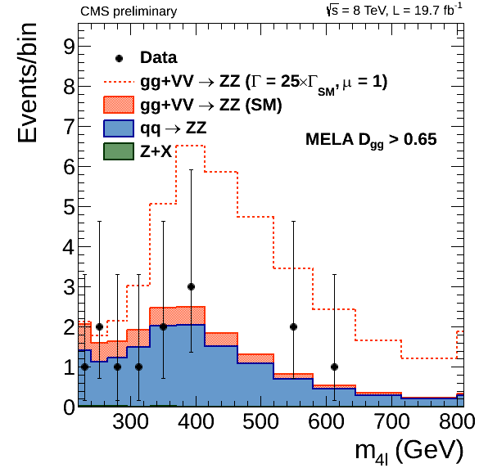
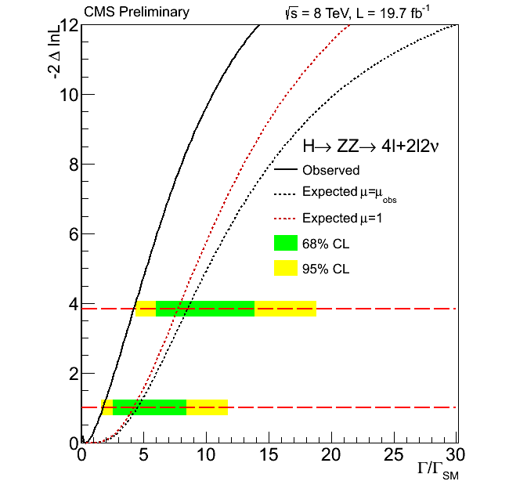
Higgs Width at LHC
CMS-PAS-HIG-14-002
New idea from Caolo and Melnikov (PRD 88 (2013) 054024)*
(Off-shell) Higgs cross-section enhanced above ZZ and tt thresholds
Depends strongly on width (4.15 MeV in SM)
CMS use H→ZZ→4l and H→ZZ→2l2ν analysis observables to constrain
Set limit: Γ_{H} < 4.2 x Γ_{H}SM (95% CL)
* See also: G. Passarino, JHEP 08 (2012) 146;
N. Kauer, G. Passarino, JHEP 08 (2012) 116;
J. Campbell et al. arXiv:1311.3589

Slide 20
Supersymmetry
Plenary talk by P. Pralavorio
Limits on light squarks and gluinos approaching or exceeding 1 TeV
Increasing emphasis on EW gauginos and heavy sflavour
T. Plehn, Prospino2
1 pb
Weak production
Strong production

Slide 21
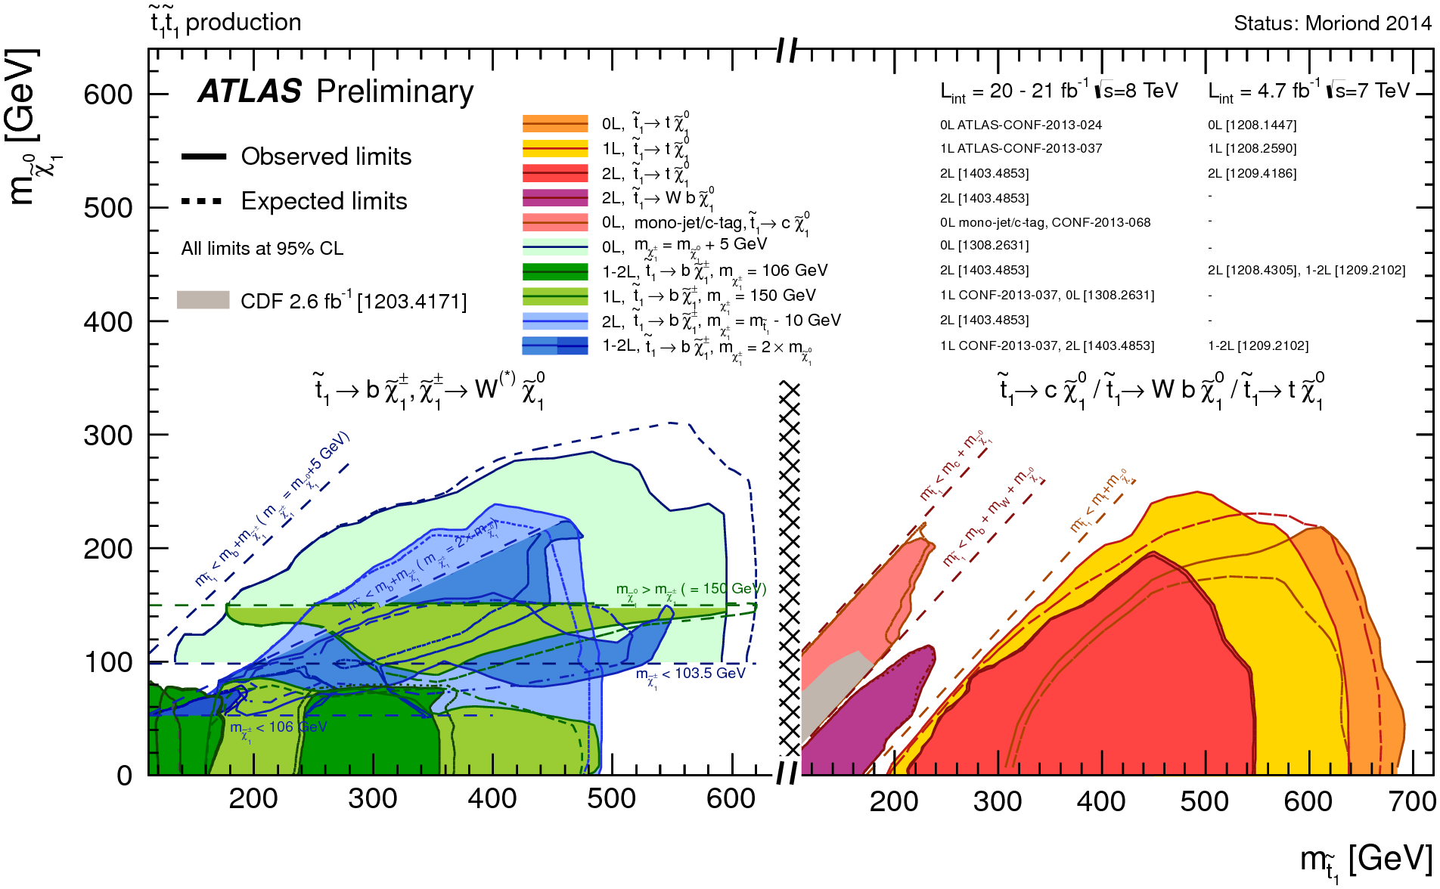
Searches for Top Squarks
Plenary talk by F. Blekman
Limits depend strongly on decay mode (SM and SUSY)
Broad search program → not just ‘under the lamp-post’

Slide 22
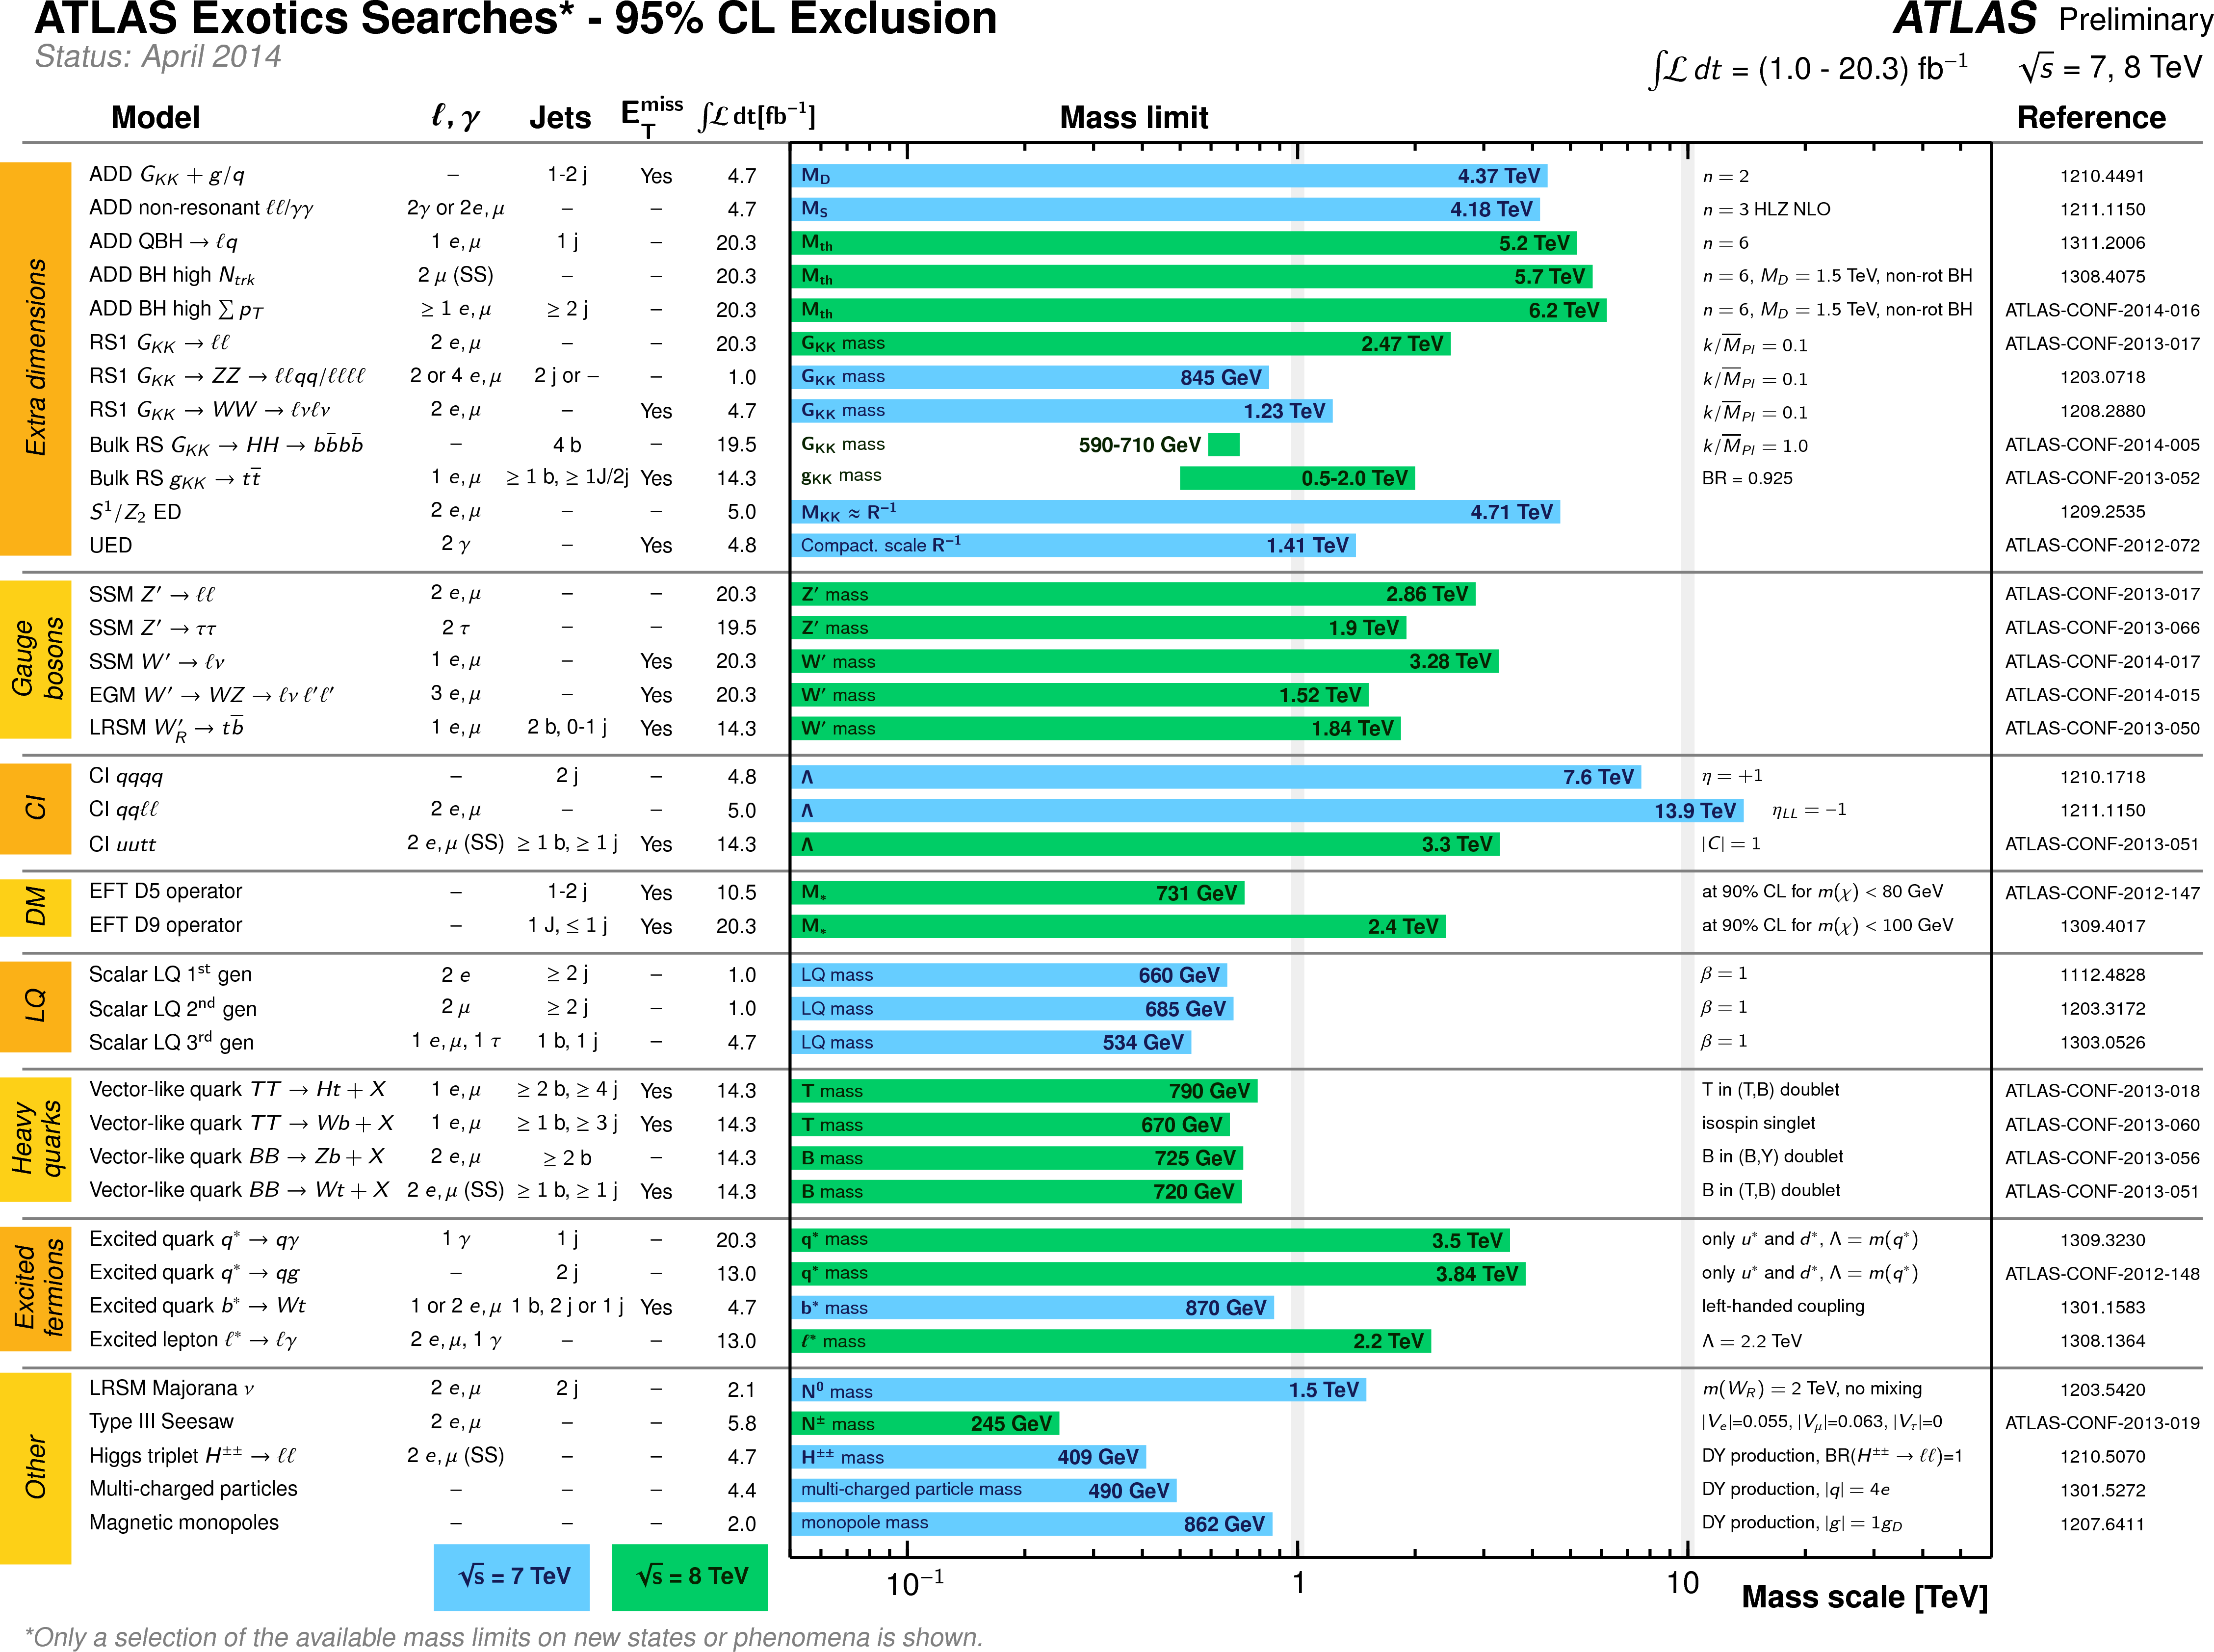
Plenary talk by E. Etzion

Slide 23
3000

Slide 24
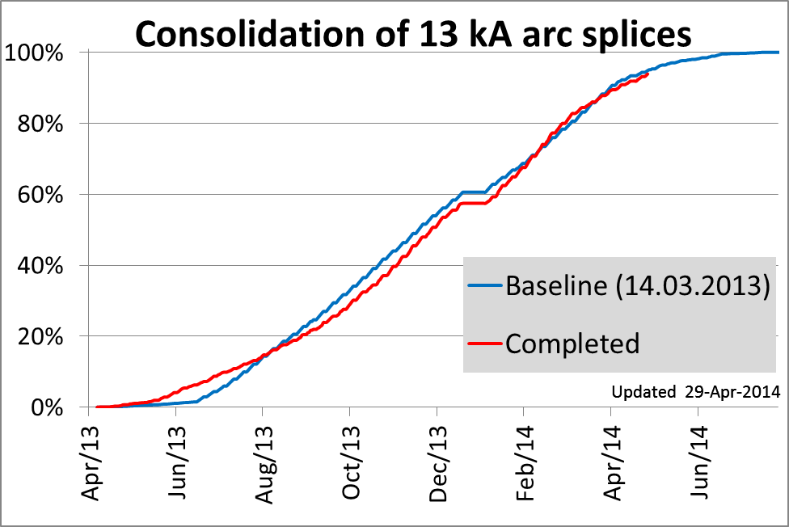
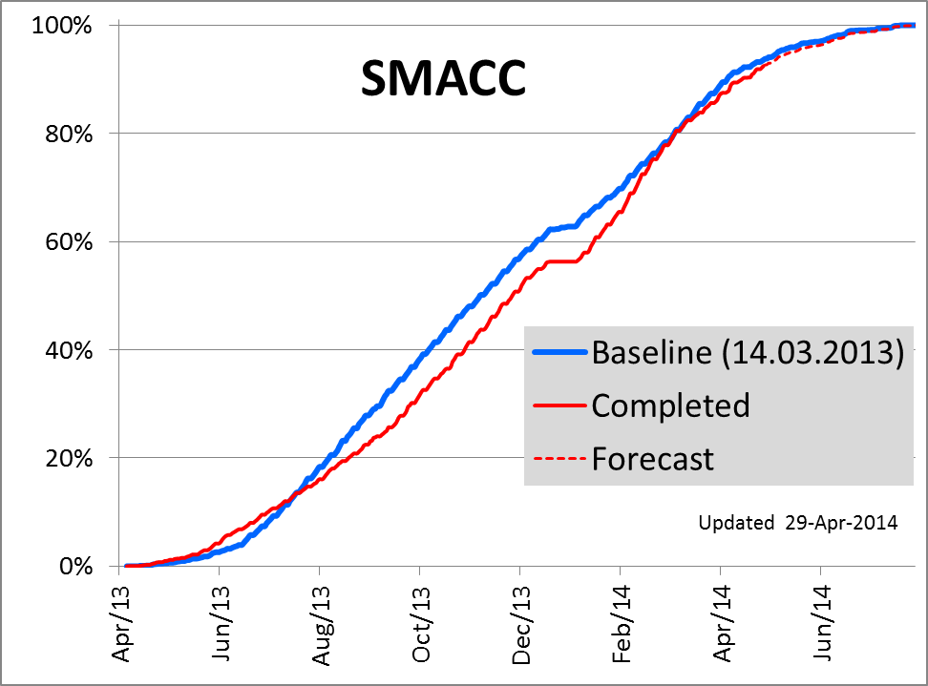
F. Bordry, LHCC 117
Both LHC and injector chain on schedule
On course for beam in January, physics in April

Slide 25
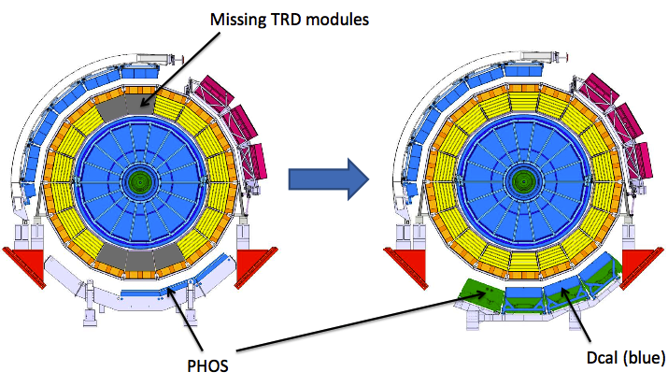
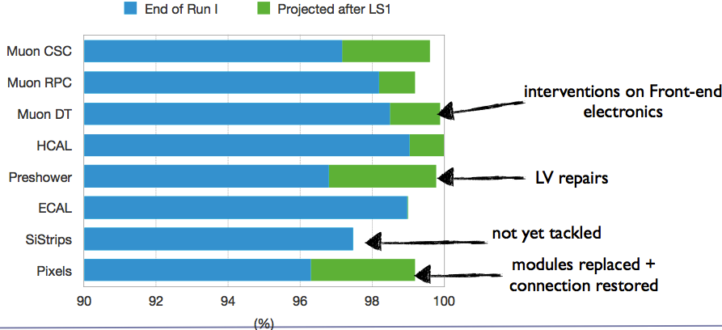
LS1 Experiment Status
Improvements in addition to general consolidation:
ALICE: Complete TRD detector, install DCAL calo, add PHOS supermodule
ATLAS: new pixel tracker (IBL), new Be beam pipe, replace ECAL low voltage power supplies, replace tracker cooling plant, improve magnet cryogenics
CMS: Add 4th muon EC station, improve electronics, replace HCAL photodetectors, improve tracker cooling
LHCb: replace 15% HCAL PMTs, improve RICH HPD photodetectors, new rad hard LED/fibre calibration system
ALICE, LHCC117
CMS, LHCC117
Operative channels (%)
LHCb, LHCC117
LHCb HCAL PMT replacement
ATLAS, LHCC117
Installed in ATLAS 7th May!

Slide 26
An Exciting Time …
Run 1: 25 fb⁻¹ at 7-8 TeV, up to 7x10³³ /cm²/s
Run 2 (2015-18): ~100 fb⁻¹ at 13 TeV, 10³⁴ /cm²/s
Gain depends on coupling (qq, gg, qg)
1 year worth ~250 years of 8 TeV data for e.g. 4 TeV Z’ or 2 TeV squarks ➔ big gains in sensitivity
125 GeV
4 TeV
26

Slide 27
LHC Upgrades
Phase-1 Upgrades
13 TeV, 10³⁴ /cm²/s
~100 fb⁻¹
13-14 TeV, ~2x10³⁴ /cm²/s
Phase-2 Upgrades
~300 fb⁻¹
14 TeV, ~5x10³⁴ /cm²/s
~3000 fb⁻¹

Slide 28
LHC Upgrade Physics
Parallel talk by R. Konoplich
Pile-up will be major challenge for phase-2 (after LS3, 2025 - 2035, ~ 3000 fb⁻¹, 5x10³⁴ /cm²/s )
Expect <μ>~140 even with lumi levelling across fill
Major trigger upgrades required to reduce rate
Inst. Lumi with lumi levelling
Radiation damage and occupancy will require replacement trackers and forward calorimetry
Simulations indicate big improvements in physics capability achievable
ATLAS-PHYS-PUB-2013-011

Slide 29
Summary
2012 a vintage year for data
Testament to the dedication of a vast team of experts working on the machine, grid computing and experiments
Many exquisite results just now reaching maturity
Hard work continuing to prepare for Run-2
2015 promises to be another vintage year, especially for high mass searches
Looking forward to tasting the results
Santé!

Slide 30
Back-up

Slide 33
Search for H→Invisible
Direct searches for decays of Higgs to invisible final states using ZH associated production
Combine results from Z(l⁺l⁻) and Z(bb) independent of SM cross-section (CMS)
BR(H→inv)<0.58 (95%CL)
Combine result from Z(l⁺l⁻) with signal strength fits assuming SM cross-section (ATLAS)
BR(H→inv)<0.37 (95%CL)
Complements searches for Higgs coupling DM

Slide 34
Searches for EW Gauginos
dghkgk
34

Slide 35
Non-SUSY Exotics

Slide 36
Dark Matter Searches
CMS-PAS-EXO-12-048
Jet/γ/Z + MET searches mimic underground DM searches
Sensitive to same interactions different energy
LHC produces DM, not the Big Bang ➔ must be sufficiently light
Sensitivity depends on coupling

Slide 38
LS1 Status
Both LHC and injector chain on schedule
On course for beam in January, physics in April
PS
SPS
PSB

Slide 39
IBL Installed 7th May 2014

Slide 41
Back-up

